Slide 1


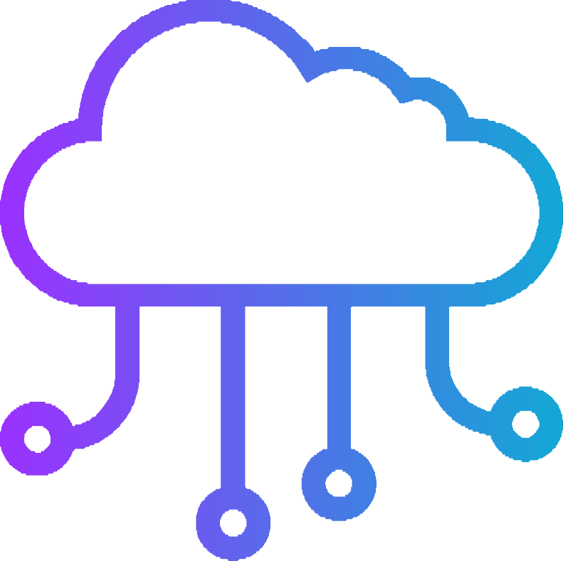
Cloud computing
CLOUD COMPUTING
PRESENTED BY-
Roshan Tiwari Pritesh Sharma

Slide 2

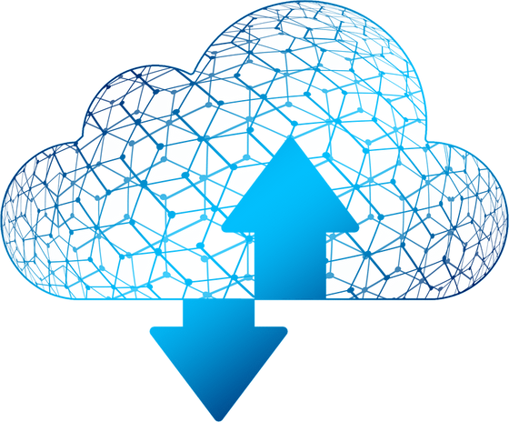

I ntroduction to Cloud Computing
Cloud computing is a model of providing on-demand access to shared computing resources, including servers, storage, applications, and services, over the internet. It allows users to access and use computing resources on a pay-per-use basis, without the need for upfront investment in hardware and software infrastructure.
Cloud computing services
Cloud computing services are offered by cloud providers who manage and maintain the infrastructure, ensuring high availability, scalability, and reliability. Cloud computing providers offer different types of services, including Infrastructure as a Service (IaaS), Platform as a Service (PaaS), and Software as a Service (SaaS).

Slide 3

Software as a Service (SaaS)
SaaS (Software as a Service) is a cloud computing model where software applications are hosted on the cloud and provided to customers over the internet on a subscription basis. SaaS eliminates the need for organizations to install and maintain software applications on their own infrastructure, as the cloud provider handles all aspects of application hosting, maintenance, and security.
With SaaS, users can access software applications using a web browser or mobile app, from any location with an internet connection. SaaS providers offer a wide range of applications, including email, customer relationship management (CRM), enterprise resource planning (ERP), human resources management (HRM), project management, and more.
SaaS provides several benefits to businesses, including:
Reduced Costs: SaaS eliminates the need for businesses to invest in hardware, software, and IT infrastructure. This results in
reduced costs for hardware, software licenses, maintenance, and upgrades.
Scalability: SaaS provides businesses with the ability to scale up or down based on changing business requirements, without having to
invest in additional

Slide 4

Platform as a Service (PaaS)
1. Reduced Costs: PaaS eliminates the need for businesses to invest in infrastructure, software, and middleware,
resulting in reduced costs for hardware, software licenses, maintenance, and upgrades.
Platform as a Service (PaaS) is a cloud computing model where cloud providers offer a platform for customers to build, test, and deploy applications without the need for managing the underlying infrastructure. PaaS provides developers with an environment to create and run applications, including development tools, libraries, and middleware, all hosted in the cloud.
With PaaS, developers can focus on application development and testing, without the need for managing infrastructure, operating systems, or middleware. PaaS providers offer different types of services, including application hosting, database management, and development tools, allowing developers to create and deploy applications quickly and easily.
PaaS provides several benefits to businesses, including:
Rapid Application Development: PaaS provides developers with pre-built development tools and middleware, allowing them to create and deploy applications quickly and easily.
Scalability: PaaS provides businesses with the ability to scale up or down based on changing business
requirements, without having to invest in additional infrastructure.
Flexibility: PaaS provides businesses with the ability to choose the development tools and middleware they
need, and to configure and manage the platform according to their specific requirements.
High Availability: PaaS providers typically offer high availability and reliability, ensuring that applications are
always available when needed.
2.

Slide 5

Including Infrastructure as a Service (I aaS)
Infrastructure as a Service (IaaS) is a cloud computing model where users can access and manage virtualized computing resources, including servers, storage, networking, and operating systems, over the internet on a pay- per-use basis. IaaS eliminates the need for businesses to invest in physical infrastructure, as they can access virtual infrastructure resources from the cloud provider.
With IaaS, users have complete control over the infrastructure, including the ability to create, configure, and manage virtual machines, storage, and networks. IaaS providers offer different types of services, including virtual machines, storage, and networking, allowing users to create and manage their own IT infrastructure in the cloud.
IaaS provides several benefits to businesses, including:
Reduced Costs: IaaS eliminates the need for businesses to invest in physical infrastructure, resulting in reduced costs for hardware, software, maintenance, and upgrades.
Scalability: IaaS provides businesses with the ability to scale up or down based on changing business
requirements, without having to invest in additional infrastructure.
Flexibility: IaaS provides businesses with the ability to choose the computing resources they need, and to
configure and manage the infrastructure according to their specific requirements.
High Availability: IaaS providers typically offer high availability and reliability, ensuring that computing
resources are always available when needed.
Security: IaaS providers typically offer high levels of security, including firewalls, intrusion detection, and encryption, ensuring that data is protected against
unauthorized access and data breaches.
1.

Slide 6








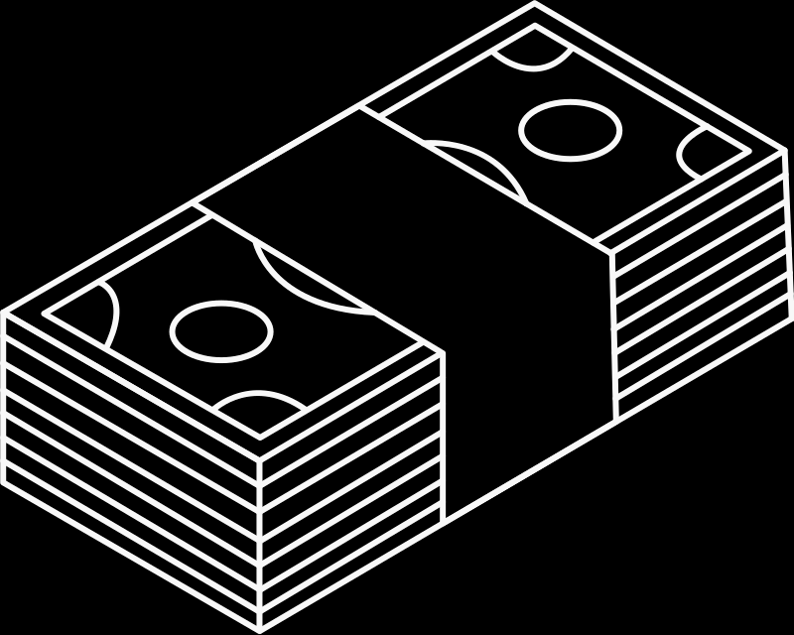



Disadvantages of cloud computing
While cloud computing offers many benefits, it also has some disadvantages. Here are some of the main disadvantages of cloud computing:
Security Concerns: Cloud computing services rely on internet connectivity, which exposes the data to the potential risks of data breaches and cyber-attacks. Organizations need to ensure that their cloud provider offers adequate security measures to protect their data.
Dependency on Internet Connectivity: Cloud computing requires a reliable and fast internet connection. Any disruption in internet connectivity can affect the availability and performance of cloud services.
Potential Vendor Lock-In: Cloud computing providers may use proprietary technologies, making it difficult for users to migrate their data and applications to another provider. This can result in dependency on the cloud provider and potential lock-in.
Limited Control Over Infrastructure: Cloud users have limited control over the underlying infrastructure, including hardware and software. This can limit the ability to customize the infrastructure to meet specific requirements.
Regulatory Compliance: Organizations in regulated industries may face challenges in complying with data privacy and security regulations when using cloud computing services.

Slide 7




Cloud computing is a rapidly evolving field, and new updates and advancements are constantly emerging. Here are a few recent updates in cloud computing:
Edge Computing: Edge computing is gaining attention
Cloud Computing
New updates
and
as more organizations look to process data closer to the source, reducing latency and improving performance. This approach involves using edge devices, such as sensors and IoT devices, to process data locally, rather than sending it to the cloud for processing.
Multi-Cloud: Many organizations are adopting a
multi-cloud approach, using multiple cloud providers to avoid vendor lock-in and improve flexibility. This approach can help organizations optimize costs, improve performance, and ensure high availability.
Artificial Intelligence and Machine Learning: Cloud providers are investing heavily in artificial intelligence (AI) and machine learning (ML) capabilities, offering a range of services that enable developers to build and deploy AI and ML applications in the cloud. These services include natural language processing, image and video analysis, and predictive analytics.
advancements
Hybrid Cloud
Multi-Cloud

Slide 8




Cloud Computing
Cloud Computing
OVERCOMING LIMITATIONS IN PERFORMANCE AND MEMORY
Apple devices do not come with the garbage collection function. The iOS app can be terminated if it becomes a source control.
Thus, it is a challenge for the iOS developers to manage memory within the app. While developing an app for a specific version of iOS, we cannot forget that same version runs varied iPhone devices and all of them are having a different degree of storage and memory.
Other 9.3%
Multi-Cloud 2.3%
Hybrid Cloud 51.9%
Edge Computing 36.5%
SECURING THE IOS APPLICATION
In this digital era when we are witnessing the increased use of innovative technologies like Artificial Intelligence and Machine Learning. Cybersecurity comes forward as one of the biggest challenges with the hackers being smart each passing day.
AS OF NOVEMBER 13, 2022
these are the market shares of major iOS versions in the TelemetryDeck data set

Slide 9

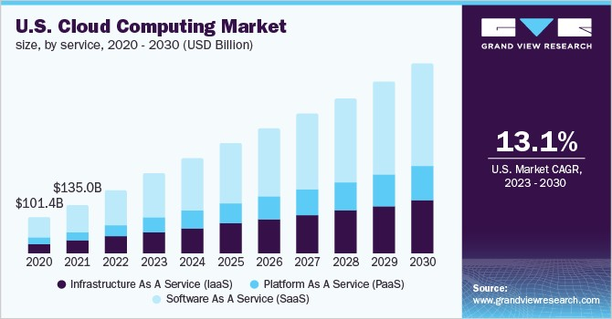
Cloud Computing
Marketing of cloud computing
Marketing of cloud computing typically involves highlighting the benefits of cloud computing and demonstrating how it can help businesses improve their operations and achieve their goals. Here are a few common strategies used in cloud computing marketing
1. Cost Savings: One of the primary benefits of cloud computing is cost savings. Cloud providers typically market their services as a way to reduce costs associated with hardware, software, and maintenance. They may provide detailed cost calculators that show how much a business can save by moving to the cloud.
MARKETING IN USA
Scalability and Flexibility: Another benefit of cloud computing is the ability to scale up or down quickly and easily, depending on business needs.

