Slide 1
Technology Challenge
The challenge is to create an application that can detect an object/face from a Video.

Slide 2
Member Names
Anagha Murtarkar.
Anushi Keswani.
Anushka Chandak.
Surabhi Gujare.
Vaishnavi Kotawar.

Slide 3
Brief Summary:
Why OpenCV over other tools?
It is an open source library.
It has a Huge Optimised library compared to others.
To track an object in a video image frames can be extracted and saved to a folder and further processing can be done.But,this consumes a lot of space on the disk depending on the size of the video and the size of the frames, plus it will also spend a considerable amount of time reading frames from the disk.

Slide 4
Brief Summary:
OpenCV functions are used to divide a video into a Stream of Frames.
In OpenCV as there are many handy methods for capturing frames from a camera/stored video real-time.
Thus the captured frame is processed using various detecting algorithms to detect the required object/face.
There are various approaches in which this can be achieved.
Approaches :
1. Object Detection.
2. Motion Detection.
3. Face Detection.

Slide 5
Technology Used:
OpenCV Real time Video Processing:
OpenCV (Open Source Computer Vision Library) is an open source computer vision and machine learning software library.
The library has more than 2500 optimized algorithms. These algorithms can be used to detect and recognize faces, identify objects, classify human actions in videos, track camera movements, track moving objects, extract 3D models of objects, produce 3D point clouds from stereo cameras.

Slide 6
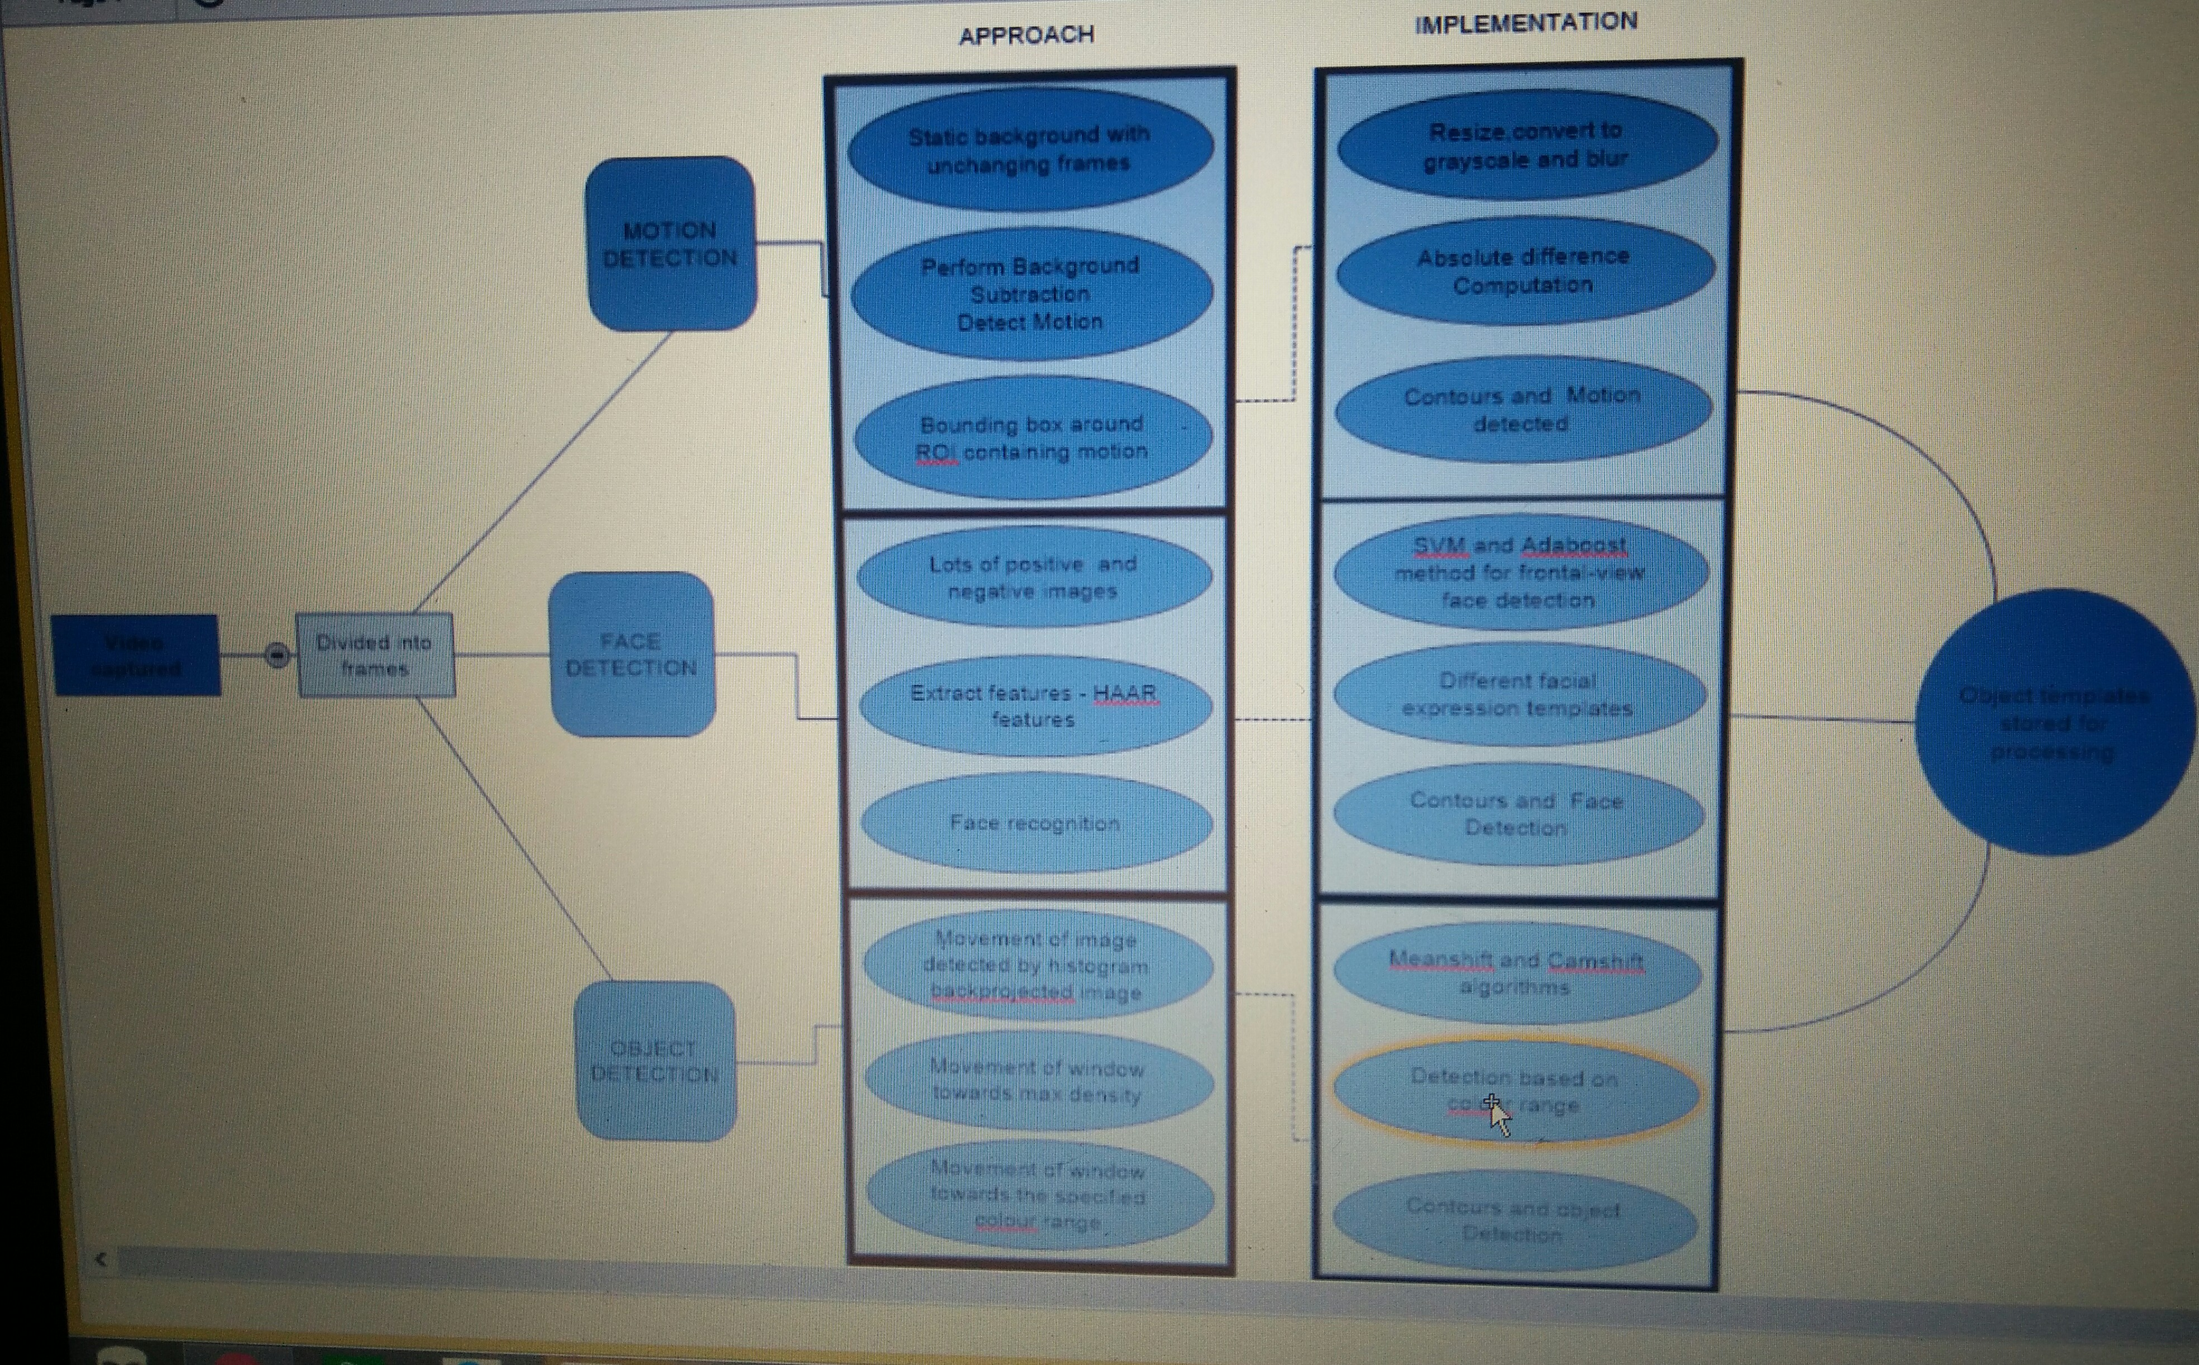
Architecture Diagram.

Slide 7
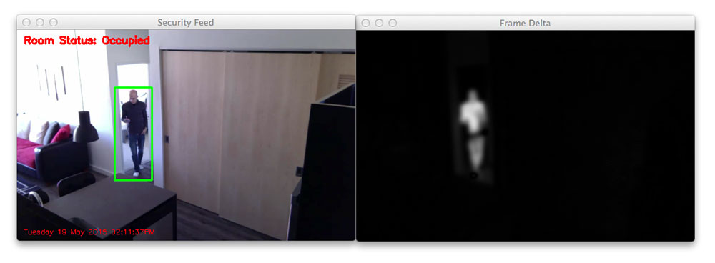
Motion Detected.

Slide 8
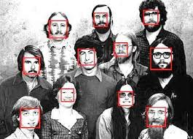
Face Detected

Slide 9
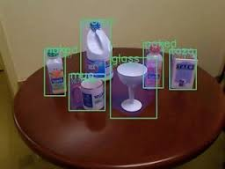
Object Detected.

Slide 10
              THANKYOU!

