Slide 1
Trash Collecting System for Drainage/Canals
Group Name: TatlongTau
Science Investigatory Project
Date: 10/17/2024

Slide 2
Trash Collecting System for Drainage/Canals
INTRODUCTION
Group Name: TatlongTau
Science Investigatory Project
Date: 10/17/2024

Slide 3
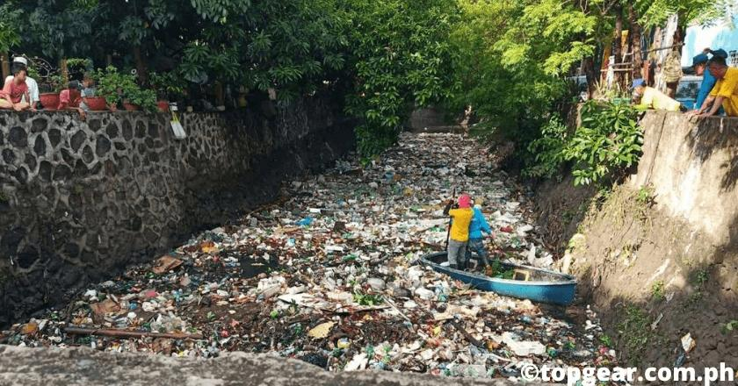
DRAINAGE CLOGGING PROBLEM
Trash Collecting System for Drainage/Canals
INTRODUCTION
Group Name: TatlongTau
Science Investigatory Project
Date: 10/17/2024
Courtesy: topgear.com.ph
The drainage system in the Philippines is often clogged with garbage. When it rains heavily, the water can’t flow properly, causing flooding. This flooding damages homes, makes it hard to get around, and can even pose health risks.

Slide 4
DRAINAGE CLOGGING PROBLEM
INTRODUCTION
The drainage system in the Philippines is often clogged with garbage. When it rains heavily, the water can’t flow properly, causing flooding. This flooding damages homes, makes it hard to get around, and can even pose health risks.
Courtesy: topgear.com.ph

Slide 5
This project’s aim is to help reduce flooding, benefiting residents of the community and improving water management methods.
DRAINAGE CLOGGING PROBLEM
The drainage system in the Philippines is often clogged with garbage. When it rains heavily, the water can’t flow properly, causing flooding. This flooding damages homes, makes it hard to get around, and can even pose health risks.

Slide 6
PROJECT CONTEXT
This project’s aim is to help reduce flooding, benefiting residents of the community and improving water management methods.

Slide 7
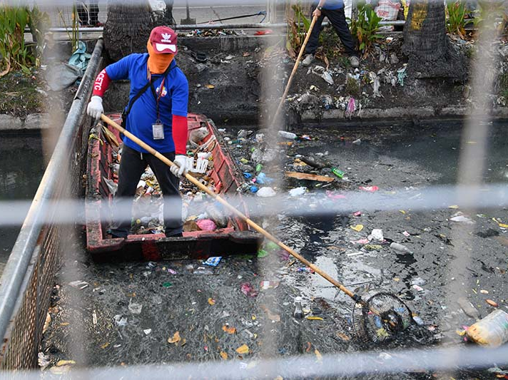
THE TEAM’S VISION
PROJECT CONTEXT
This project’s aim is to help reduce flooding, benefiting residents of the community and improving water management methods.
Courtesy: mmda.gov.ph
This project will aid on drainage systems by developing a mechanism to collect trash and debris. By reducing the risk of clogging, we can prevent flooding. Additionally, this solution will support enhanced irrigation efficiency.

Slide 8
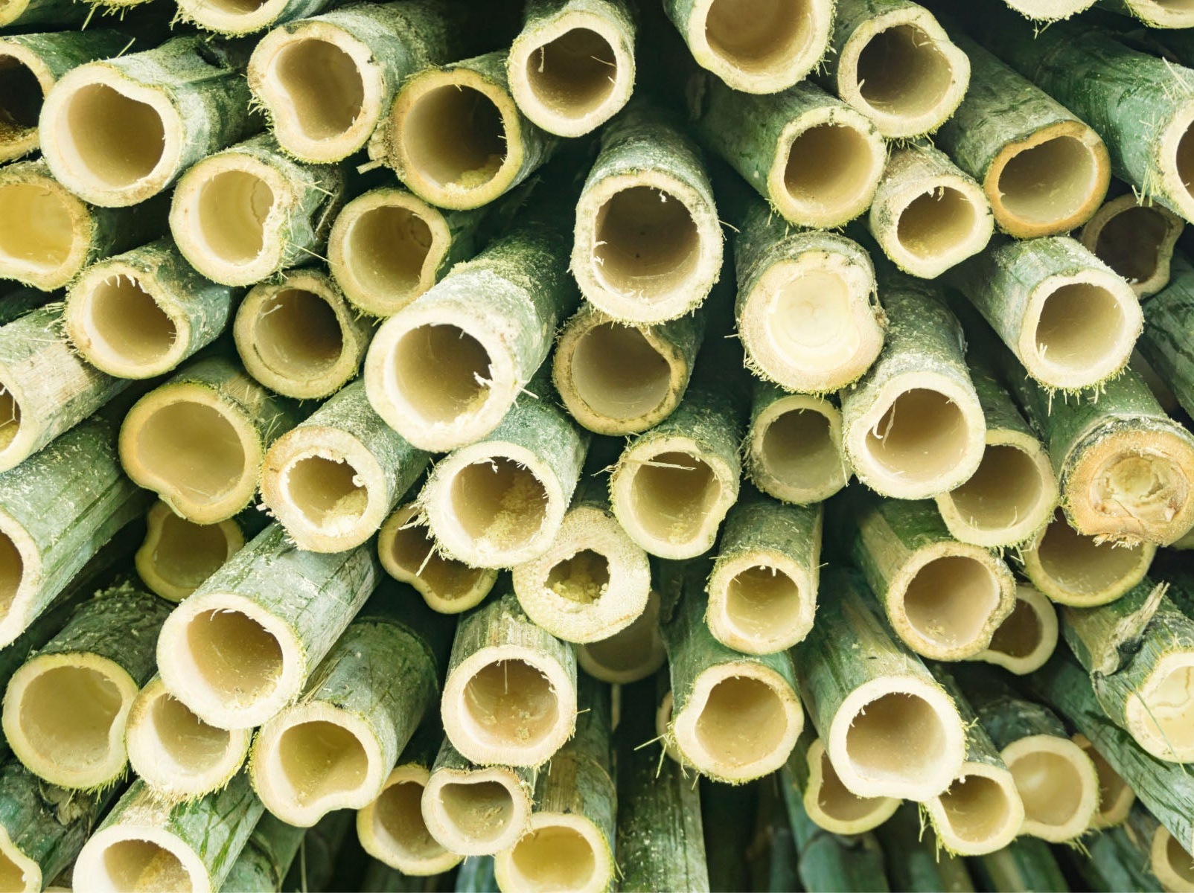
PROPOSED SOLUTION
THE TEAM’S VISION
This project will aid on drainage systems by developing a mechanism to collect trash and debris. By reducing the risk of clogging, we can prevent flooding. Additionally, this solution will support enhanced irrigation efficiency.
Courtesy: mmda.gov.ph
Courtesy: onetreeplanted.org
PROJECT CONTEXT

Slide 9
THE DESIGN
THE TEAM’S VISION
PROPOSED SOLUTION
Install a mesh-like device in waterways to filter trash and debris.
(design may vary)
Use durable materials, such as steel wires for the mesh and bamboo* for the posts, to ensure longevity and effectiveness.
Courtesy: onetreeplanted.org
This project will aid on drainage systems by developing a mechanism to collect trash and debris. By reducing the risk of clogging, we can prevent flooding. Additionally, this solution will support enhanced irrigation efficiency.

Slide 10
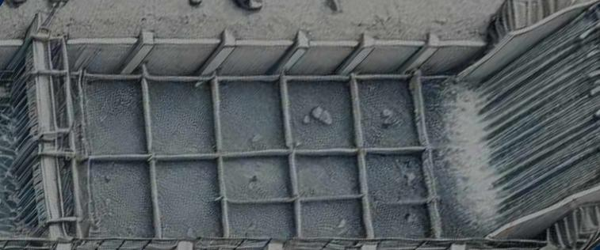
THE DESIGN

Slide 11
Mesh installed in drainage canals to capture debris.
Regular maintenance ensures the system remains functional.
Focus on preventing flooding and improving drainage safety.
THE DESIGN

Slide 12
Material and Maintenance
MATERIALS
Durable materials that resist wear and tear from water exposure.
Mesh designed to be easy to maintain and clean.
MAINTENANCE PLAN
Regular inspections to prevent system failures.
Ensure efficient functioning of the collection system.

Slide 13
Material and Maintenance
Conclusion
MATERIALS
Durable materials that resist wear and tear from water exposure.
Mesh designed to be easy to maintain and clean.
MAINTENANCE PLAN
Regular inspections to prevent system failures.
Ensure efficient functioning of the collection system.
Implementing sustainable water management strategies reduces the risks of flooding and crop damage, ensuring more resilient agricultural systems. Even though these solutions can address drainage problems, people must still be responsible about where they dispose of their garbage to prevent blockages. By promoting effective water usage, these strategies help maintain soil health and water availability, contributing to food security. The next step is to continue refining the design and plan for pilot implementations to test their effectiveness on a larger scale.

Slide 14
Conclusion
THANK YOU!
Material and Maintenance
Implementing sustainable water management strategies reduces the risks of flooding and crop damage, ensuring more resilient agricultural systems. Even though these solutions can address drainage problems, people must still be responsible about where they dispose of their garbage to prevent blockages. By promoting effective water usage, these strategies help maintain soil health and water availability, contributing to food security. The next step is to continue refining the design and plan for pilot implementations to test their effectiveness on a larger scale.
MATERIALS
Durable materials that resist wear and tear from water exposure.
Mesh designed to be easy to maintain and clean.
MAINTENANCE PLAN
Regular inspections to prevent system failures.
Ensure efficient functioning of the collection system.

Slide 15
THANK YOU!

