Slide 1
Foundation AI-Driven Cloud & DevSecOps Capstone Project
Inventory Management System — Acme Retail Ltd.
Group 17 | Foundation Level
A production-inspired modernization of one application using AI engineering, CI/CD, security automation, Docker, and Terraform.
FastAPI
Pytest
Gitleaks
Docker
Terraform
Secure • Automated • Reproducible
Group 17 • Foundation Capstone
1

Slide 2
1. Business Problem & Capstone Objective
Why Acme Retail needs a DevSecOps modernization
P
Business problems
M
Mission & target state
Manual infrastructure provisioning and deployments
No Infrastructure as Code or standardized CI/CD
Weak automated security validation
Poor documentation and inconsistent engineering practices
No common AI engineering standards
Modernize the delivery lifecycle for a single IMS application
Introduce AI Engineering Specifications before implementation
Automate testing, security validation and infrastructure checks
Use Docker + Terraform for reproducible local validation
Deliver a secure, maintainable, production-inspired solution
Group 17 • Foundation Capstone
2

Slide 3
2. Engineering Approach
Specification first, then implementation, validation, and documentation
01
Understand
02
Specify
03
Build
Business problem & scope
Six AI Engineering Specifications
FastAPI application + tests
04
Secure
05
Package
06
Validate
Gitleaks + Trivy + Checkov
Docker container + Terraform
GitHub Actions + local checks
Key principle: AI accelerates engineering work; every artifact is reviewed, tested, secured, and validated by the engineer.
Group 17 • Foundation Capstone
3

Slide 4
3. Overall Solution Architecture
Single FastAPI application with automated DevSecOps controls
Developer
GitHub
GitHub Actions
Security Gates
Docker
Terraform
FastAPI Application
Python • in-memory storage
Product CRUD
Search
Stock In / Out
Low / Out of Stock
Status
Health
Cloud-ready design; current validation is local and reproducible without dedicated cloud resources.
Group 17 • Foundation Capstone
4

Slide 5
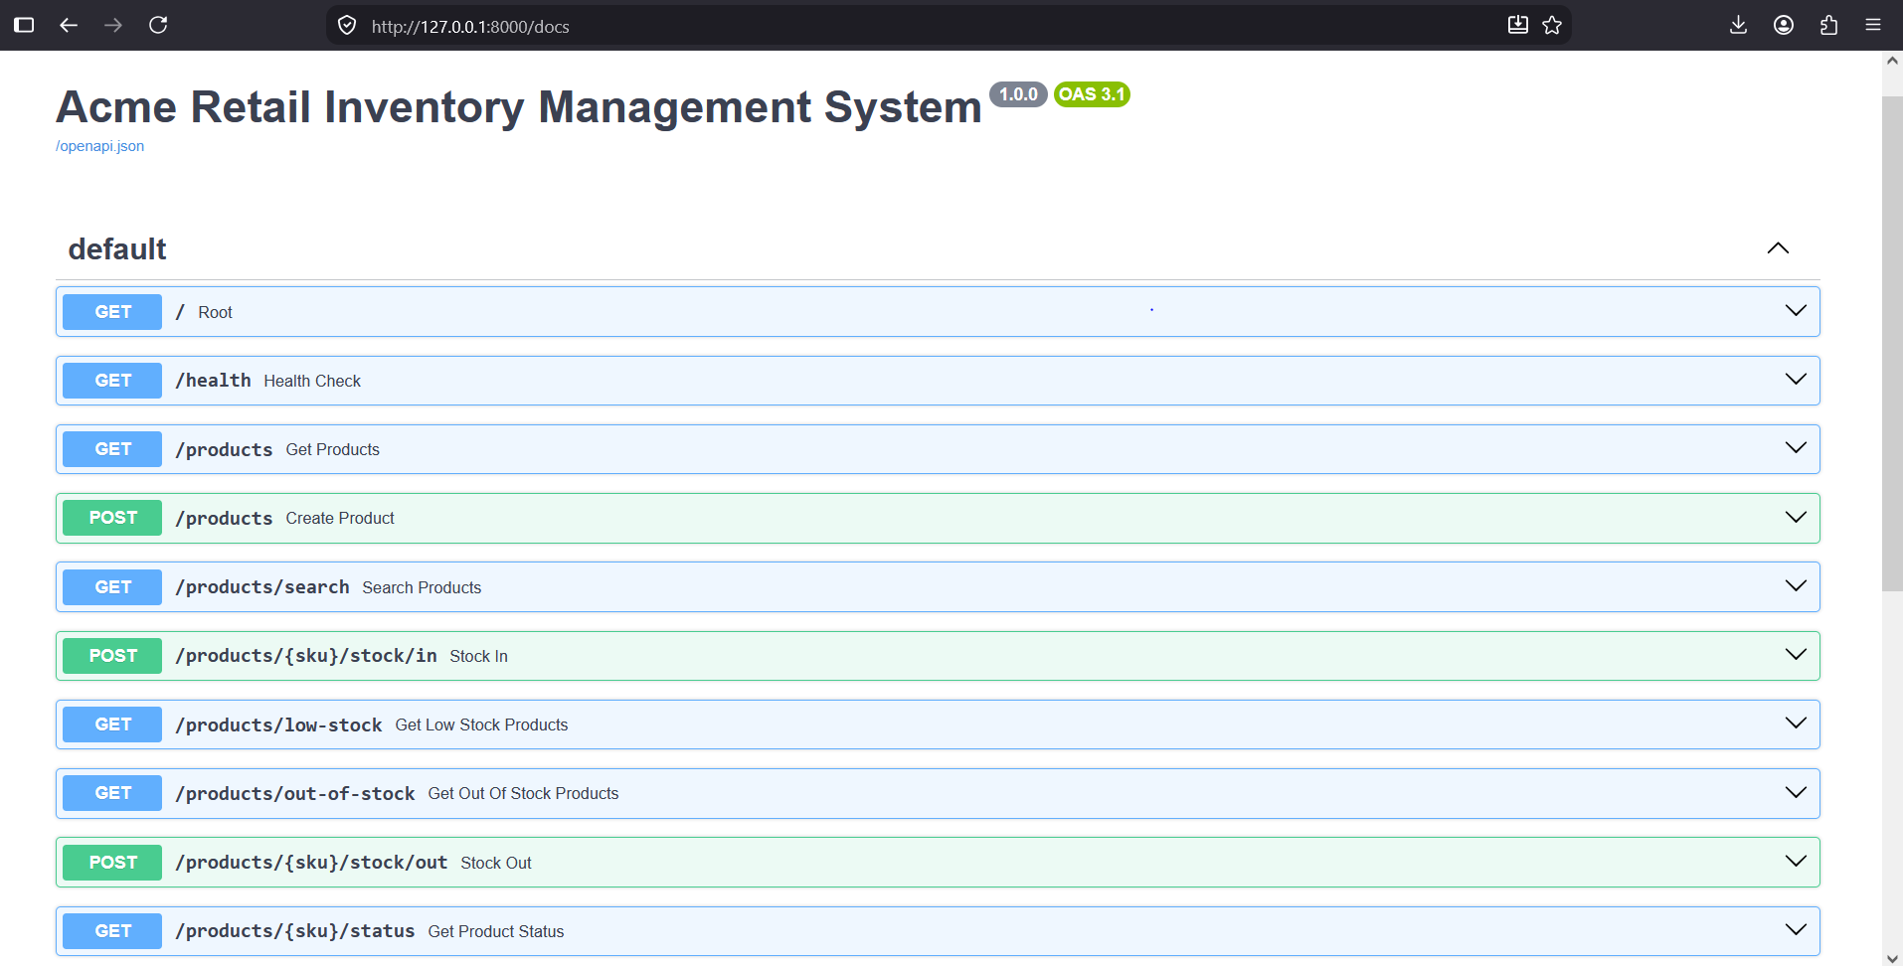
4. Application & API Capabilities
FastAPI inventory management service exposed through REST-style endpoints
Implemented capabilities
Create / retrieve / update / delete products
Search by SKU, name or category
Stock in and stock out operations
Prevent negative inventory
Low-stock and out-of-stock detection
Product status + health check
Swagger UI verified locally at /docs
Group 17 • Foundation Capstone
5

Slide 6
5. AI Engineering Specifications & Documentation
The Capstone requires specification-driven engineering
MD
application-spec.md
MD
infrastructure-spec.md
Application requirements & scope
IaC approach & validation
MD
cicd-spec.md
MD
security-spec.md
CI workflow & automation
Security controls & scans
MD
testing-spec.md
MD
documentation-spec.md
Test strategy & acceptance
Documentation & operational guidance
Engineering decision: temporary in-memory storage keeps the Foundation solution simple, reproducible, and aligned to the current scope.
Group 17 • Foundation Capstone
6

Slide 7
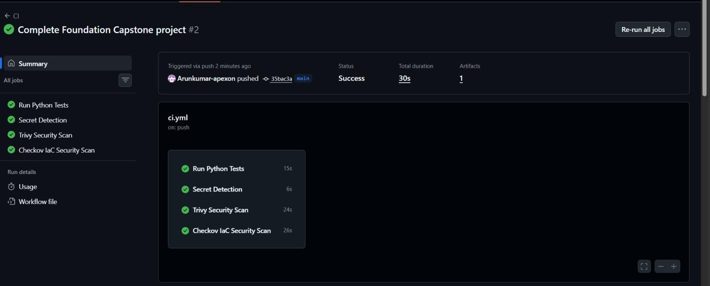
6. DevSecOps CI/CD Pipeline
Every push validates code, security, containerization and infrastructure
✓
✓
✓
✓
✓
✓
Python Tests
Gitleaks
Trivy
Checkov
Docker Build
Terraform Validate
Group 17 • Foundation Capstone
7

Slide 8
7. Security & Quality Gates
Shift-left security validation in the CI pipeline
✓
Gitleaks
Detect hard-coded secrets in repository history/code.
✓
Trivy
Scan the filesystem and dependencies for HIGH/CRITICAL vulnerabilities.
✓
Checkov
Validate Terraform configuration against IaC security rules.
✓
Pytest
Protect behavior with automated regression tests.
Result: current GitHub Actions workflow is green across the implemented gates.
Group 17 • Foundation Capstone
8

Slide 9
8. Containerization with Docker
Consistent runtime packaging for local execution and CI validation
1
2
3
4
python:3.12-slim
pip install
COPY src
uvicorn :8000
Validated locally
Docker image built as acme-retail-inventory:latest
Container exposed on host port 8000
Swagger UI reachable from the browser
GET /health returned {"status":"healthy"}
Container image build is also validated automatically in GitHub Actions.
Group 17 • Foundation Capstone
9

Slide 10
9. Infrastructure as Code with Terraform
Local IaC validation without requiring dedicated cloud resources
1
terraform init
Provider/plugins initialized
2
terraform validate
Configuration syntax and references valid
3
terraform plan
Plan reviewed: 1 local resource to add
4
terraform apply
Local infrastructure-info.txt generated
Current state: Terraform validates the Infrastructure-as-Code structure locally; cloud resources are not provisioned in this Foundation build.
Group 17 • Foundation Capstone
10

Slide 11
10. Validation Results & Deliverables
What has been verified and packaged for review
24/24
6
6
0
pytest tests
AI specification files
CI validation jobs
Cloud resources required
Repository deliverables
Acceptance & demonstration
README.md and architecture documentation
Local FastAPI + Swagger validation
ai-specifications/ (six .md files)
Docker runtime validation
app/ with FastAPI source, models and tests
Terraform init / validate / plan / apply
infrastructure/ with Terraform configuration
CI tests + security scans + Docker build + Terraform validate
.github/workflows/ci.yml
engineering-decisions/ and presentation/ folders
Group 17 • Foundation Capstone
11

Slide 12
11. Final Outcome
A secure, automated and reproducible delivery workflow for the Acme Retail IMS
Application
Delivery
Security
Infrastructure
FastAPI inventory APIs
CRUD + stock operations
GitHub Actions
repeatable validation
Gitleaks • Trivy • Checkov
shift-left controls
Docker + Terraform
local reproducibility
Next state
Cloud deployment can be added later; this Foundation submission is intentionally validated without dedicated cloud resources.
Thank you • Questions
Group 17 • Foundation Capstone
12

