Slide 1

A Study on Customer Retention in E-Commerce Business
-Pooja Mishra

Slide 2
INTRODUCTION
E-commerce is a term for any type of business that involves the exchange of information across electronic networks. It involves all aspects of an organization’s interaction or commercial transaction with suppliers, clients, stakeholders, and customers, etc. The best advantage is its huge reach across the global market and being able to conduct business 24x7x365 days by selling various kinds of goods and service.
Retaining on loyal customers creates a regular income, the goal of every seller is to transform occasional customers into loyal a one. Thus, it has urged sellers to create various retention strategies to increase profitability and gain market share by retaining customers. With this project we are analysing all important features that are necessary for customer retention.
The factors that are considered to be influential towards the purchase decision of e-commerce consumers are responsiveness, contact point, convenience, merchandising, site design, security, serviceability, contact interactivity customization and care.

Slide 3
PROBLEM STATEMENT
The significant growth of e-commerce industry has made the competition more intense among marketers. Maintaining customer retention strategies has been recognized as essential factors for business survival and growth. The objectives of the study were to know about the customer retention strategies in e-commerce business .The study was descriptive in nature with convenience sampling method employed. A well-structured questionnaire was distributed to the respondents.
The study has developed a e- satisfaction model which ties together factors representing major contexts namely convenience, merchandising, site design, security, and serviceability. The study identified that special attention to convenience, site design, age, gender, financial security produce most positive outcome pertaining to satisfaction.
This project comprises of well- structured questionnaire with closed ended questions was used to collect data from the respondents.

Slide 4
ABOUT DATA
The dataset contains two sheets (one is detailed) and second is encoded. In this dataset the number of column(s) is more than 47.
Here, we will provide a brief description of dataset features. Since there are 81 features thus describing each could be tough so mentioning each datatype here to understand the dataset.
Detailed Dataset Description: This detailed dataset consists of 71 features describing every aspect of the Indian customers related to online shopping. In this data, the features are described in detailed format that are understandable at first look.
Encoded Dataset Description: This Encoded dataset consists of 71 features describing every aspect of the Indian customers related to online shopping. In this data, the features are described in coded format which need data analysis to understand it.

Slide 5
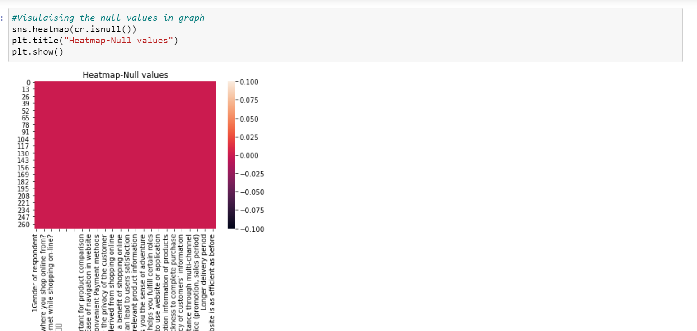
DATA CLEANING
There are no null values in both dataset.

Slide 6
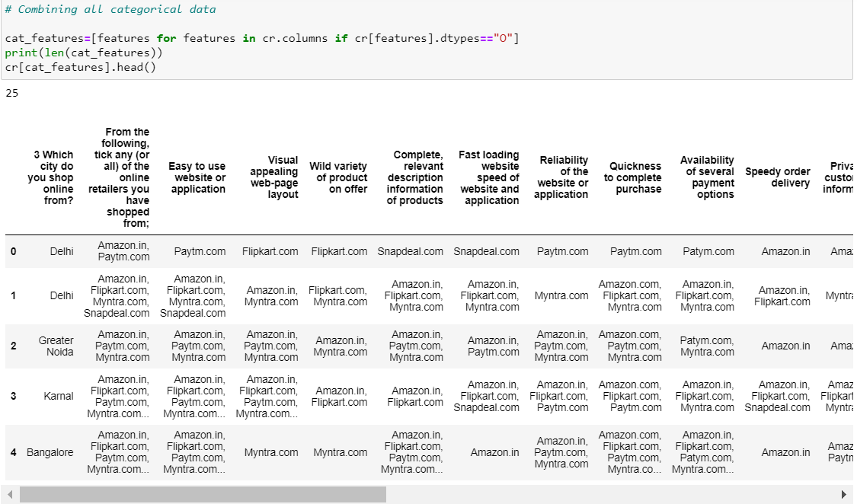
DATA ANALYSIS
CATEGORICAL FEATURES:

Slide 7
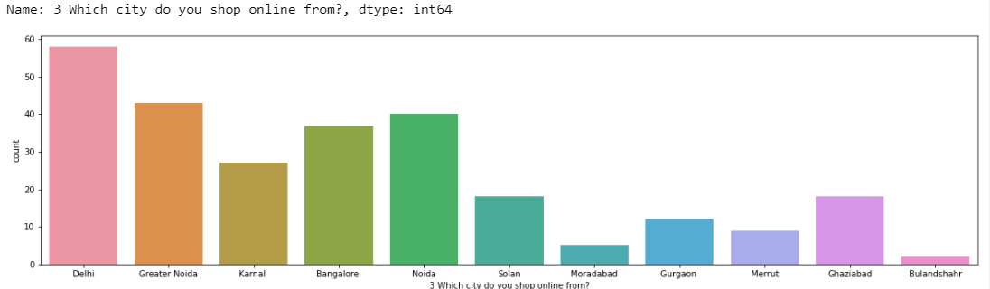
DATA VISUALIZATION ON CATEGORICAL FEATURES
Which City do you shop online from?
The graph illustrates thar maximum number of users who do online shopping are from Delhi and least number are from Bulandshr.

Slide 8
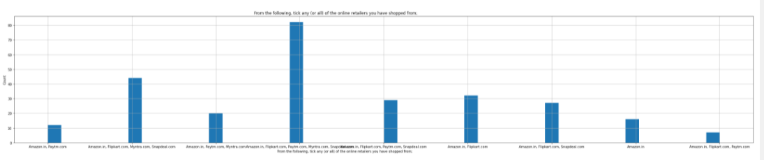
ONLINE RETAILERS YOU HAVE SHOPPED FROM
Amazon.in, Flipkart.com, Paytm.com, Myntra.com, Snapdeal.com – Highest
Amazon.in, Flipkart.com, Paytm.com - Least

Slide 9
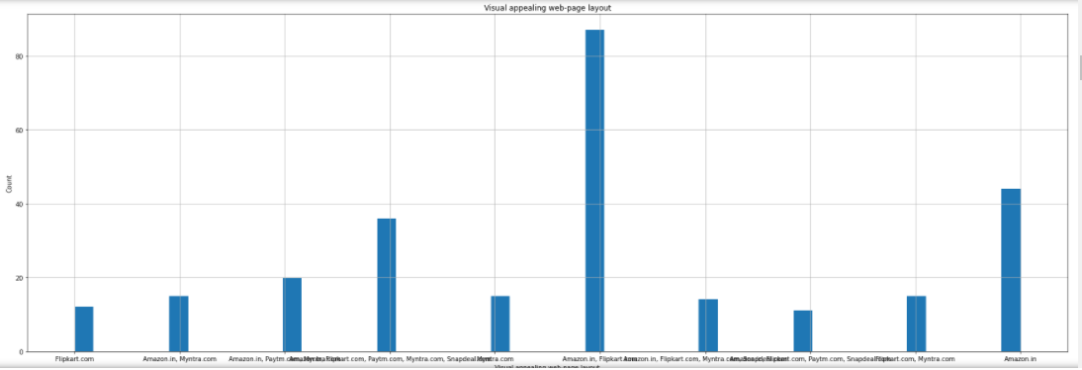
Visual appealing web-page layout
From graph we analysed that Amazon.in+Flipkart.com have best visual appealing than other sites. Thus we can say that Amazon, Flipkart, Myntra have best visual appealing.
Lowest visual appealing webpage is Snapdeal and Paytm

Slide 10
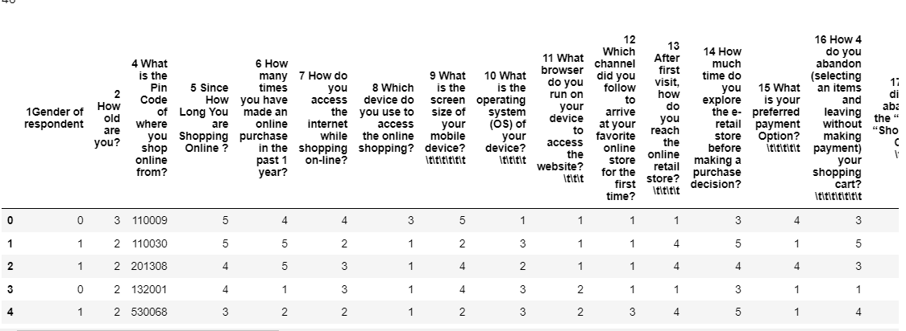
NUMERICAL FEATURES

Slide 11
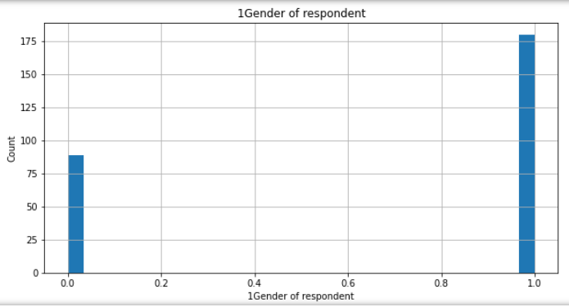
Gender Analysis
Here we have analysed that rate of females is much higher than males for online shopping. from the graph we have observed that females count is much higher than males count.

Slide 12
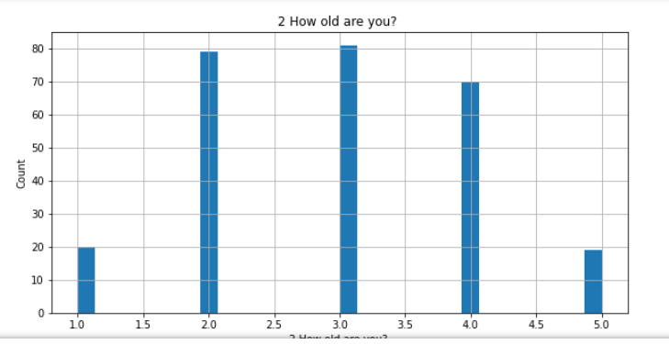
Age Analysis
From the graph we analysed that online shopping is higher for age between 31-40 years and least with age 51 and above years.

Slide 13
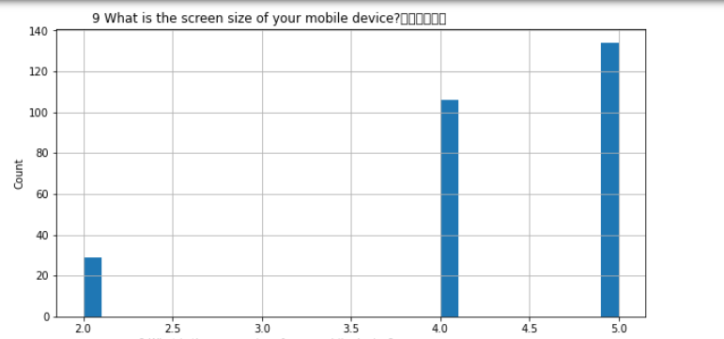
Screen size of mobile device
With help of graph visualization, we analysed that maximum number of users who are using others category for their mobile screen size that are around count of 135. After that 5.5 inch mobile screen size used by customers for online shopping that are around count of 100. Least count is for 5 inch and 4.7 inch of mobile device users.

Slide 14
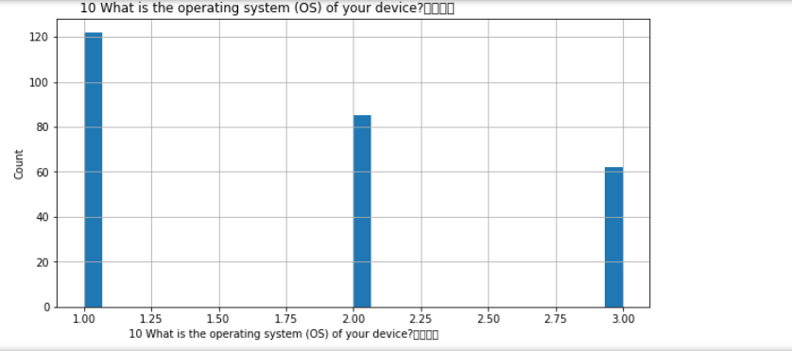
What is the operating system (OS) of your device?
We analysed that maximum users doing online shopping are using Window/Windows mobile that are around 123 and after the maximum users are Android OS users that are around count of 86. Least number of users whose mobile OS is IOS/Mac.

Slide 15
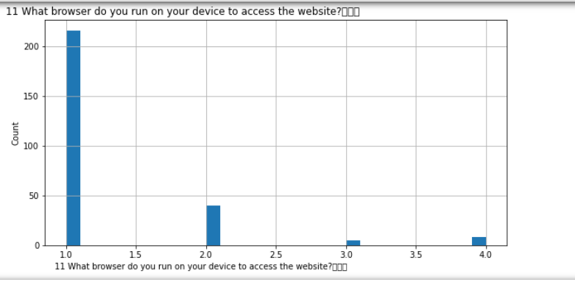
What browser do you run on your device to access the website?
The maximum users who are using Google chrome browser to access the website that count is around 217. The least count is of Mozilla Firefox browser users.

Slide 16
SUGGESTIONS
After the study, I would like to suggest that modifying the return policy, quality guarantee and refund policy creates a new impact on online purchase so the e-commerce companies should know about more responsive factors on their websites the success factor in e-commerce business will attract the customers and make them repurchase of products

Slide 17
CONCLUSION
The study has found that clear state of return policy, quality guarantee, monetary benefits and refund policy are important for the customers while making online purchase. These are useful findings which organized e-commerce websites need to keep in mind while conducting their business through websites. E-commerce websites must be convenient for customers to find what they want complexity in using a website may lead customers in switching over to another websites

Slide 18
THANK YOU

