Slide 1

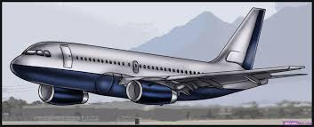
KNIPPO AIRWAYS
KNIPPO AIRWAYS
Since 1990

Slide 2

AIRLINE BOOKING SYSTEM
A DBMS PROJECT BY:
NISHTHA MEHROTRA ( RIT2012042 )
PRATHMA RASTOGI ( RIT2012069 )
KUSHAGRA AGARWAL ( RIT2012066 )
Under remarkable guidance of
Dr. O.P Vyas Sir
Dr. Saurabh Mishra Sir
Mr. Apoorva Sir
KNIPPO AIRWAYS

Slide 3
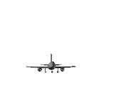
PROBLEM STATEMENT
Information about the route , cancellation of tickets, departure time, arrival time , number of domestic or international (as per need ) available and other related information.
Store and retrieve information about the various transactions related to Airways travel.
Keep track of all its passengers and thus schedule their journey accordingly.
Maintain records of passengers required details.
User friendly interface for both user and administrator.

Slide 4
Functions of Different Types of Users

Slide 5
FUNCTIONS OF ADMIN
Add/Remove Flights
Add/Remove User
Book Ticket
Cancel Ticket
Get Passenger List
Login and Logout

Slide 6
FUNCTION OF USER
FLIGHT INFORMATION
BOOK TICKET
Payment
Check PNR Status
Cancel Ticket
Login and Logout

Slide 7
E-R DIAGRAM

Slide 8
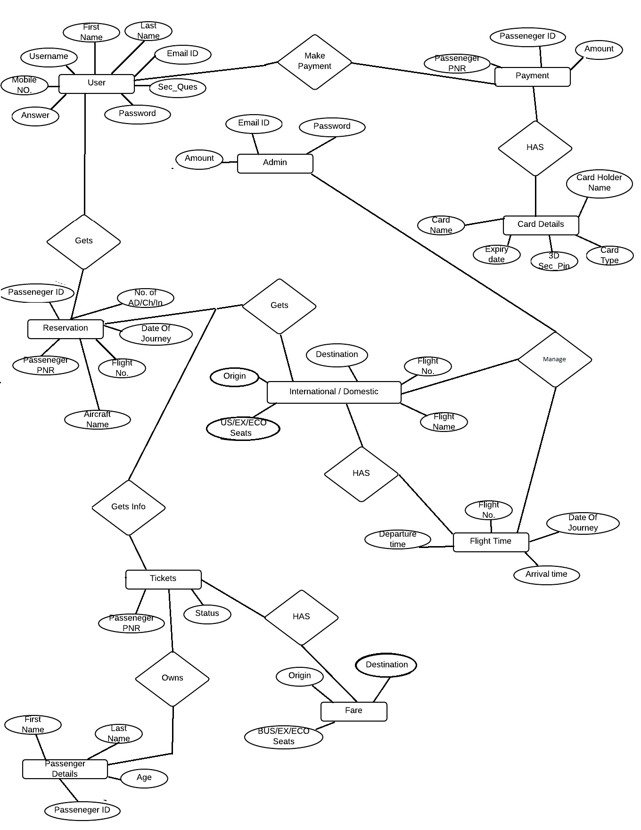
E-R
D
I
A
G
R
A
M
Card Num
Admin Name
Ticket Num

Slide 9
NORMALISED TABLES AND THEIR ATTRIBUTES . . . . .

Slide 10
ADMIN TABLE
ATTRIBUTES:
Admin Name ( Primary Key )
Email Address
Password
NOTE : The above table consists of Admin_name as Primary Key which determines all other attributes of it . There is no partial and transitive dependencies so it is in 3NF.

Slide 11
USER_DATA_TABLE
ATTRIBUTES:
User_Name ( Primary Key )
First_Name
Last_Name
Mobile_Number
.
(Continued………)

Slide 12
Contd. USER_DATA_TABLE
Email_Address
Password
Security_Question
Answer
NOTE: The above table consists of User_name as Primary Key which determines all other attributes of it . There is no partial and transitive dependencies so it is in 3NF.

Slide 13
RESERVATION
ATTRIBUTES:
Passenger_PNR ( Primary Key )
Passenger_ID ( Foreign Key )
Flight_Number
Number_of_Adults
Number_of_Children
Number_of_Infants
Date_of_Journey
References ( Passenger Details)

Slide 14
DOMESTIC_FLIGHTS
ATTRIBUTES:
Flight_Number ( Primary Key )
Flight_Name
Aircraft_Name
Origin
Destination
BUS_Seats_Avl
EX_Seats_Avl
Eco_Seats_Avl

Slide 15
INTERNATIONAL_FLIGHTS
ATTRIBUTES:
Flight_Numer ( Primary Key )
Flight_name
Aircraft_Name
Origin
Destination
Bus_Seats_Avl
Ex_Seats_Avl
Eco_Seats_Avl

Slide 16
Contd.
NOTE : Flight_Number is Primary Key for both International and Domestic Flights tables. It consists of atomic values of attributes and there is no partial and transitive dependency so it is in 3NF.

Slide 17
FLIGHT_TIMINGS
ATTRIBUTES:
Flight_Number ( Primary Key)
Date_of_Journey ( Primary Key )
Arrival_Time
Departure_Time

Slide 18
SEATS
ATTRIBUTES:
Aircraft_Number
Aircraft_Name
Business_Class_Seats
Executive_Class_Seats
Economy_Class_Seats

Slide 19
PASSENGER_DETAILS
ATTRIBUTES:
Passenger_ID ( Primary Key )
First_Name
Last_Name
Age
Gender

Slide 20
FARES
ATTRIBUTES:
Origin ( Primary Key )
Destination ( Foreign Key )
Business_Class_Fare
Executive_Class_Fare
Economic_Class_Fare

Slide 21
PAYMENT
ATTRIBUTES:
Passenger_PNR( Primary Key )
Passenger_ID ( Foreign Key )
Amount
References Passenger_Details

Slide 22
CARD_DEATAILS
ATTRIBUTES:
Card_Number ( Primary Key )
Passenger_ID ( Foreign Key )
Card_Type
Card_Holder_Name
3-D Security_Pin
Expiry_Date
References Passeneger_Details

Slide 23
TICKET
ATTRIBUTES:
Ticket_Number ( Primary Key )
PNR_NUMBER ( Foreign Key )
Status
References Passenger_PNR

Slide 24
LEVEL 0
ADMIN
USER
AIRLINERESERVATION DATABASE

Slide 25
User Level 1
USER
PAYMENT
Enter Information
PAYMENT
Enter user_Id and Password
Ticket Details
REGISTER
LOGIN
PNR ENQUIRY
TICKET
BOOK TICKET
ENTER SOURCE AND DESTINATION
FLIGHT
Returns Flight
AIRWAYS ENQUIRY
USER DATABASE

Slide 26
ADMIN LEVEL 1
ADMIN
Add/Remove Flights
FLIGHT
Add/Remove User
LOGIN
USER
Passenger List
TICKET
Book Ticket
ADMIN DATABASE

Slide 27

THANK YOU !!
NOW HERE COMES A DEMO OF KNIPPO AIRWAYS!!!

