Slide 1
Mobile-First Fatigue Prediction on Apple Health
CS655 Wearable Computing Project
Team Project Presentation
Notes:
Open with the problem and course framing.
Likely question: Why mobile-first?
Answer: CS655 emphasizes sensing + deployment realism, so on-device path is primary.

Slide 2
Rubric Alignment Map
Rubric Category | Where Covered in This Deck
Understanding of paper | Slides 3-5: motivation, related work, architecture
Technical accuracy | Slides 6-8: implementation details and exact metrics
Critical analysis | Slides 8, 10, 12: dual snapshots, limits, Q&A
Organization and flow | Slides 1-2 roadmap + Slide 9 demo script
Visual aids and delivery | Figures + concise notes + backup slides
Notes:
Use this slide to show intentional rubric-first organization.
Likely question: Do we cover all categories?
Answer: Yes, each has explicit slide mapping.

Slide 3
Motivation: Why This Problem Matters
Fatigue impacts focus, reaction time, and daily productivity.
Apple Watch/iPhone collect useful nightly and vital signals already.
Cloud-first prediction raises privacy risk for sensitive biometrics.
Goal: practical, local prediction on personal mobile devices.
Notes:
Connect real user impact to privacy and feasibility.
Likely question: Why not cloud?
Answer: on-device inference reduces data exposure and latency.

Slide 4
Related Work and Key Challenges
Actigraphy and HRV studies inform sleep/readiness modeling.
Most prior work focuses on sleep stages, not subjective fatigue.
Wearable data are noisy; labels are subjective and person-specific.
Edge AI motivates compact, interpretable models for phones.
Notes:
Position this work relative to literature without overclaiming novelty.
Likely question: What is our gap target?
Answer: subjective fatigue with real HealthKit + edge deployment.

Slide 5
System Architecture (Mobile-First)
HealthKit/Watch data -> nightly feature aggregation on phone.
Offline training exports compact JSON model contract.
iOS app loads contract and runs local inference (no cloud).
UI presents prediction, confidence, readiness, and trend history.
Notes:
Walk through pipeline left-to-right.
Likely question: Where is training done?
Answer: offline in Python; inference is on-device only.

Slide 6
Technical Solution: iOS Implementation
HealthKitManager handles permissions, queries, and data readiness.
FatigueModel loads contract, imputes missing fields, predicts locally.
ContentView supports Fetch+Predict and 7-night trend flow.
Simulator validates UI/demo mode; real HealthKit requires iPhone.
Notes:
Keep this implementation-focused (not model-tuning-focused).
Likely question: What happens with missing data?
Answer: robust imputation keeps inference runnable.

Slide 7
Evaluation Setup
Dataset: 359 nights with binary subjective fatigue labels.
Split: deterministic chronological 70/30 (251 train, 108 test).
Metrics: accuracy, weighted F1, confusion matrix.
Mobile metrics: model size and single-prediction latency.
Notes:
Emphasize leakage-aware temporal split for realism.
Likely question: Why not random CV?
Answer: avoids future-to-past leakage in time-dependent behavior.

Slide 8
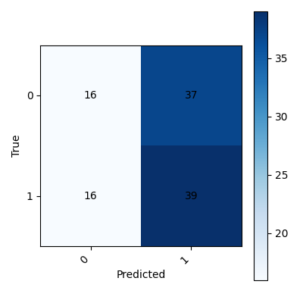
Results: Two Snapshots, Honest Framing
Report snapshot: RF ~0.51 F1, ~52% accuracy (time split).
Latest mobile artifact: SGD ~0.4906 F1, ~49.07% accuracy.
On-device profile: ~10.55 KB model, p95 ~5.62 ms.
Takeaway: mobile viability is strong; predictive quality is early-stage.
Figure: Confusion matrix from report artifacts
Notes:
Show both snapshots transparently with context.
Likely question: Which number is final?
Answer: both are valid snapshots from different project stages.

Slide 9
Live Device Demo Plan + Realistic Limits
1) Request Health access (sleep + vitals).
2) Tap Fetch + Predict to run local inference.
3) Open Last 7 Nights trend and discuss readiness state.
Fallback: if live fetch fails, use simulator demo-data path.
Notes:
Present this as your grading-time execution checklist.
Likely question: Why fallback?
Answer: demo continuity while still explaining real-device requirement.

Slide 10
Conclusion and Key Takeaways
Primary contribution: end-to-end mobile/wearable system integration.
Inference is local and privacy-preserving by design.
Current ML performance is exploratory, not benchmark-level.
Next: stronger personalization and larger real-device datasets.
Notes:
Close with honest scope and practical engineering value.
Likely question: Is this clinically ready?
Answer: no; it is a non-clinical exploratory CS655 system prototype.

Slide 11
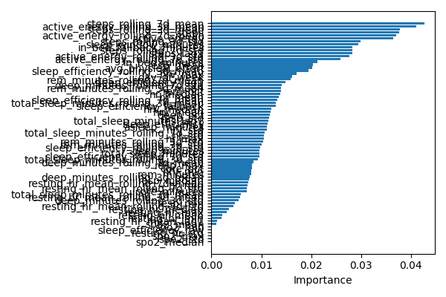
[Backup] A1: Feature Importance Insight
Rolling activity features are prominent in this snapshot.
Pattern suggests cumulative exertion influences fatigue.
Interpretation is exploratory and dataset-specific.
Use this slide when asked about model interpretability.
Figure: Feature importance from report artifacts
Notes:
Use for Q&A on why the model predicts fatigue in certain cases.
Likely question: Are these causal findings?
Answer: no, only associative within this dataset.

Slide 12
[Backup] A2: Q&A Prep
Why mobile-first? -> Course scope + privacy + deployment realism.
Why modest F1? -> Small noisy subjective labels + hard target.
Is privacy real? -> No cloud inference required for prediction.
What next? -> More history, personalization, broader data collection.
Notes:
Keep answers concise and evidence-based.
If asked to prioritize, always return to mobile/wearable systems contribution.

