Slide 1



01 / 13
CS655 MOBILE / WEARABLE COMPUTING
Next-Day Fatigue Prediction From Apple Watch Data
359 nights
Dataset scale
A privacy-preserving iOS system that reads HealthKit data, computes features locally, and runs fatigue inference on device.
On-device
Main contribution
Main effort: make the mobile path real
10.55 KB
Mobile artifact size
Shashikant | CS655 | George Mason University
Notes:
Frame the project as mobile and wearable computing first. The key claim is not state-of-the-art prediction quality; it is that the full HealthKit to feature to inference path works locally on iPhone.
[Sources]
- latex_report/codexlatex.tex
- prediction-sleep/ios_healthkit_demo/README.md
- prediction-sleep/reports/mobile_model_report.json

Slide 2
02 / 13
PRESENTATION FOCUS
Where The Project Effort Went
This talk emphasizes system design, implementation, and failure analysis because that is where the main technical work happened.
System integration
Edge deployment
Lessons learned
Most effort went into
turning noisy HealthKit
records into a reliable
nightly feature pipeline on
iPhone.
We had to export a compact
contract, load it in Swift,
and verify that the app
computes predictions locally
without Python or cloud
services.
The meaningful outcomes are
the engineering tradeoffs:
missing data, simulator
limits, feature parity, and
what still blocks stronger
mobile realism.
Notes:
Use this slide to explain why the presentation is structured around the mobile system. That directly matches the professor guidance about reflecting where the real project effort went.
[Sources]
- prediction-sleep/ios_healthkit_demo/README.md
- latex_report/codexlatex.tex

Slide 3
03 / 13
MOTIVATION
Why This Problem Matters
Wearable sensing is already available; the challenge is turning it into a private, realistic mobile system.
Fatigue affects daily function
Wearables already collect the inputs
Cloud-first pipelines are a bad default
Attention, reaction time,
and productivity are
impacted even when the
signal is subjective and
hard to measure directly.
Apple Watch and iPhone
provide sleep, heart rate,
HRV, respiratory rate, and
oxygen saturation.
Sending sensitive health
telemetry to remote servers
adds privacy, stewardship,
and latency concerns.
Notes:
The motivation is not clinical diagnosis. It is everyday readiness prediction from consumer devices under privacy constraints.
[Sources]
- latex_report/codexlatex.tex

Slide 4
04 / 13
ENGINEERING CHALLENGES
Why This Was Harder Than A Benchmark Project
The main difficulty was not fitting a model once. It was making the full mobile path behave correctly under noisy data and iOS constraints.
Health data is messy
Parity matters
Deployment is real work
Permissions, partial nights,
missing vitals, and Apple
Watch versus phone source
selection all affect the
live feature pipeline.
The mobile app must match
the exported contract
exactly for feature order,
imputation, scaling,
coefficients, and threshold
behavior.
Physical device behavior
differs from the simulator,
and some history-dependent
features are locally imputed
when full longitudinal data
is unavailable.
Notes:
This slide is the bridge from motivation to implementation. It tells the graders why the talk is heavier on engineering challenges and lessons than on broad model comparisons.
[Sources]
- latex_report/codexlatex.tex
- prediction-sleep/ios_healthkit_demo/README.md
- prediction-sleep/reports/mobile_model_report.json

Slide 5
05 / 13
LOCAL FEATURE PIPELINE
How Raw HealthKit Data Becomes A Feature Vector
The live iOS path turns HealthKit samples into a [String: Double] payload before the model runs. This is done in Swift inside HealthKitManager.
Sleep query
Stage aggregation
Vitals and activity
Live payload
SleepAnalysis samples are
grouped into nights using a
minus 6 hour shift so
cross-midnight sleep maps to
one night key.
The app computes in-bed,
REM, deep, core, asleep,
total sleep, efficiency, and
sleep-stage percentages from
selected night samples.
It fetches HR, HRV,
respiratory rate, and SpO2
stats during the night, plus
day-before steps, active
energy, and exercise time.
That yields 33 directly
computed features before
missing contract slots are
filled locally for
inference.
No cloud inference at prediction time. The app reads, computes, predicts, and renders locally on iPhone.
Notes:
Be explicit here that the feature vector is created on device. Mention watch-source preference and that night grouping happens in Swift, not in a remote preprocessing service.
[Sources]
- prediction-sleep/ios_healthkit_demo/README.md

Slide 6
06 / 13
ON-DEVICE INFERENCE
How The Model Computes On Device
FatigueModel.swift runs a 61-feature linear contract in pure Swift: 33 features come from the live HealthKit path and the remaining 28 are filled locally from the contract medians.
Bundled contract
FatigueModel.predict()
mobile_linear_contract.json
feature_order: 61
imputer_median
scaler_mean / scaler_scale
coef + intercept
classes = [0, 1]
decision_threshold = 0.5
features = completeFeatures(raw)
for f in feature_order:
x = raw[f] ?? imputer_median[f]
z = (x - mean[f]) / max(scale[f], 1e-12)
logit += z * coef[f]
p1 = 1 / (1 + exp(-logit))
label = p1 >= 0.5 ? 1 : 0
Key point: the app ships the model as a JSON contract and executes every inference step locally in Swift without a Python runtime.
Notes:
This is the most technical slide. Walk through the contract fields and then the exact execution order: impute, scale, weighted sum, sigmoid, threshold.
[Sources]
- prediction-sleep/ios_healthkit_demo/README.md

Slide 7
07 / 13
RUNTIME DIAGNOSTICS
What The App Exposes About Edge Runtime
The UI and HealthKit manager surface missing-feature behavior, local latency, and OS-level integration points instead of hiding them.
Missing-data path
Local timing
OS integration
The UI shows
missingFeatureCount and
flags local median
imputation when contract
features are absent.
runPrediction() records
lastInferenceMs and the
footer explicitly says the
inference ran locally with
no server request.
HealthKitManager enables
hourly background delivery
and HKObserverQuery for
local refresh when new sleep
data arrives.
Notes:
This slide reinforces that the app is instrumented as an edge system. Mention that the UI literally shows feature count, missing features, and local timing.
[Sources]
- prediction-sleep/ios_healthkit_demo/README.md

Slide 8
08 / 13
EVALUATION SETUP
Evaluation Still Stays Honest
The dataset is small and the split is chronological, so any claims about on-device ML quality should stay exploratory and course-demo appropriate.
359
70 / 30
108
Labeled nights
Time-based split
Hold-out rows
from the report dataset
251 train / 108 test
chronologically later nights
Notes:
Keep this honest. The point is not a massive benchmark; it is a small but realistic end-to-end system evaluation.
[Sources]
- latex_report/codexlatex.tex

Slide 9
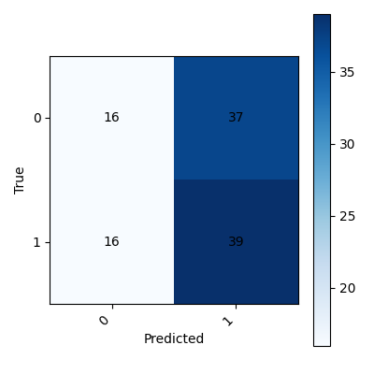
09 / 13
RESULTS AND LESSONS
The ML Score Is Modest, The System Result Is Stronger
That is consistent with where the project effort went: proving the mobile path and characterizing its limits, not chasing benchmark gains.
0.51 F1
52% acc
Report RF
Report RF
hold-out
hold-out
0.4906 F1
10.55 KB
Mobile artifact
Artifact size
2026-04-05, SGD
p95 5.62 ms
Report-era Random Forest confusion matrix.
Interpretation: accuracy is exploratory, but the mobile artifact is compact, fast, and suitable for private on-device inference.
Notes:
Keep the distinction explicit: report-era Random Forest numbers are one context, but the mobile artifact matters more for the edge-computing story.
[Sources]
- latex_report/codexlatex.tex
- prediction-sleep/reports/mobile_model_report.json
- prediction-sleep/reports/confusion_matrix.png

Slide 10
10 / 13
LIVE DEMO
Physical Device Demo Plan
Real HealthKit requires a physical iPhone. The simulator is useful only for UI flow and demo-mode fallback.
Step 1
Step 2
Fallback
Run on a real iPhone, grant
Health permissions, and tap
Fetch plus Predict.
Show the prediction card and
open the 7-night history
view from recent synced
data.
If live HealthKit fetch
fails, use simulator demo
mode to prove the local
feature and inference path
still works.
Notes:
This slide matters because the course framing is deployment realism. Mention simulator limits before anyone asks.
[Sources]
- prediction-sleep/ios_healthkit_demo/README.md
- latex_report/codexlatex.tex

Slide 11
11 / 13
CONCLUSION
Key Takeaways
The strongest contribution is the mobile integration story: real HealthKit sensing, Swift feature engineering, local contract math, and clear lessons from what still breaks or gets imputed.
Private
61 / 33 / 28
10.55 KB
No cloud inference
Contract / live / imputed
Compact artifact
prediction stays local
current edge path
p95 5.62 ms in artifact report
Notes:
Close by stating that this is a mobile systems project with exploratory ML. The next technical step is improving on-device history coverage and robustness, not just swapping models.
[Sources]
- latex_report/codexlatex.tex
- prediction-sleep/reports/mobile_model_report.json

Slide 12
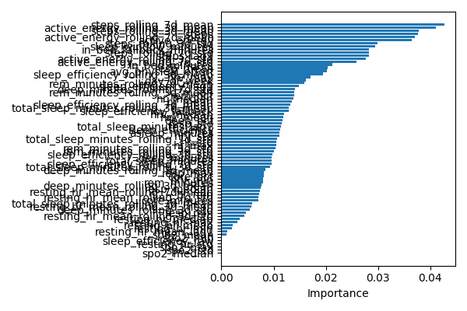
12 / 13
BACKUP
Feature Importance: Physical Load Dominates
The strongest predictors reflect cumulative activity, not only isolated one-night sleep measurements.
Interpretation
Rolling steps and active
energy outrank isolated
overnight measures. That
suggests subjective fatigue
is cumulative across days.
Use this backup slide only if asked what the model appears to prioritize.
Feature importance from the report-era Random Forest model.
Notes:
Use this slide only if asked what the model appears to be using. Keep the interpretation cautious.
[Sources]
- prediction-sleep/reports/feature_importance.png
- latex_report/codexlatex.tex

Slide 13
13 / 13
BACKUP
Likely Q&A Topics
These are the main limitations and design decisions I expect to be asked about.
Why mobile first?
Why not claim strong ML?
What improves this next?
Because privacy, latency,
and deployability are the
course framing, and the app
path is a real native
implementation.
The dataset covers 359
nights with subjective
labels, so the performance
should be treated as
exploratory.
More participant data,
missing-sensor robustness
tests, and real device
memory and battery
measurements.
Notes:
If questions come, start by reaffirming the mobile-system framing and then answer the ML part with appropriate caution.
[Sources]
- latex_report/codexlatex.tex
- prediction-sleep/MOBILE_READINESS_MEMORY.md
- prediction-sleep/reports/mobile_model_report.json

