Slide 1
Cost of Treatment of Melaleuca quinquenervia Standing Biomass by Various Methods
Jennifer Fugett
EMBA Final Project Presentation,
October 7, 2001
Exotic Control
Notes:
Introduction: Good Afternoon. Thank you for the opportunity to present my research on the exotic plant species Melaleuca.

Slide 2
What is Melaleuca ?
Exotic, invasive plant species
  Australian native
Distribution in Florida
  1906 Sydney, Australia
  1937 Aerial Dispersion to Dry Wetlands
  1941 Erosion Control
  Today – Controlled Invasive Species
Notes:
Exotic plant species: Australian native tree, introduced to Florida in early 20th century, 1906 seeds sent from Sydney Australia, Around 1937 seeds aerial dispersed over eastern portion of Everglades, 1941 used for erosion control on levees, Today – Melaleuca is an exotic pest species that is controlled on Florida lands

Slide 3
Why an Invasive Species in Florida?
Strangles out native flora
Takes over wetland habitats
Deprives other species of valuable food resources
Flourishes in variety of ecological conditions
Rapid colonization and population growth
Notes:
Melaleuca produces

Slide 4
Why Control Exotic Invasive Species?
Cost billions of dollars annually in the US
  Crop damage
  Rangelands
  Waterways
  Government maintained lands
Cause losses greater than $138 billion per year in the US

Slide 5
Background
Challenge for DEP Funding by Entrepreneur from Future American Corp.
  Future American’s Treatment Method
Way of Testing Proposed Method Against Other Methods
Notes:
Future American Corp – more cost effective method using prison laborers – teach valuable life skills while accomplishing objectives of exotic control
Much is known about chemical treatments, some biological control methods currently being researched (

Slide 6
Overall Project Objectives
Analyze Cost of Five Different Methods of Exotic Vegetation Treatment
Determine the Least Expensive of the Five Methods Analyzed
Determine Dry Weight Standing Biomass
Determine Population Density
Further Research Recommendations

Slide 7
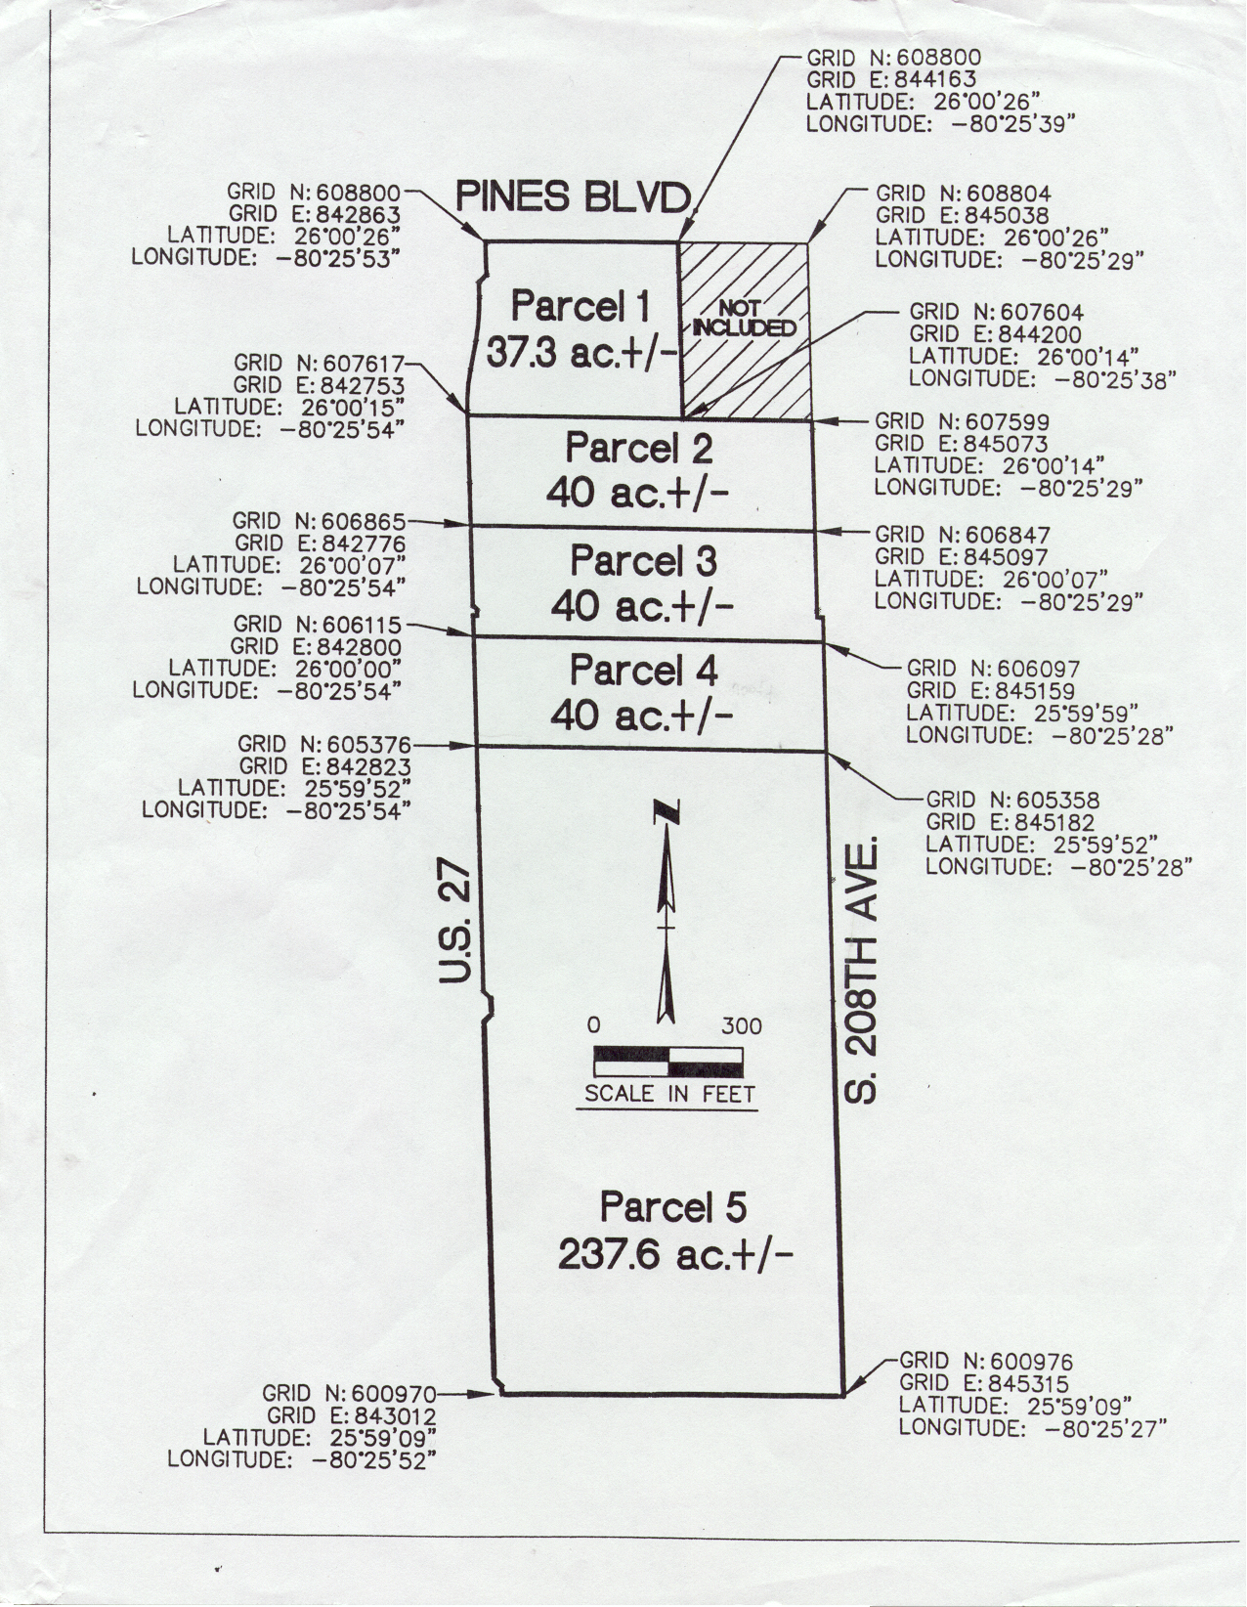
Project Site
161.9 hectare (400 Acre) Land Parcel
4 ∝ 15 hectare (40 acre) parcels
  Various treatment methods
1 – 96.15 hectares (237 Acre) Parcel
  Aerial spraying
SFWMD Survey Sketch

Slide 8
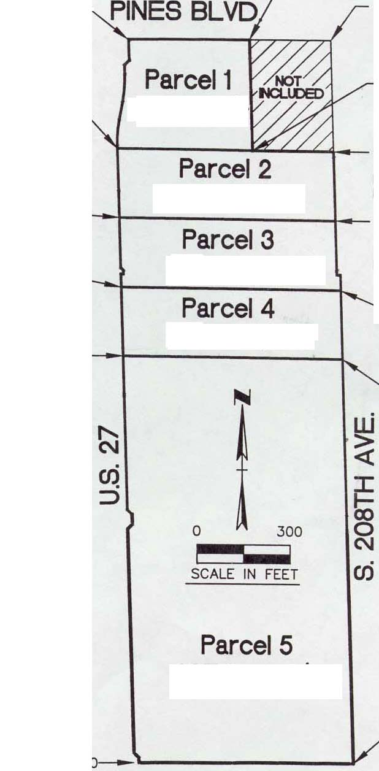
Methods
Established 3 100m² plots in Parcels 1 thru 4
Parcel 5 Not Included in Biomass Data
Collected Data
  Melaleuca dbh
  Number Melaleuca seedlings
  Number of each type Native species present
Predictive Equation developed by USGS Scientists
SFWMD Survey Sketch
Notes:
Established 3 plots 10m x 10m in each parcel
Collected Data
Melaleuca dbh for calculating the biomass contained with in each Parcel of land
Number of Melaleuca seedlings – From the total number of Melaleuca present, mature trees and seedlings, determined population density
3. Types and number of natives collected in order to look at future regrowth and re-establishment of natives

Slide 9
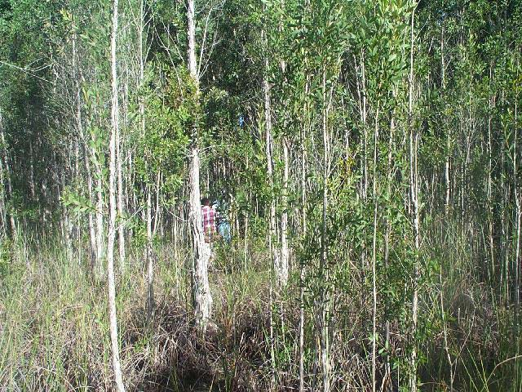
Measuring 10m X 10m Plots
Notes:
First plot established approximately 40m eastward and 20m northward into parcel
40m between plots

Slide 10
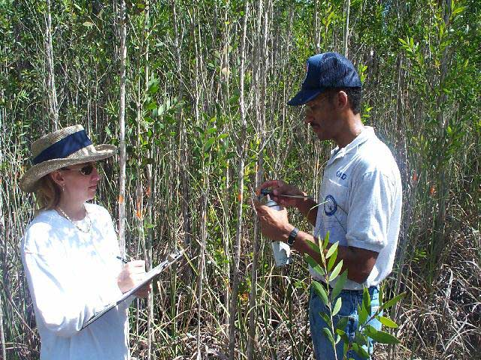
Data Collection
Notes:
Dbh measured with digital micrometer
Measurement recorded
Tree sprayed with survey paint to avoid recounting the same tree

Slide 11
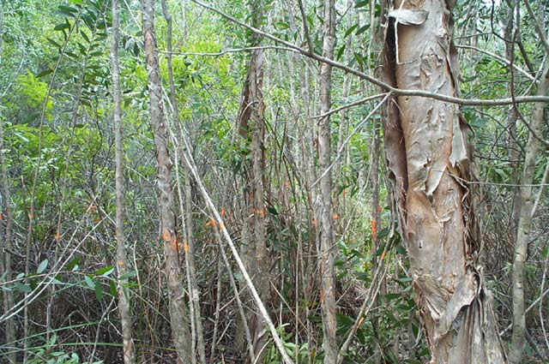
Marked Plot

Slide 12
Parcel No. 1
Method of Treatment
Future American Corporation
Use Inmate Labor
  Shear trees and cut manually with chainsaws
  Treat stumps with herbicide
Trees Moved to Staging Area
  Chipped
  Loaded onto trucks
Delivered to Prisons or Power Plant
Treatment has not Started

Slide 13
Parcel No. 2
Method of Treatment
Habitat Restoration Resources
Cut Down and Spray trees
  Tracked Feller Buncher
Move Debris to Project Boundaries
  Shovel Loader
Chip Trees w/ Whole Tree Chipper
Haul chips away
Remove Remaining saplings
  Gyro Trac Forestry Mower
Hand Labor to Treat Stumps w/ Herbicide
Retreat Site in 6-8 weeks for Re-growth

Slide 14
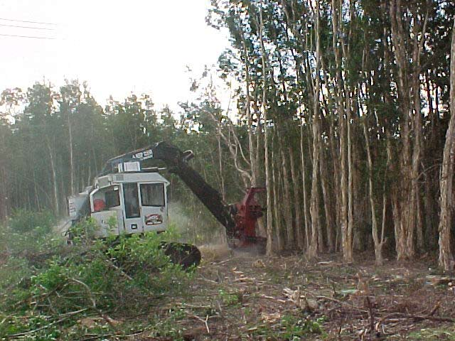
Parcel No. 2
Tracked Feller Buncher Cutting Trees
Notes:
Tracked feller buncher cutting trees

Slide 15
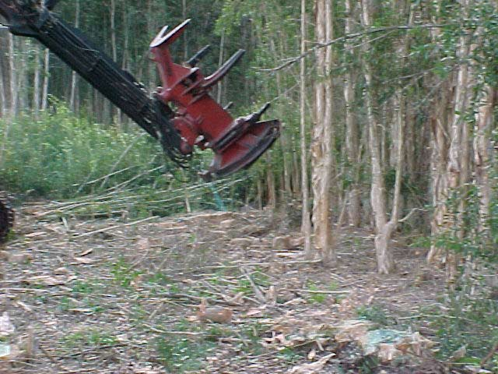
Parcel No. 2
Tracked Feller Buncher Spraying Stumps
Spraying
Treated Stump
Notes:
Tracked Feller Buncher spraying herbicide
Treated stump

Slide 16
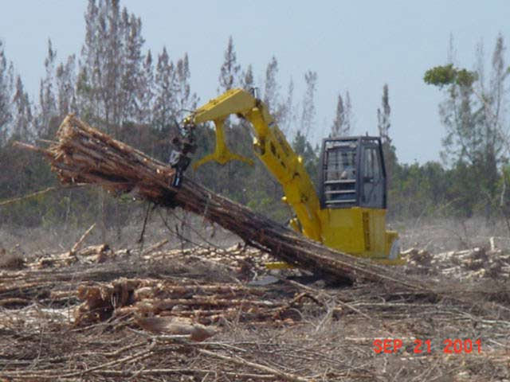
Parcel No. 2
Shovel Loader Moving Trees

Slide 17
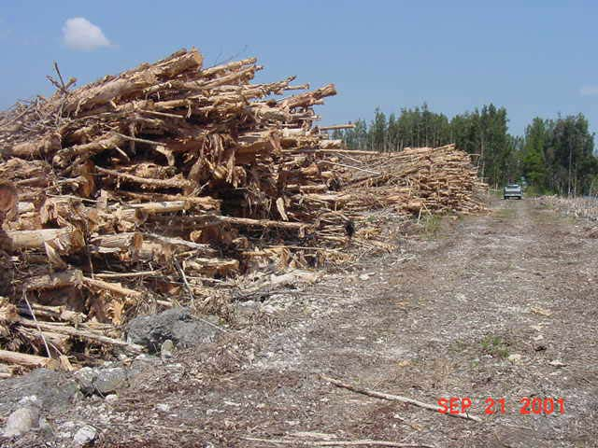
Parcel No. 2
Trees Stacked in Staging Area

Slide 18
Parcel No. 3
Method of Treatment
Applied Aquatic Management, Inc.
Use Hand Labor
  Cut Trees with Chainsaws
  Treat stumps with Herbicide Application
  Remove seedlings
Do Not Remove Melaleuca Biomass from Site

Slide 19
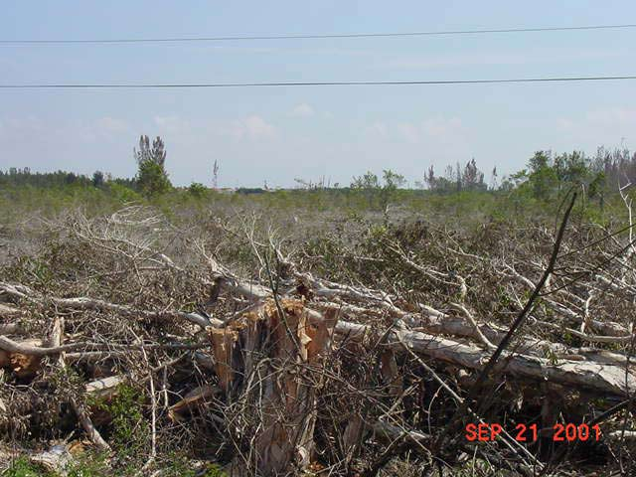
Parcel No. 3 – After Treatment
Notes:
Debris/Biomass not removed
High Percentage of Native Remaining
Seeds left to germinate. Expect high re-growth on this site

Slide 20
Parcel No. 4
Method of Treatment
Florida Environmental Clearing
Knock Trees Down and Mulch into Ground
  Clear-More Tree Chipper Stumper
Leave Site in Level Condition
Re-treat Re-Growth Aerially within One Year

Slide 21
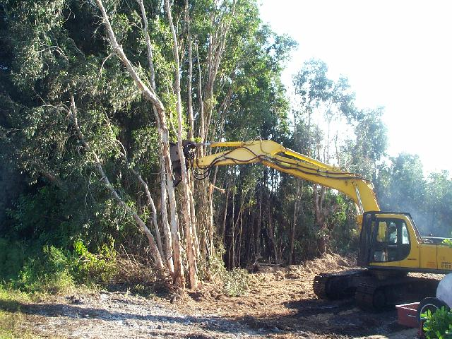
Parcel No. 4
Clear-More Tree Chipper Stumper Knocking Down Trees

Slide 22
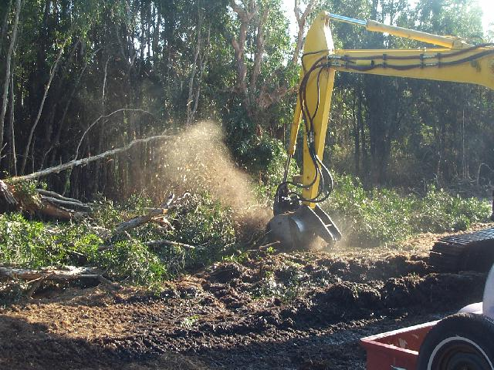
Parcel No. 4
Clear-More Tree Chipper Stumper
Grinding /Mulching

Slide 23
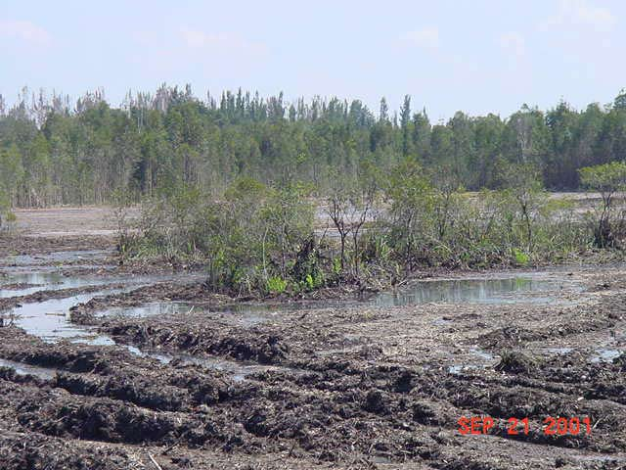
Parcel No. 4 - After Treatment
Remaining Natives
Ground Rutting

Slide 24
Parcel No. 5
Method of Treatment
Helicopter Applicators
Aerially Broadcast herbicide over Parcel
Innermost 180 Acres Treated
Method used to compare low cost of aerial treatment method

Slide 25
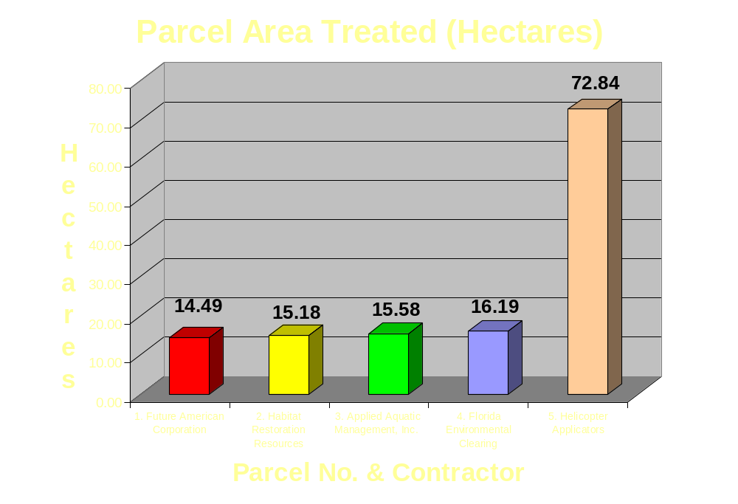
Results 1

Slide 26
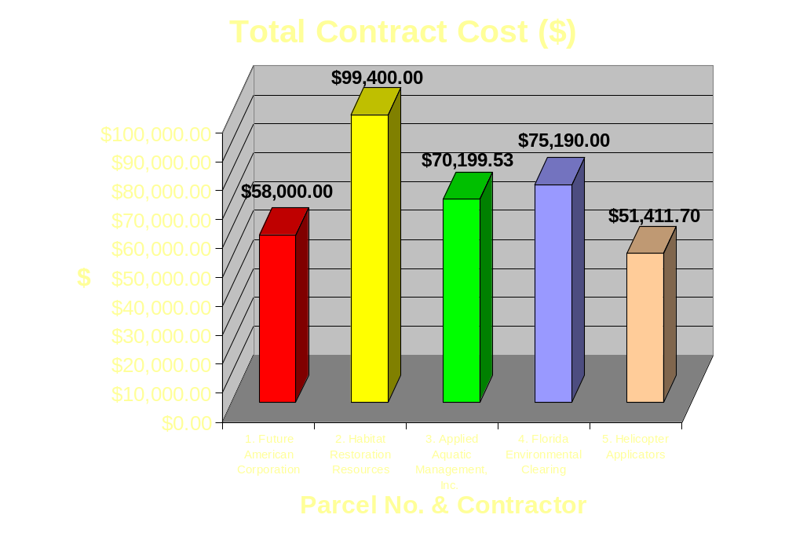
Results 2

Slide 27
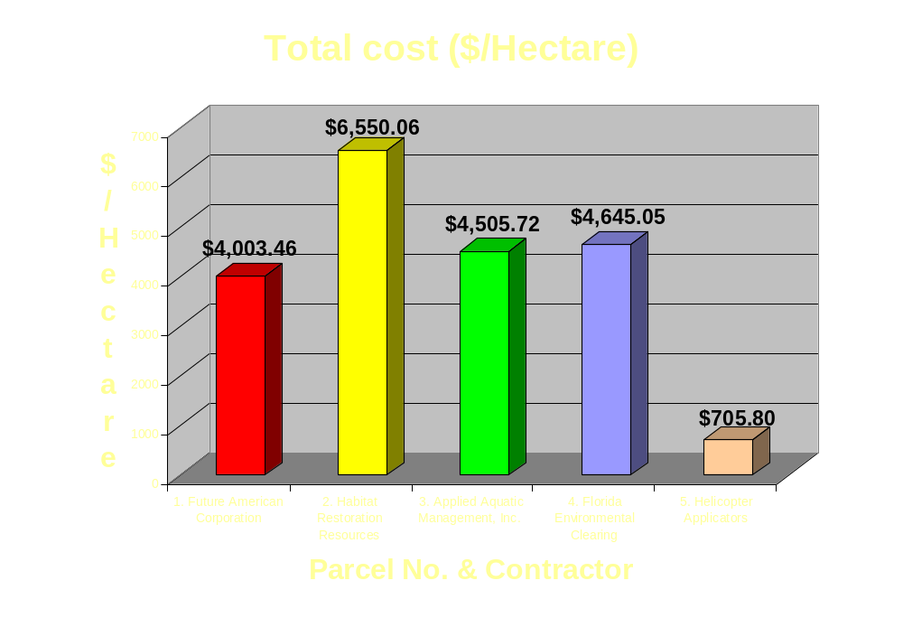
Results 3

Slide 28
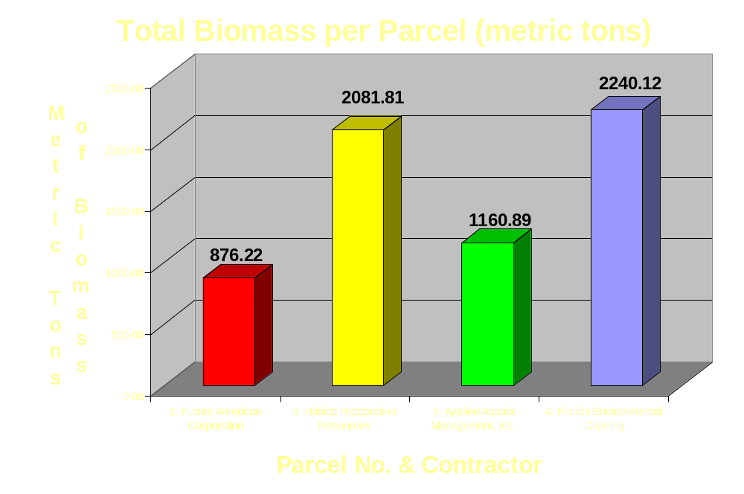
Results 4

Slide 29
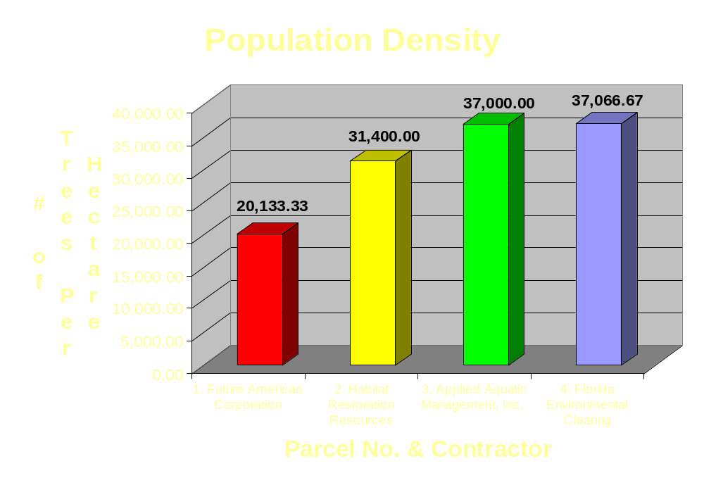
Results 5

Slide 30
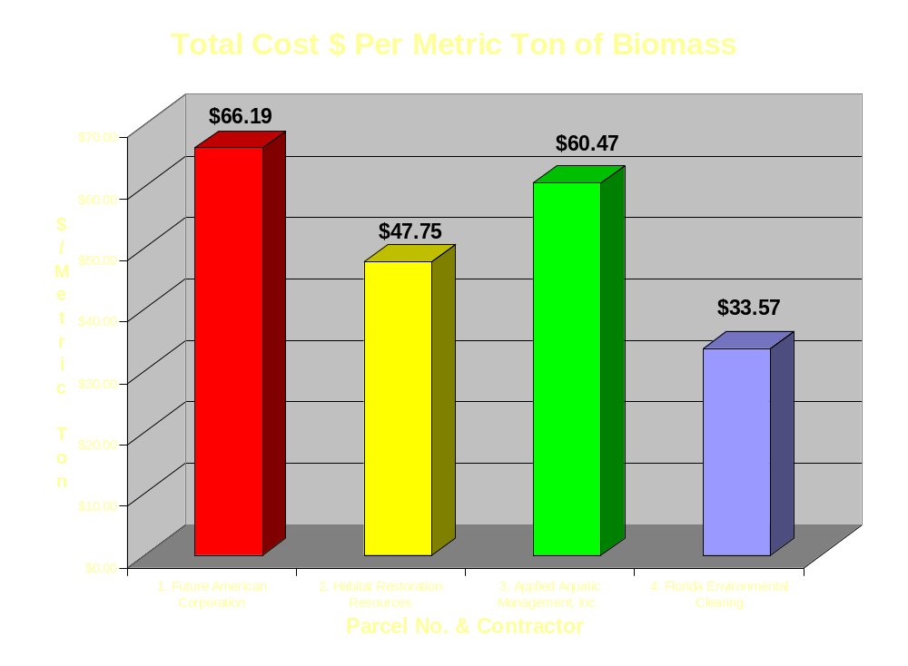
Results 6

Slide 31
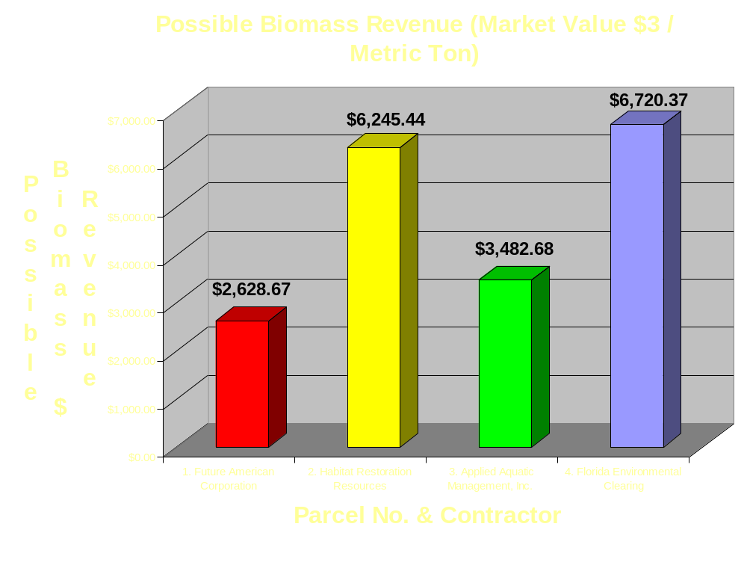
Results 7

Slide 32
Future Considerations
Develop method to Analyze Re-Growth as an indicator of Method Effectiveness
Analyze Costs to Treat Re-growth in each Parcel
Prepare Estimates for Each Contract Using Industry Standard Estimation Software – Analyze Contract Costs
  Are Contract Amounts Accurate
Cost-Benefit Analysis of Social Good of Future American Corporation’s Method
Repeat Research on Similar Parcel of Land to Validate using $/Amount of Biomass Method of Comparison

Slide 33
Acknowledgements
Francois LaRoche , SFWMD
  Project idea, mentoring, and opportunity to continue developing project
Thai Van, USGS
  Assistance reproducing Standing Biomass methods and interpreting biomass data
Linda Yarrish, SFWMD
  Data collection
Gordon Baker, SFWMD
  Data collection

Slide 34

QUESTIONS?

