Slide 1



CHAPTER 03
Development and GitHub Workflows
What if one supervised workflow carried a change from the first edit to a merge-ready pull request?
github.com/github/copilot-app-for-beginners
Notes:
This chapter puts the app, sessions, worktrees, and context together into two connected loops. The inner loop happens on your machine. The outer loop happens on GitHub. The app connects both, and you stay responsible for the evidence and for what ships.

Slide 2

CHAPTER 03
CHAPTER 03
In this chapter
01
Inner loop on your machine
Plan, change, inspect, test, build, and preview. Repeat until the evidence is clean.
Outer loop on GitHub
02
Issue, pull request, review feedback, and checks. Merge only when everything agrees.
Notes:
This chapter has 2 parts: Inner loop on your machine, Outer loop on GitHub.

Slide 3
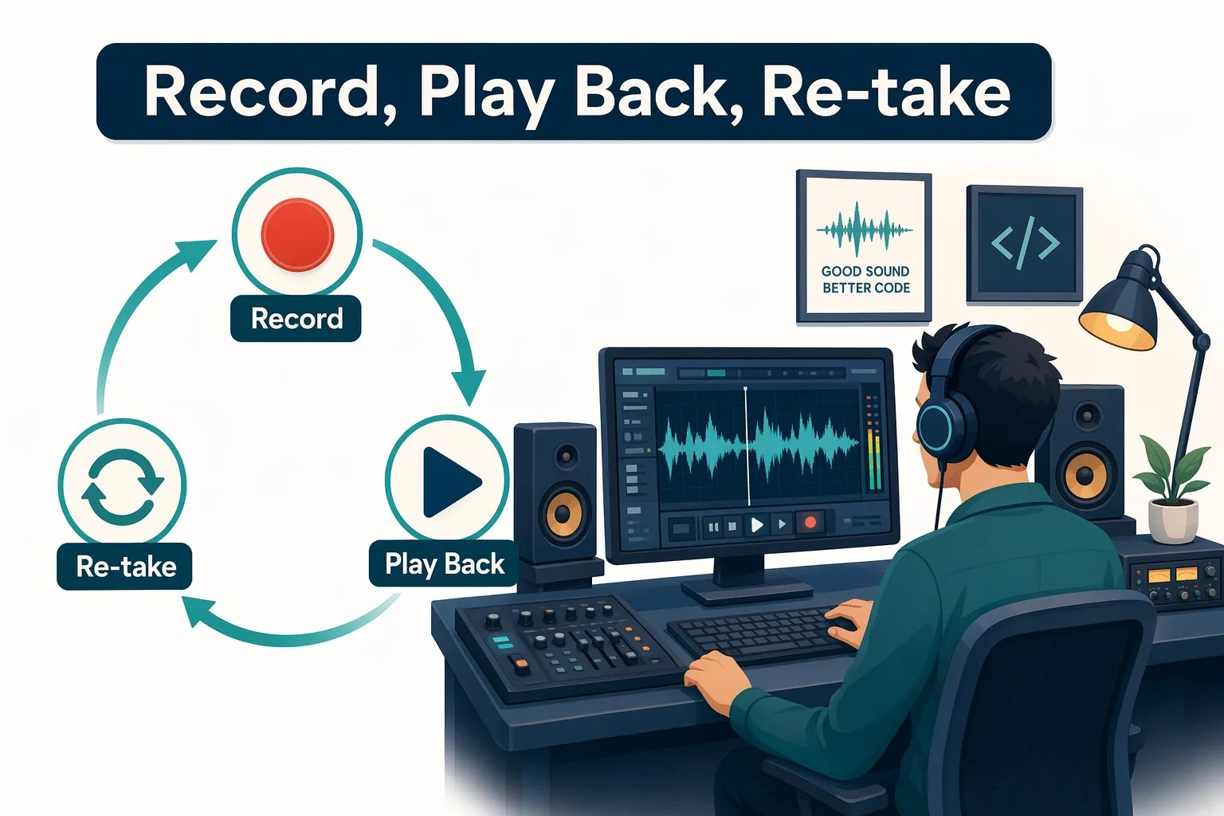
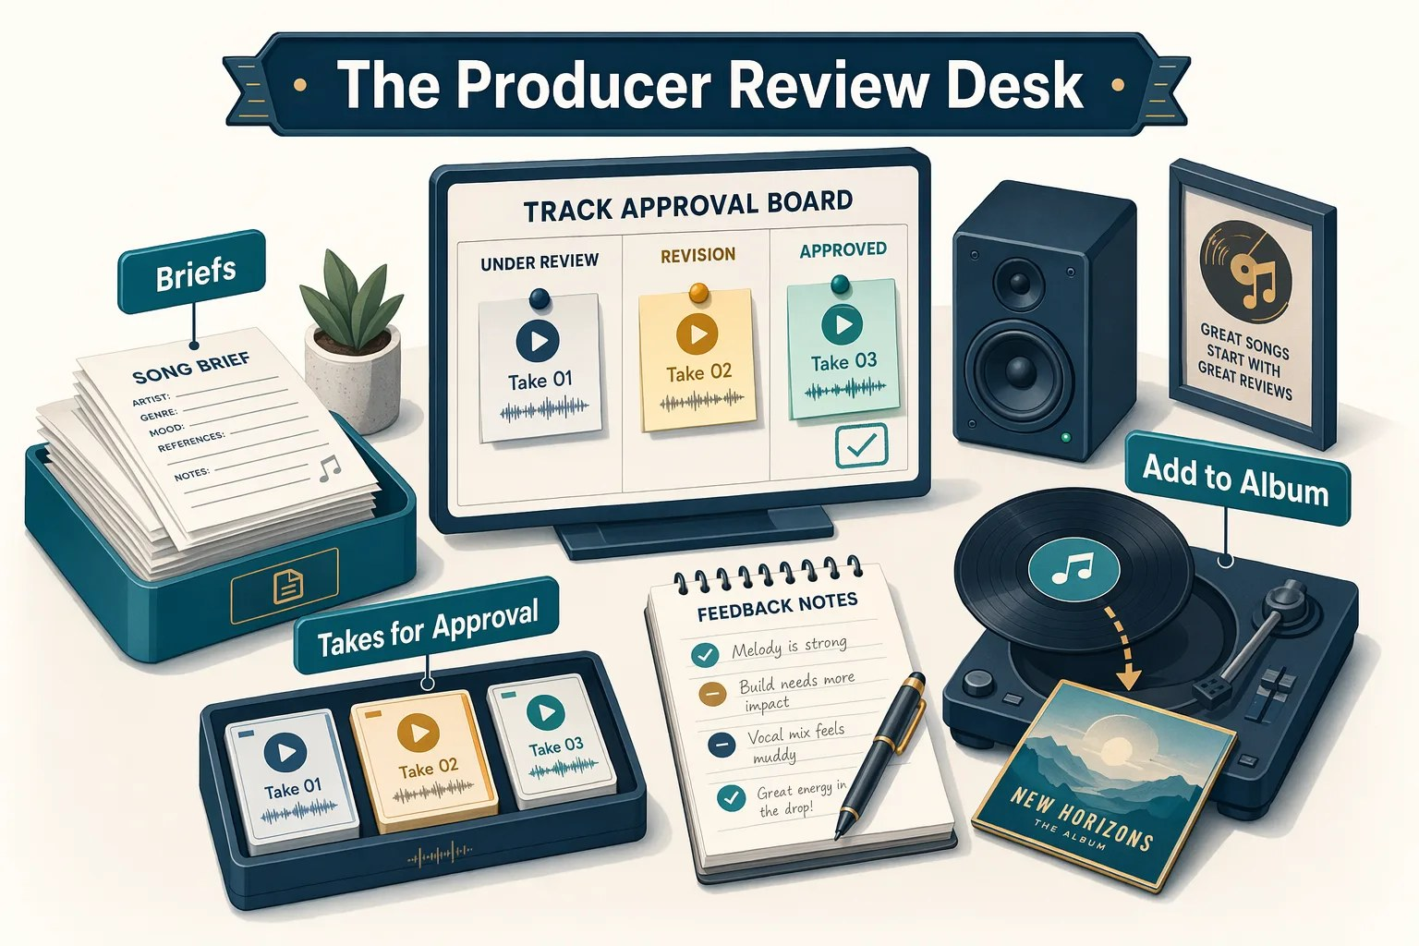


CHAPTER 03
FROM THE STUDIO
From take to final mix
Inner loop
Outer loop
Record, play back, and retake.
The producer approves the final mix.
Notes:
A musician does not keep the first take just because it is finished. They record, listen, adjust, and record again. That is the inner loop: make a change, then inspect the evidence. A finished take still moves through production: the producer tracks the brief, feedback, quality checks, and final approval. That is the outer loop on GitHub.

Slide 4
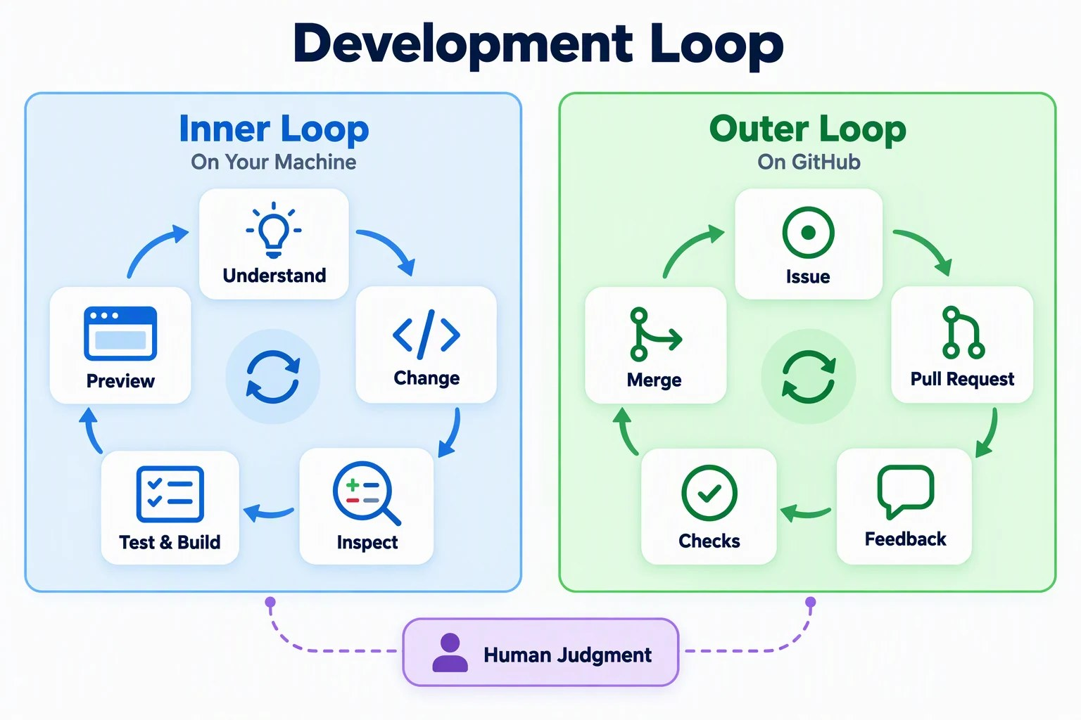

CHAPTER 03
THE BIG PICTURE
Two connected loops
The app runs both. You judge the evidence and decide what ships.
Inner loop
Understand, change, inspect, test, preview. Repeat.
Outer loop
Issue, pull request, feedback, checks, merge.
Notes:
The inner loop is fast and local: understand, change, inspect the diff, run tests and the build, preview, and repeat. The outer loop moves validated work through GitHub: issue, pull request, feedback, and checks. The diagram puts human judgment between them and over both.

Slide 5




CHAPTER 03
CORE CONCEPT
Trust the evidence, not the confidence
A change is ready only when all four agree with your review.
Diff
Tests and build
Running app
GitHub checks
CHANGES TAB
TERMINAL TAB
BROWSER TAB
PULL REQUESTS VIEW
Focused and understandable.
Complete successfully.
Behaves as expected.
CI agrees with your local results.
Notes:
A confident response from Copilot is not the same as validated software. These are the four evidence surfaces: the diff in the Changes tab, test and build output in the Terminal tab, the running app in the Browser tab, and continuous integration checks on the pull request. A change is ready only when all of them agree with human review.

Slide 6
CHAPTER 03
SECTION 1 OF 2
Inner loop on your machine
01
Plan, change, inspect, test, build, and preview. Repeat until the evidence is clean.
Notes:
Section 1: the inner loop, on your machine.

Slide 7


CHAPTER 03
BEFORE ANY CHANGE
Start from a known-good baseline
If tests pass now, a later failure means something.
4
tests pass
2 test files. The build succeeds.
Terminal
$ cd samples/book-app-web
$ npm install
New worktree? Run npm install first.
$ npm test -- --run
$ npm run build
Bash and PowerShell snippets in a response have a Run button that runs them in this terminal.
Notes:
Open the review panel and its Terminal tab. Install dependencies, run the tests once with the run flag so Vitest exits, and run the build. You should see four passing tests. The repository file .github/copilot-instructions.md tells Copilot about the sample app and its validation commands, so you can also ask Copilot to summarize the test framework and build tool. Dependencies are not shared between worktrees. When Copilot gives you a Bash or PowerShell snippet, you can copy it into the Terminal tab, or select the Run button next to the snippet to run it in the session terminal. The terminal reuses the existing shell, so the working folder and environment carry over.

Slide 8
CHAPTER 03
REVIEW AND FIX A BUG
Reading stats ignore active filters
Branch practice-unread-count-bug, issue #2.
1
Start from the branch
Create from > Branches > the practice branch.
2
Plan from the issue
Attach #2 in Plan mode. Ask for the root cause.
Exit plan mode, implement
3
Back in Interactive. Keep the fix small.
4
Inspect the diff
It should only touch the filtered-book data flow.
Notes:
In Chapter 02 you attached an issue for context. Now use that as the start of a full inner loop. Start from the practice branch and attach issue 2 in Plan mode with the prompt: use the attached issue as the source of truth, review samples/book-app-web/src, identify the root cause, and create a short fix and validation plan. The plan should connect the statistics to the books shown after filtering. Select Exit plan mode and I will prompt myself; the mode returns to Interactive. Ask Copilot to implement the plan, keep the fix small, explain the root cause, and run the relevant tests. Then inspect the diff. If it is not focused, ask Copilot to revise it.

Slide 9
CHAPTER 03
VALIDATE THE FIX
Prove it in the browser
Genre Fantasy + Status Unread, with an empty search.
Terminal
UNREAD COUNT
$ npm test -- --run
$ npm run build
WITH THE BUG
AFTER THE FIX
$ npm run dev
5
1
Open the Local URL in a Browser tab. Stop the server with Ctrl+C.
Uses the full list
The Night Circus
Notes:
If Copilot already ran the tests and build, review its output. Otherwise run them, start the dev server, and open the Local URL in a Browser tab. Leave search empty, choose Fantasy and Unread. Only The Night Circus should appear and the unread count should be 1. With the bug, the count stays at 5 because stats use the full book list. Selecting Unread alone would not reveal the bug, since all five unread books would still be visible. That completes one inner-loop cycle.

Slide 10




CHAPTER 03
PROTECT THE FIX
Lock it in, then get a second opinion
Add a regression test
Ask the rubber duck
It must fail with the bug and pass with the fix. Never weaken an existing test.
A critic that uses a different model to find gaps in your evidence.
PROMPT
PROMPT
Test Fantasy + Unread with an empty search. Expect an unread count of 1.
/rubber-duck Critique this session's diff, tests, and browser check.
Notes:
A regression test proves the bug would fail before the fix and pass after it. Inspect the test in Changes and confirm it checks visible filtered results rather than weakening an expectation. Then run tests and build again. Optionally, with tests in place, refactor filterBooks into small helpers. Then ask the rubber duck agent to critique the session. It uses a different AI model from your session, and Copilot uses it only when a suitable critic model is available. If the command is unavailable, choose a different model or send the same request without the slash command. Address any real gap before you open a pull request.

Slide 11
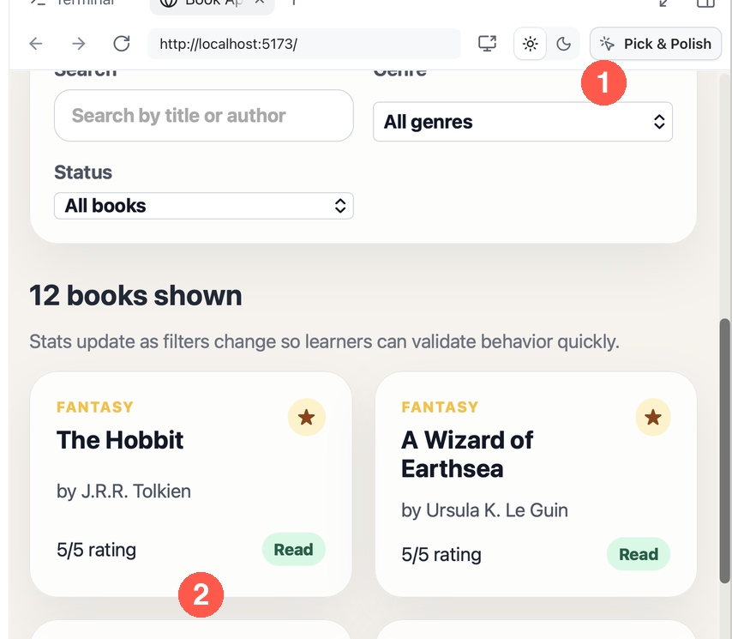

CHAPTER 03
OPTIONAL · UI CHANGES
Point at it with Pick & Polish
Attach a live page element to your next prompt.
1
Turn on Pick & Polish
In the preview toolbar.
2
Select a book card
Click its empty background.
3
Prompt with it attached
article.book-card appears.
Notes:
Pick and Polish is optional. Use Create from to start a session on the practice-card-polish branch, run the app, and open it in the Browser tab. Turn on Pick and Polish and select a book card. An article.book-card attachment appears in the prompt box. Ask for a small spacing and hierarchy improvement that keeps the design and accessible text. The attachment shows that Copilot got context from the rendered page. Finish with the same diff, test, build, and browser evidence as any other change.

Slide 12
CHAPTER 03
SECTION 2 OF 2
Outer loop on GitHub
02
Issue, pull request, review feedback, and checks. Merge only when everything agrees.
Notes:
Section 2: the outer loop, on GitHub.

Slide 13
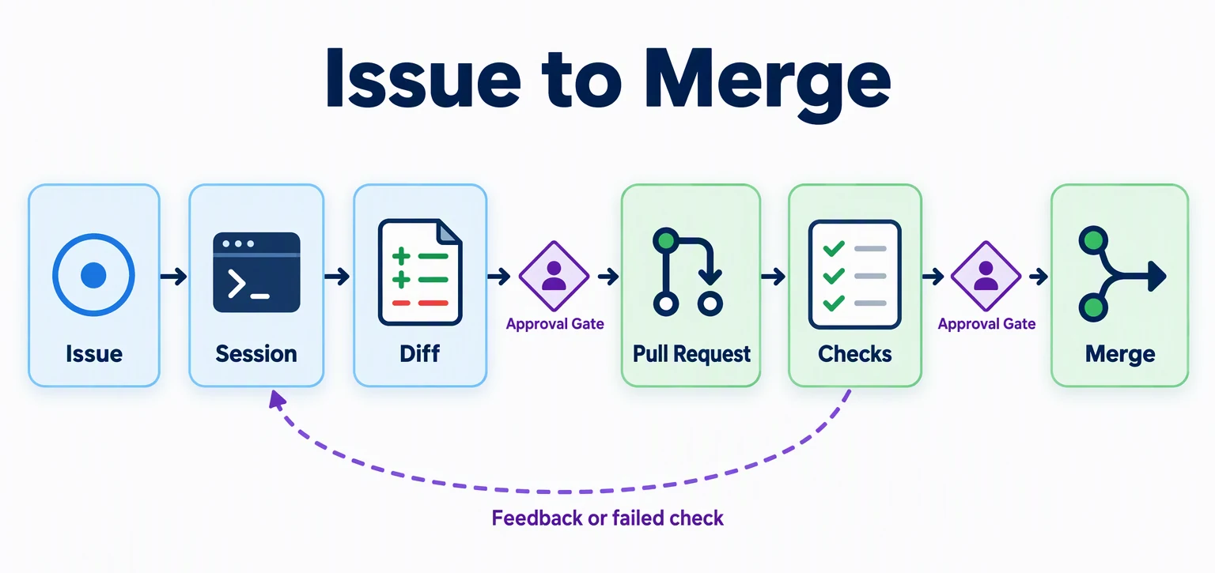
CHAPTER 03
THE OUTER LOOP
From issue to merge
Feedback or a failed check sends the work back to the session.
Notes:
The outer loop: start from a GitHub issue, implement and validate in a session, review the diff and evidence, open and review a pull request, respond to feedback and failing checks, and merge only when the diff, local evidence, and checks agree. The approval gates in the diagram are where you decide.

Slide 14
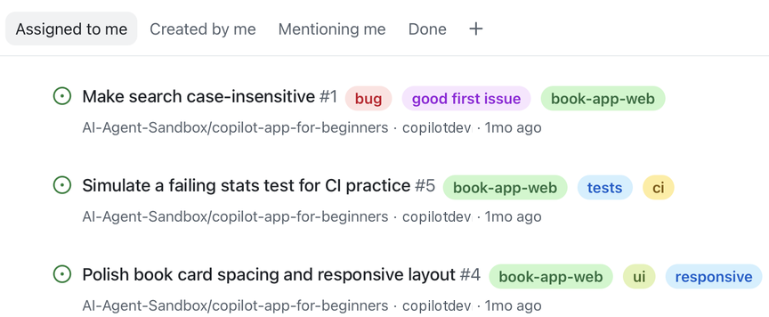
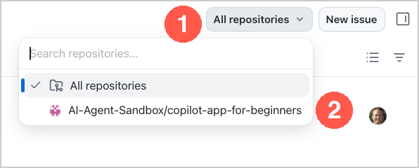
CHAPTER 03
ISSUES AND PULL REQUESTS
Find the course work
Pick your fork in each view's repository picker.
1
Issues > Assigned to me
Select All repositories, then your fork.
2
Pull requests > Authored by me
Pick your fork there too.
Notes:
The Issues and Pull requests views in the sidebar list GitHub work that involves you. Select Issues and stay on Assigned to me. Select All repositories at the top, then your fork. The view now lists only the practice issues. Do the same in Pull requests; each view keeps its own repository selection, and the practice PRs appear on Authored by me. You can also filter with a query: select the filter icon and add repo:OWNER/copilot-app-for-beginners. A typed query resets when you change tabs, so the picker is easier.

Slide 15
CHAPTER 03
ISSUE TO PULL REQUEST
Make search case-insensitive
Branch practice-search-case-bug, issue #1.
1
Create from the branch
Not New session: that starts from main.
2
Plan, then implement
Attach #1. Add a test for upper and lower case.
3
Run the inner loop
Diff, tests, build, then hobbit vs HOBBIT.
4
Create the PR
Draft an honest summary, then Create PR.
Only claim checks that appear in terminal or CI output. Do not merge this practice PR.
Notes:
Open the Make search case-insensitive issue in the Issues view and read it. The issue has a New session button, but it starts from main, where search already works. So use Create from and pick the practice-search-case-bug branch. Attach issue 1 in Plan mode, review the plan, exit plan mode, and implement it with a focused regression test. Run the inner loop, including a browser check that hobbit and HOBBIT return the same result. Ask Copilot to draft a pull request summary that includes only validation you actually saw. Then select Create PR at the top of the session. You can open it above the prompt box or in the Pull requests view. Do not merge it; main already has the correct behavior.

Slide 16
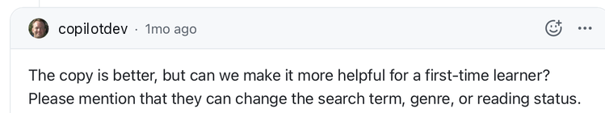
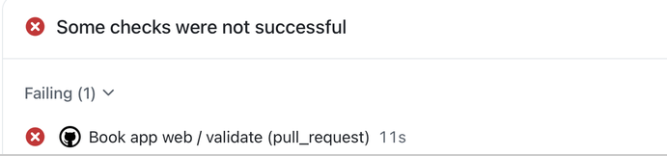


CHAPTER 03
FEEDBACK AND CHECKS
Respond to comments and failed checks
IMPROVE EMPTY-STATE COPY
FAILING STATS CHECK PRACTICE
PROMPT
PROMPT
Address this PR comment with the smallest useful change. Show me the diff first.
Analyze the failing check. Propose the smallest fix. Don't weaken the test.
Notes:
Select Pull requests in the sidebar; the practice PRs are on Authored by me. For the review comment: open Improve empty-state copy and select New session at the top of the pull request. Ask Copilot to address the comment with the smallest useful change. Inspect the diff, ask Copilot to commit and push, and confirm the update on the pull request. For the failing check: open Failing stats check practice and select New session. The session's PR tab has a Fix failing checks button, but this exercise uses your own prompt so you can see and steer each step. The fix should restore favorite counting for read and unread favorites. Validate locally, commit and push, and confirm the Book app web check passes on rerun.

Slide 17
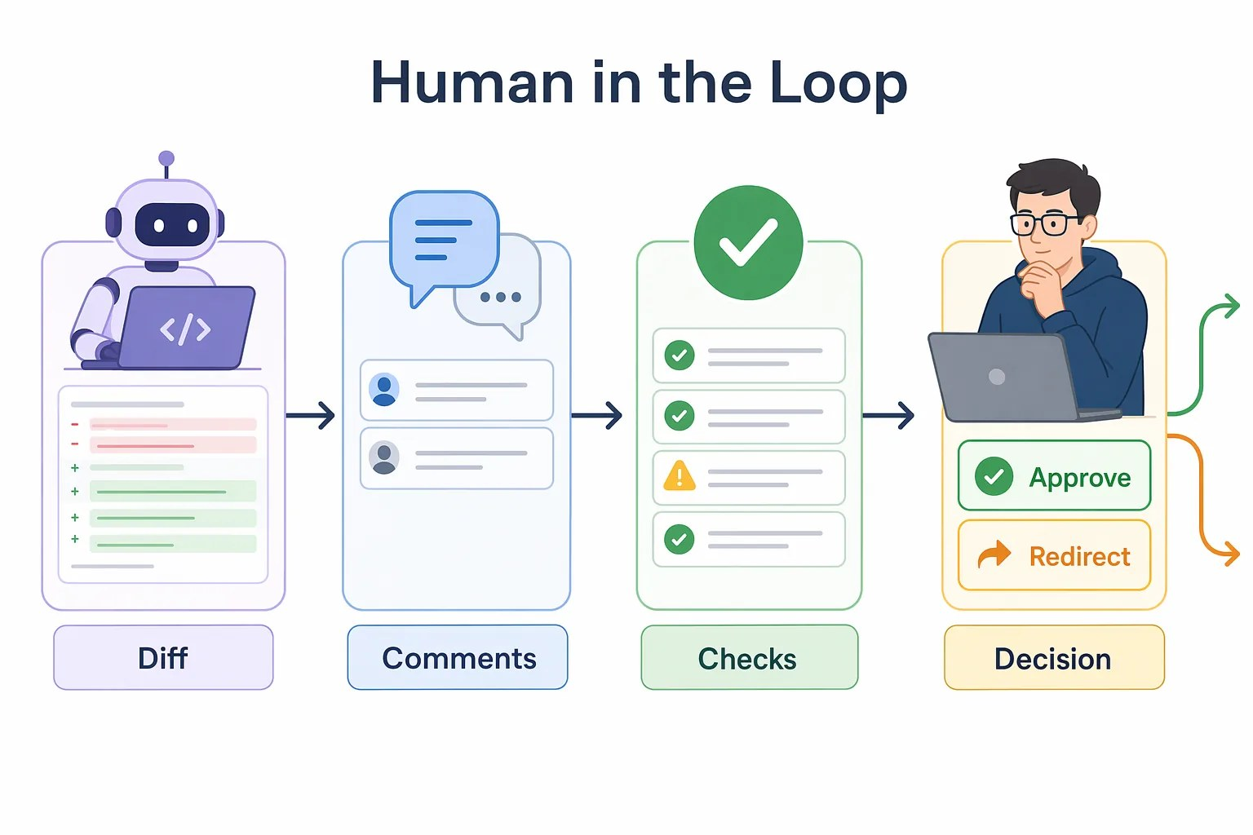

CHAPTER 03
OPTIONAL · AGENT MERGE
A finishing aid, not a reviewer
Agent Merge carries a PR through checks to merge. You still decide.
Use it when
The PR is small and reviewed
Checks are meaningful and pass
Avoid it for
Secrets, auth, billing, or deployments.
Notes:
To find Agent Merge, select the merge-readiness button at the top of a pull request, such as Ready to merge. The Merge pull request panel opens with an Agent merge toggle. It runs in the background, survives app restarts, and merges only when GitHub allows it. You will not use it in this course. Use it only for small, well-scoped changes that you reviewed, with meaningful passing checks, understood review comments and merge rules, and where your organization allows it. Avoid it for secrets, authentication, permissions, billing, production data, or deployment logic unless your team explicitly approved it.

Slide 18

CHAPTER 03
YOUR TURN
Run both loops on a small UI task
Card polish from issue #4, or better filter-row labels.
1
Plan
One small UI improvement.
Success
2
Implement
In Interactive mode.
A focused diff, passing checks, and a PR summary that only claims what you saw.
3
Validate
Tests, build, wide and narrow.
4
Ship
An honest PR. Checks pass.
Notes:
The assignment runs both loops on a small UI task. If you skipped Pick and Polish, use issue 4 and Create from on the practice-card-polish branch. Otherwise start from main and improve filter-row labels or helper text. Plan, implement, inspect the diff, run tests and build, and preview at a wide and a narrow width by dragging the review panel edge. Open a pull request with an honest summary, and confirm the Book app web check passes in the Pull requests view.

Slide 19
CHAPTER 03
KEY TAKEAWAYS
What to remember
Inner loop: understand, change, inspect, test, build, and preview.
Outer loop: issue, pull request, feedback, checks, and merge.
1
2
Tests protect behavior. Never weaken a failing test.
Ready means the diff, local results, CI, and your review all agree.
3
4
REVISIT THIS CHAPTER
NEXT · CHAPTER 04
Open Chapter 03 on GitHub
Skills and Custom Agents →
Notes:
Recap the two loops. The review panel keeps the diff, terminal, and preview together, and the Issues and Pull requests views connect GitHub work to sessions. Next, Chapter 04 makes this workflow reusable with a review skill and a read-only custom agent.

