Slide 1


CHAPTER 06
06
Canvases
What if you and the agent shared a real-time progress board instead of a buried chat thread?
GITHUB COPILOT APP
FOR BEGINNERS
github.com/github/copilot-app-for-beginners
Notes:
Once a session is doing real work, a long chat thread gets hard to scan. A canvas is a shared board in the side panel. You create one with slash create-canvas and a description, and both you and the agent can read and update it.

Slide 2

CHAPTER 06
CHAPTER 06
In this chapter
01
Why a shared board
Chat is great for talking. Real work needs state you can see at a glance.
02
Try and create a canvas
Try a community canvas, then build a simple board of your own.
03
Build a Feature Workbench
Add buttons that run real work, and keep the plan and evidence on one board.
Notes:
This chapter has 3 parts: Why a shared board, Try and create a canvas, Build a Feature Workbench.

Slide 3
CHAPTER 06
SECTION 1 OF 3
Why a shared board
01
Chat is great for talking. Real work needs state you can see at a glance.
Notes:
Section 1: why canvases exist.

Slide 4
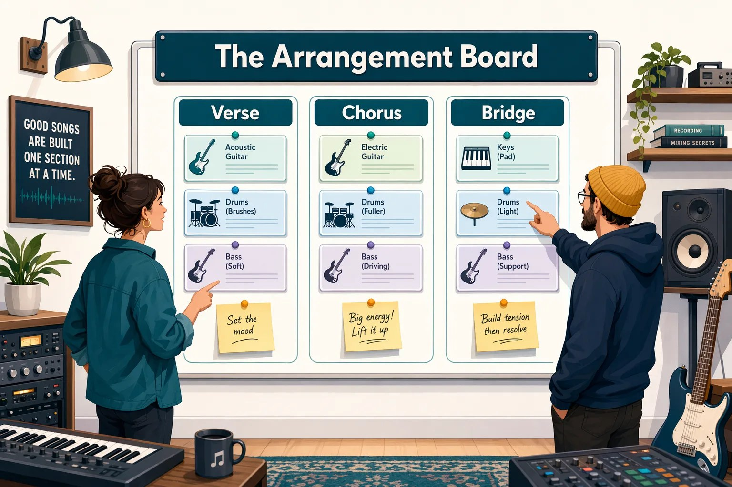
CHAPTER 06
FROM THE STUDIO
The band's arrangement board
Decisions get buried in a group chat. A board keeps them visible.
GROUP CHAT
ARRANGEMENT BOARD
Good for discussion
Shared, current state
Hard to scan later
Easy to inspect
Updates get buried
Updates stay visible
Notes:
Imagine a band planning a song. They could argue their options in a long group chat, where decisions get buried, or use a shared arrangement board that keeps everything visible. A canvas is the app's arrangement board for human-agent work.

Slide 5
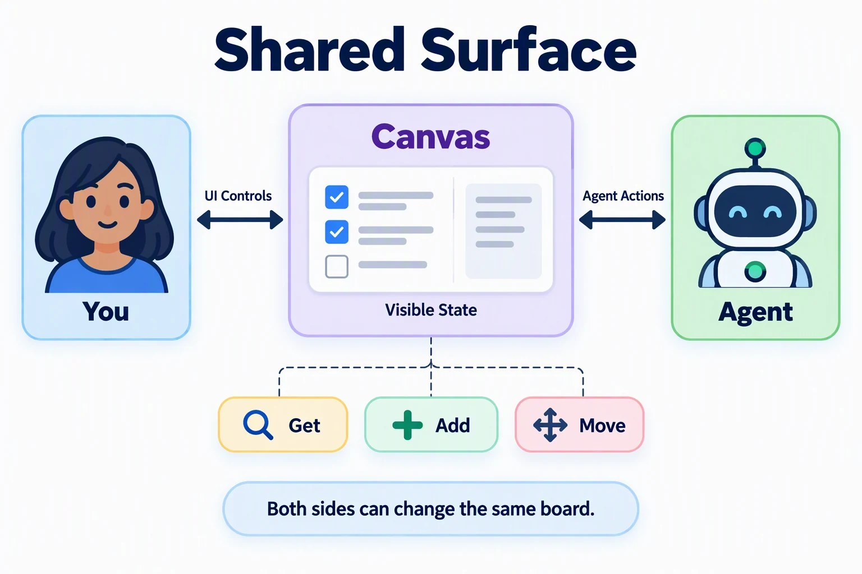
CHAPTER 06
CORE CONCEPT
A canvas is a shared control panel
You and the agent change the same board.
1
Copilot adds plan steps
They appear on the board.
2
You change the board
Uncheck a step or add a note.
3
Copilot continues from your update
Not from a buried chat line.
Notes:
Canvases are bidirectional. The agent writes to the board, you write to the board, and the agent continues from your change. A custom canvas can include visible state, controls, agent-callable actions such as updating a checklist item, and artifacts such as plans and dashboards. The built-in surfaces you already use, Plan, Terminal, Browser, and Changes, still come first. Use chat for quick answers and short tasks. Use a canvas when the task has recurring steps and needs visible state.

Slide 6
CHAPTER 06
SECTION 2 OF 3
Try and create a canvas
02
Try a community canvas, then build a simple board of your own.
Notes:
Section 2: try one someone else built, then create a small one.

Slide 7
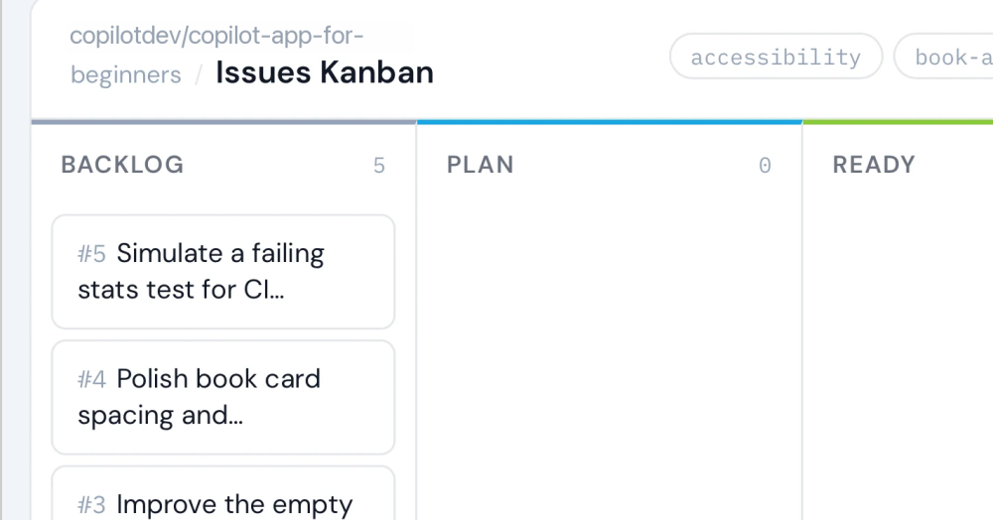
CHAPTER 06
EXERCISE 1
Try a community canvas
Repository Issues Kanban turns issues into a board.
1
Install it
Open in Copilot app, then Install.
2
Reload extensions
Send Restart canvas extensions.
3
Open it and drag an issue
Review panel + > Canvas.
Notes:
Before the exercises, prepare a worktree session from main and record the baseline test and build totals. On the Repository Issues Kanban page of the Awesome Copilot website, select Open in Copilot app. Allow the Install plugin dialog, confirm the name accessibility-kanban@awesome-copilot, and select Install. Confirm it is listed under Installed in Customize, Plugins. Ask the session to restart canvas extensions. Then in the review panel select plus, Canvas, Repository Issues Kanban. Drag an issue between columns. If your organization blocks plugins, read this exercise and continue to Exercise 2.

Slide 8

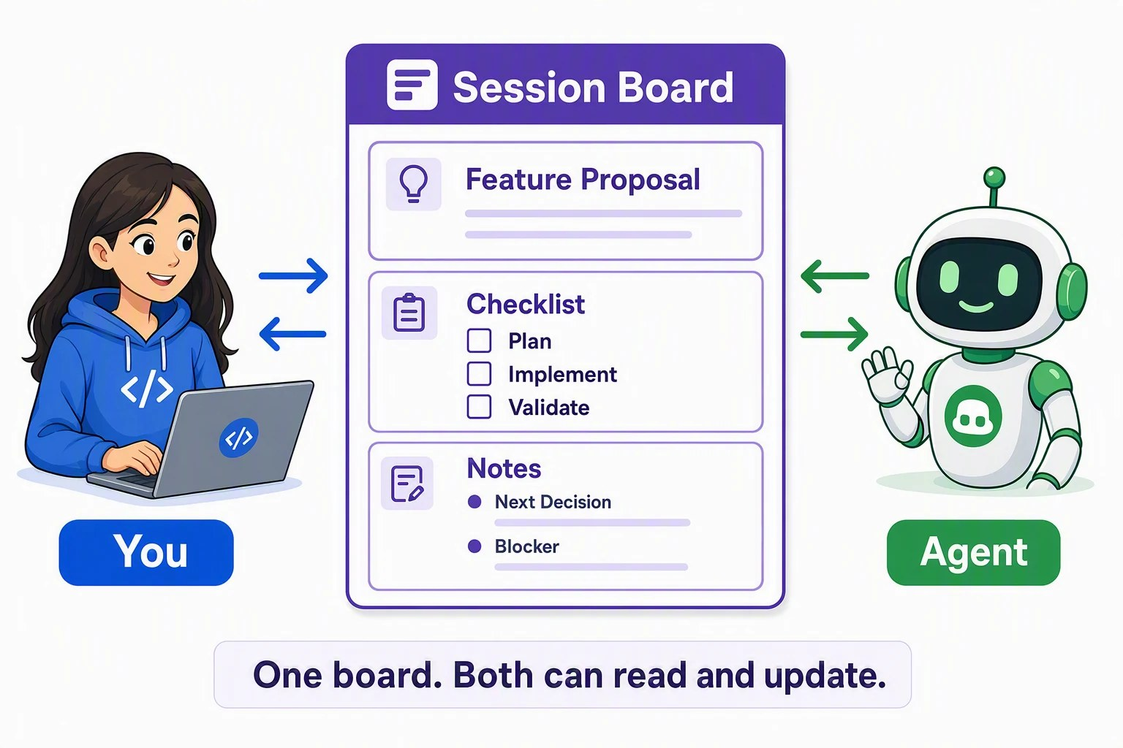

CHAPTER 06
EXERCISE 2
Create a session board
Type /create-canvas, then describe the board.
PROMPT
Create a simple, user-scoped Session Board canvas with a Feature proposal field, a Plan / Implement / Validate checklist, and Notes. Let the user and the agent both update it. Do not edit repository files.
Update the board, then ask the agent to summarize it. They should match.
Notes:
This small board works like a shared checklist. Create it with slash create-canvas and the full prompt from the chapter. Confirm it has the proposal, checklist, and notes with Next decision and Blocker fields. Enter a proposal, mark Plan complete, and add a next decision. Ask the agent to summarize the board and check that its answer matches your changes. The canvas is user scoped, so Changes should show no repository edits. This board does not run tests or edit the app. The next exercise adds that.

Slide 9
CHAPTER 06
SECTION 3 OF 3
Build a Feature Workbench
03
Add buttons that run real work, and keep the plan and evidence on one board.
Notes:
Section 3: the Feature Workbench manages the local inner loop for a new Book App feature.

Slide 10
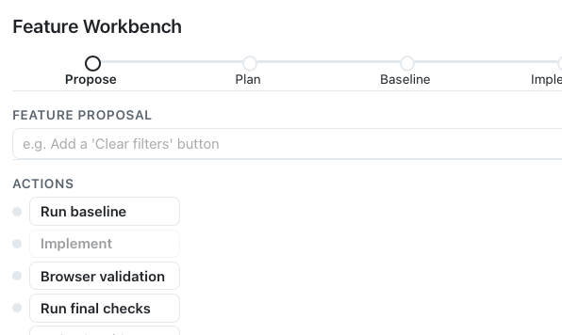




CHAPTER 06
EXERCISE 3
The Feature Workbench
One /create-canvas prompt builds it.
Five stages
Propose to Validate.
Proposal
One field, one Generate plan button.
Actions
Each one asks the agent to do work.
Checklist and evidence
Marked only from real output.
Notes:
The prompt is dense because it is written for the app, not for you to memorize. It asks for a progress rail with five stages, a proposal field with one Generate plan button, eight checklist items, action buttons that ask the agent to do real work with long timeouts, and a read-only evidence area. Use your most capable model for the first generation. Results differ between runs. If a part is missing, use one of the focused repair prompts in the chapter. After two failed repairs, use the Markdown fallback.

Slide 11
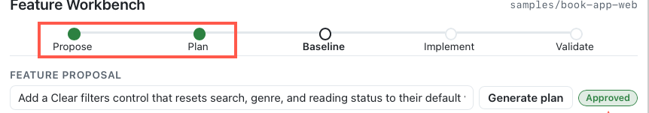
CHAPTER 06
PROPOSE, PLAN, AND BASELINE
Plan on the board. Approve in the Plan tab.
Proposal: a Clear filters control, shown only when a filter is active.
1
2
Generate plan, approve with Exit plan mode, then Run baseline: 4 tests pass before any change.
Notes:
Paste the Clear filters proposal and select Generate plan. The session switches to Plan mode and the status pill shows Working. Review the plan in the Plan tab. In the Review plan box at the bottom of the chat, choose Exit plan mode and I will prompt myself, then select the Feature Workbench tab; the canvas shows Approved. Then select Run baseline. The canvas records the Vitest total and build result. Expand the tool calls in chat to confirm Copilot ran npm test and npm run build, and that the evidence matches their output. The board is only useful if it stays linked to evidence from this session.

Slide 12
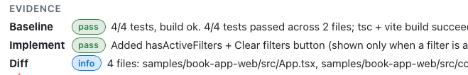

CHAPTER 06
IMPLEMENT AND VALIDATE
Implement, then check five states
Select Implement, then Browser validation.
STATE
CLEAR FILTERS
No filters active
Hidden
Check the Changes tab: only the approved feature.
Any filter set
Visible
After selecting it
All filters reset
Notes:
Select Implement. When it finishes, the canvas marks Implement complete, checks off the implementation items, and adds a Diff row to the evidence, as shown. Select the Changes pill above the prompt box and confirm the changes are limited to the approved feature. Then select Browser validation. The agent starts or reuses the dev server, exercises the feature, and captures screenshots. Check it yourself too: with no filters the control is hidden; with a search, genre, or status it appears; selecting it resets all three; afterward it disappears and the full list and statistics return. When you finish, select Background above the prompt box and stop the dev server; until it stops, Browser validation can keep showing Working.

Slide 13

CHAPTER 06
EVIDENCE
The board reflects what happened
Select Run final checks. You decide if the evidence is enough.
4
9
The final total must never be lower than the baseline.
BASELINE
tests
FINAL
tests
Notes:
Select Run final checks and compare with the baseline. Test counts can go up when implementation adds focused tests, but the final total must never be lower than the baseline. In this example, 4 baseline tests became 9. Use your own numbers from this worktree, not from the screenshot. Confirm the baseline matches the original terminal output, the diff is limited to the feature, all browser states were checked, and final tests and build pass. Uncheck anything that lacks evidence.

Slide 14


CHAPTER 06
YOUR TURN
Add an Assess stage
Compare a proposal with current behavior before planning.
Propose
→
Assess
→
Plan
→
Baseline
→
Implement
→
Validate
Core
Optional
Use /create-canvas to add the stage. Then run a new, small improvement through it.
Add actions that open an issue and a linked PR.
Notes:
Extend the workbench with an Assess stage after Propose. Type slash, select create-canvas, and send a focused change request: keep the current canvas, add an Assess stage between Propose and Plan that compares the proposal with current behavior and records the result as evidence, and do not redesign parts that work. Pick a small improvement you have not shipped yet and run it through every stage with evidence from this session. Success means you can see evidence-backed progress and name the next decision without rereading the chat. If you have permission, the optional challenge adds the Chapter 03 outer loop: an issue, a linked pull request, and a Copilot review if it is available to you. Do not merge the pull request.

Slide 15
CHAPTER 06
KEY TAKEAWAYS
What to remember
A canvas is a visible, shared board in the side panel.
Create one with /create-canvas and a short description.
1
2
Try community canvases before you build your own.
Board evidence must come from real output, not chat.
3
4
REVISIT THIS CHAPTER
NEXT · CHAPTER 07
Open Chapter 06 on GitHub
Automations →
Notes:
Canvases made session work visible. Next, Chapter 07 makes repeatable work reusable with automations, starting with a manual review readiness report.

