Slide 1



CHAPTER 00
Set Up the GitHub Copilot app
A little setup now means a lot more hands-on learning later.
github.com/github/copilot-app-for-beginners
Notes:
Before you can direct agents in the GitHub Copilot app, you need the app installed and signed in, your copy of the course repository connected, and the practice items that later chapters use. This chapter walks through that setup and checks the tools the exercises use.

Slide 2

CHAPTER 00
CHAPTER 00
In this chapter
01
Install and sign in
Download the desktop app and sign in with your GitHub account.
02
Connect your repository
Fork the course, add it to the app as a project, and start your first project session.
03
Soundcheck and seed
Check your tools, then seed your fork with the practice work for later chapters.
Notes:
This chapter has 3 parts: Install and sign in, Connect your repository, Soundcheck and seed.

Slide 3




CHAPTER 00
FROM THE STUDIO
Setting up the studio
Every chapter ties agent work to making a record.
Sign in for access
Sign in with GitHub.
Plug in your gear
Connect your fork.
Load the song
Add the practice work.
Run a soundcheck
Send your first prompts.
Notes:
Throughout the course, a recording studio is the recurring analogy. Before you record anything, you get the studio ready: sign in for access, plug in your gear, load the song, and run a quick soundcheck. This chapter is that preparation.

Slide 4

CHAPTER 00
BEFORE YOU START
What you need
You will verify the tools from inside the app.
GitHub account
Signs in to the app and owns your fork of the course
Or your own model provider. Organizations must enable the GitHub Copilot app policy.
Copilot plan
Git
Clones and manages your repository
Node.js LTS
Runs samples/book-app-web in the exercises
GitHub CLI (gh)
Runs the one-time setup script
Note: The Copilot app policy is separate from the Copilot CLI policy.
Notes:
Five prerequisites. The Copilot plan can be replaced by your own model provider during sign-in. For Copilot Business or Enterprise, the GitHub Copilot app policy must be enabled, and it is separate from the Copilot CLI policy. Git, Node.js, and the GitHub CLI are checked later in the Terminal tab.

Slide 5
CHAPTER 00
SECTION 1 OF 3
Install and sign in
01
Download the desktop app and sign in with your GitHub account.
Notes:
Section 1: install the app and sign in.

Slide 6
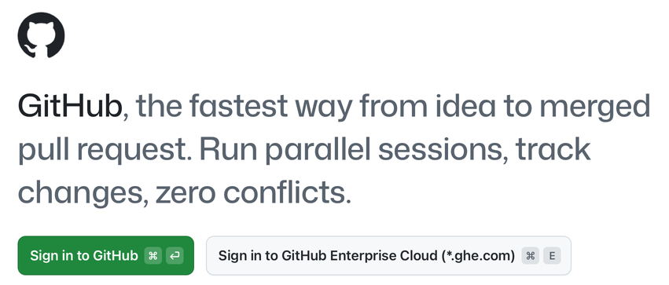
CHAPTER 00
INSTALL AND SIGN IN
Three steps to the New view
1
Download and install
Get the app for your operating system.
2
Sign in to GitHub
On *.ghe.com, use Sign in to GitHub Enterprise Cloud.
3
Skip repositories for now
Leave them unselected, then select Continue.
Notes:
Download and install the app from github.com/features/ai/github-app, then select Sign in to GitHub. Enterprise Cloud users with a ghe.com domain use the second button. At Connect your repositories, leave every repository unselected and select Continue; you will connect your fork in the next section. The app opens the New view. If it shows a short tip about a new feature, you can close it.

Slide 7
CHAPTER 00
SECTION 2 OF 3
Connect your repository
02
Fork the course, add it to the app as a project, and start your first project session.
Notes:
Section 2: give the app a repository to work in, your own fork of the course.

Slide 8
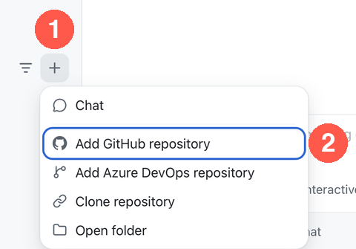
CHAPTER 00
CONNECT YOUR REPOSITORY
Fork it, then add it as a project
A fork is your own copy of the course on GitHub.
1
Fork the course
On GitHub.com, fork github/copilot-app-for-beginners.
2
Add it to the app
Select + (1), then Add GitHub repository (2).
3
Select your fork
The result that starts with your username.
Notes:
Fork the course repository so you have your own copy to change. In the app, select the plus next to Projects and choose Add GitHub repository. Type copilot-app-for-beginners in the search box and select your fork, the result that starts with your GitHub username, not github/copilot-app-for-beginners. The app clones it and adds the project to the sidebar. If you already have a local clone, use Open folder. If you have the URL, use Clone repository.

Slide 9
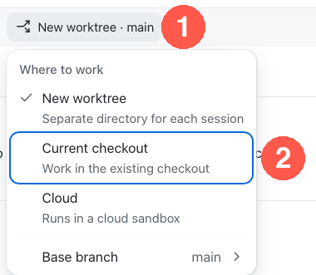
CHAPTER 00
CONNECT YOUR REPOSITORY
Start a session in your current checkout
Only for this one-time setup. Chapter 02 introduces worktrees.
1
Start a project session
Point to the project, then select +.
2
Choose Current checkout
In the workspace selector below the prompt.
3
Send a test prompt
"Name the top-level folders in this repository."
Notes:
Point to the project in the sidebar and select the plus that appears. In the workspace selector below the prompt box, choose Current checkout. This uses the clone already on your machine. You will learn about the other options later. Then submit a short prompt to create the session: Name the top-level folders in this repository. Do not change any files.

Slide 10
CHAPTER 00
SECTION 3 OF 3
Soundcheck and seed
03
Check your tools, then seed your fork with the practice work for later chapters.
Notes:
Section 3: the soundcheck. Confirm the tools work, then load the song.

Slide 11


CHAPTER 00
SOUNDCHECK
Check your tools in Terminal
Open View > Toggle Review Panel > Terminal.
Terminal
Each shows a version
$ git --version
$ node -v
Install only what is missing, then check again.
$ npm -v
$ gh --version
# gh has its own sign-in
$ gh auth status
Check the gh account
It must own your fork. If not, run gh auth login.
Notes:
Terminal runs commands; the prompt box sends requests to the agent. Run the four version checks. Each should print a version number. On Windows, if npm fails because running scripts is disabled, use npm.cmd instead. The GitHub CLI has its own sign-in, separate from the app. It must use the account that owns your fork, because the setup script creates items there. If needed, run gh auth login, choose GitHub.com and Login with a web browser, then check again.

Slide 12

CHAPTER 00
LOAD THE SONG
Seed your fork with practice work
Preview the script before you run it.
1
Enable Actions in your fork
Forks turn workflows off by default.
You get
2
Preview with a dry run
Labels
Confirm Repository: shows your fork.
Issues
node .github/scripts/setup-training-scenarios.js --dry-run
Practice branches
Pull requests
3
Run it
Wait for Setup complete.
node .github/scripts/setup-training-scenarios.js --yes
Bugs stay off main.
Notes:
In a browser, open your fork, select the Actions tab, and enable workflows so the practice checks can run. Then run the script with dry-run from the repository root. It ends with Dry run complete, No changes were made. Confirm the Repository line shows your fork. Then run it for real with the yes flag. It creates labels, issues, practice branches with intentional bugs, and pull requests with a review comment and a failing check. If it stops with Setup failed, fix the reported problem and run it again; it does not make duplicates.

Slide 13

CHAPTER 00
SOUNDCHECK
Learn more about the course repository
Use the prompt box in the project session, not Terminal.
PROMPT
Give me an overview of the copilot-app-for-beginners course repository. Focus on the learning path and the samples/book-app-web folder.
Expected: A summary of the course path that names samples/book-app-web as the sample app.
Notes:
Send this prompt from the project session prompt box. The expected answer summarizes the course structure and identifies samples/book-app-web as the web sample used later. If the script could not run, the Training GitHub Scenarios appendix has manual steps.

Slide 14
CHAPTER 00
KEY TAKEAWAYS
What to remember
The GitHub Copilot app is a desktop control center for agent-driven coding work.
Your fork is connected as a project. The course uses samples/book-app-web.
1
2
Terminal runs commands. The prompt box sends requests to the agent.
The setup script created the practice work that later chapters use.
3
4
REVISIT THIS CHAPTER
NEXT · CHAPTER 01
Open Chapter 00 on GitHub
Tour the App →
Notes:
Your studio is ready. Next, Chapter 01 answers why you would use the desktop app if you already use Copilot in an editor or terminal, then tours the interface, session types, and modes.

