Slide 1



CHAPTER 05
MCP Servers and Plugins
What if the agent could look up the documentation it needs instead of relying only on what it already knows?
github.com/github/copilot-app-for-beginners
Notes:
Chapter 04 introduced reusable instructions and roles. This chapter extends what the app can access. You connect Context7, an MCP server for up-to-date documentation, and install a plugin that supplies a web-guidance skill.

Slide 2

CHAPTER 05
CHAPTER 05
In this chapter
01
MCP servers connect services
Give the agent a live connection to up-to-date documentation.
02
Plugins package capabilities
Install a package, then invoke the capability inside it. Installing is not running.
Notes:
This chapter has 2 parts: MCP servers connect services, Plugins package capabilities.

Slide 3
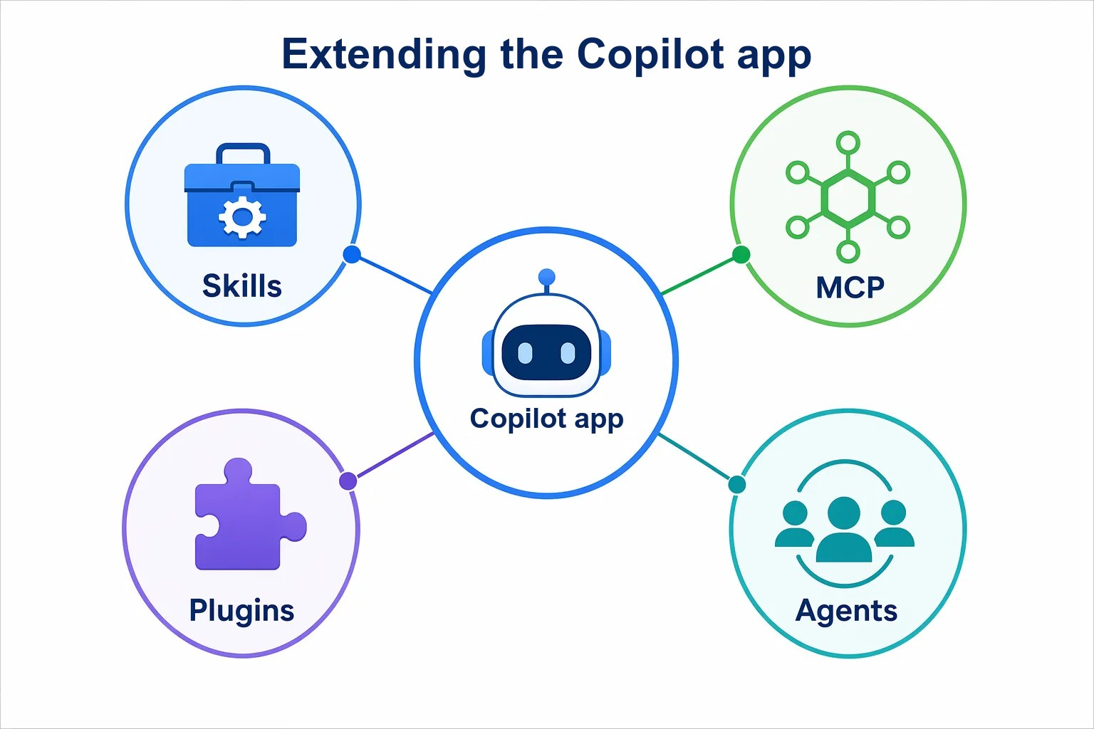



CHAPTER 05
FROM THE STUDIO
Connecting the gear
A song chart says what to play. It does not plug in a microphone.
Skills and agents
Customize how the app works.
MCP servers
Connect it to services and data.
Plugins
Install packaged capabilities.
Notes:
Skills and agents customize how the app works. MCP servers and plugins extend what it can reach. An MCP server is like connecting a piece of equipment: it exposes tools. A plugin is a packaged set of additions you install. Check what is included and what access it needs before you enable it.

Slide 4

CHAPTER 05
CORE CONCEPT
MCP server or plugin?
Both live under Customize. They are not the same thing.
MCP server
Plugin
Supplies tools that connect the app to a service or data source.
An installable package of skills, agents, MCP servers, or canvases.
Here: Context7 for React docs
Here: Modern Web Guidance
Worktrees do not isolate installed tools. They can affect every session.
Notes:
An MCP server supplies tools that connect the app to a service or data source; it can run locally or at a remote service. A plugin is a package that can contain skills, agents, MCP servers, or canvas extensions. A plugin can include an MCP server, and you can connect a server directly without a plugin. Installed tools are not isolated by worktrees, so check whether an integration is already installed before adding another. Add an integration only when the task needs it.

Slide 5
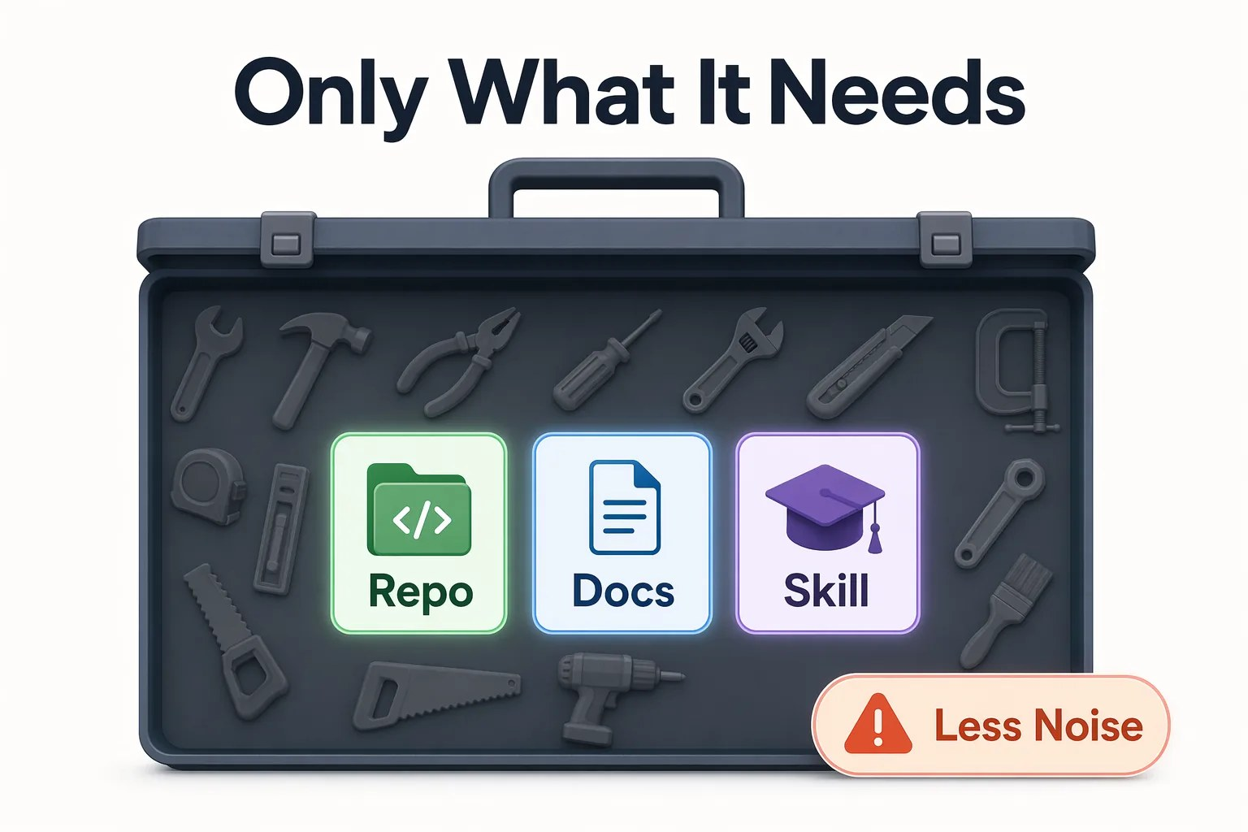



CHAPTER 05
CORE CONCEPT
Give the agent only what it needs
Every extra tool is more noise for the agent and more access to review.
Start with what you have
The app already reads and searches files.
Add only what the task needs
One connection per service.
Review the access
Know what each tool can do and send.
Notes:
Start with the tools you already have. Add an integration only when it supplies something the task needs. Every extra tool is more noise for the agent and more access to review. Before adding an MCP connection or plugin, check whether it is already installed and enabled; do not create a duplicate.

Slide 6
CHAPTER 05
SECTION 1 OF 2
MCP servers connect services
01
Give the agent a live connection to up-to-date documentation.
Notes:
Section 1: MCP servers.

Slide 7
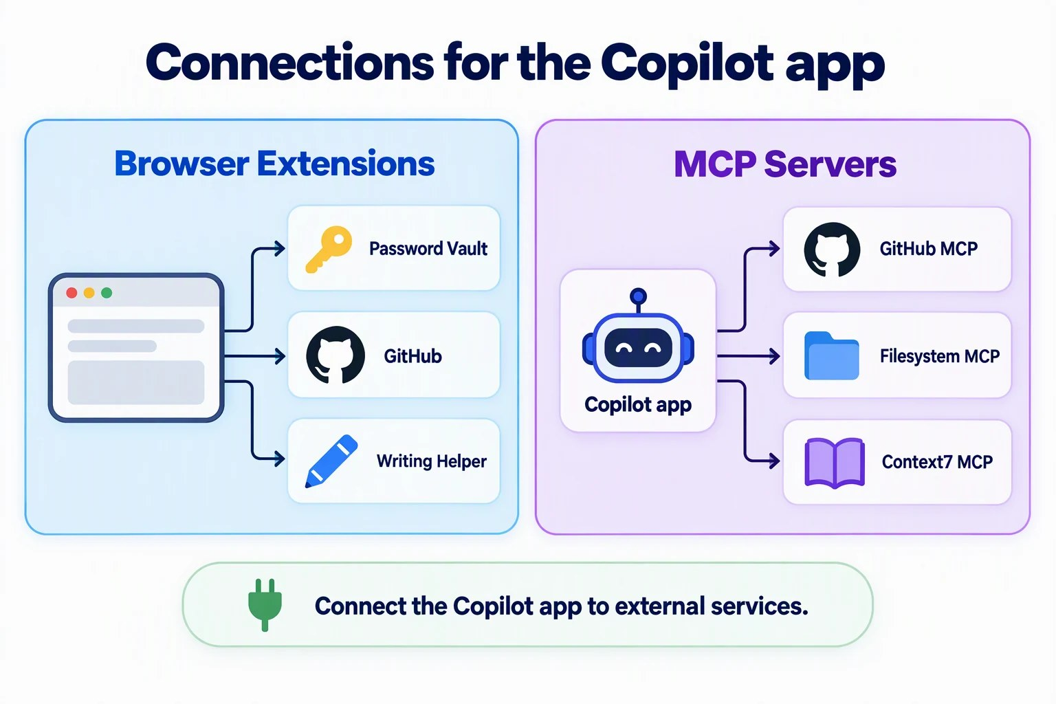


CHAPTER 05
FROM THE STUDIO
Like a browser extension
An extension connects a browser to a service. MCP does that for the app.
The server supplies tools
Local or hosted at a service.
Context7 supplies docs
Current React documentation.
Not an app dependency
The Book App code does not change.
Notes:
Model Context Protocol defines how an AI application connects to tools and data. An MCP server supplies those tools. The graphic shows example connections, not required installations. The app already reads and searches local files, and you do not need another GitHub server for the Chapter 03 work. Configure MCP under Customize, MCP, not the Extensions tab.

Slide 8
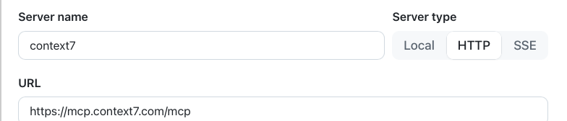
CHAPTER 05
EXERCISE
Connect Context7
Skip this if it is already connected.
1
Customize > MCP
2
Review the values
3
Confirm it
Search context7, then Add server.
HTTP means a hosted server.
Connected icon, toggle on.
Notes:
Open Customize, then MCP. Search for context7 and select Add server on the Context7 row. Review the configuration: server name context7, server type HTTP, and the URL https://mcp.context7.com/mcp. HTTP means the app connects to a hosted server instead of starting a local process. After adding it, confirm that Context7 appears under Installed in the MCP tab with its connected icon and enabled toggle. An enabled toggle alone does not prove it is connected. Use one connection per service.

Slide 9





CHAPTER 05
EXERCISE
Ask a general question. Compare locally.
Use the docs without sending your code to the service.
Step 1 · Goes to Context7
Step 2 · Stays local
PROMPT
PROMPT
Use the Context7 MCP tools to find React guidance on input labels: nested labels vs. htmlFor and id. Include source links. Do not send repository code.
Compare that guidance with @samples/book-app-web/src/components/BookFilters.tsx. Keep this comparison local. Do not edit files.
Expected: Inputs are nested in <label>, so they are labeled.
Notes:
In React, a label htmlFor value can match an input id. A label can also wrap its input. Ask Context7 a general question about the two patterns, with no repository code or paths. Expand the tool activity, confirm a Context7 tool returned documentation, and open a source link. Then compare that guidance with BookFilters.tsx locally. The inputs and selects are nested inside label elements, so a missing htmlFor is not a defect. No source files change.

Slide 10
CHAPTER 05
SECTION 2 OF 2
Plugins package capabilities
02
Install a package, then invoke the capability inside it. Installing is not running.
Notes:
Section 2: plugins.

Slide 11


CHAPTER 05
EXERCISE
Install Modern Web Guidance
Read what a plugin contains before you install it.
awesome-copilot
Marketplace
modern-web-guidance
+ Install
A skill and CLI tool that help agents build web apps with modern, secure APIs.
1
Find it
2
Check the source
3
Install and confirm
Search, then expand awesome-copilot.
GoogleChrome/modern-web-guidance
Listed under Installed, toggle on.
Notes:
A marketplace is a catalog of plugins. Read a plugin's contents, not only its description; some start processes, call services, or run hooks, which are commands triggered by agent events. In Customize, Plugins, search for modern-web-guidance, then expand the awesome-copilot marketplace under Available; the app searches a marketplace only after you expand it. If it is missing and policy allows, select the gear icon, Manage marketplaces, and add github/awesome-copilot. Confirm the source, then install it and check that it appears under Installed in the Plugins tab with its toggle on. The skill uses npx, so it needs Node.js and internet access. If enterprise policy blocks it, record the exercise as blocked and continue.

Slide 12


CHAPTER 05
EXERCISE
Invoke the plugin's skill
Run /skills reload, then select the skill from the / menu.
Expected
PROMPT
The skill loads and finds a guide
Use the modern-web-guidance skill to look up guidance for wrapping short headings. Use only general terms in external queries.
One small CSS idea, or none
No files change
Then inspect BookCard.tsx and app.css locally. Propose at most one CSS-only improvement for long titles on narrow screens. Do not change files.
Ideas like text-wrap: balance must cover older browsers.
Notes:
The displayed command can include a plugin prefix. The full prompt in the chapter also asks the skill to name the guide, explain browser support, and give a browser check. Inspect the skill activity and guide-search output. The recommendation should refer to the current book-title element and CSS. Unlike the repository skill in Chapter 04, this one arrived in an installed package. You still invoke it, inspect it, and check it against the code.

Slide 13

CHAPTER 05
YOUR TURN
Summarize the evidence, not the claims
Ask for a table built only from this session. Then check it.
CAPABILITY
EVIDENCE IT RAN
WHAT WE LEARNED
Context7 · MCP
Tool call and a source link
The inputs are already labeled
Modern Web · plugin
Skill loaded, guide found
One CSS idea, with a fallback
No invented links. Blocked exercises say so. Changes is empty.
Notes:
For the assignment, ask the default agent to summarize both exercises in a table with the capability, the evidence it ran, the source evidence, and what you learned. The rows here are examples of good answers. Compare the table with the actual tool activity and correct unsupported claims. Confirm that Changes is empty. Explain why Context7 is an MCP server and Modern Web Guidance is a plugin that supplies a skill. Disable only what you added if you do not want to keep it.

Slide 14
CHAPTER 05
KEY TAKEAWAYS
What to remember
An MCP server supplies tools that connect to a service.
A plugin packages capabilities. Installing it does not run it.
1
2
General questions do not need your repository code.
Check the tool activity and sources, not only the claims.
3
4
REVISIT THIS CHAPTER
NEXT · CHAPTER 06
Open Chapter 05 on GitHub
Canvases →
Notes:
You can now connect external tools and use packaged capabilities without confusing installation with successful execution. Add only what you need; worktrees do not isolate installed tools. Next, Chapter 06 uses canvases, starting with a community canvas installed through a plugin.

