Slide 1

FAIRify Energy Data for Knowledge Graph Exploration
Md. Siam
Student ID: 19701075
Supervisor: Dr. Rudra Pratap Deb Nath,
Associate Professor
Department of Computer Science & Engineering,
University of Chittagong
October 31, 2024

Slide 2




Problem Statement
The power grid transfers energy from plants to substations and consumers
Power Plant
Distribution
Line
Substations
Consumer
Power Grid
Transmission Line
Monitor
Transmission Line
PDF
Slower
processing
NLDC
Electricity data
BPDB
Machine
Bangladesh Power Development Board (BPDB) publishes grid data in PDFs, monitored by NLDC
Non-machine-readable PDFs limit automated analysis.
Md. Siam||FAIRify Energy Data for Knowledge Graph Exploration
1

Slide 3


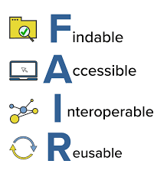
Objectives
FAIRify 1-star electricity document data into 5-star linked open electricity data by creating Electricity Knowledge graph, ElecKG.
Human Readable
Machine Readable
Not
FAIR
FAIR
1-star
Electricity Data
5-Star
Linked Open Electricity Data
Electricity Document Data
Slower
To Process
Faster
Process
Transform
Ineffective
Analysis
Effective
Analysis
Current state
Final state
FAIR Data is -
Findable easily in the internet
Accessible through universal accessible protocols
Interoperate with other data
Reusable optimizely
FAIR Electricity Data
Md. Siam||FAIRify Energy Data for Knowledge Graph Exploration
2

Slide 4
Research Challenges (RC) & Unique Contribution (UC)
RC1 Turning non-FAIR electricity data into FAIR UC1: Converts BPDB's non-FAIR electricity data into RDF triples, making it findable, accessible, interoperable, and reusable
RC2: Representing unstructured data into multidimensional schema UC2: Organizes BPDB's electricity PDF data into a multidimensional structure using QB4OLAP vocabulary for enhanced analysis
RC3: Converting electricity data into a knowledge graph, ElecKG UC3: Generates ElecKG through semantic extraction, transformation, and loading (ETL) processes, converting electricity CSV data into RDF triples
RC4: Interlinking ElecKG with external knowledge graphs UC4: Links grid areas of BPDB’s electricity data with GeoNames and WikiData knowledge graphs, enhancing data value and meaning
RC5: Enabling OLAP operations on non-OLAP compatible electricity data UC5: Defines multidimensional data of ElecKG with QB4OLAP constructs to support OLAP queries for deeper insights
Md. Siam||FAIRify Energy Data for Knowledge Graph Exploration
3

Slide 5
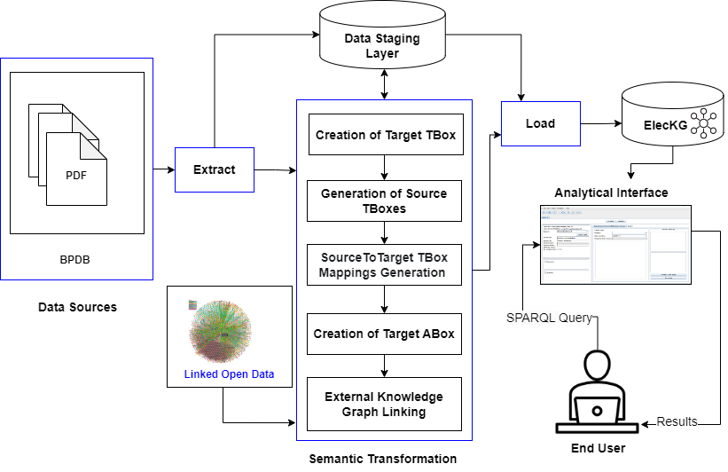
Methodology
ETL Workflow:
Merge PDFs: BPDB’s reports combined using PDFtk
Extract Data: Convert PDFs to CSV with ONLINE2PDF.com
Clean Data: Refined and structured using OpenRefine and Excel
Semantic Transformation: Data transformed into RDF triples with SETLBI
External Linking: Grid data linked to external sources (e.g., Bangladesh divisions)
Load Data: RDF triples loaded into Virtuoso Conductor for querying
Md. Siam||FAIRify Energy Data for Knowledge Graph Exploration
4

Slide 6
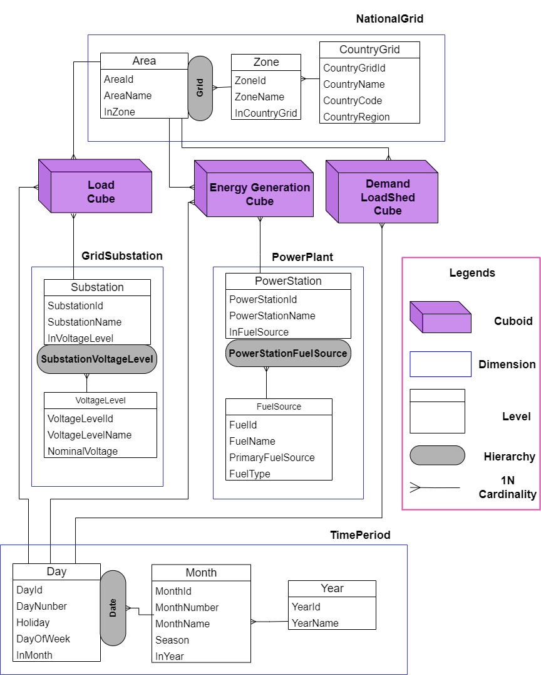
Methodology
Target TBox Definition
The dataset features:
4 dimensions
10 level
35 level attributes
1,141 instances
4,996 RDF triples generated
8 external links
ElecKG contains:
3 cuboids
1,534,983 RDF triples
Total size of 208.92 MB
Md. Siam||FAIRify Energy Data for Knowledge Graph Exploration
5

Slide 7
Results
ETL Process Efficiency
ETL:
Phase | Extraction | Transformation | External Linking | Loading | Total
Time (hours) | 15.00h | 1.50h | 0.50h | 0.25h | 17.25h
Percentage (%) | 86.96% | 8.69% | 2.88% | 1.47% | 100%
Extraction: Merging PDFs, cleaning, and conversion to CSV.
Transformation: Mapping and TBox generation in SETLBI.
Linking: Linking data via OpenRefine.
Loading: Uploading to Virtuoso Conductor.
FAIRification of ElecKG
Access Points:
SPARQL Endpoint: Virtuoso Conductor
OLAP Interface: Available via SETBI
(https://github.com/bi-setl/SETL)
ABox
(https://bike-csecu.com/datasets/ElecKG/abox.ttl)
Tbox
(https://bike-csecu.com/datasets/ElecKG/tbox.ttl)
FAIR Principles Applied:
Findable: Data accessible via unique IRIs and URLs
Accessible: SPARQL endpoint at http://bike-csecu.com:8896/.
Interoperable: Integrated with external ontologies (GeoNames, Wikidata)
Reusable: Licensed datasets with comprehensive metadata and guidelines
Md. Siam||FAIRify Energy Data for Knowledge Graph Exploration
6

Slide 8
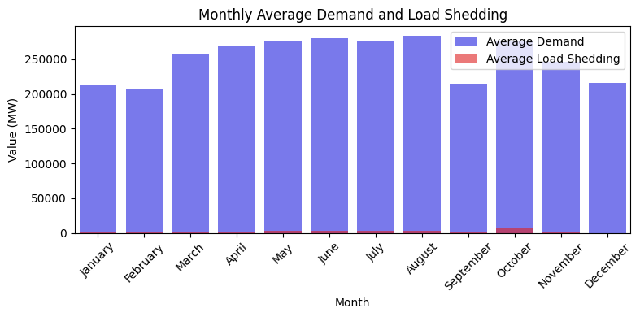
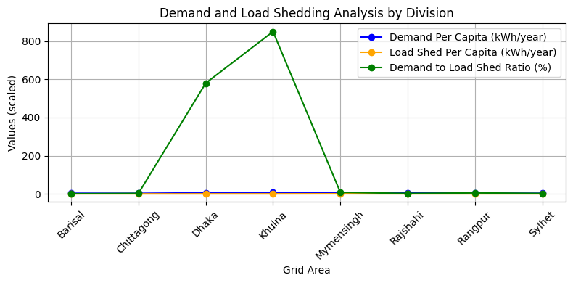
Results
Electricity Demand and Load Shedding Trends in Bangladesh’s Divisions
(a)
(b)
Fig: Comparison of Monthly Average Demand and Load Shedding (a) with Demand and Load Shedding Analysis across Different Divisions (b)
Md. Siam||FAIRify Energy Data for Knowledge Graph Exploration
7

Slide 9
Conclusion
ElecKG transforms static energy datasets into dynamic, machine-readable formats.
Uses OLAP to analyze energy consumption and load shedding
Links external datasets for richer analysis
Enables seamless access and reuse through FAIR principles
Future Direction
Stronger Queries: Enhance federated query capabilities.
Predictive Power: Use Machine Learning for forecasting and grid optimization.
Md. Siam||FAIRify Energy Data for Knowledge Graph Exploration
8

Slide 10
Thank You

