Slide 1

NIR

Slide 2











Finding new home at new place is hazardous
House owner
student
Found a random tenant
The searching process burns both time and energy
After all the effort there is not guarantee of finding the required place
Could turn out to be criminal
Students trying to find a place to live in
House owners trying to find Tenant

Slide 3

Comprehensive Platform: Accessible via website and mobile app.
Flat
Ease of Use: Browse listings, view photos, contact landlords.
Student
NIR
Rent Negotiations: Easily negotiate rents and avail potential discounts.
Intermediary Services: Facilitates smooth transactions between property owners and student renters.
House owner

Slide 5
UGC Annual Reports on 50 Public University Students
Approximately 60% of students lack residential facilities.
Estimating an additional 10-20% of housed students may prefer off-campus options.

Slide 6




Total Students
(50 public university)
= 292,296
Immediate
Addressable Market
=175,378 students
Extended
Potential Market
=11,804 to 23,607 students
Total Potential Market =187,182 to 198,985 students.

Slide 7




















NIR BUSINESS MODEL
Key Partners
Key Resources
Revenue Stream
Channels
Cost Structure
Land Lord
Payment Processor
Network House Owner and Renter
Advertisement
Commission Fees
Website
Mobile App
Development Cost
Marketing Expenses
Tech Platform
University Ambassador
Web Host Partner
Advanced Algorithm and Data Analysis
Subscription
Value-Added Service
Social Media
On-campus Promotion
Operational Cost
Legal and Compliance
Customer Segment
Renter
House Owner
Looking for House
Looking for Renter
Looking for Cost Effective
Promote His House
Looking for Comfort and Hassle Free
Smart Maintenance

Slide 8
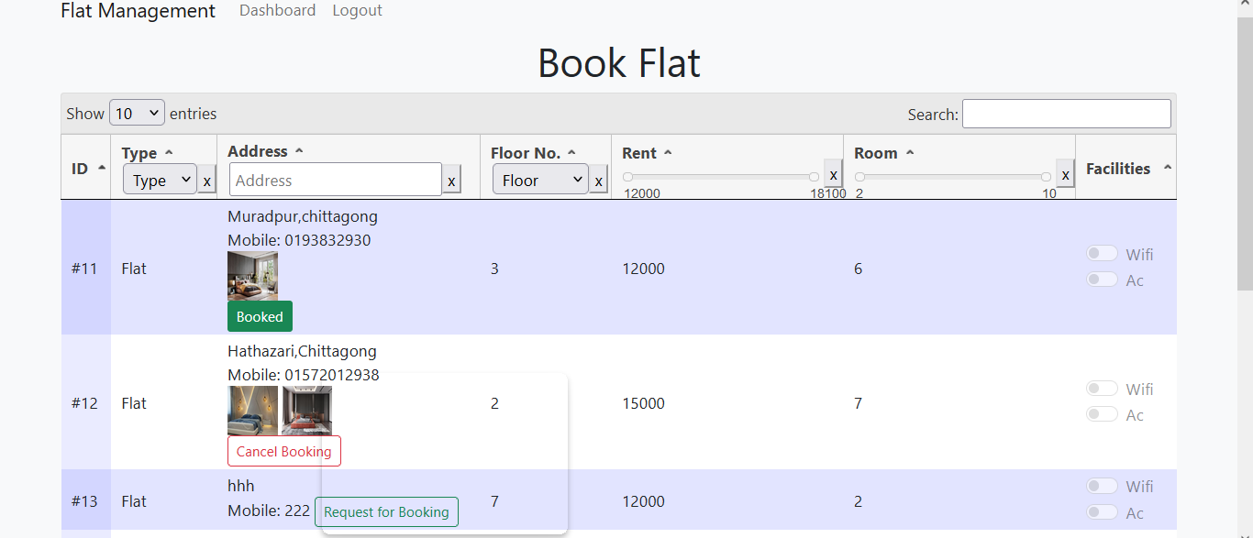
Current Status
User Search Panels
1.Filter Wise Search 2.Send Request Available Flats 3. View Facilities

Slide 9
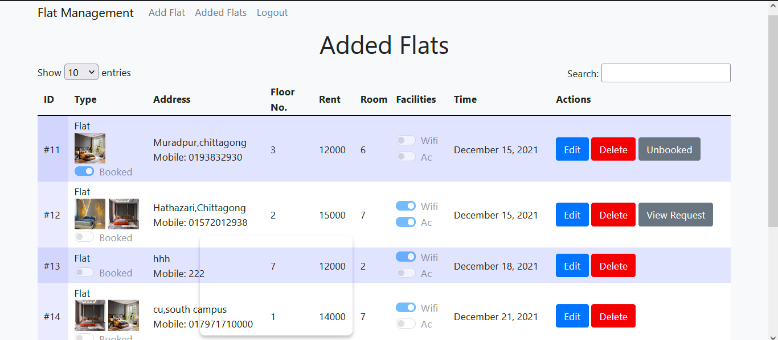
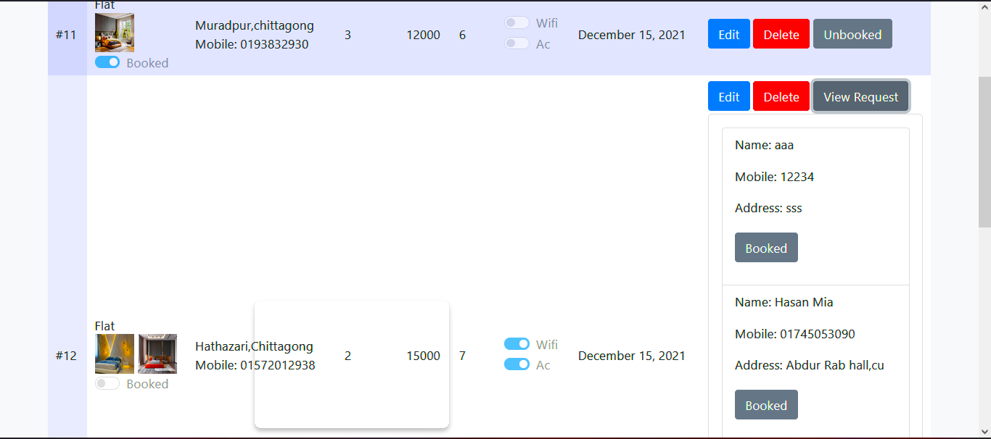
Flat Owner Panel:
1.View added flats
2.Edit Details
3.View booking request

Slide 10
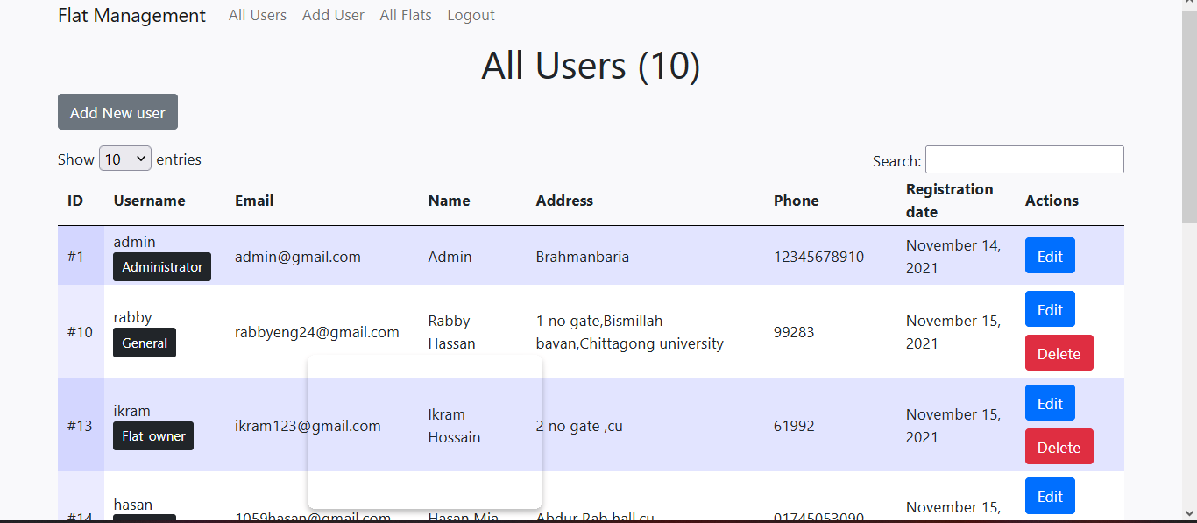

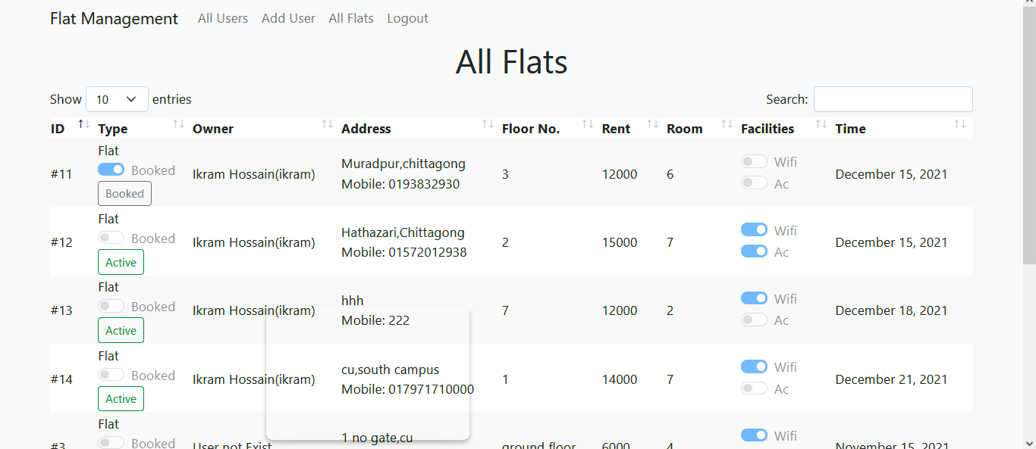
Admin Panel

Slide 11






null
Current
Competitors

Slide 12



Our Uniqueness
j
Comprehensive connection of university cities across Bangladesh.
j
Presence of trusted agents in each city for face-to-face assistance
Additional services and amenities catering specifically to student needs.

Slide 13
Competitive Advancement
Integration of additional services like moving and cooking.
Niche Focus
Tailored services for university students.
Connected Networks
Strong engagement with universities and student communities.
Comprehensive Offering

Slide 14




Why Needs Funding
Developing and Maintaining Scalable Technology Platform
Executing Effective Marketing Strategies To Drive User Acquisition And Build Trust.
Providing excellent customer support and ensuring smooth operational management

Slide 15


Funding
Funded by founders
Investment from family, friends, and respected mentors
Donation by renowned organizations

Slide 16

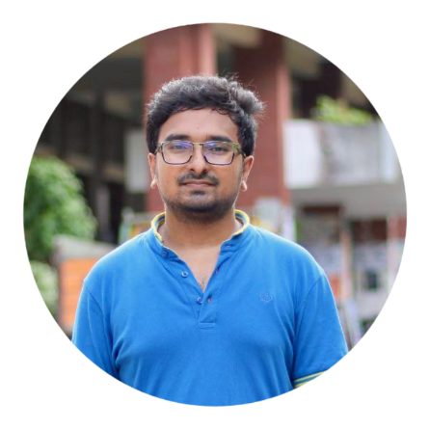
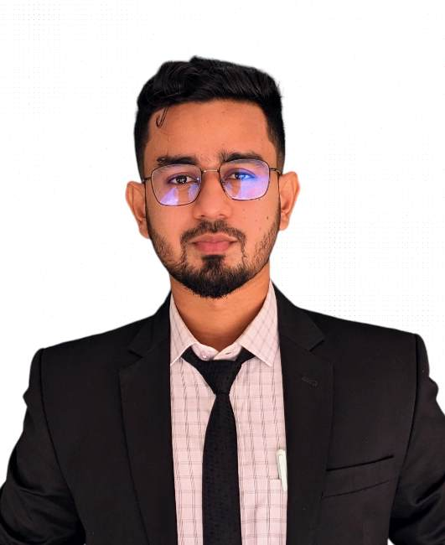

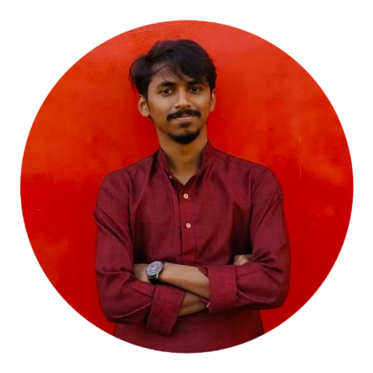
Team Name: Trip
MD. SIAM
Project Leader
Dept. Of CSE
SHEIKH NOOR E SHAMS
Market Analyst
Dept. Of CSE
JAHIDUL HASSAN
Business Analyst
Dept. Of Banking & Insurance
TASMIM AZAD
System Architect
Dept. Of CSE
JAHANGIR JEHAD
Tec Lead
Dept. Of CSE

Slide 17
Team Management
Idea Generator
Md. Siam
Tech team:
Tech Lead: Jehad
Web: Jehad, Azad
Apps: Jehad, Siam, Shams
Ui & Ux: Jacky, Shams, Jehad, Siam, Azad
Marketing team:
Jacky, Azad ,Shams
Business Intelligence Team:
Jacky, Siam, Shams
Mentor:
Rudra Pratap Deb Nath
Project Leader:
Md. Siam
Mentor
Project
Manager
Tech Lead
Business
Analyst
Market
Analyst
Business
Process
Target
Market
UI
UX
Website
Mobile Apps

Slide 18
Thank You

