Slide 1
MedicalNet
078bme031.prayash
It is a deep learning project for medical image segmentation.
The goal was to train the model, evaluate its performance and visualize its predictions.
We systematically debugged and improved the entire pipeline from data handling and training to visualization and logging.

Slide 2
Training Crash
Executed train.py to begin training the model segmentation.
The script crashed during the first validation script.
The ground truth labels used for the validation were not being resized to match the model’s output dimension causing shape mismatch inside seg_eval function.
This was fixed by adding code to train.py to correctly resize the validation labels allowing the training and validation process to complete successfully

Slide 3
Generating Visualizations
With a trained model in 10 epochs and 3 batch for each epoch, the result was visualized with necessary arguments.
An image showing side by side comparison of original scan, the ground truth and the model’s prediction was generated successfully.
Also, graphs depicting average loss vs epoch, learning rate plot and validation dice plot with an excel sheet of training log was generated.

Slide 4
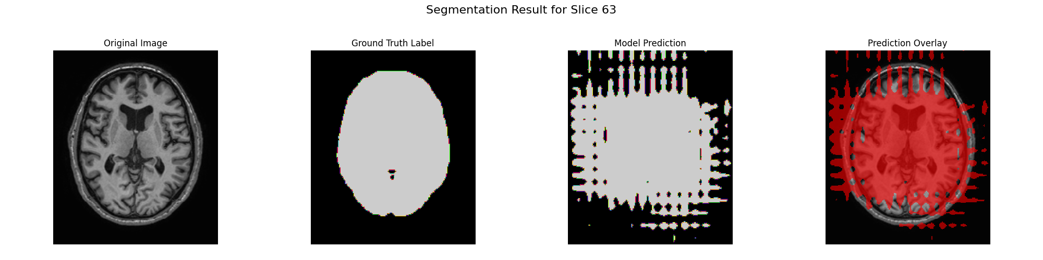
The first one is the original image which is the raw input slice from the medical scan.
The second one is the ground truth label which is the correct segmentation provided in the the dataset. Model tries to replicate it.
The third one is the model prediction which is the segmentation mask generated by the model. Model’s best attempt at identifying target region.
The last one is the prediction overlay. It shows model’s prediction laid on top of original image. We can judge how well the prediction aligns with actual anatomy.

Slide 5
The model demonstrates excellent performance on slice 63.
The predicted segmentation shows a good overlap with the ground truth.
With clean boundaries and minimal false positives or negatives.
This visual result is consistent with the high validation Dice score achieved during training.

Slide 6
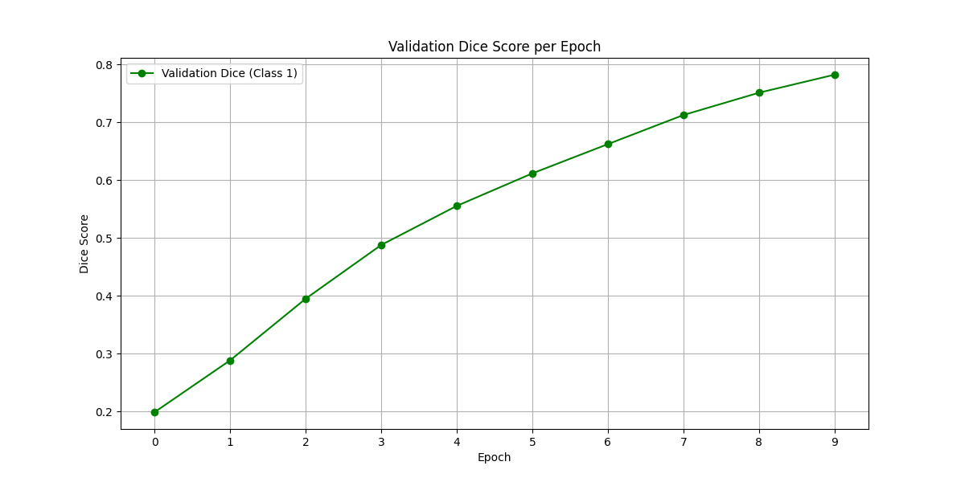

Slide 7
The "Validation Dice Score per Epoch" graph plots the model's segmentation accuracy on the validation dataset at the end of each training epoch.
The Dice Score is a metric that measures how well the model's predicted segmentation overlaps with the ground truth label.
Score of 1.0 is perfect match and score of 0.0 is no overlap.
The upward trend means that with each epoch, the model is getting better at segmenting the target anatomy on unseen data. It is successfully learning generalizable features.
The validation dice score obtained at the end of training was 78.24%.

Slide 8
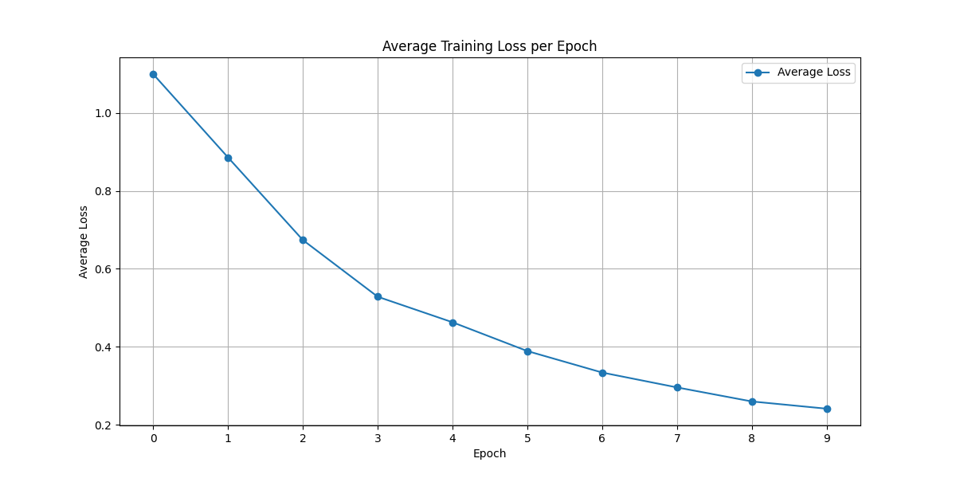

Slide 9
From the graph, we can see that the average loss is decreasing with each successive epoch. This indicates that the model is successfully learning.
With each epoch, the model adjusts its weights to reduce the error or loss.
This shows that the optimization process is working correctly.
The model is getting progressively better at mapping the input images to the correct segmentation masks for the data in the training set.
It is learning to generalize its knowledge to new, unseen data.

Slide 10
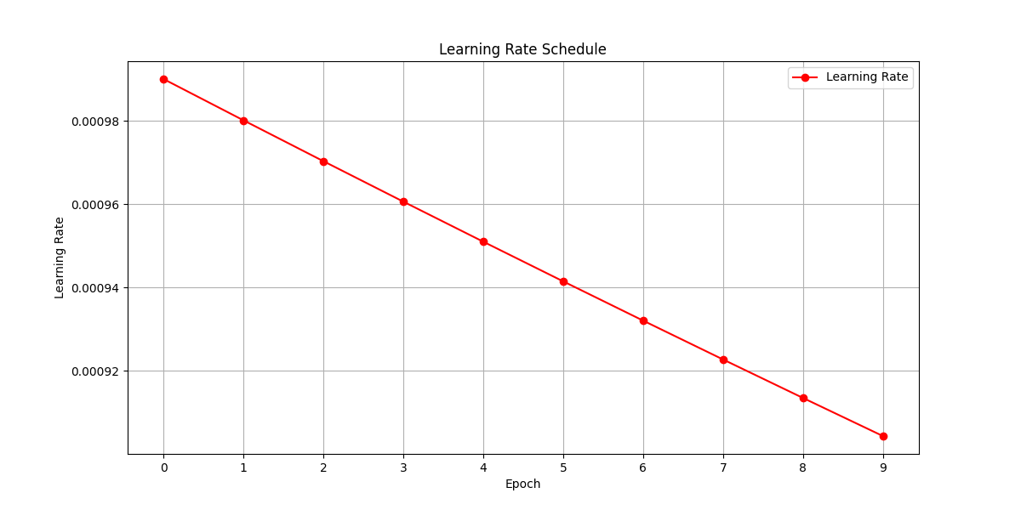

Slide 11
The graph is a downward sloping line, showing the learning rate decreasing with each epoch.
It is the "step size" the optimizer takes when updating the model's weights. A higher learning rate means bigger updates, and a lower learning rate means smaller, more precise updates.
Although the decay is technically exponential, over small number of epoch (10), the exponential curve looks like a straight line.
We start with a higher learning rate for rapid initial progress and gradually reduce it to allow the model to fine tune its weights and converge to a more stable and accurate solution.

Slide 12
THANK YOU

