Slide 1
Software Development Life Cycle (SDLC)

Slide 2
SDLC Model
Software Development (or Design) Life Cycle
It is a term used in systems engineering, information systems and software engineering to describe a process for planning, creating, testing, and deploying an information system. Following are phases of SDLC:
  Preliminary Investigation: [Includes goal, objectives, cost, time, submit plan with suggestions, nature or scope of problem, alternative solutions, benefits etc.]
  Requirement Analysis: [requirement definition & specifications etc]
  System Design: [layouts, models, DFD, ERD, Pseudo-code etc]
  Implementation: [real code is written here]
  Integration & Testing: [units/components are designed and tested, units are combined into modules and tested]
  Installation & Maintenance: [beta versions, production, upgradation and extensions]
  Evaluation: [surveys, feedback, statistics]

Slide 3
Capability Maturity Model (CMM)
A bench-mark for measuring the maturity of an organization’s software process.
A development model created after study of data collected from organizations that contracted with the U.S. Department of Defense, who funded the research.
CMM defines 5 levels of process maturity based on certain Key Process Areas (KPA)
The model's aim is to improve existing software-development processes

Slide 4
CMM Levels
Level 1 – Initial (~ 70%)
Uncontrolled, undocumented and reactive manner by users or events.
Provides a chaotic or unstable environment for the processes.
Level 2 – Repeatable (~ 15%)
Some processes are repeatable, possibly with consistent results.
Level 3 – Defined (< 10%)
There are sets of defined and documented standard processes established and subject to some degree of improvement over time.
Level 4 – Managed (< 5%)
Using process metrics, management can effectively control development process.
Level 5 – Optimizing (< 1%)
Focus is on continually improving process performance through both incremental and innovative technological changes/improvements.

Slide 5
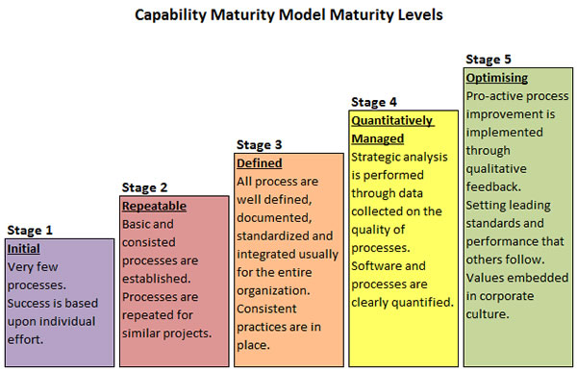

Slide 6
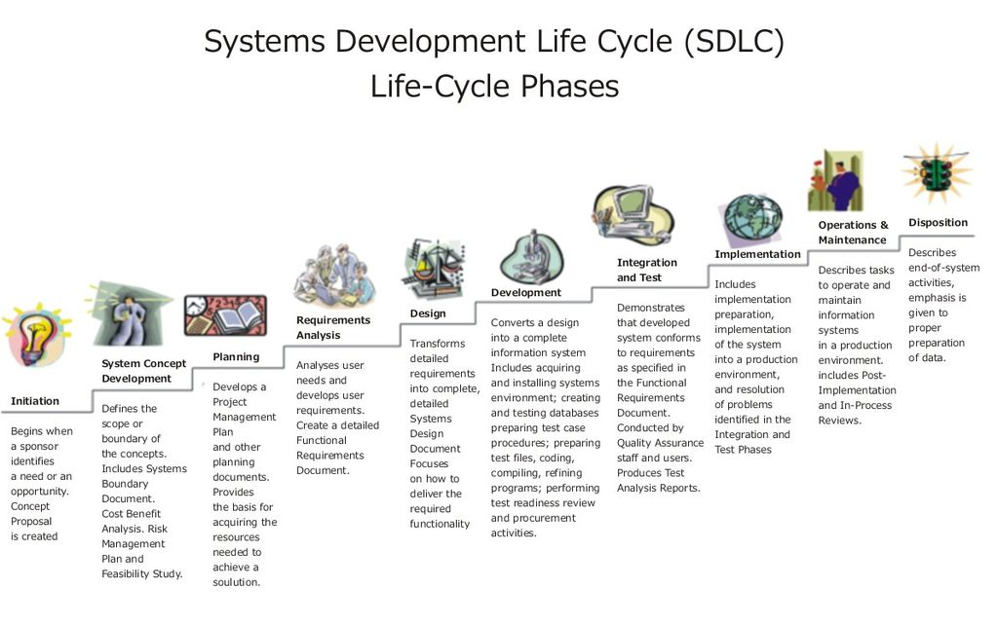

Slide 7
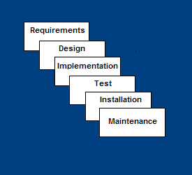
1- Waterfall Model
Requirements – defines needed information, function, behavior, performance and interfaces.
Design – data structures, software architecture, interface representations, algorithmic details.
Implementation – source code, database, user documentation, testing.

Slide 8
Waterfall Strengths
Easy to understand, easy to use
Provides structure to inexperienced staff
Milestones are well understood
Sets requirements stability
Good for management control (plan, staff, track)
Works well when quality is more important than cost or schedule

Slide 9
Waterfall Deficiencies
All requirements must be known upfront
Deliverables created for each phase are considered frozen – inhibits flexibility
Can give a false impression of progress
Does not reflect problem-solving nature of software development – iterations of phases
Integration is one big bang at the end
Little opportunity for customer to preview the system (until it may be too late)

Slide 10
When to use the Waterfall Model
Requirements are very well known
Product definition is stable
Technology is understood
New version of an existing product
Porting an existing product to a new platform.

Slide 11
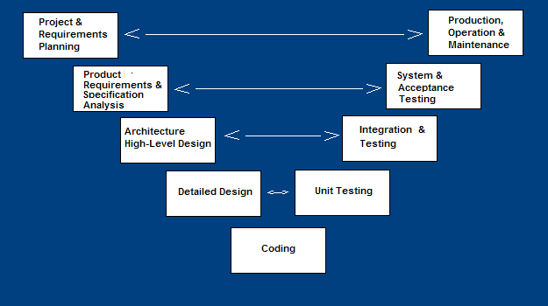
2- V-Shaped SDLC Model
A variant of the Waterfall that emphasizes the verification and validation of the product.
Testing of the product is planned in parallel with a corresponding phase of development

Slide 12
V-Shaped Steps
Project and Requirements Planning – allocate resources
Product Requirements and Specification Analysis – complete specification of the software system
Architecture or High-Level Design – defines how software functions fulfill the design
Detailed Design – develop algorithms for each architectural component
Production, operation and maintenance – provide for enhancement and corrections
System and acceptance testing – check the entire software system in its environment
Integration and Testing – check that modules interconnect correctly
Unit testing – check that each module acts as expected
Coding – transform algorithms into software

Slide 13
V-Shaped Strengths
Emphasize planning for verification and validation of the product in early stages of product development
Each deliverable must be testable
Project management can track progress by milestones
Easy to use

Slide 14
V-Shaped Weaknesses
Does not easily handle concurrent events
Does not handle iterations or phases
Does not easily handle dynamic changes in requirements
Does not contain risk analysis activities

Slide 15
When to use the V-Shaped Model
Excellent choice for systems requiring high reliability – hospital patient control applications
All requirements are known up-front
When it can be modified to handle changing requirements beyond analysis phase
Solution and technology are known

