Slide 1
Modern Data Platform
QA Handover from
Ram Baskar

Slide 2
Agenda
Context Diagram ( Not an architecture diagram)
Pre-Requisites
Items delivered
List of SQL scripts
Location of SQL scripts
QA Pipeline
Test Plan/Test Cases – ADO
Test Evidence
Bronze Layer Test
SCD Type2 Test
Silver Layer – Transformation Test
Silver Layer Data validation Test

Slide 3

Pre-Requisites ( Project/Technical)
Project related pre-requisites
Understanding about Modern Data Platform architecture – Refer Context Diagram
Understand the business requirements
Understand the Source Systems for Use Case1 – Signed Movement Report
Understand the data format from source – target across multiple layers
Understand the Source – Target mapping
Technical pre-requisites
Understand the file/data location in ADLS Gen2 container(s)
Basic concept of Azure Cloud
Basic knowledge of Azure tools like ADF/Synapse/Data Lake/Delta Lake etc.
Basic knowledge of file formats Parquet/Delta/JSON etc.
Good Knowledge of ETL/Data Warehouse/Data pipeline concepts
Strong SQL/T-SQL knowledge
Knowledge of Control Framework – how it works ( Have a session with Data Engineers)

Slide 4







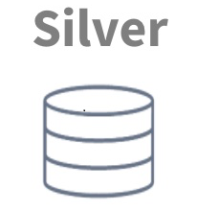
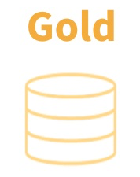




Modern Data Platform – Context Diagram
Consumers
Business User Group/3rd Party
Source Data
(On-Premise)
Filter, Cleansing,
Joins
Transform etc.
Business Logic
Aggregates etc.
Eclipse
Batch Data
Ingestion (Daily)
Synapse Data Pipeline
&
Data Bricks Notebook
Velocity
GXLP
Synapse
Data Pipeline
&
Data Bricks
Reporting/Visualisation
Data Extract/3rd Party
AI/ML Predictive Analysis etc.
Batch Data
Ingestion (Daily)
Landing DB
In Synapse
Profisee
Outbound
MDP
Source
(Outside BRIT)
Lloyds
Inbound
Source Data
Data Ingestion & Orchestration
Data Consumption

Slide 5
Document/Scripts/Pipeline delivered by Ram
1. Documents
Test Strategy – Not signed-off yet
Test Plan document – Not signed off yet
2. Pipeline
“PL_GetcontrolDataForQa” – available in feature/qaautomation branch under template
3.Test Scripts
Bronze Layer (Eclipse Source System)
Data validation using Parquet file (Script type:- Stored Procedure)
Data Reconciliation
Data Completeness
Data Correctness
SCD Type2 script (Script type:- Standalone SQL Script)
Summary – with count of records with pass/fail status for a given parameter as entity name
Detail – with pass/fail status by record level for a given parameter as entity name
Delete scenario using SCD Type 2 script
Silver Layer (Eclipse Source System + Profisee tables for Look up etc)
Data validation using Parquet File (Script type:- Stored Procedure)
Data Reconciliation
Data Completeness
Data Correctness
Transformation Rule validation (Script type:- Standalone SQL Script)
Transformation/Business Rule validation per entity
Look up Transformation
Gold Layer
No script developed by Ram

Slide 6
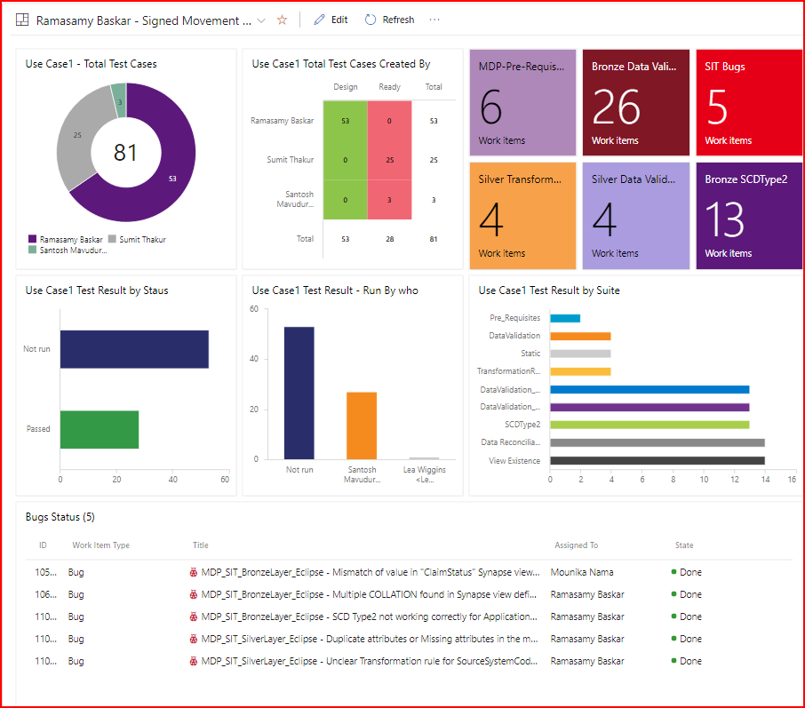
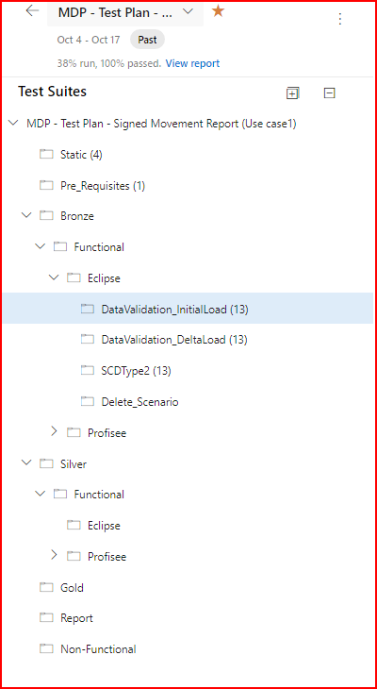
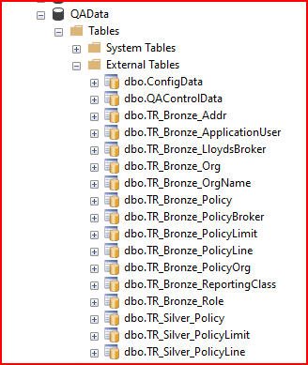
Links/Location of
Documents & SQL Scripts
Use Case1 – ADO QA Dashboard
Use Case1 - ADO Test Plan​
BronzeLayer - SQL Scripts
Silver Layer - SQLScripts​
Documents​
Test Evidence​
ADO Dashboard​
External Tables/Procedures
“QAData” Database

Slide 7
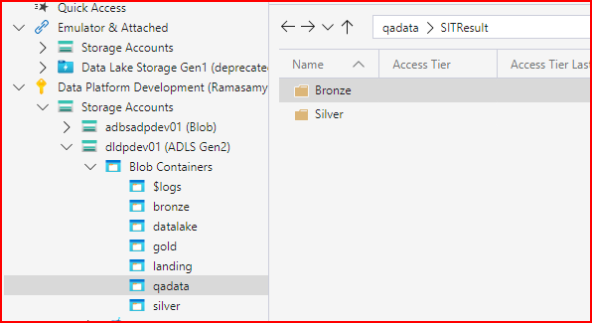
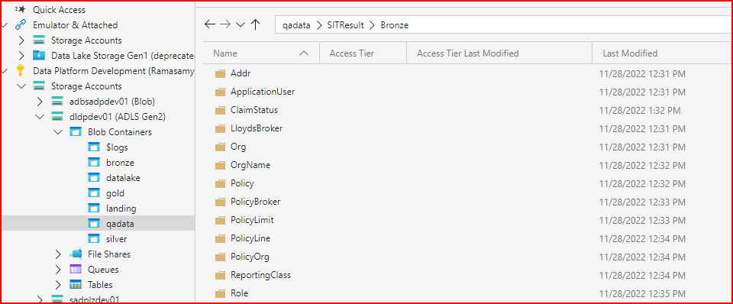
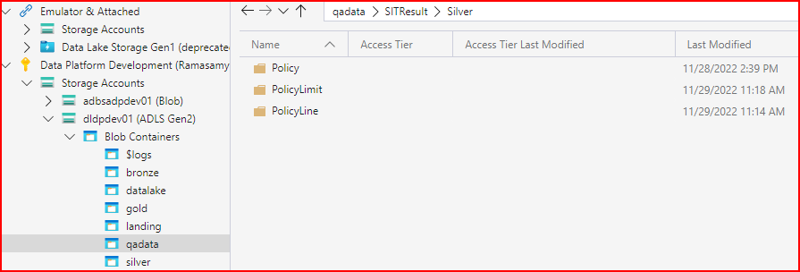
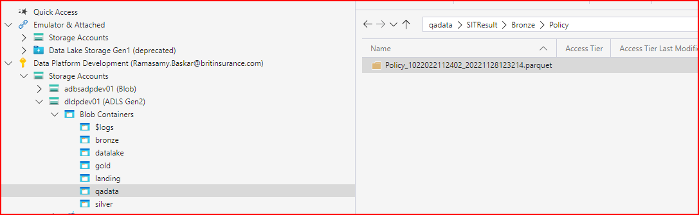
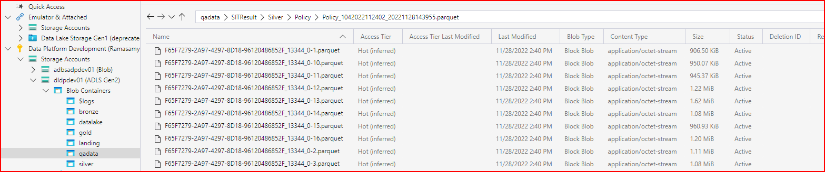
Location of TestResult Output in “qadata” container

Slide 8
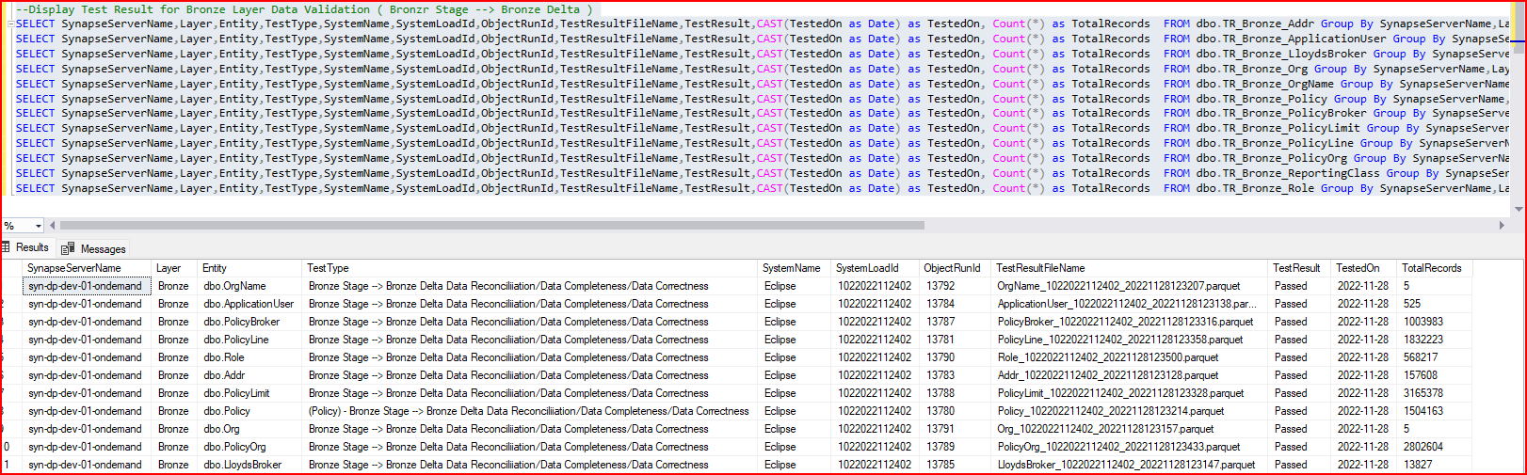
Test Evidence - Bronze Layer
Summary of all Bronze Layer Entities – Data validation from Bronze Stage – Bronze Delta

Slide 9
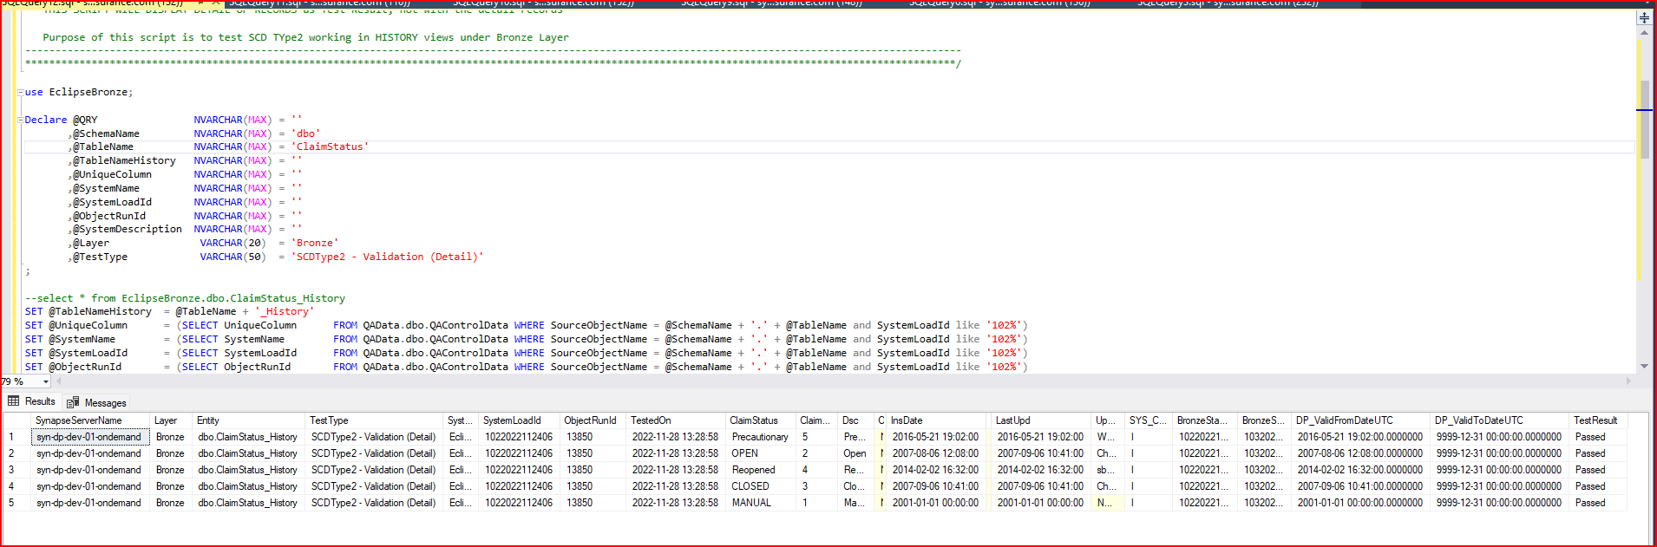
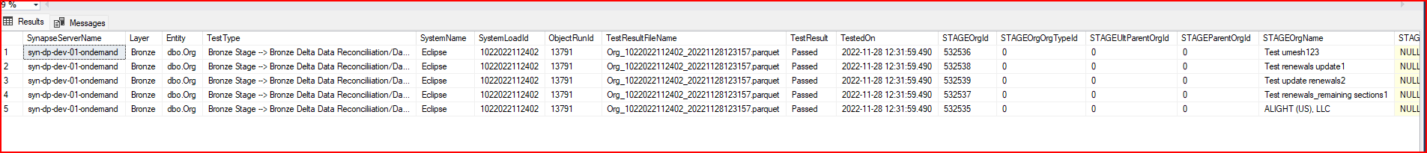

Slide 10
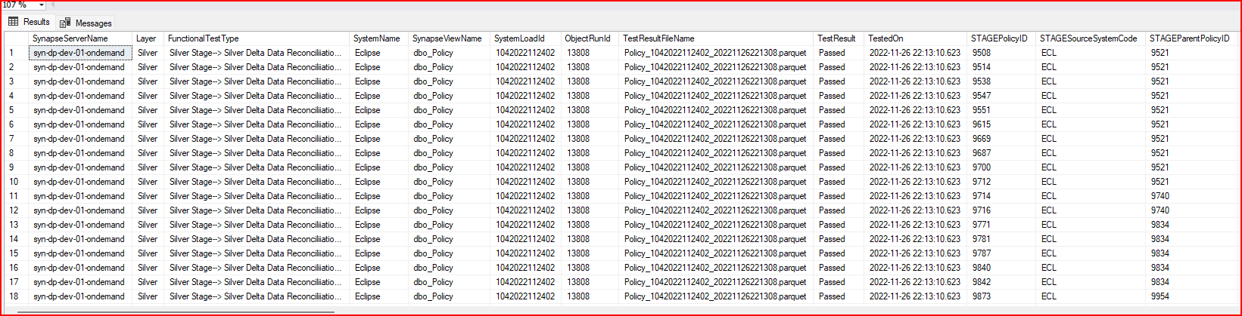
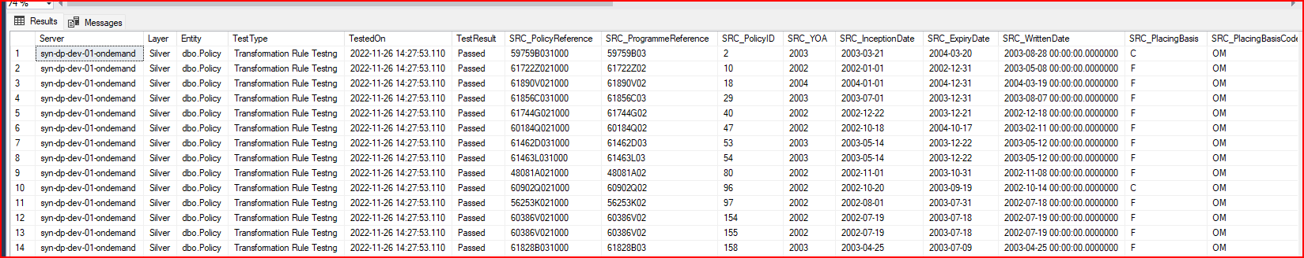
Silver Layer Test Result Output
1. Sample Test Result – Output for Silver Stage – Delta Data validation(External Table)
2.Sample Test Result – Output for Transformation Rule Testing ( Not in External Table)

Slide 11
next Steps to be continued ……..
Ram
No more scripts will be developed from week commencing 05/12
Ram full day time-off on 06/12
Support Sumit for any doubts from handover document (07/12/ - 09/12)
Anna D
To arrange handover session – 2 if required
Sumit
Go-through the handover document and come back with questions (if any)
Understand the documents STM/LDM/PDM
Check access to documents including SQL scripts etc. as per the link mentioned in previous slide
Estimate remaining tasks for QA readiness for execution based on priority
Bronze Layer - Scripts (Profisee)
Silver Layer – Scripts (remaining eclipse + Profisee entities)
Gold Layer – Scripts (Dim/Fact & Bridge tables)
Test Case design for remaining Bronze/Silver/Gold layer tasks
Design ADO Dashboard

Slide 12
End of the Document

