Slide 1



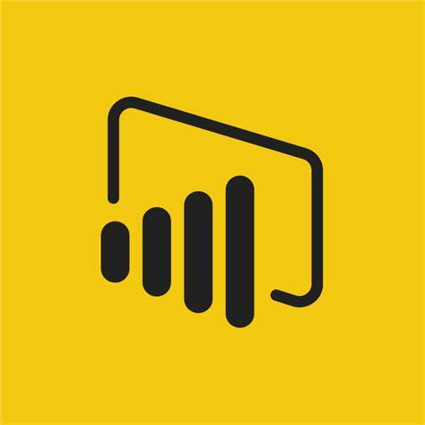

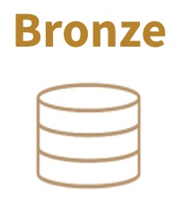
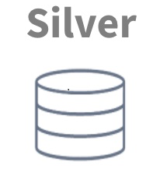
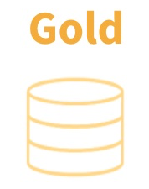




Modern Data Platform – Context Diagram
Consumers
Business User Group/3rd Party
Source Data
Filter, Cleansing,
Joins
Transform etc.
Business Logic
Aggregates etc.
Eclipse
Batch Data
Ingestion (Daily)
(Current Design)
Synapse Data Pipeline
&
Data Bricks Notebook
Velocity
Reporting/Visualisation
Data Extract/3rd Party
AI/ML Predictive Analysis etc.
ADLS Gen2 Data Lake
Synapse
Data Pipeline
&
Data Bricks
GXLP
Ingestion Tables
Raw/Delta Format
Refined Tables
Delta Format
Feature/Aggregated
Data Store
Delta
Format
MDS
Streaming Data
Ingestion
Event Hub/Kafka etc
( Future Design )
Azure Data Lake Storage (ADLS Gen2)
On-Premise
Data Ingestion & Orchestration
Data Consumption

