Slide 1



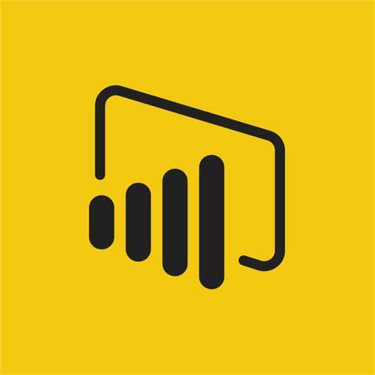



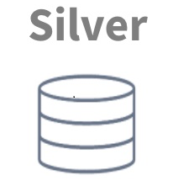
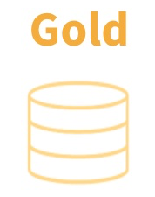




Modern Data Platform – Context Diagram
Consumers
Business User Group/3rd Party
Source Data
(On-Premise)
Filter, Cleansing,
Joins
Transform etc.
Business Logic
Aggregates etc.
Eclipse
Batch Data
Ingestion (Daily)
Synapse Data Pipeline
&
Data Bricks Notebook
Velocity
GXLP
Synapse
Data Pipeline
&
Data Bricks
Reporting/Visualisation
Data Extract/3rd Party
AI/ML Predictive Analysis etc.
Lloyds
Batch Data
Ingestion (Daily)
Ingestion Tables
Raw/Delta Format
Refined Tables
Delta Format
Feature/Aggregated
Data Store
Delta Format
Source
(Outside BRIT)
Inbound
Azure Data Lake Storage (ADLS Gen2)
Profisee
Outbound
Source Data
Data Ingestion & Orchestration
Data Consumption

