Slide 1
Menu

Slide 2
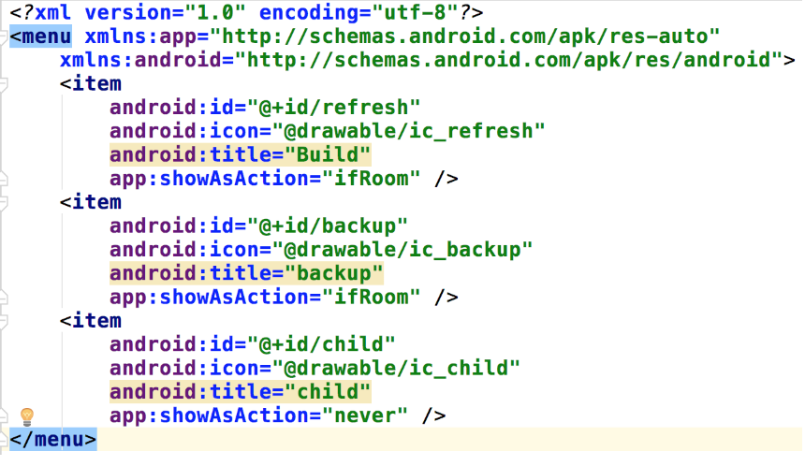

Slide 3
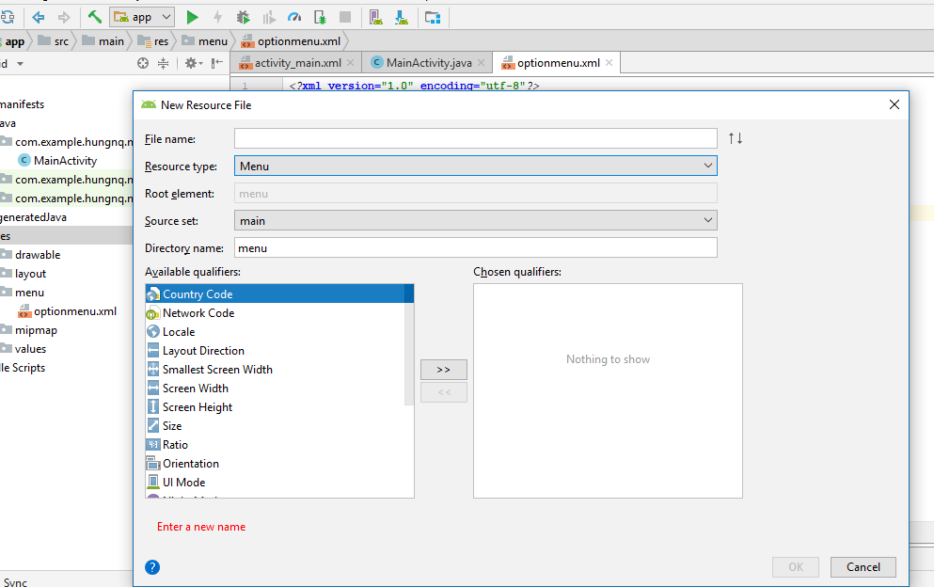

Slide 4
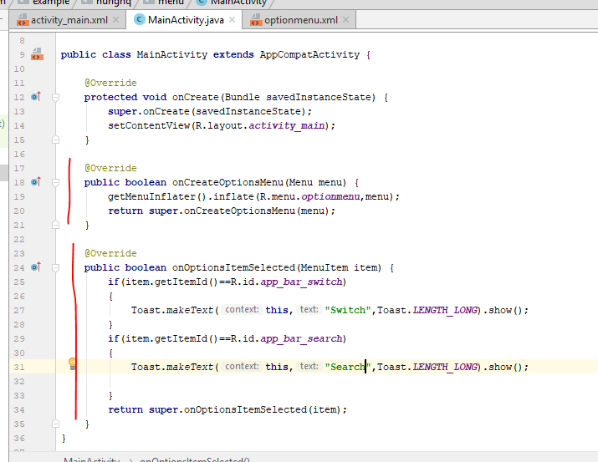

Slide 5
ContextMenu

Slide 6

Tao contextMenu

Slide 7
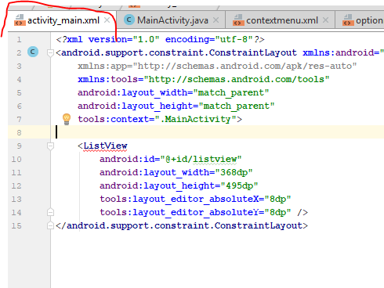
Tao listview

Slide 8
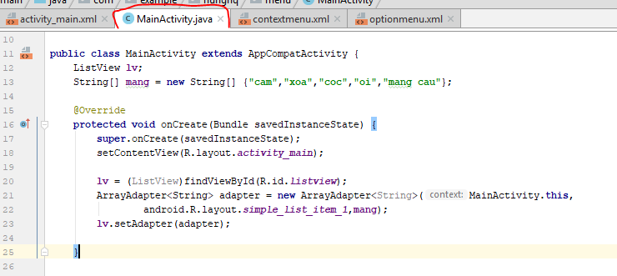

Slide 9
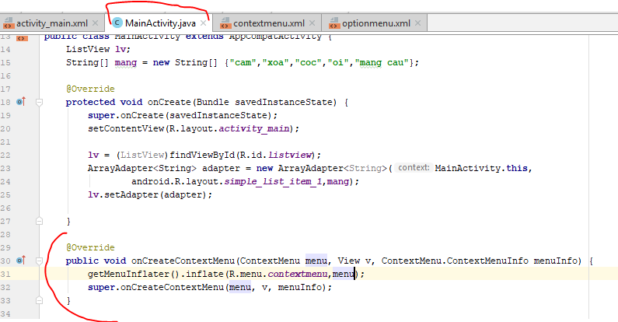
Tao oncreate contextmenu

Slide 10
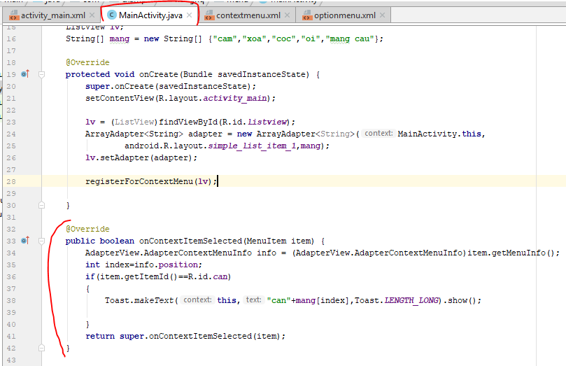
Tao su kien context item selected

Slide 11
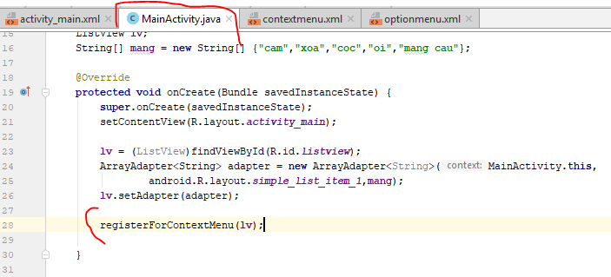
Dang ky su kien trong onCreate

Slide 12
Toolbar

Slide 13
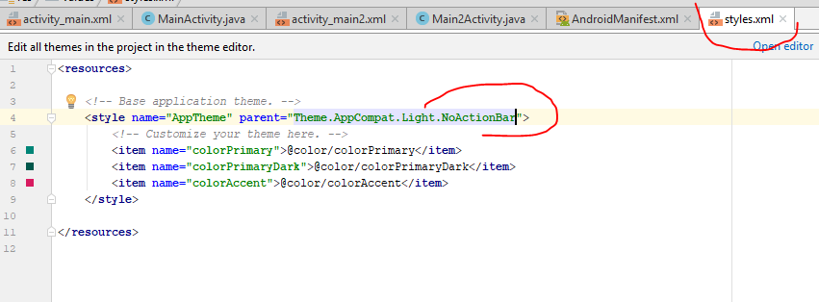
Remove ActionBar

Slide 14
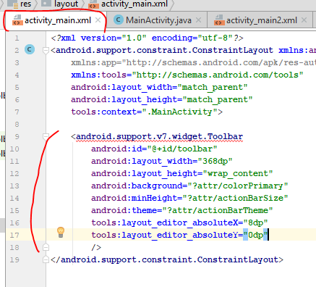

Slide 15
