Slide 1
expression

Slide 2
Application
quantitate gene expression by counting reads per genes, transcripts and exons
opens up new possibilities for quality control.
expression is often estimated at the gene level or the exon level instead
gene level counts are not optimal for differential expression analysis for those genes which undergo isoform switching, because the number of counts depends on transcript length
Notes:
Eukaryotic genes typically produce several transcript isoforms via alternative splicing and promoter usage.
transcript isoforms often have common or overlapping exons.
the coverage along transcripts is not uniform because of mappability issues and biases introduced in library preparation.

Slide 3
ANNOTATION-BASED QUALITY METRICS
Saturation of sequencing depth.
expression profiling
splicing analysis
transcript construction
Read distribution between different genomic features.
Exonic
coding, 5′UTR and 3′UTR exons
protein coding genes, pseudogenes,
ribosomal RNA (rRNA), miRNAs
Intronic
intergenic regions
Notes:
If a high proportion of reads map to intronic or intergenic regions, it might be worth looking for novel isoforms and genes, but this could also be a sign
of contaminating genomic DNA.

Slide 4
ANNOTATION-BASED QUALITY METRICS
Coverage uniformity along transcripts
location biases

Slide 5
Tools for Annotation-Based Quality Control
RSeQC
RNA-SeQC
implemented in Java
Qualimap
Picard’s CollectRNASeqMetrics tool

Slide 6
RNA-SeQC
mean coverage
coverage for transcript end regions,
bias for 3′ and 5′ ends, and the number
cumulative length
percentage of gaps.

Slide 7
Qualimap
the number of detected features at different sequencing depths
many new features are detected by increasing the sequencing depth by one million
how reads are distributed between protein coding genes, pseudogenes, rRNA, miRNAs,
Notes:
Qualimap is a Java program and it uses R and certain Bioconductor
packages internally.

Slide 8
RseQC
it reports also several bins upstream and downstream of transcripts.
it calculates the saturation status for splice junctions in addition to genes
it annotates splice junctions to known, novel and partially novel.
Notes:
RseQC consists of several Python programs and it takes genomic annotations in BED format.

Slide 9
QUANTITATION OF GENE EXPRESSION
When an annotated reference genome is available, mapped reads can be counted per genomic features based on the location information.
if there is no reference genome available, reads can be mapped to transcriptome and counted
If there is no reference transcriptome either, you can assemble one using a de novo assembler

Slide 10
Expression factor
sequencing depth
Transcript length
Transcriptome Composition
GC bias
sequence-specific bias
obvious
harder to pinpoint

Slide 11
normalization
FPKM (Fragments Per Kilobase per Million mapped reads)
RPKM (Reads Per Kilobase per Million mapped reads)
TPM (Transcripts Per Million)
Notes:
RPKM in order to correct counts for library size and transcript length
TPM takes into account the distribution of transcript lengths in the sample

Slide 12
Counting Reads per Genes
The simplest way of estimating expression is to count reads per genes.
HTSeq
BEDTools
Qualimap
Rsubread
GenomicRanges
cufflink
Notes:
1) They differ in the way how they handle multimapping reads (reads which map to several genomic locations due to homology or sequence repeats): HTSeq ignores these multireads altogether, Qualimap divides the counts equally between the different locations, and Cufflinks has an option to divide each multimapping read probabilistically based on the abundance of the genes it maps to.
2) Counting tools also provide different options for dealing with reads which overlap with more than one gene, or which fall partly in intronic regions.

Slide 13
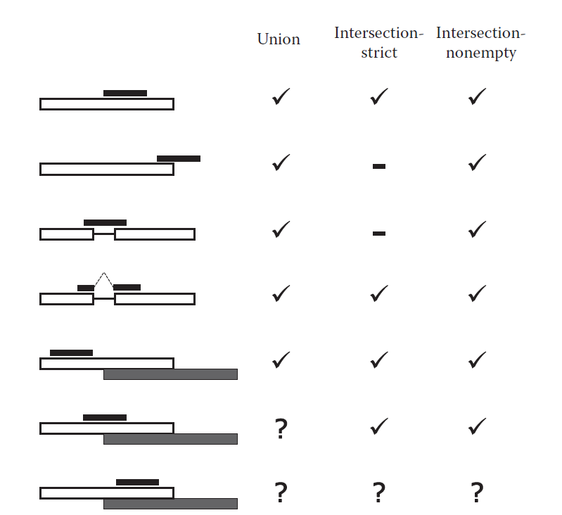
HTseq

Slide 14
Htseq-count finds the exons that the reads overlap with and then groups the exon-level counts based on the exons’ gene ID in the GTF file.
This requires that all the exons of a particular gene have the same gene ID.
While Ensembl GTF files follow this rule, the GTF files available in the UCSC Table browser have a transcript ID repeated as a gene ID.

Slide 15
Counting Reads per Transcripts
Counting reads at the transcript level is complicated by the fact that transcript isoforms typically have overlapping parts
an expectation maximization (EM) approach is used(two step)
an expectation step where reads are assigned to transcripts with a probability according to those transcripts’ abundances
a maximization step where the abundances are updated based on the assignment probability

Slide 16
Cufflinks and eXpress
Cufflinks uses a batch EM approach
eXpress uses an online EM algorithm
Both Cufflinks and eXpress can resolve multimappings of reads across gene families, learn fragment length distribution from data, and correct for sequence-specific bias near the ends of fragments, which arises due to primers used in library preparation.

Slide 17
Counting Reads per Exons
DEXSeq
construct a set of nonoverlapping exonic regions.
the number of reads that were not counted
they were not aligned at all (__notaligned)
the alignment quality was lower than the user-specified threshold
the alignment overlapped with more than one exon counting bin
the alignment didn’t overlap with any exon counting bin

