Slide 1
Re-echo Mobile application design and development 1
Abalos, Elijah
Abon, Jeremy Grace
Chakas, Shary Gayle
Nabua, Gino
Tabun, Julius Angelo

Slide 2
Re-echo
This application gives you a chance to restores file in your android device. The software works like a recycle bin in PC in the sense that all the files you delete will go into the software.

Slide 3
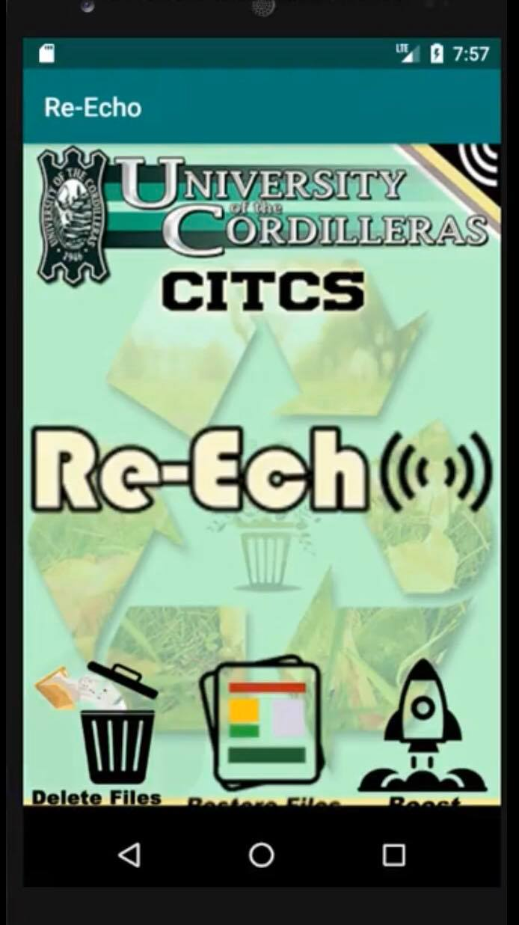
When the application is downloaded. It will ask for a confirmation to access your files.
Once you confirmed the application will generate you to the main menu.
This will be the main menu design of Re-Echo.

Slide 4
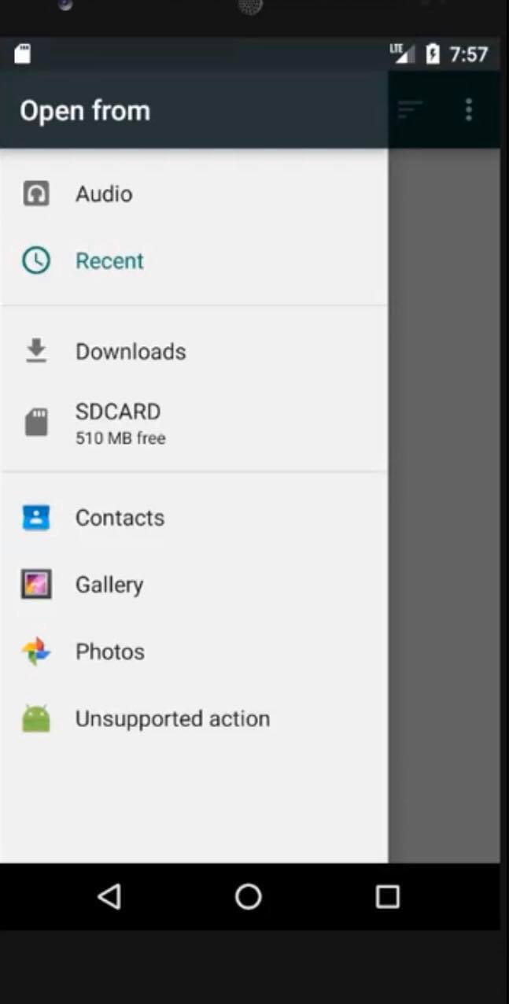
Delete Files Button
Restore Files Button

Slide 5
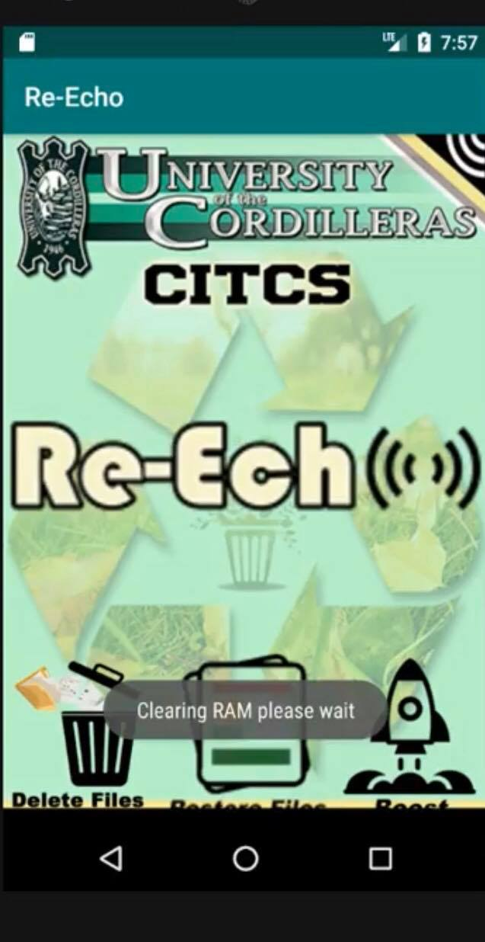
One feature of this app is that you can boost the application's performance by clearing cache.

Slide 6
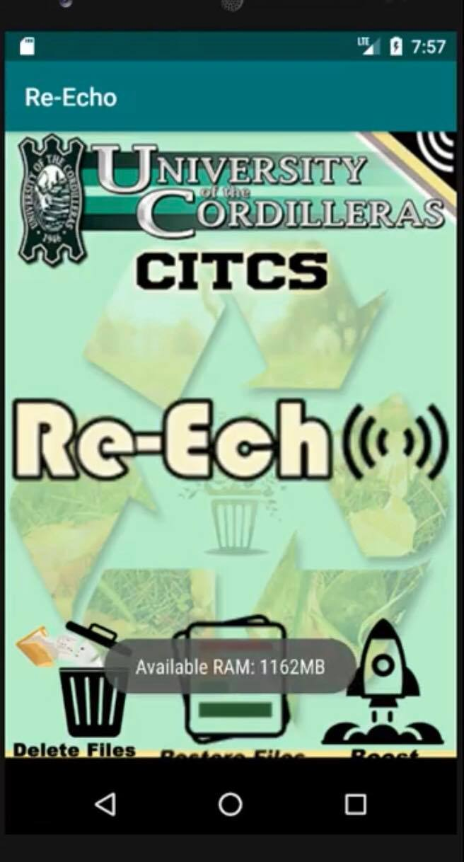
The Boost features is used for clearing cache if your application taking to much time to render, tap the boost option cache helps you save storage space on your phone.

