Slide 1

A simulation of Out of Band Resonances (OBR) of the SAFARI FDM
Amin Aminaei, On behalf of the SRON SAFARI Team
ISG-TECH Plenary Meeting, 4 March 2020

Slide 2
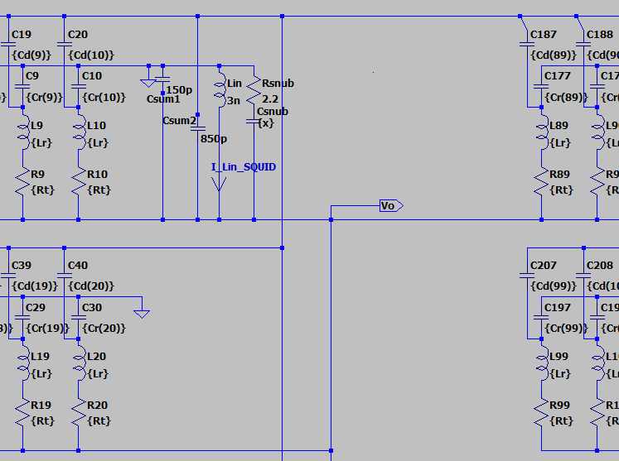
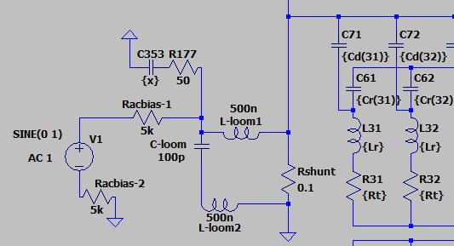
Simulation of the SAFARI FDM blocks up to the input of the 1st SQUID
V__{ACbias}
Loom__{in}
176Resonators
Summing Point
_{Lin-1st SQUID}
Snubber in use at the input of SQUID
R 2.2 Ohm and C 10 nF
Snubber-1 (Theory) after Rac-bias
Optimal values,R 50 Ohm and C 10 nF

Slide 3
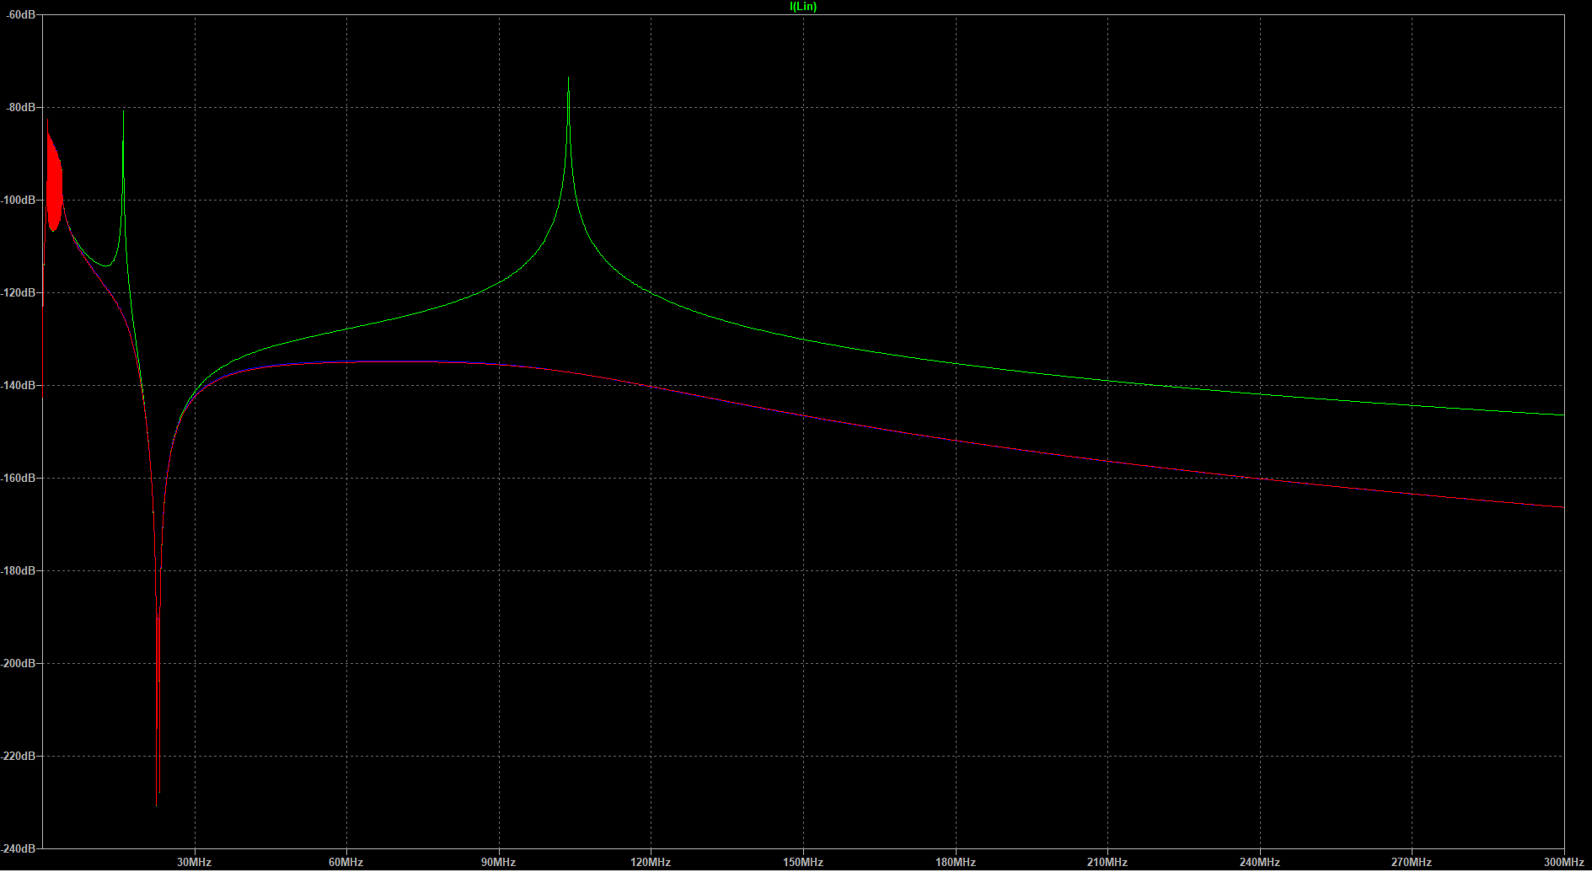
I(SQUID)
ωr1=~1/[L-loom-in*(C-loom-in)]^0.5
@15.9 MHz
ωr2=~1/[Lin*(Csum1+Csum2)]^0.5
@98.7 MHz
R,C-snubber1 after Rac-bias
R,C-snubber2 used at Summing Point
FDM Resonances 1MHz-3.8MHz
A nearby OBR could occur which depends on the Loom impedance
300MHz
f

