Slide 1

Simulation and Measurement of Out-of-Band Resonances for the FDM Readout of a TES Bolometer
-Lab Measurement
Amin Aminaei, Qian Wang, Hiroki Akamatsu
Thanks to Jan van der Kuur
17 May 2021

Slide 2
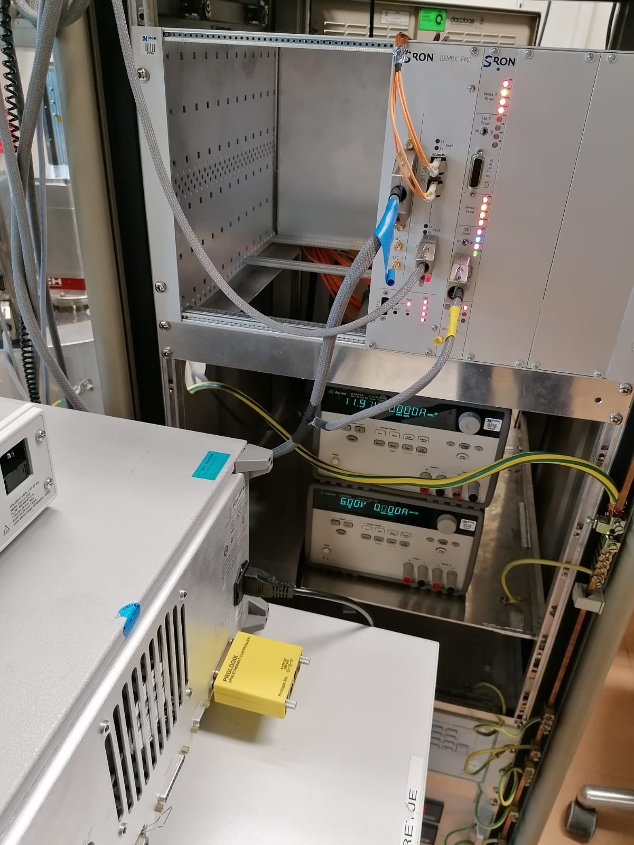
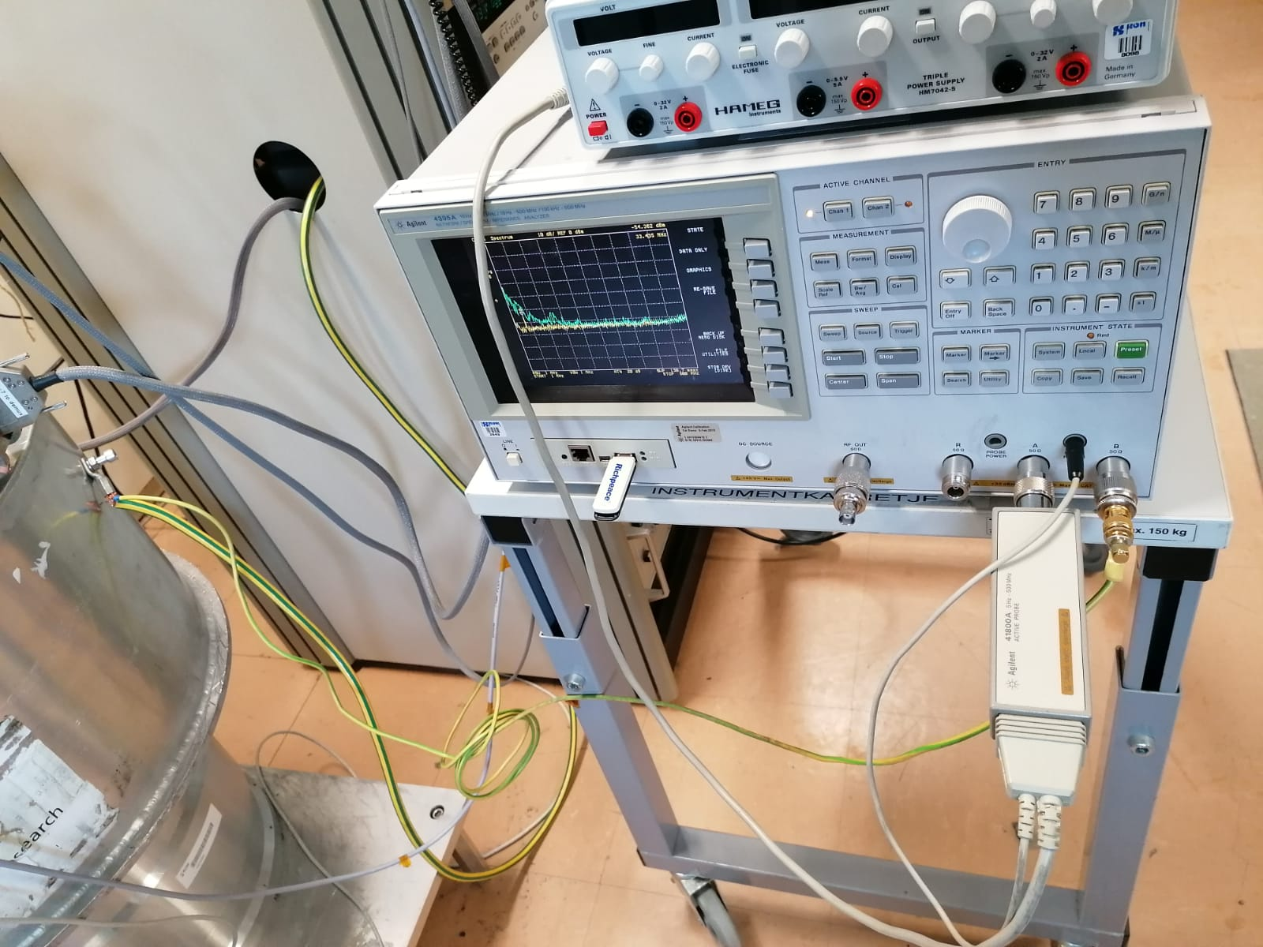
Grounding
SA is grounded with ADR GND
AC mains is supplied via the rack

Slide 3
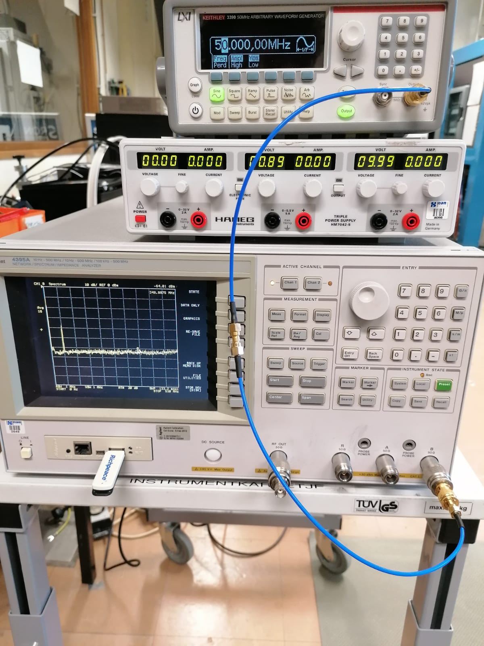
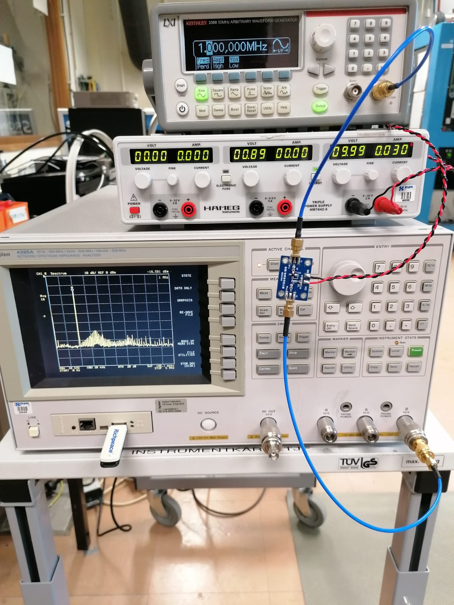
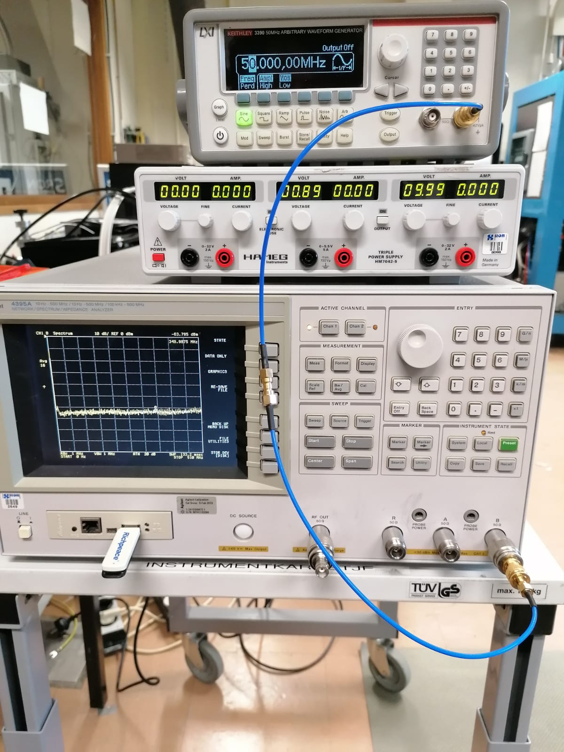
LNA – Spectrum Analyzer Calibration
Cable-SG Off
Cable-SG On 1,5,20,50 MHz
LNA & Cable 1,5,20,50 MHz
To measure the variation of LNA gain for various frequencies
To probe the harmonics /modulation

Slide 4
?
80MHz
200MHz
400MHz
IM - Harmonics
G(1MHz)=19.80dB
G(5MHz)=19.50dB
G(20MHz)=19.50dB
G(50MHz)=19.71dB
We continued the test with FEE, focusing on the first OBR for now

Slide 5
Revisit the Impact of SQUID
The SQUID setting is: stable
Amp:
bias 140 uA 140 uA
flux -6 Ua -6UA
FE:
bias 60 uA 60uA
flux -5 Ua -5UA
============================
The SQUID setting is: Osc
Amp:
bias uA 140uA
flux uA -6uA
FE:
bias Ua 60uA
flux +15u A
(#sqosc file)

Slide 6
SQUID stable, Rbbfb=1k
SQUID Osc, Rbbfb=1k
Rbbfb=10k
Rbbfb=10k
Contrary to simulation, the impact of Rbbfb is not seen (perhaps to small to be seen by FEE, maybe by LNA?

Slide 7
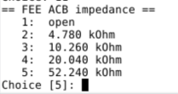
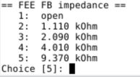
I only have one question about the BBFB resistance in your slide 6.
You seems have Rbbfb = 50 k Ohm, I assume you are using FEE,
and from FEE settings, the AC bias resistances, we use 52 kOhm usually:
and the feedback chain:
the highest value is 10 kOhm. So I don't know where you get 50 kOhm Rbbfb.

Slide 8
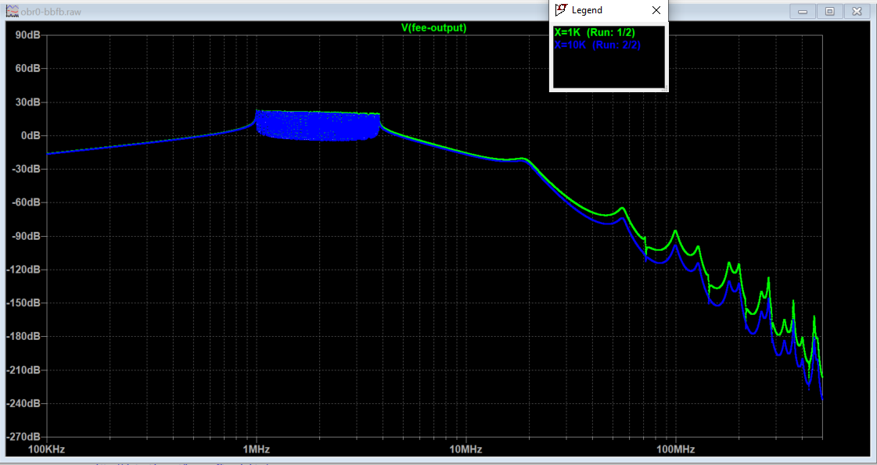
Impact of R_{bbfb}:

Slide 9
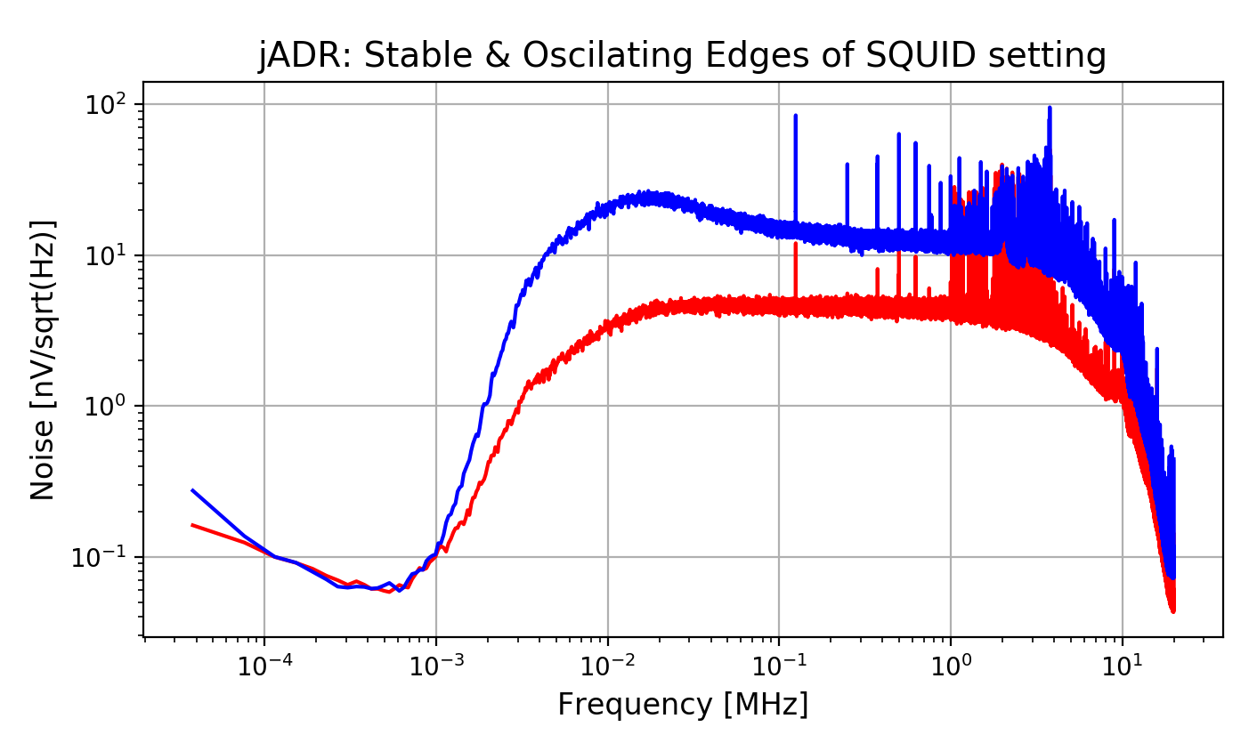
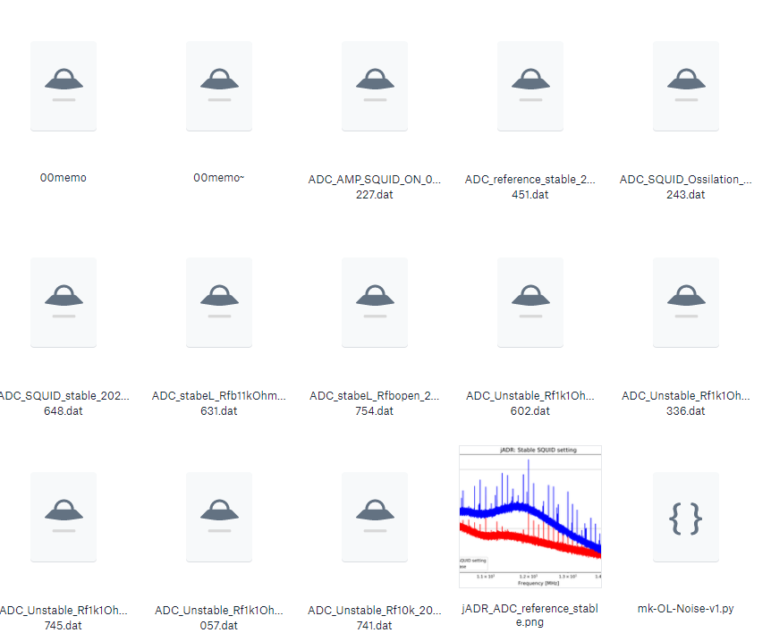
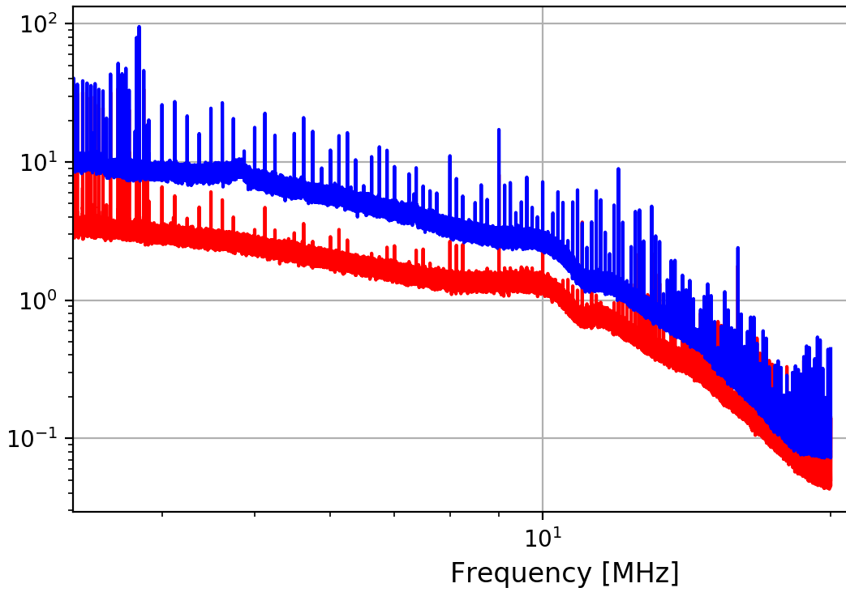
Analysis in Process

Slide 10
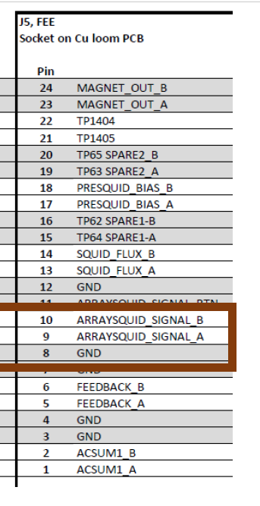
Harness length
Impact of Harness – No SQUID (Dummy load)
CNC Cooler in Utrecht:
OBR@
A matched terminated load to the twisted pair (i.e 68 Ohm)?
We can also make it short / open to see the extreme case of standing waves
NEXT : Harness + Cryo LNA
We already saw the effect of twisted pair connected to LNA
long adapter: OPEN LOOP SPECTRUM IS NOISY
Short adapter: additional noise is significantly reduced
Is flight model (4m-8m) harness replicable in Groningen setup?
The impact of snubber
?

