Slide 1
A Simulation of Out of Band Resonances (OBR) of the FDM Bolometer -Noise Analysis -Power Dissipation
Amin Aminaei
13-09-2021

Slide 2
* [1] Galeazzi, Fundamental Noise Processes in TES Devices, IEEE Transactions on Applied Superconductivity 21, Issue 3, 267 - 271 (2011)
Full Noise Analysis would include:
-Equilibrium Johnson noise* which could be modelled with LT-Spice
-Phonon noise
-Excess noise
To Be Investigated and compared with SAFARI Prototype Noise Measurement

Slide 3
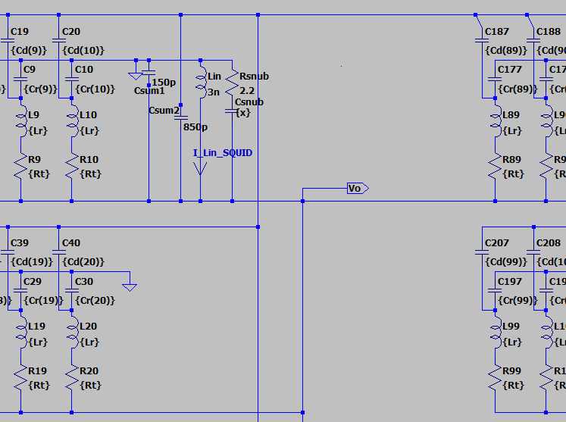
Simulation of the FDM readout up to the input of the 1st SQUID
-Impact of Lin SQUID
-Impact of C Snubber Circuit
V__{ACbias}
Loom__{in}
176Resonators
Summing Point
_{Lin-1st SQUID}
Snubber in use at the input of SQUID, Lin 3nH
R 2.2 Ohm and C 10 nF

Slide 4
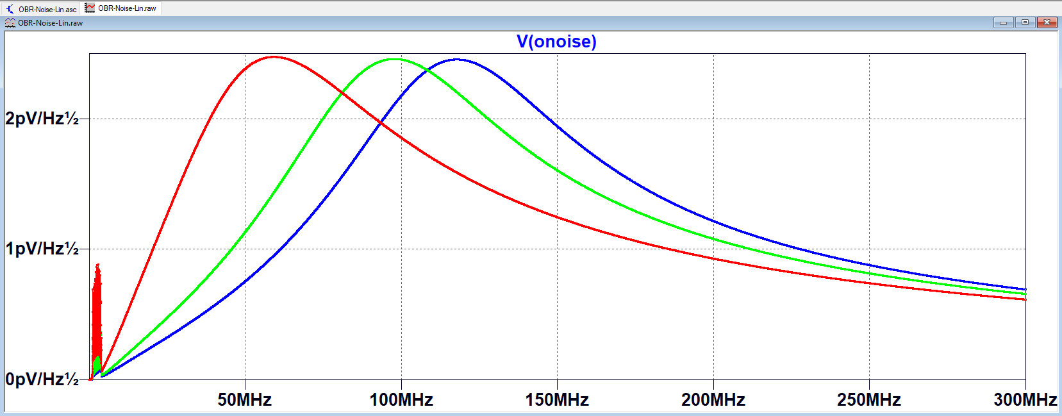

Johnson Noise Analysis vs L_{in-SQUID} at 50mK
L_{in_SQUID}
Snubber in use R 2.2 Ohm and C 10 nF
input inductance of SQUID: Lin 2,3,10 nH
Because the R_{TES} is a fixed resistor in the model, the absolute values are not accurate. However, it shows that with higher Lin, thermal noise at FDM band increases and the peak occurs at lower frequencies.

Slide 5
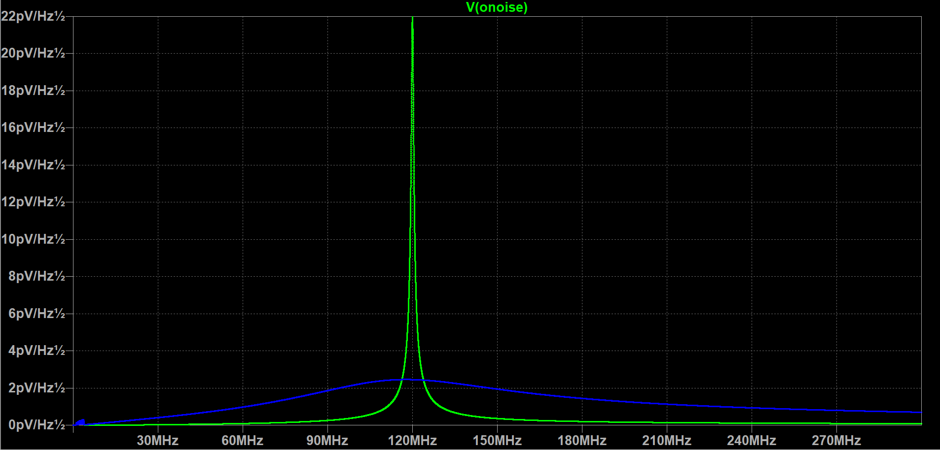
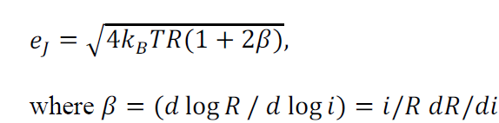
Johnson Noise at 50mK
No Snubber
Snubber, 2.2 Ohm, 10 nF
*[1]
β is ignored for this analysis
R_{TES}=40mOhm

Slide 6
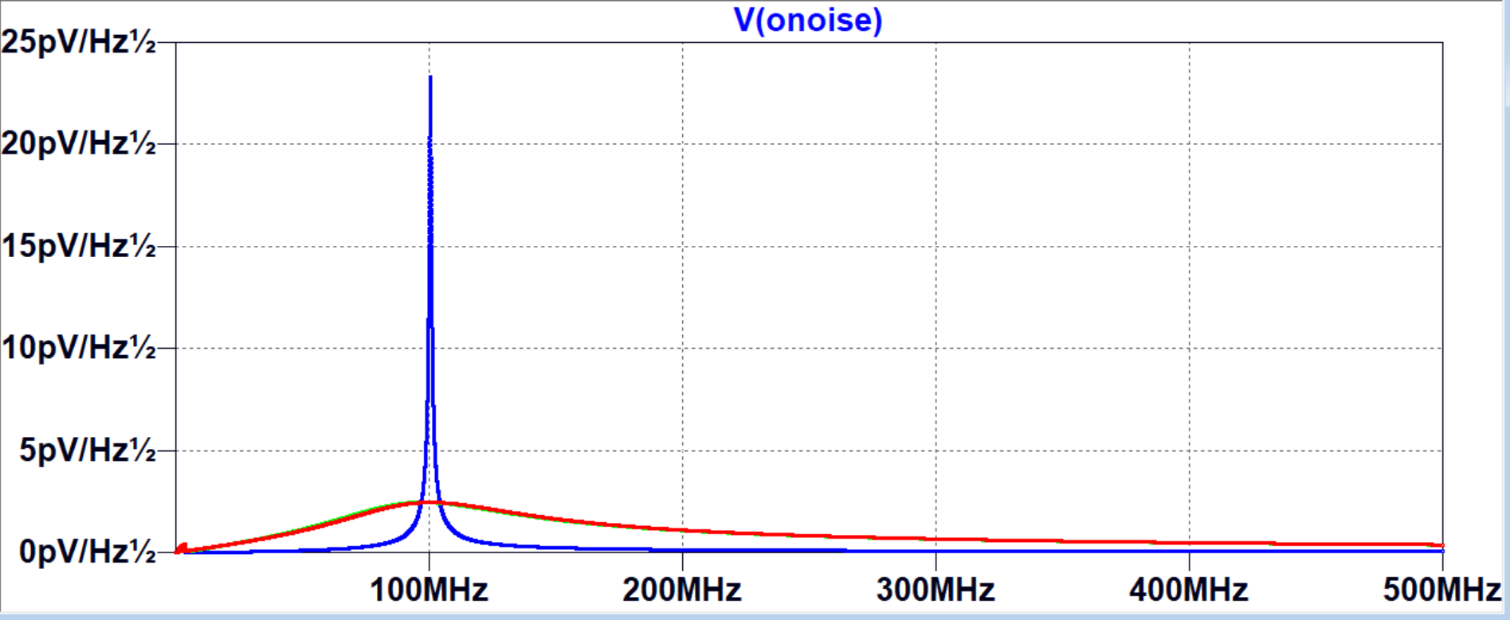
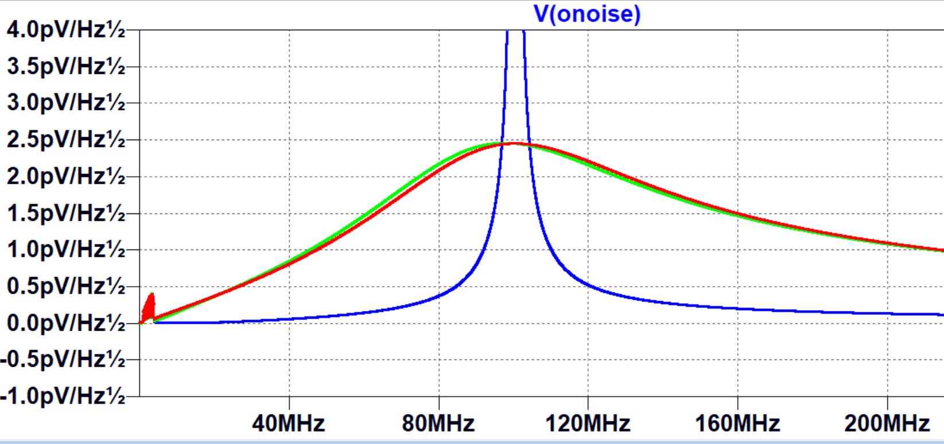
As expected, Johnson Noise is not affcted by capacitor in the snubber circuit
No Snubber
R=2.2Ohm
R=2.2Ohm, C=10nF

Slide 7
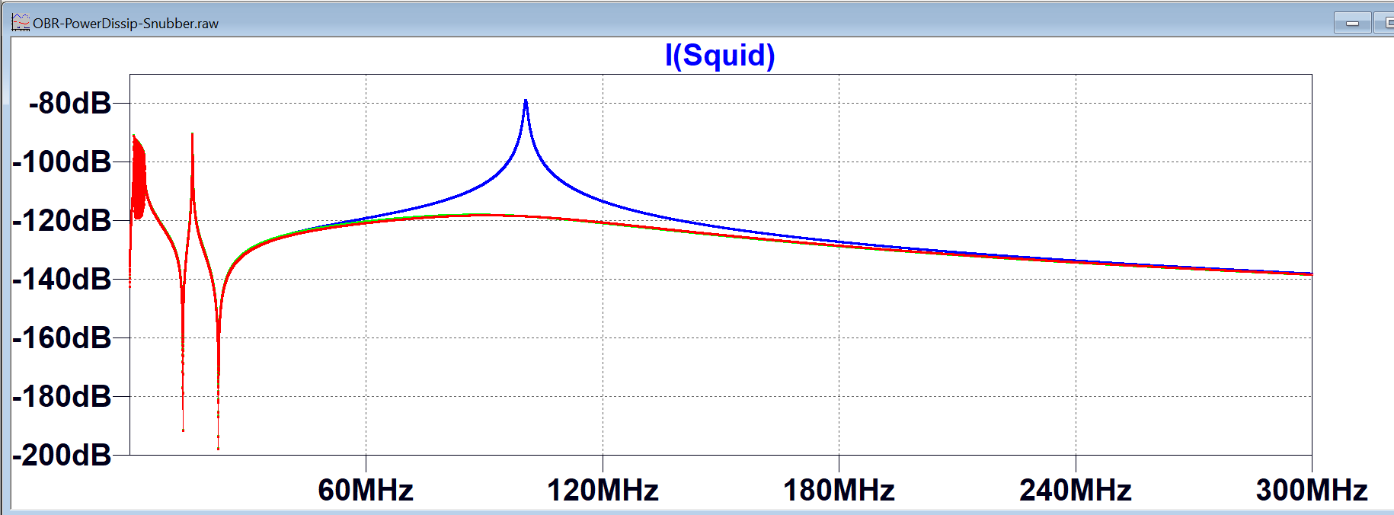
Power Dissipation Reminder: I (input inductor of SQUID) without snubber (blue) 2.2 Ohm snubber with and without 10nF capacitor (red and green on top of each other)

Slide 8
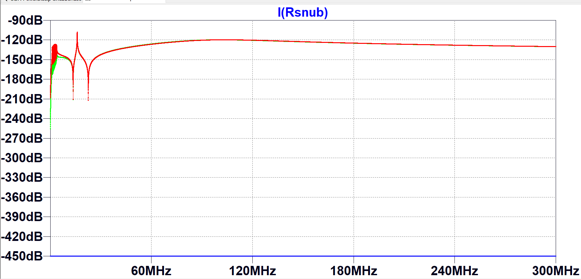
Power Dissipation: Cuurent of the snubber circuit is compared: green with 10nF cap. Red only 2.2 Ohm resistor and blue (c=0, no snubber)

Slide 9
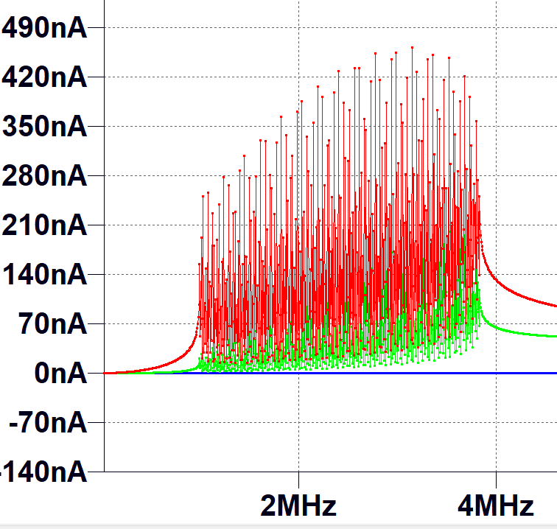
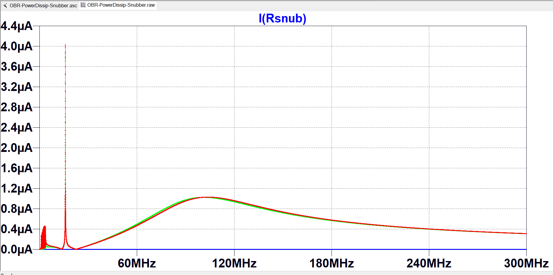
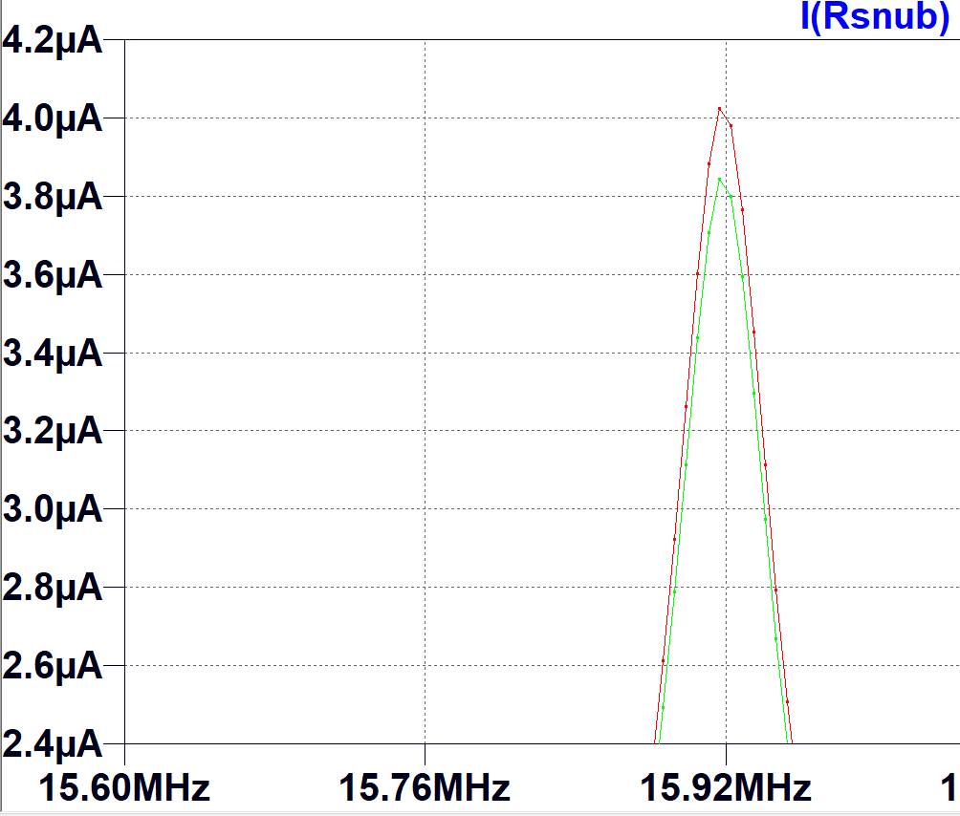
Power Dissipation (ctd, linear scale) green with 10nF cap. The difference is significant at FDM band (current becomes half at 4 MHz when using 10nF c

Slide 10
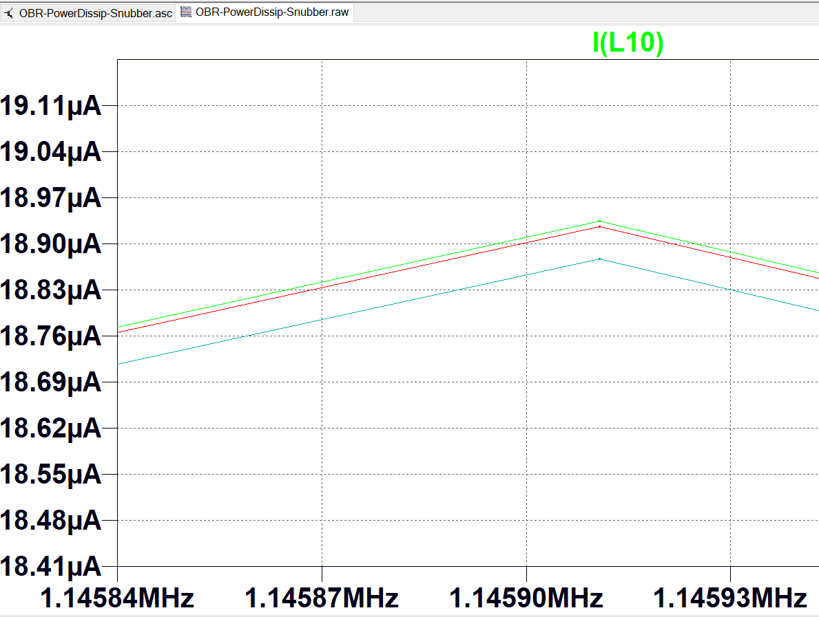
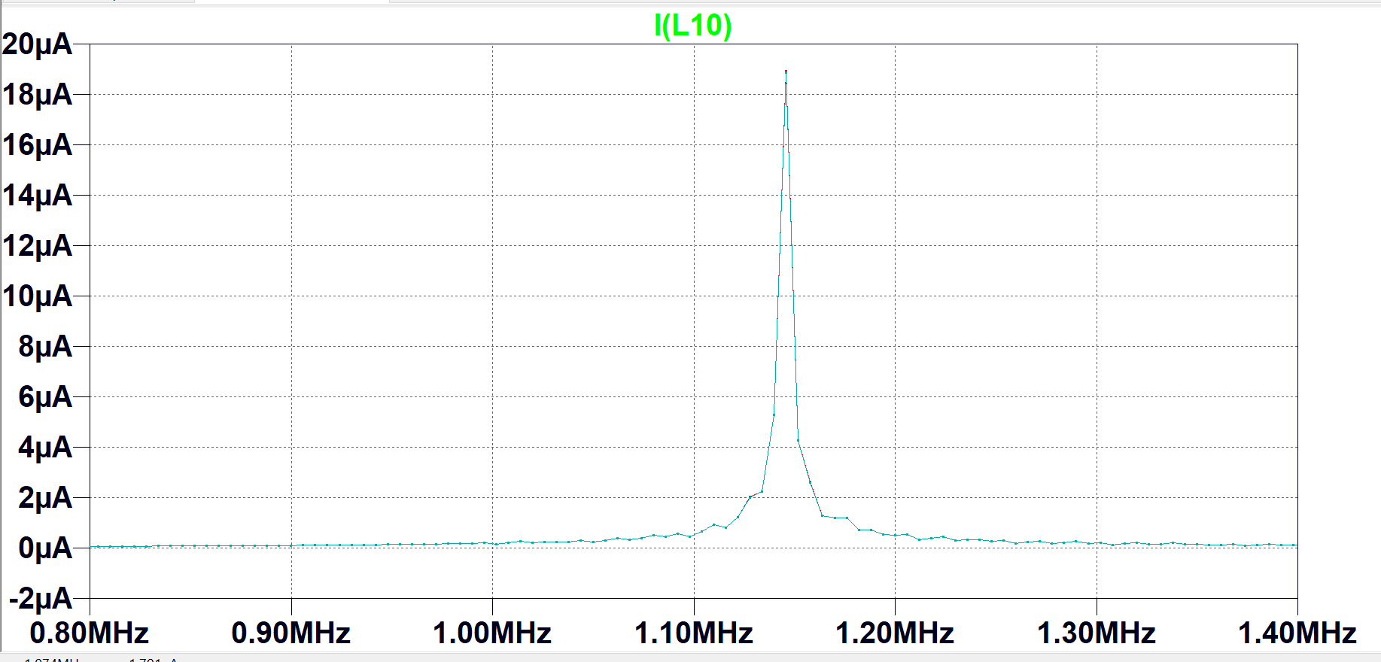
Current of LC resonators are the same green: snubber with capacitor blue no snubber red : snubber is only a resistor

Slide 11
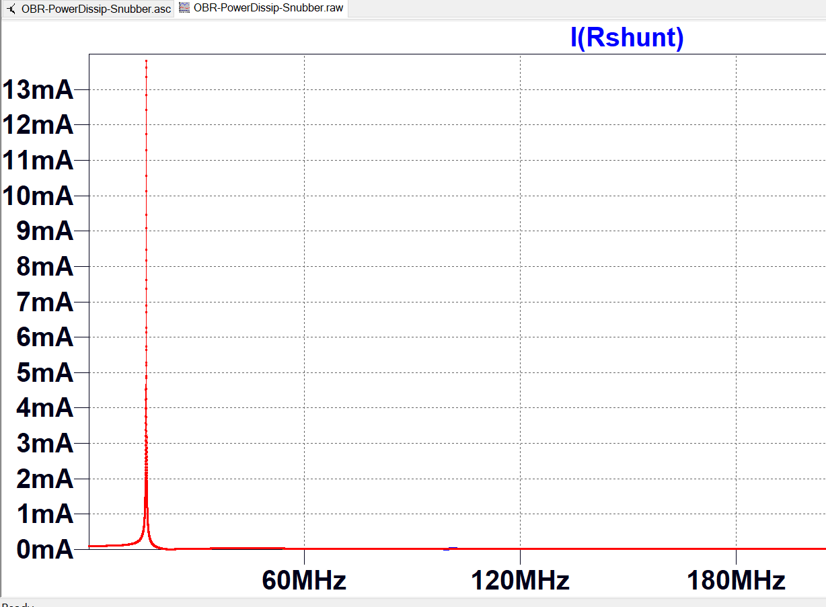
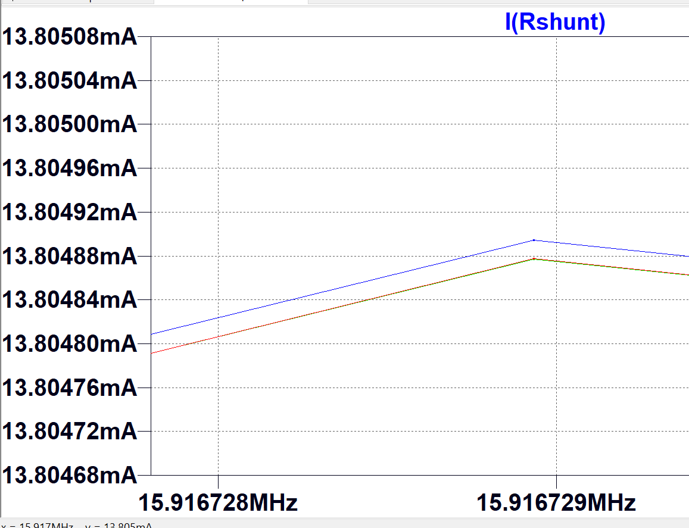
Currents of R-AC bias and R-Shunt also do not have a significant change.

