Slide 1
Assignment 1
File created on: 6/14/2023 1:04:29 AM

Slide 2
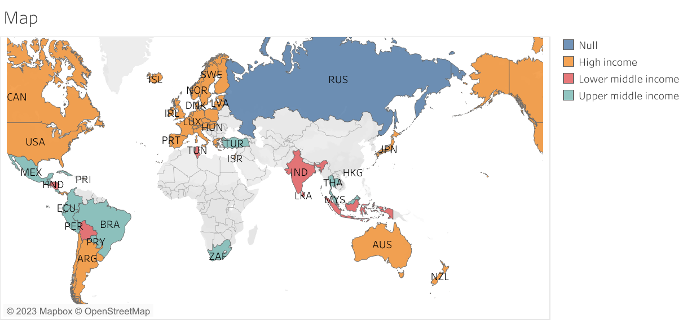

Slide 3
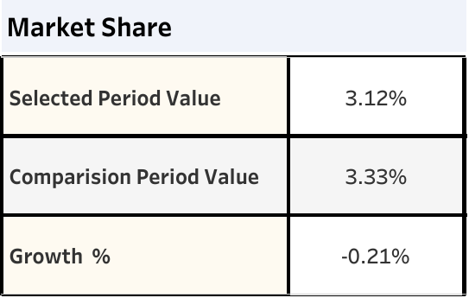

Slide 4
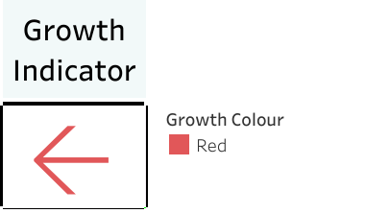

Slide 5
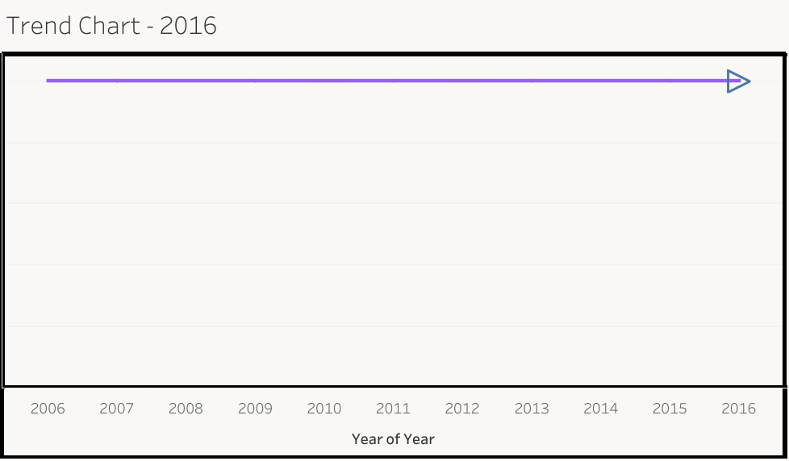

Slide 6
