Slide 1
Capstone Project – The Battle of Neighborhoods
Finding a Better Place in Scarborough, Toronto

Slide 2
INTRODUCTION
Many people are migrating to various states of Canada and needed lots of researches for good housing prices and comfortable facilities and and schools for their children.
This Project aim to create an analysis of features for a people in exploring better facilities around the neighborhood, making smart and efficient decision on selecting great neighborhood out of numbers of other neighborhoods in Scarborough, Toranto to search a best neighborhood as a comparative analysis between neighborhoods.
The features include median housing price and better school according to ratings, crime rates of that particular area, road connectivity, weather conditions, good management for emergency, water resources both freash and waste water and excrement conveyed in sewers and recreational facilities.

Slide 3
DATA SECTION
Data Link: https://en.wikipedia.org/wiki/List_of_postal_codes_of_Canada:_M
I will use Scarborough dataset which is scrapped from Wikipedia.
Dataset consisting of latitude and longitude, zip codes.
Foursquare API data

Slide 4
FOURSQUARE API
This project would use Four-square API as its prime data gathering source as it has a database of millions of places, especially their places API which provides the ability to perform location search, location sharing and details about a business.
Foursquare is a location data provider with information about all manner of venues and events within an area of interest. Such information includes venue names, locations, menus and even photos.

Slide 5
FOURSQUARE API DATA
The data retrieved from Foursquare contained information of venues within a specified distance of the longitude and latitude of the postcodes. The information obtained per venue as follows:
Neighbourhood
Neighbourhood Latitude
Neighbourhood Longitude
Venue
Name of the venue e.g. the name of a store or restaurant
Venue Latitude
Venue Longitude
Venue Category

Slide 6
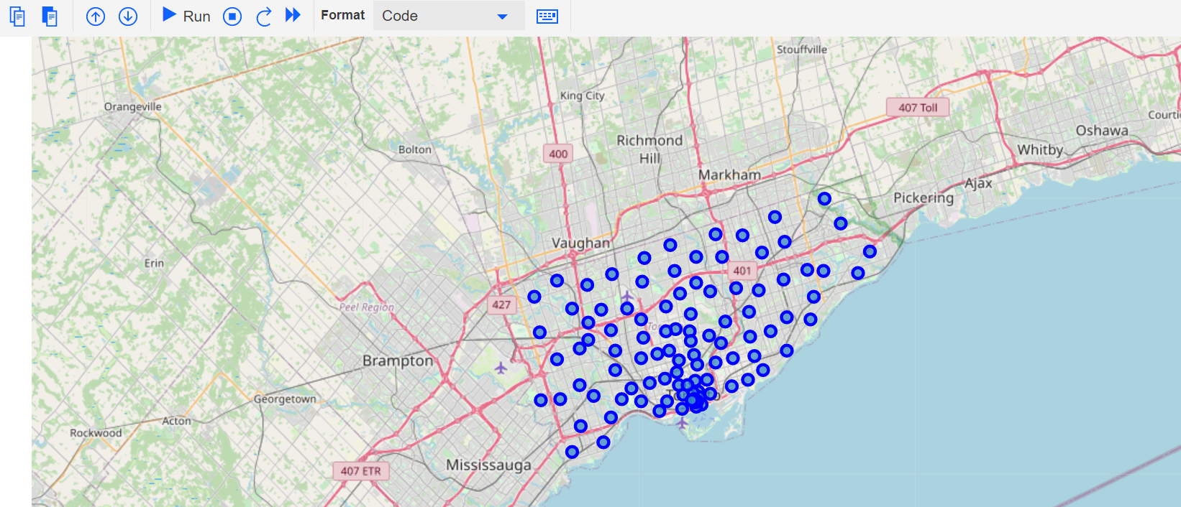
Map of Scarborough

Slide 7
METHODOLOGY
Clustering Approach:
To compare the similarities of two cities, we used clustering approaches, which are k-means clustering algorithm in order to explore neighborhoods, to segment them, and to group them.
After that we will find similar neighborhoods in a big city like New York and Toronto. Given that, data is a form of unsupervised machine learning.

Slide 8
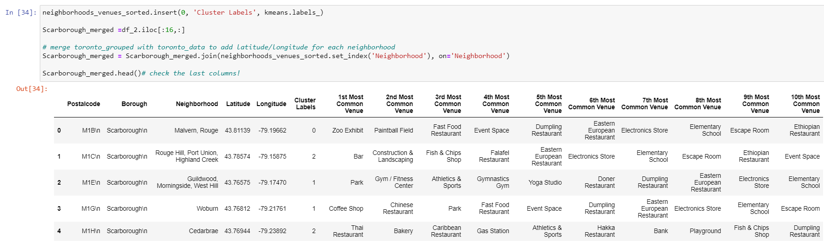
K-MEANS CLUSTERING

Slide 9
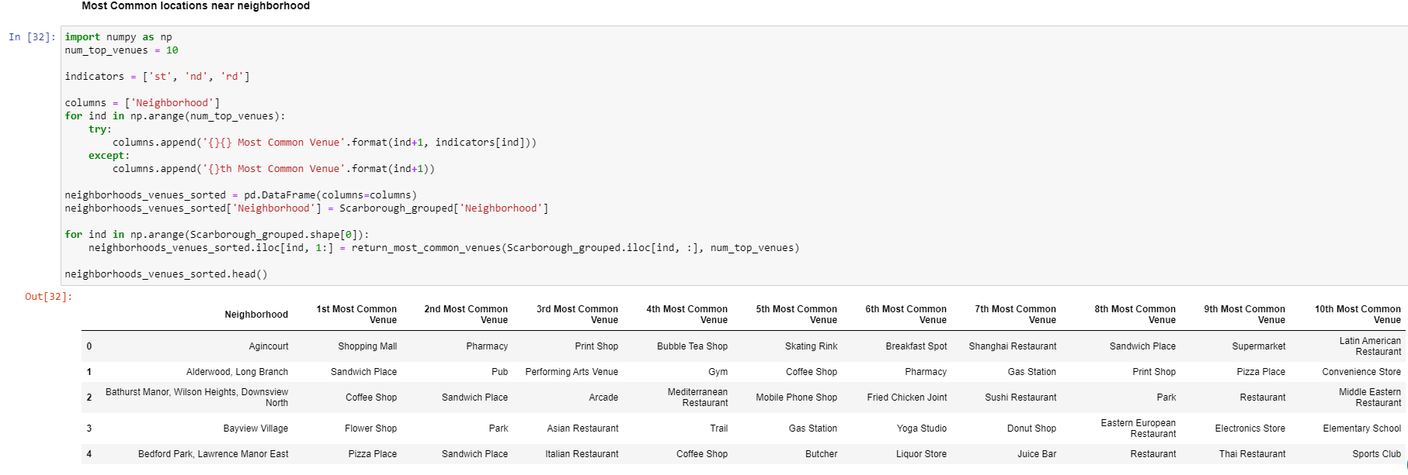
Most Common venues near Neighborhood

Slide 10
WORKFLOW
Using credentials of Foursquare API features of near-by places of the neighbourhoods would be mined.
Due to http request limitations the number of places per neighbourhood parameter would reasonably be set to 100 and the radius parameter would be set to 500.

Slide 11
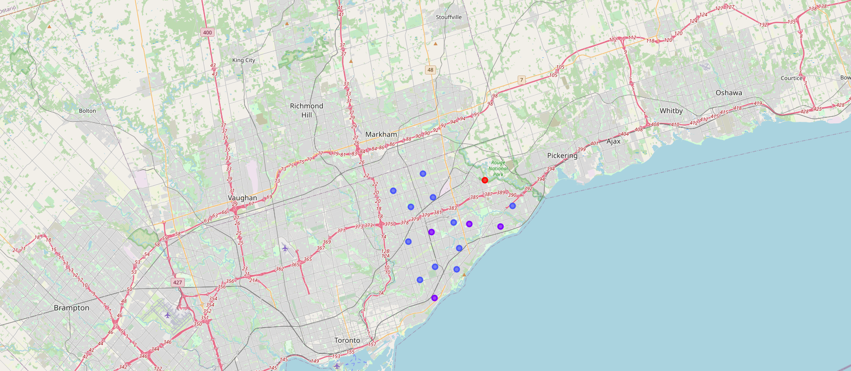
RESULTS-Map of clusters in Scarborough

Slide 12
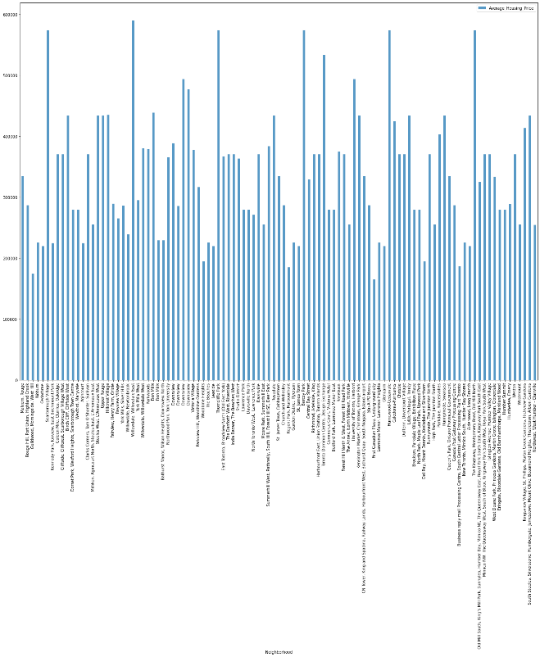
RESULTS- Average Housing Price by Clusters in Scarborough

Slide 13
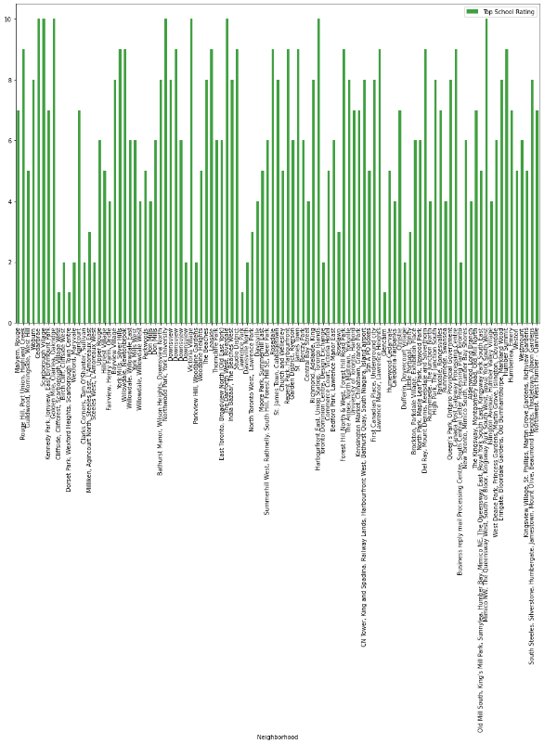
RESULTS- School Ratings by Clusters in Scarborough

Slide 14
DISCUSSION
The major objectives of this project, is to suggest a migrating person, who are shiffting to Scarborough, Toronto, for a better place to live. Neighborhood is the key factors such as housing prices, connectivity to the airport, bus station, city center, markets and other daily needs things nearby.
Sorted list of house in terms of housing prices in a ascending or descending order
Sorted list of schools in terms of location, fees, rating and reviews

Slide 15
CONCLUSION
To sum up, the neighborhood is separated into 10(Ten) different clusters and for 103 different lattitude and logitude from dataset using k-means cluster algorithm, which have very-similar neighborhoods around them. Using the charts above results presented to a particular neighborhood based on average house prices and school rating have been made.
This project can be continued for making it more precise in terms to find best house in Scarborough. Best means on the basis of all required things(daily needs or things we need to live a better life) around and also in terms of cost effective.

