Slide 1
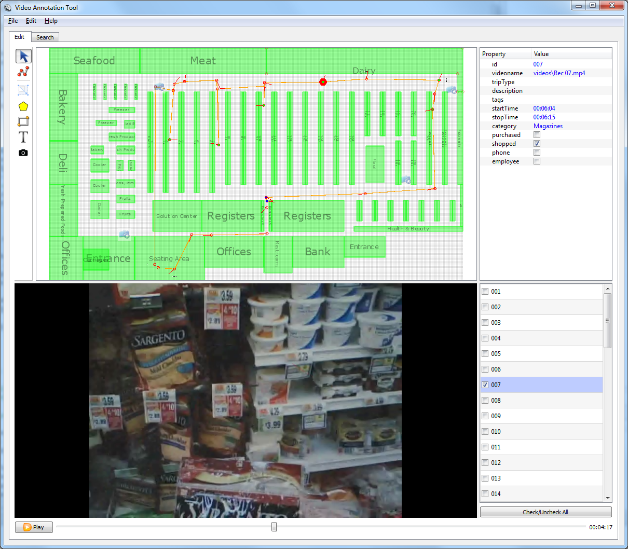
Menu
Drawing Area
Toolbar
Field Editor
Video Area
Object List

