Slide 1

Minor Project – IA1 Master of Computer Applications- MCA III Semester – 2025
School of Computer Science and Applications

Slide 2
Multi-class image segmentation using Deep learning
Presented by: Pranjal Prakash & Shubham Singh
Under the Guidance of: Prof Vinay G
Assistant Professor

Slide 3
Outline
Abstract
Introduction
I. Problem Statement
II. Motivation
System Requirements
Architecture Diagram
Literature Review
Data Collection / Dataset Description
Gantt Chart / Project Timeline
Conclusion

Slide 4
1. ABSTRACT
Semantic segmentation enables pixel-level scene understanding, supporting tasks beyond basic object detection such as terrain analysis and navigation. While transformer-based models offer strong global context modeling, they are often computationally demanding. This project integrates a lightweight, pretrained transformer segmentation model into an efficient inference framework that runs on commonly available hardware. In addition to segmentation masks, the system generates depth-based heatmap overlays and estimates an optimal traversal path across image terrain, enhancing spatial awareness. The framework produces intuitive visualizations and serves as a modular foundation for safety analysis, environmental monitoring, and assistive perception applications.
4

Slide 5
INTRODUCTION
2.1 Problem Statement
Applying semantic segmentation to unstructured real-world environments remains challenging despite advances in Vision Transformer–based models, particularly due to computational constraints in lightweight systems. Natural terrains introduce visual ambiguity, where similar textures and unclear boundaries reduce segmentation reliability, and raw masks alone lack practical interpretability. This project addresses these limitations by integrating depth-based heatmap overlays and optimal path estimation to convert segmentation outputs into actionable, navigation-oriented insights.
5

Slide 6
2. INTRODUCTION
2.2 Motivation
Computer vision has progressed from basic object detection to holistic scene understanding, where multi-class semantic segmentation assigns a meaningful label to every pixel. Leveraging deep learning particularly transformer-based architectures enables the capture of complex spatial relationships across diverse natural and man-made environments. However, true usability requires going beyond segmentation masks. By incorporating depth-based heatmap visualization and optimal path estimation across terrain, pixel-level understanding is transformed into interpretable spatial cues that support navigation, safety awareness, and intelligent decision-making in real-world scenarios.
6

Slide 7
3. System Requirements
GPU (Minimum): NVIDIA GPU with 4 GB VRAM for basic inference
Storage (Minimum): 20 GB free space (HDD acceptable)
RAM (Minimum): 8 GB DDR4
Programming Language: Python 3.8+ (Python 3.9 or 3.10 recommended)
Deep Learning Framework:
Minimum: PyTorch 1.10+ (CPU inference supported)
Recommended: PyTorch 2.0+ with CUDA 11.8 / 12.1 support
Key Libraries: Hugging Face Transformers, NumPy, OpenCV
Additional Tools (Recommended): Gradio, Weights & Biases, Albumentations, Scikit-learn
Pipeline is modular: preprocessing, model inference, and post-processing are decoupled.
7

Slide 8
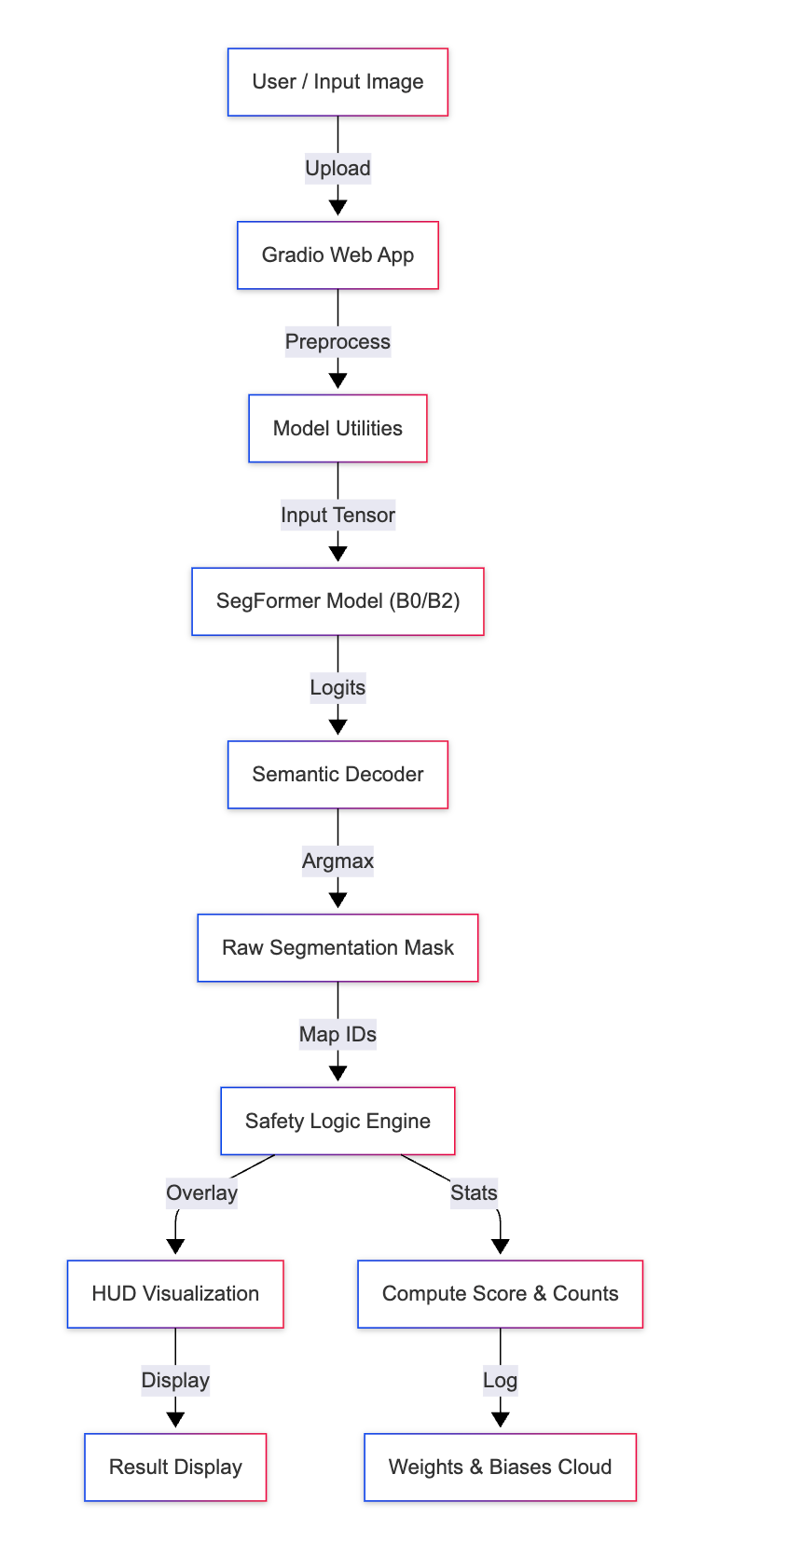
4. Architecture Diagram
End-to-end inference pipeline: A user-uploaded image is processed through a lightweight SegFormer model to generate pixel-level semantic segmentation masks.
Actionable output generation: Segmentation results are converted into safety-aware HUD visualizations and quantitative scores, enabling interpretable, real-time scene understanding and analysis.
8

Slide 9
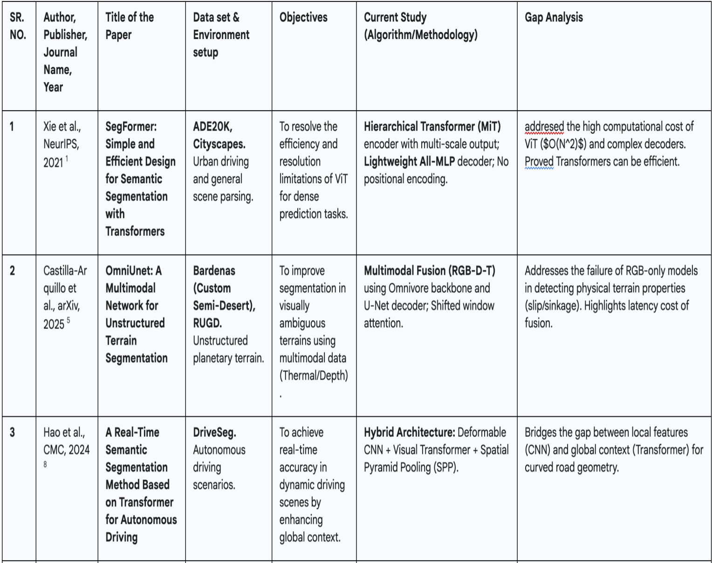
5. Literature Survey
9

Slide 10
Limitations
1. Xie et al., NeurIPS 2021 — SegFormer
Focuses primarily on architectural efficiency and segmentation accuracy, without addressing how outputs can be used for safety, navigation, or decision-making.
2. Castilla-Arquillo et al., arXiv 2025 — OmniUnet
Does not emphasize lightweight deployment or the translation of segmentation results into actionable, user-interpretable outputs.
3. Hao et al., CMC 2024 — Real-Time Transformer for Driving
Designed for structured urban driving scenarios and assumes well-defined road geometry.

Slide 11
6. Dataset Description
This section details the implementation strategy, covering the dataset, the training protocols, and the metric definition.
Dataset Description (Alternative to ADE20k)
While the current model uses ADE20k (which requires registration), we recommend COCO-Stuff for accessible, open-source reproduction.
Dataset: COCO-Stuff 10K
Description: A subset of the common COCO dataset enriched with pixel-level stuff annotations (sky, grass, road) in addition to things (person, car).
Accessibility: Publicly available via direct download (no registration gate).
License: Creative Commons Attribution 4.0.
Why it works: It contains all the critical classes needed for this project: grass, road, water, person, vehicle.
10

Slide 12
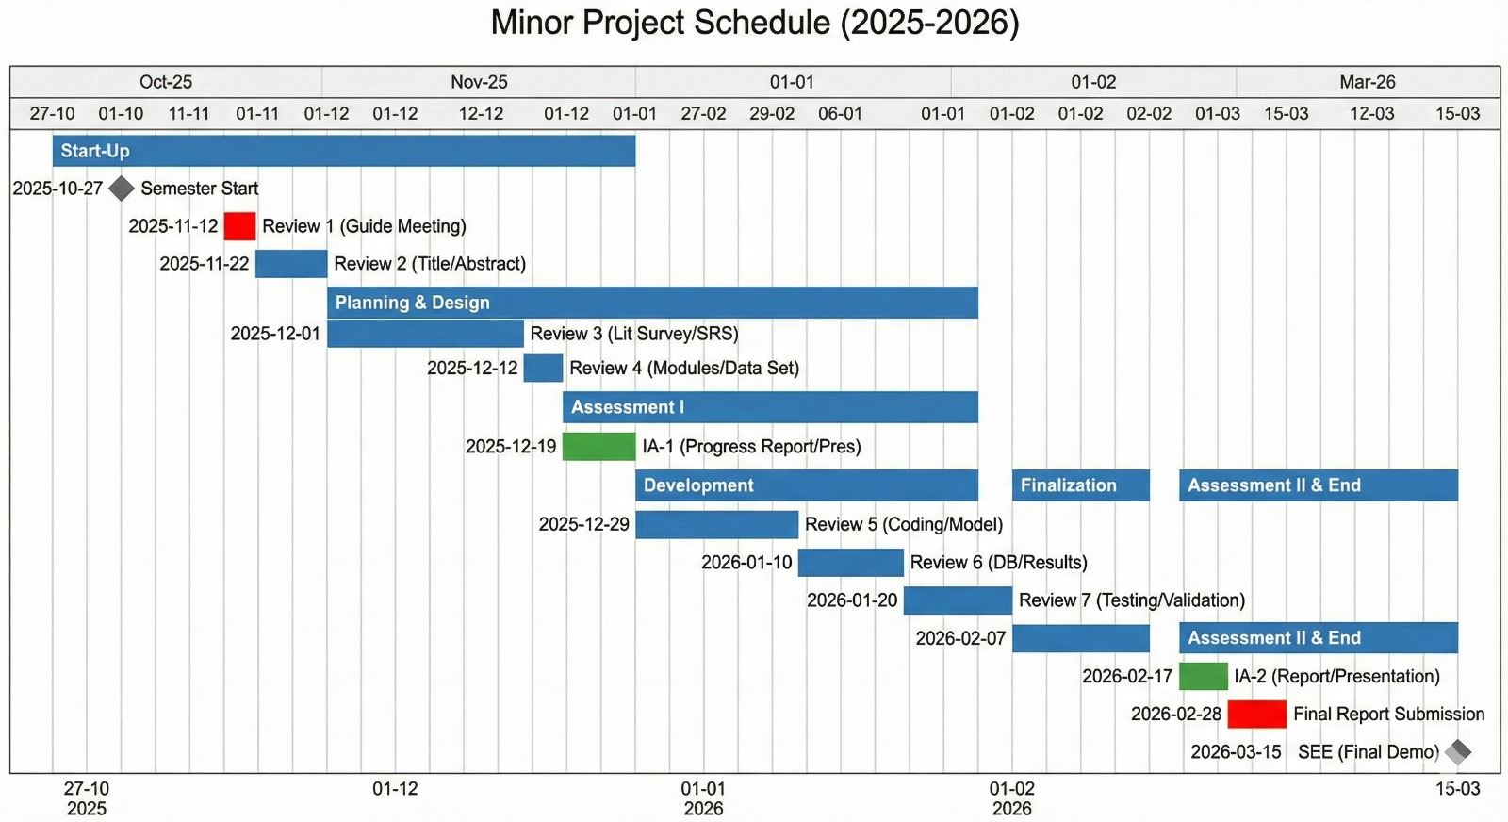
7. Gantt Chart
11

Slide 13
8. Conclusion
This project demonstrates a practical real-time semantic segmentation framework for understanding unstructured environments using the SegFormer transformer architecture. By leveraging global contextual modeling, the system overcomes limitations of traditional CNN-based approaches while remaining deployable on accessible hardware.
The integration of a Safety Logic Engine, along with intuitive HUD visualizations and modern MLOps tools such as Gradio and Weights & Biases, bridges the gap between raw perception and actionable insights. Overall, the work serves as a proof-of-concept that safety-aware, high-fidelity scene understanding can be achieved efficiently, supporting the broader adoption of autonomous and assistive perception technologies.
12

Slide 14
Thank You

