Slide 1
Github introduction
蓝天云 12211082

Slide 2
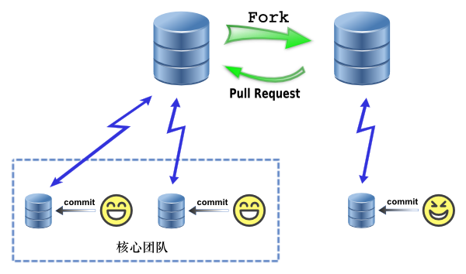

Slide 3
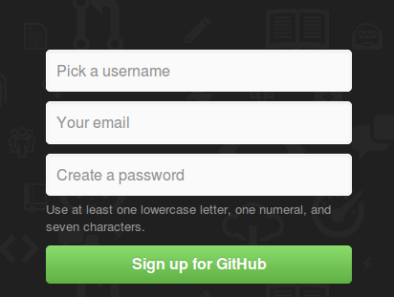
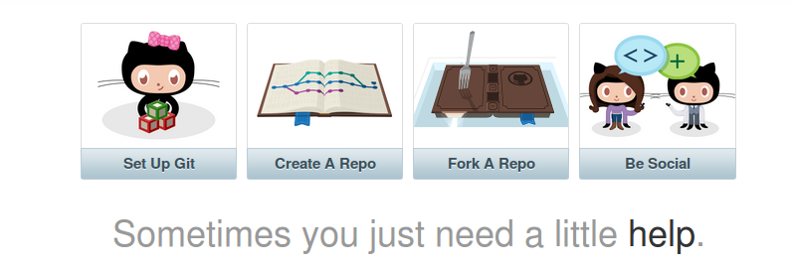

Slide 4
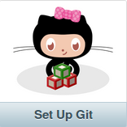

Slide 5
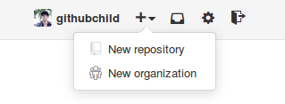
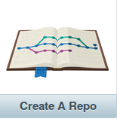
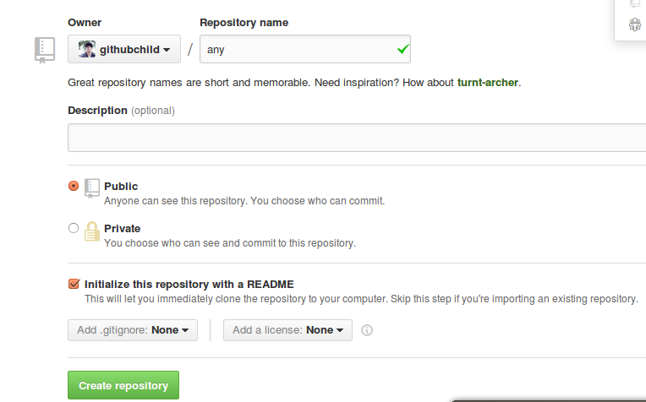

Slide 6
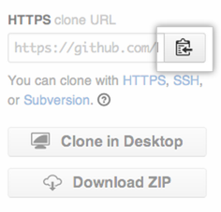
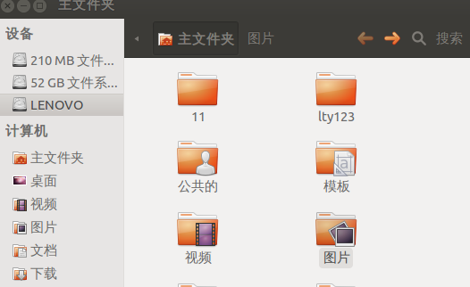
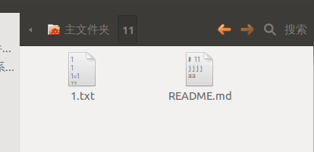
git clone (paste the URL you copied)
For example:
git clone https://github.com/githubchild/11.git

Slide 7
cd directory
git add README.md
git commit -m "first commit"
git push -u origin master

Slide 8
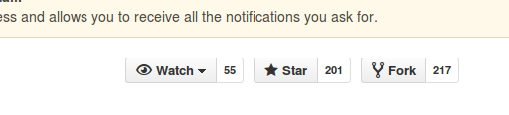
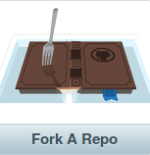
Clone
Rewrite
Commit

Slide 9

Pull request

Slide 10
Syncing a fork
git remote -v
git remote add upstream (paste the URL you copied)
git remote -v
git fetch upstream
git checkout master
git merge upstream/master

Slide 11
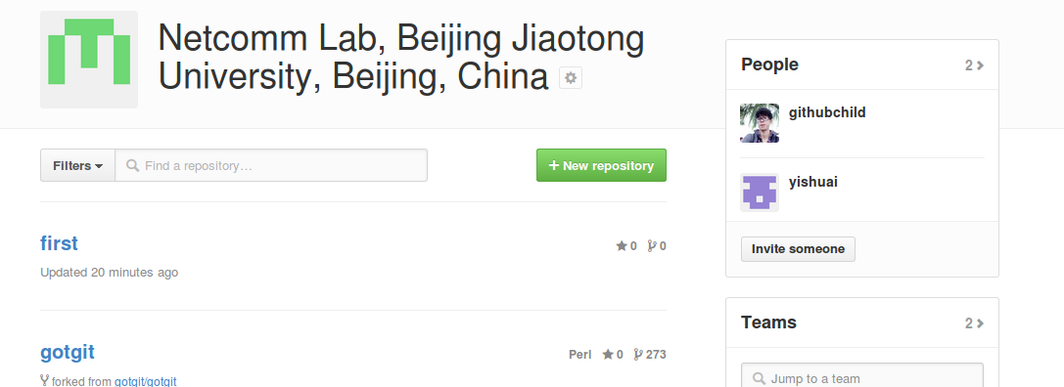
organizition

Slide 12
END

