Slide 1
Choosing a Jazz Venue in Manhattan
Where are the existing Venues?
What features do the neighborhoods share?

Slide 2
Data Acquisition
List of neighborhoods in Manhattan – taken from https://cocl.us/new_york_dataset
Population Density – taken from https://opendata.cityofnewyork.us/
Location of existing Jazz Clubs and other venues – taken from Foursquare API

Slide 3
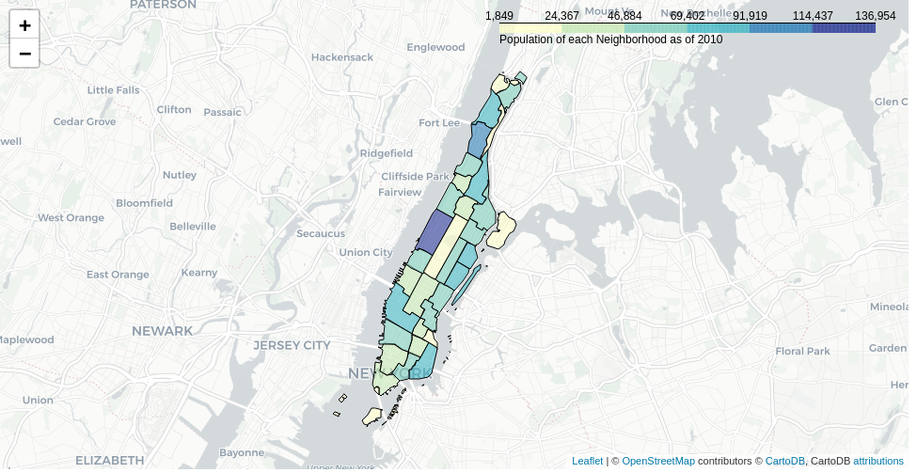
Population density

Slide 4
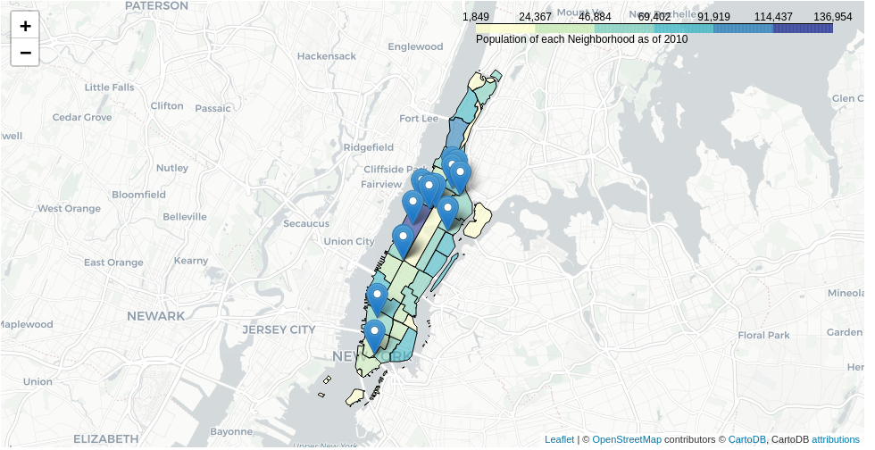
Jazz club locations
Similar population density for each of the Jazz Venues

Slide 5
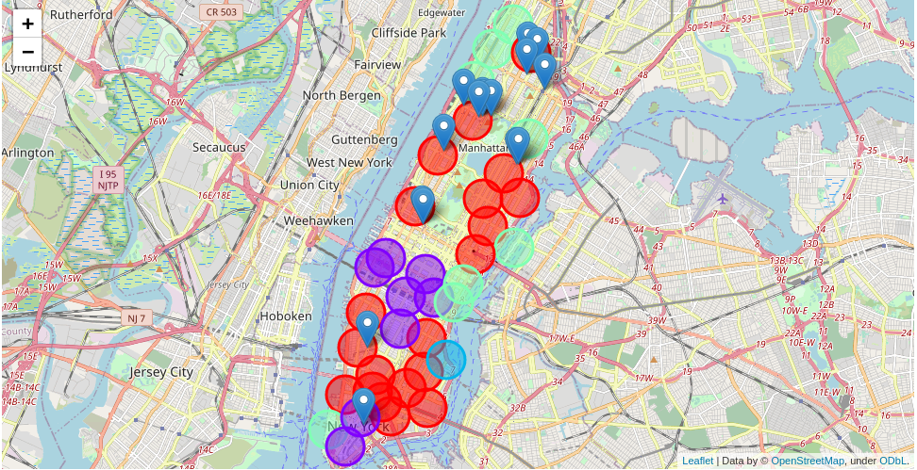
Jazz clubs with clustering
Cluster 0 = red
All the Jazz clubs are in
similar ‘red’ clusters

Slide 6
Results
Jazz clubs are univerally located in Cluster 0 neighborhoods
Eastern side of Manhatten has potential cluster 0 venues without a local jazz club, with similar population density

Slide 7
Conclusions
This is a good indicator of potential locations
The factors used here are not an exhaustive list
Future research should include more research into neighborhood ambience, traffic noise, public transport options, etc.

