Slide 1

CONNECT
A WEB APPLICATION TO CONNECT PEOPLE

Slide 2
CONNECT
"CONNECT" is an user-friendly web application
Efficient way for approaching people
Creates a link between people
Provides the best possible way to approach them online.
If given, can also provide their contact details

Slide 3
PROBLEM STATEMENT
Tedious and error-prone process to find the contacts of people and networking with others online reliably.
2

Slide 4
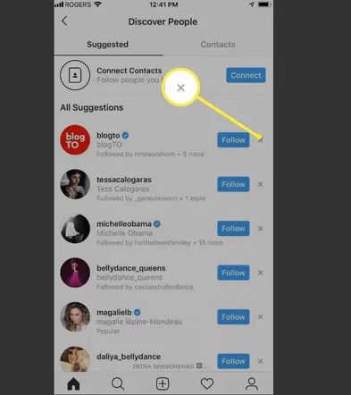
FEATURES OF INSTAGRAM
Shows mutual friend list we follow and vice versa
We can search for a particular person
Works within our friends circle
2

Slide 5
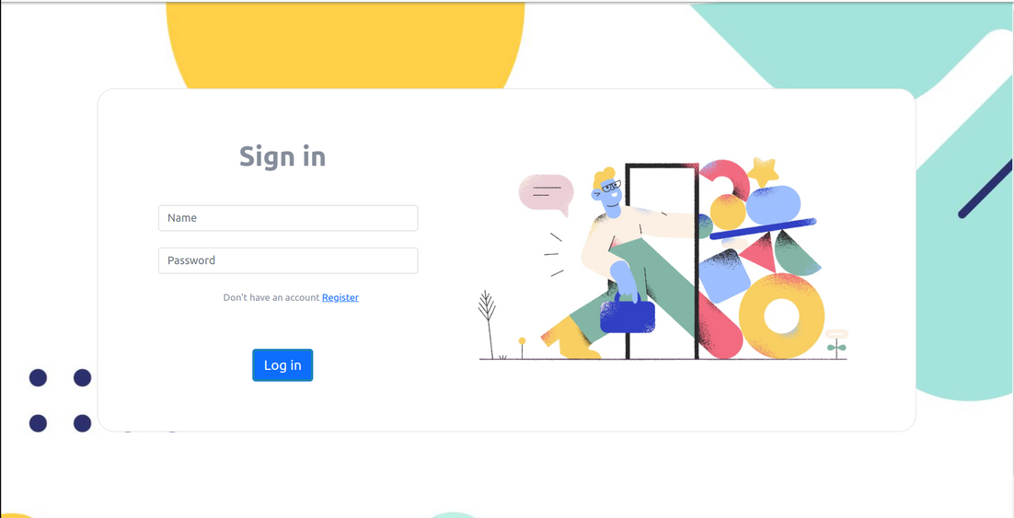
WHY CONNECT OVER INSTAGRAM
If the link between one person and the other is high, then CONNECT is more preferable than Instagram
Provides long paths in short time
2
Fig 1: Sign in page

Slide 6
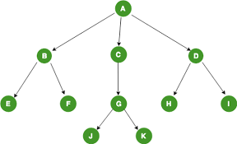
ADVANTAGES OF CONNECT
Exposes intermediary contacts that were hitherto unbeknownst to them.
Provisions for the user to choose from a variety of different valid paths.
2

Slide 7
THANK
YOU

