Slide 1


Helping people in
manufacturing visualize their production in real time.

Slide 2
Revenue model
SUBSCRIPTION
INTEGRATION SUPPORT
TEAMS
ALARMS
CHAT BOT INTERFACE
DATA STORAGE
FREEMIUM
WEB INTERFACE
TUTORIALS
API
© 2017-2022 Kartano Tech Oy, All Rights Reserved.

Slide 3
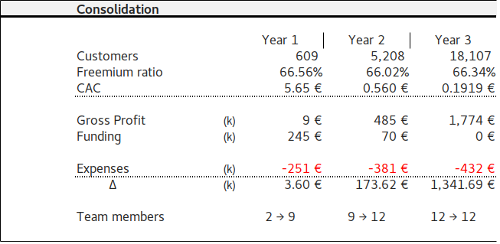
Financial numbers
© 2017-2022 Kartano Tech Oy, All Rights Reserved.

Slide 4
Critical Success Factors
#1 Efective customer onbording
People subscribing to the system using free subscription
#2 Customer conversion
A customer decide to go for a paid subscription and purchase our sensors
© 2017-2022 Kartano Tech Oy, All Rights Reserved.

Slide 5
Key Performance Indicators
#1 Customers
New customer subscriptions
Active customers
Sleeping customers
Lost customers
#2 Customer conversion
Customer subscribe paid version
Customer cancel subscription
#3 Production
Sales delivered
Open orders
Forecast
© 2017-2022 Kartano Tech Oy, All Rights Reserved.

Slide 6
ERP project Key Performance Indicators
#1 Training
Internal team training according plan
Training effectiveness
#2 Data conversion
Inserting data to ERP system vs original plan
Milestone GO LIVE
#3 Manual orders vs ERP orders
No manual order shall be issues after Go live
#4 weekly audit
Discrepancy level between ERP number and spot inventory count.
© 2017-2022 Kartano Tech Oy, All Rights Reserved.

Slide 7
kartano.33co.de
© 2017 Kartano Tech Oy, All Rights Reserved.

Slide 8

to help PEOPLE IN MANUFACTURING
visualize their production in real time
using
DATA COLLECTED
BY IoT SENSORS
© 2017 Kartano Tech Oy, All Rights Reserved.

