Slide 1


Helping people in
manufacturing visualize their production in real time.

Slide 2

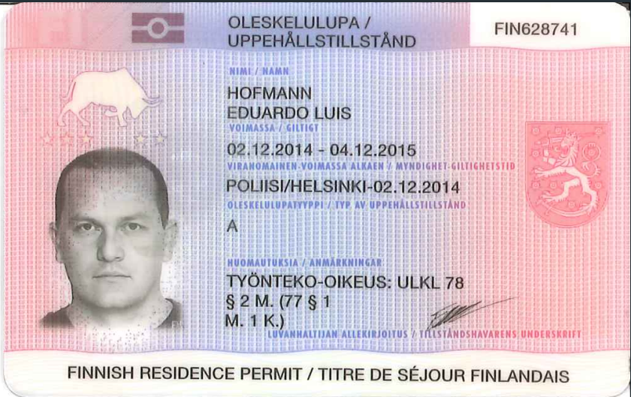
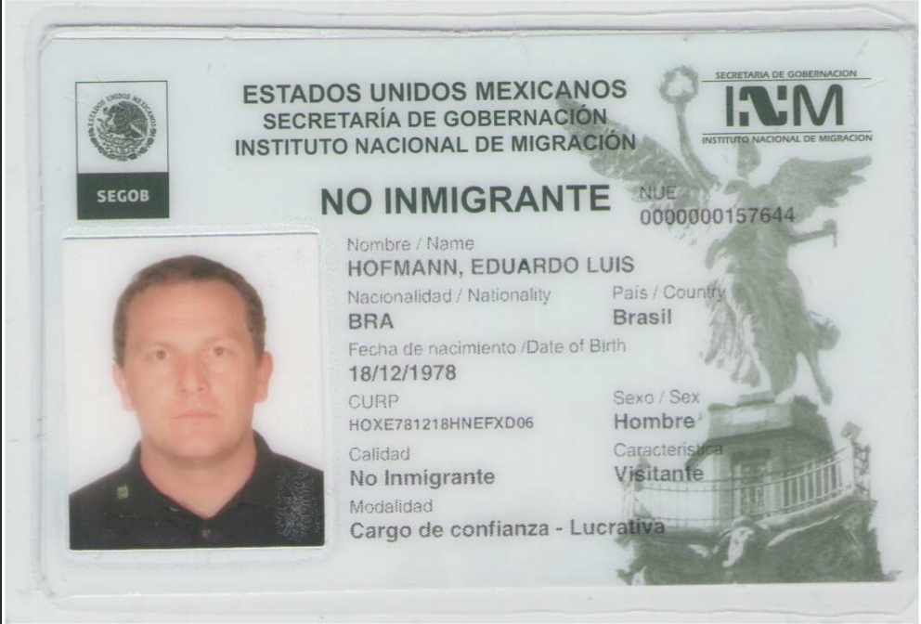
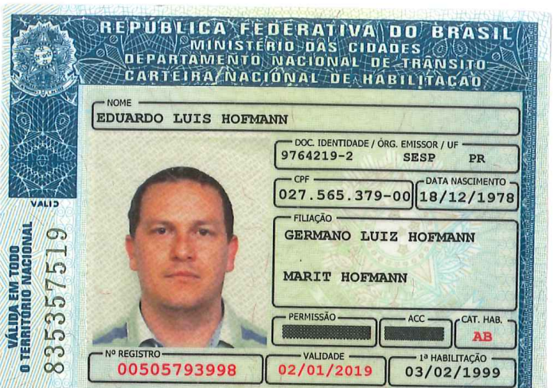
- myself
Eduardo Hofmann
CEO and Founder
Working in manufacturing since 1998.
Experience in Brazil, Mexico, Finland
and Worldwide Companies.
© 2017 Kartano Tech Oy, All Rights Reserved.

Slide 3

The problem that Kartano is solving is that:
People in manufacturing don’t have information about their most IMPORTANT machines
where the money is made
© 2017 Kartano Tech Oy, All Rights Reserved.

Slide 4


- market
Only in Europe, there are 2 millions SMEs in Manufacturing sector. These enterprises are out there producing every day good products using legacy machinery.
It’s important to bear in mind: They will not replace existing machinery only to be connected in a digital world.
However, these enterprises want to have the benefits of a connected world on their manufacturing shop-floor.
Manuf
2 mi
SMEs
22 millions SMEs in Europe
© 2017 Kartano Tech Oy, All Rights Reserved.
Notes:
The MARKET
It’s important to have in mind….
But these people want information
let’s make a comparison...after posting on facebook or linkedin….
People from manufacturing are hungry for information
They told me that they want to see from anywhere how things are moving

Slide 5
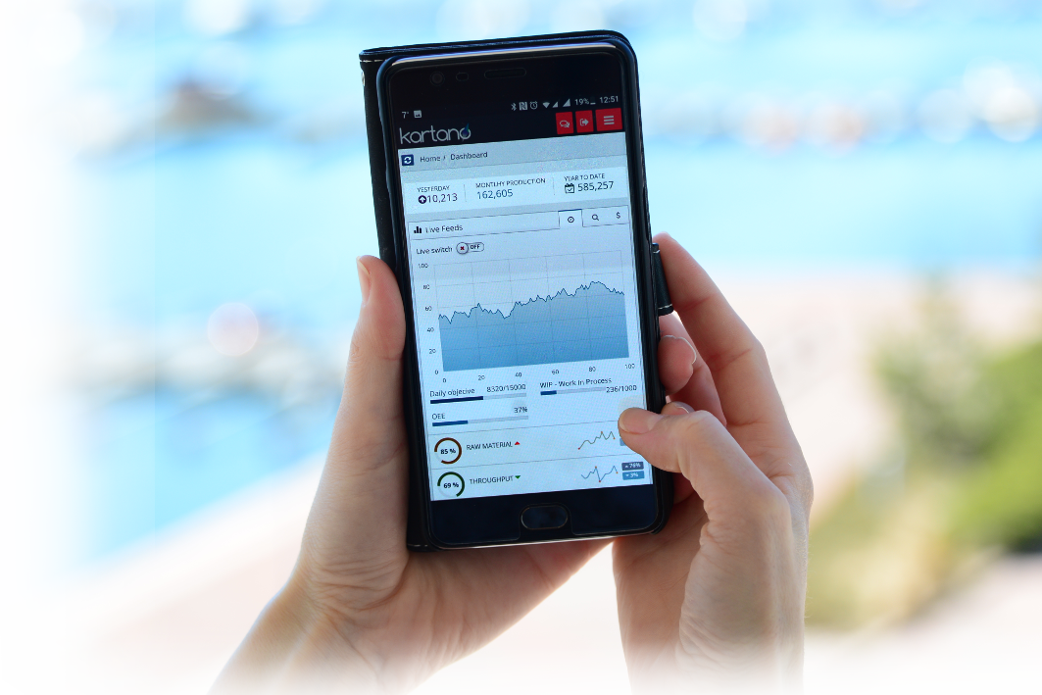

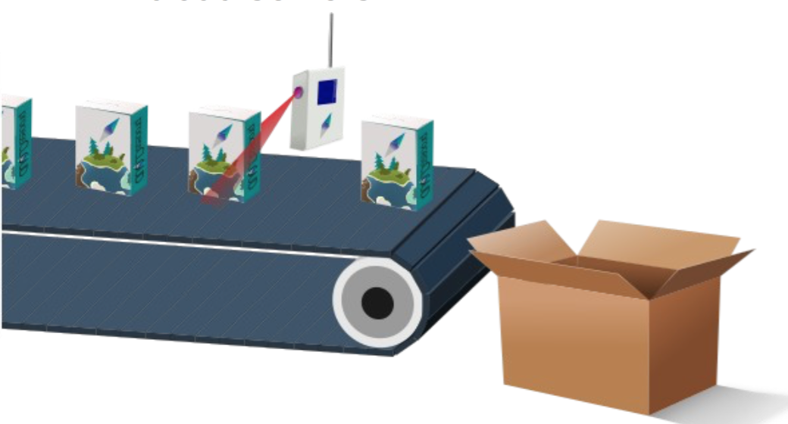
Multiples way to collect sensor data
3
KartanoUM, our IoT sensor, is connected to any kind of machine and allow several types of sensor for data collection.
The information is securely transmitted to Kartano Cloud, where the analytics on the big amount of data is performed.
Kartano users have the flexibility to visualize the analytics through mobile app or web-browser.
1
Multiples ways to read your data
© 2017 Kartano Tech Oy, All Rights Reserved.

Slide 6
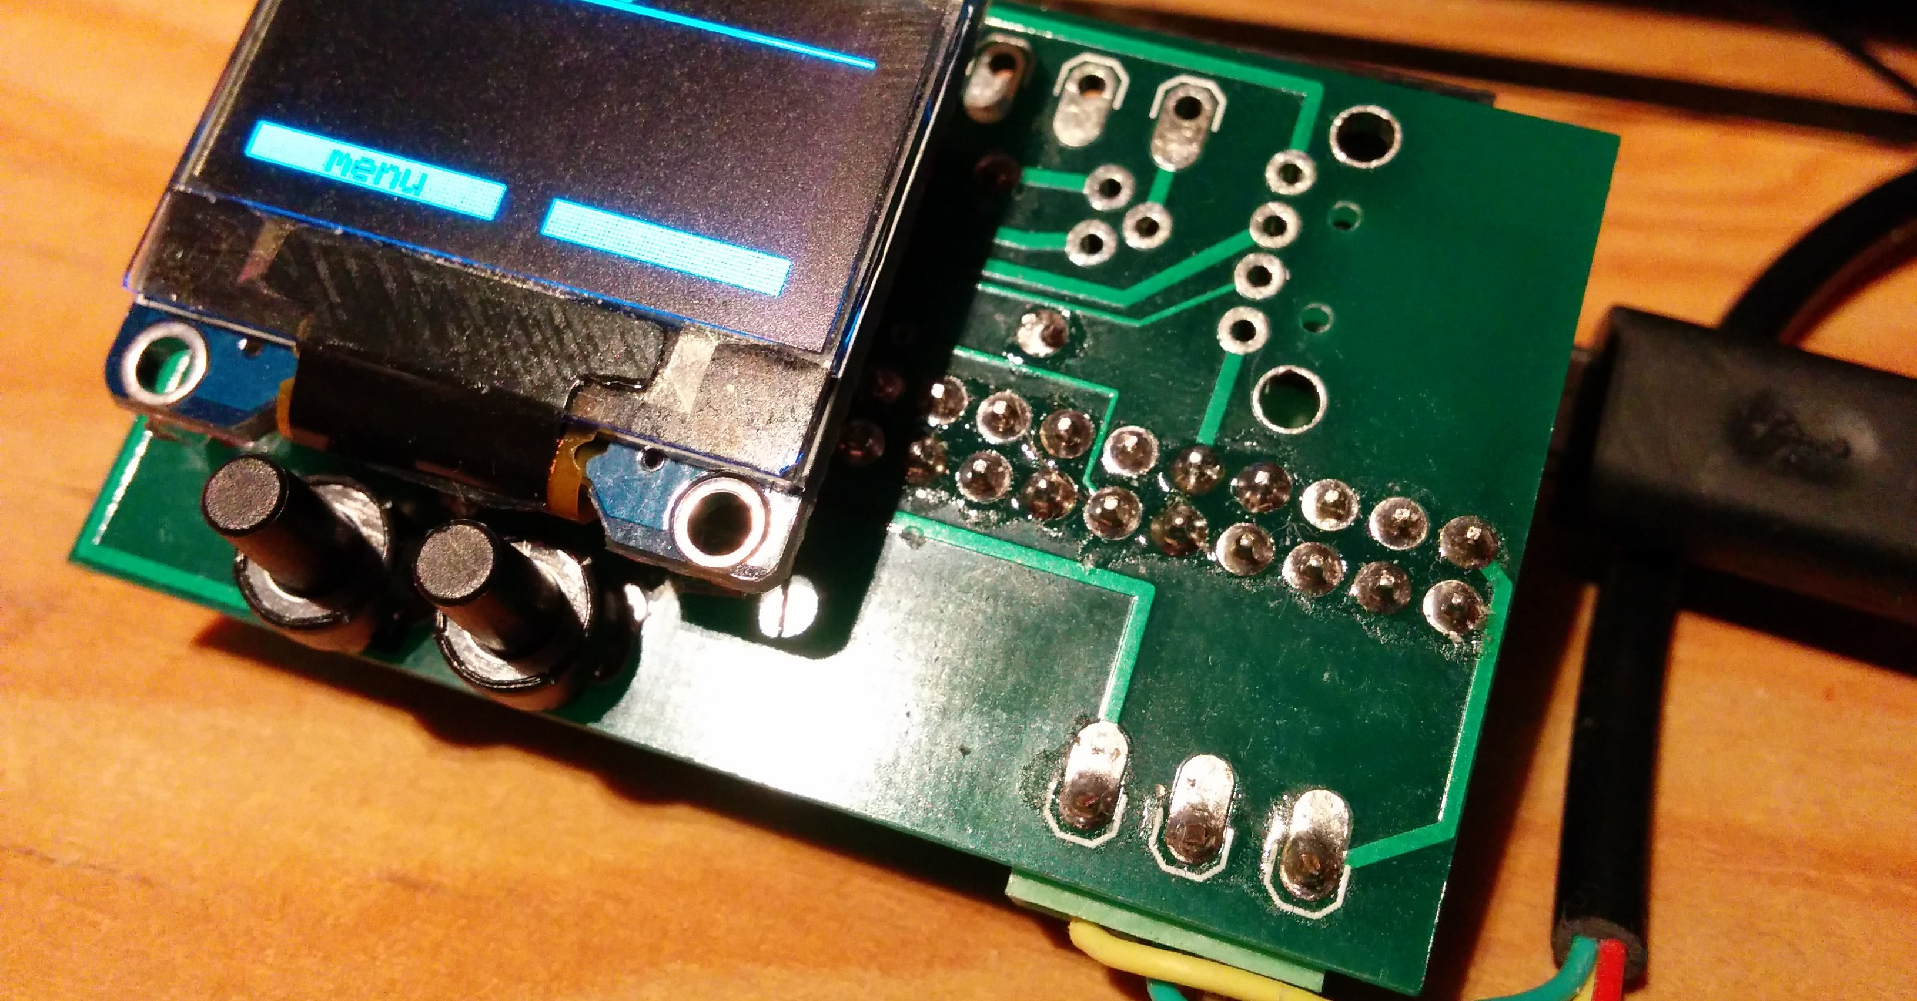

Kartano product
Kartano product use a wide range of sensors selection combined with the power and flexibility of cloud services presented in a web and mobile interface.
© 2017 Kartano Tech Oy, All Rights Reserved.

Slide 7
revenue model
SUBSCRIPTION
INTEGRATION SUPPORT
TEAMS
ALARMS
CHAT BOT INTERFACE
DATA STORAGE
FREEMIUM
WEB INTERFACE
TUTORIALS
API
© 2017 Kartano Tech Oy, All Rights Reserved.

Slide 8
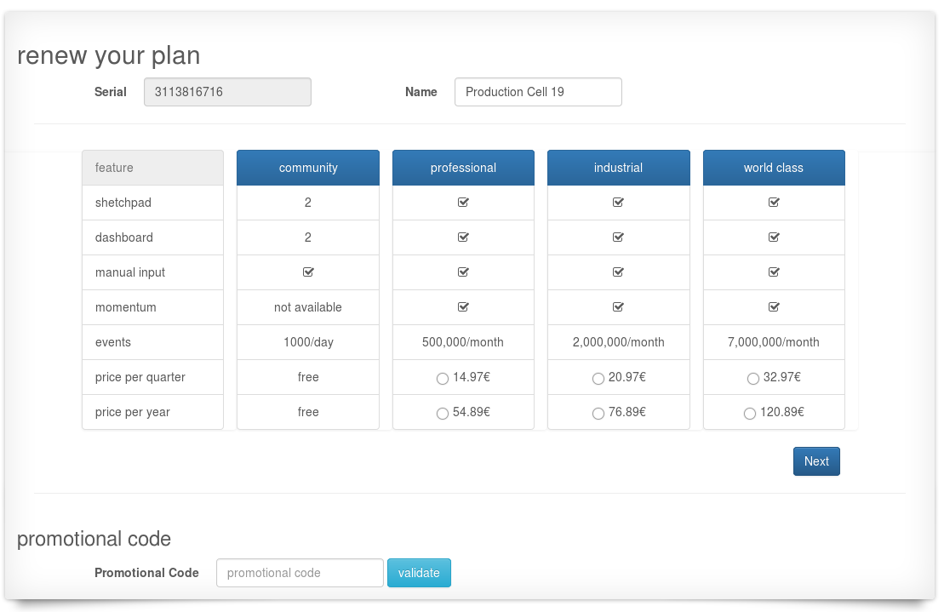
revenue model
© 2017 Kartano Tech Oy, All Rights Reserved.

Slide 9
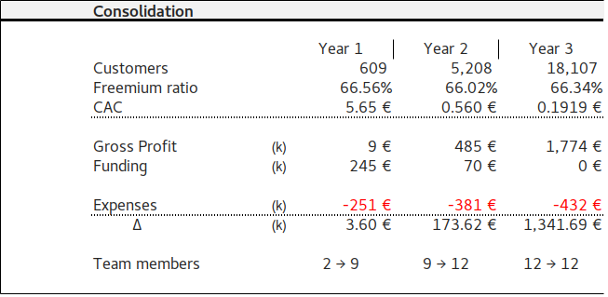
financial numbers
© 2017 Kartano Tech Oy, All Rights Reserved.

Slide 10













competitors
Affordable cost
AWS IoT
Easy integration
Erp’s systems
© 2017 Kartano Tech Oy, All Rights Reserved.

Slide 11
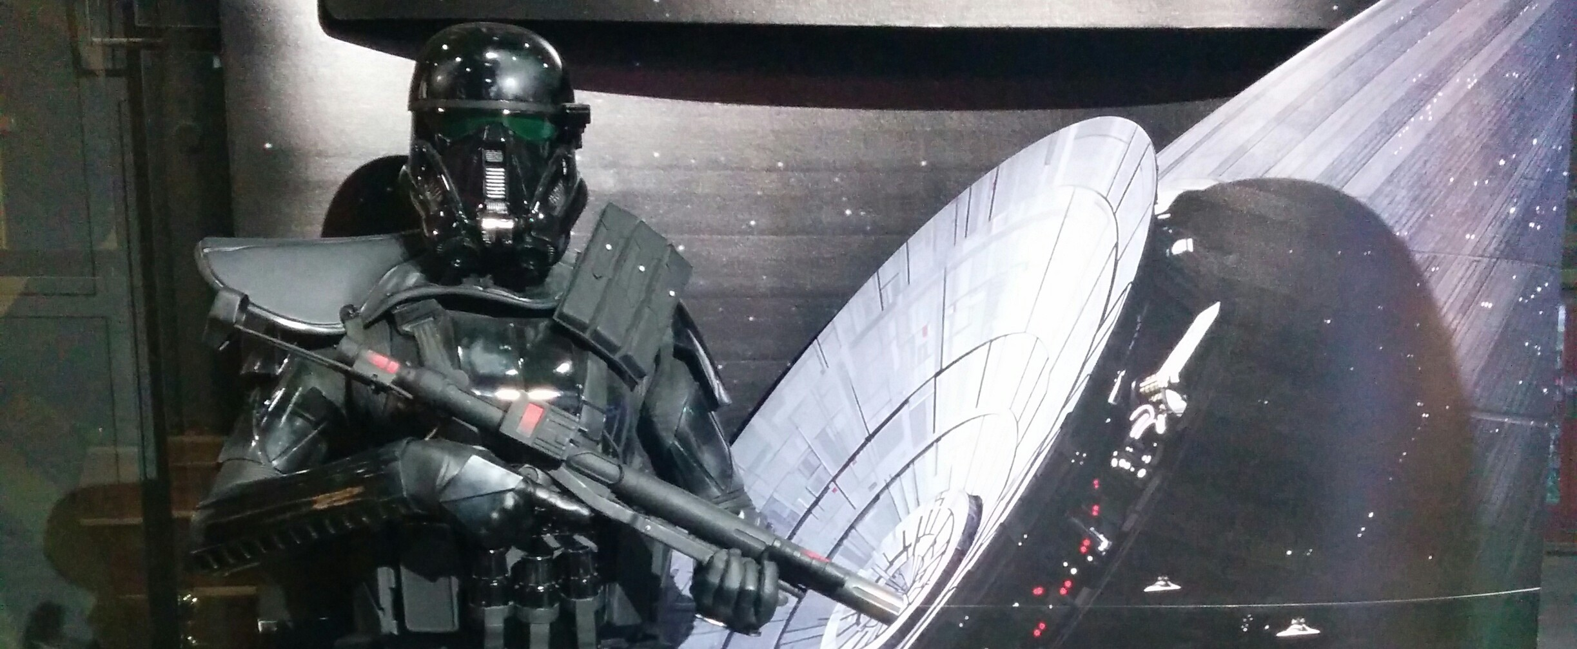

Sensor and cloud
crowfunding
On Indiegogo
Community
Features +
Innovation
Next steps...
© 2017 Kartano Tech Oy, All Rights Reserved.

Slide 12
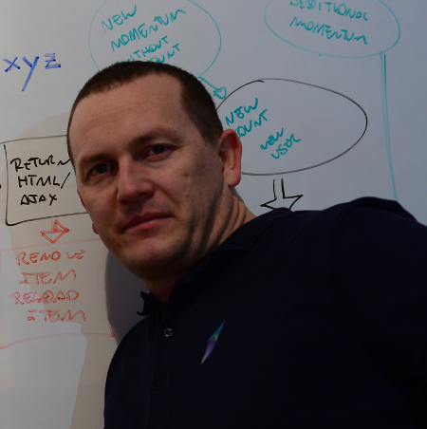




team
Eduardo Luis Hofmann
Founder
Jukka
Software Engineer
To be hired
Marketing and Social Media
Logistics
Customer care
Developer I
Developer II
Hardware Engineer
Technical support
Sales Exec 1
Sales Exec 2
Sales Exec 3
Carlos
Advisor
Strategy and Coaching
© 2017 Kartano Tech Oy, All Rights Reserved.

Slide 13
kartano.33co.de
© 2017 Kartano Tech Oy, All Rights Reserved.

Slide 14

to help PEOPLE IN MANUFACTURING
visualize their production in real time
using
DATA COLLECTED
BY IoT SENSORS
© 2017 Kartano Tech Oy, All Rights Reserved.

