Slide 1
1
The order: triage tickets like an experienced L2 agent
Swiss Life challenge at the Swiss {ai} Weeks: an AI support agent for operational service desks
SEVEN FIELDS TO GET RIGHT, PER TICKET
The problem
Work type
Affected service
Manual triage eats time.
Answers to similar tickets get rewritten again and again, and the documentation is scattered.
Quality and speed depend on the single analyst.
1
2
Incident or Service Request, despite misleading titles
the real one, not the supplied value
Service team(s)
Assignee
3
4
the team that owns the service
the actual routing person
Priority
Resolution status
What we get
5
6
must match urgency × impact (matrix)
done, cancelled, clarification, cannot reproduce
20,000
Resolution comment
Human stays in control
every suggestion is reviewed before it counts
historical tickets, deliberately noisy
7
concrete, plausible, in the assignee's voice
20
new tickets, fields partly empty or wrong, scored blind
Demo metrics classification accuracy · draft acceptance rate · time to resolution
TicketTriage · Swiss {ai} Weeks · Challenge brief (docs/requirements.md)
Notes:
The order from Swiss Life: service desks lose a lot of time with manual triage, searching scattered documentation and rewriting similar answers, and quality depends on the individual analyst. We get 20,000 historical tickets that are deliberately noisy, and 20 new tickets with fields that are partly empty or wrong. For each new ticket we must get seven fields right: work type, affected service, service team, assignee, priority (which must be consistent with urgency and impact), resolution status and a concrete resolution comment in the assignee's voice. The human stays in control. Swiss Life will look at classification accuracy, the draft acceptance rate (how many suggestions are approved unchanged) and the time to resolution.

Slide 2
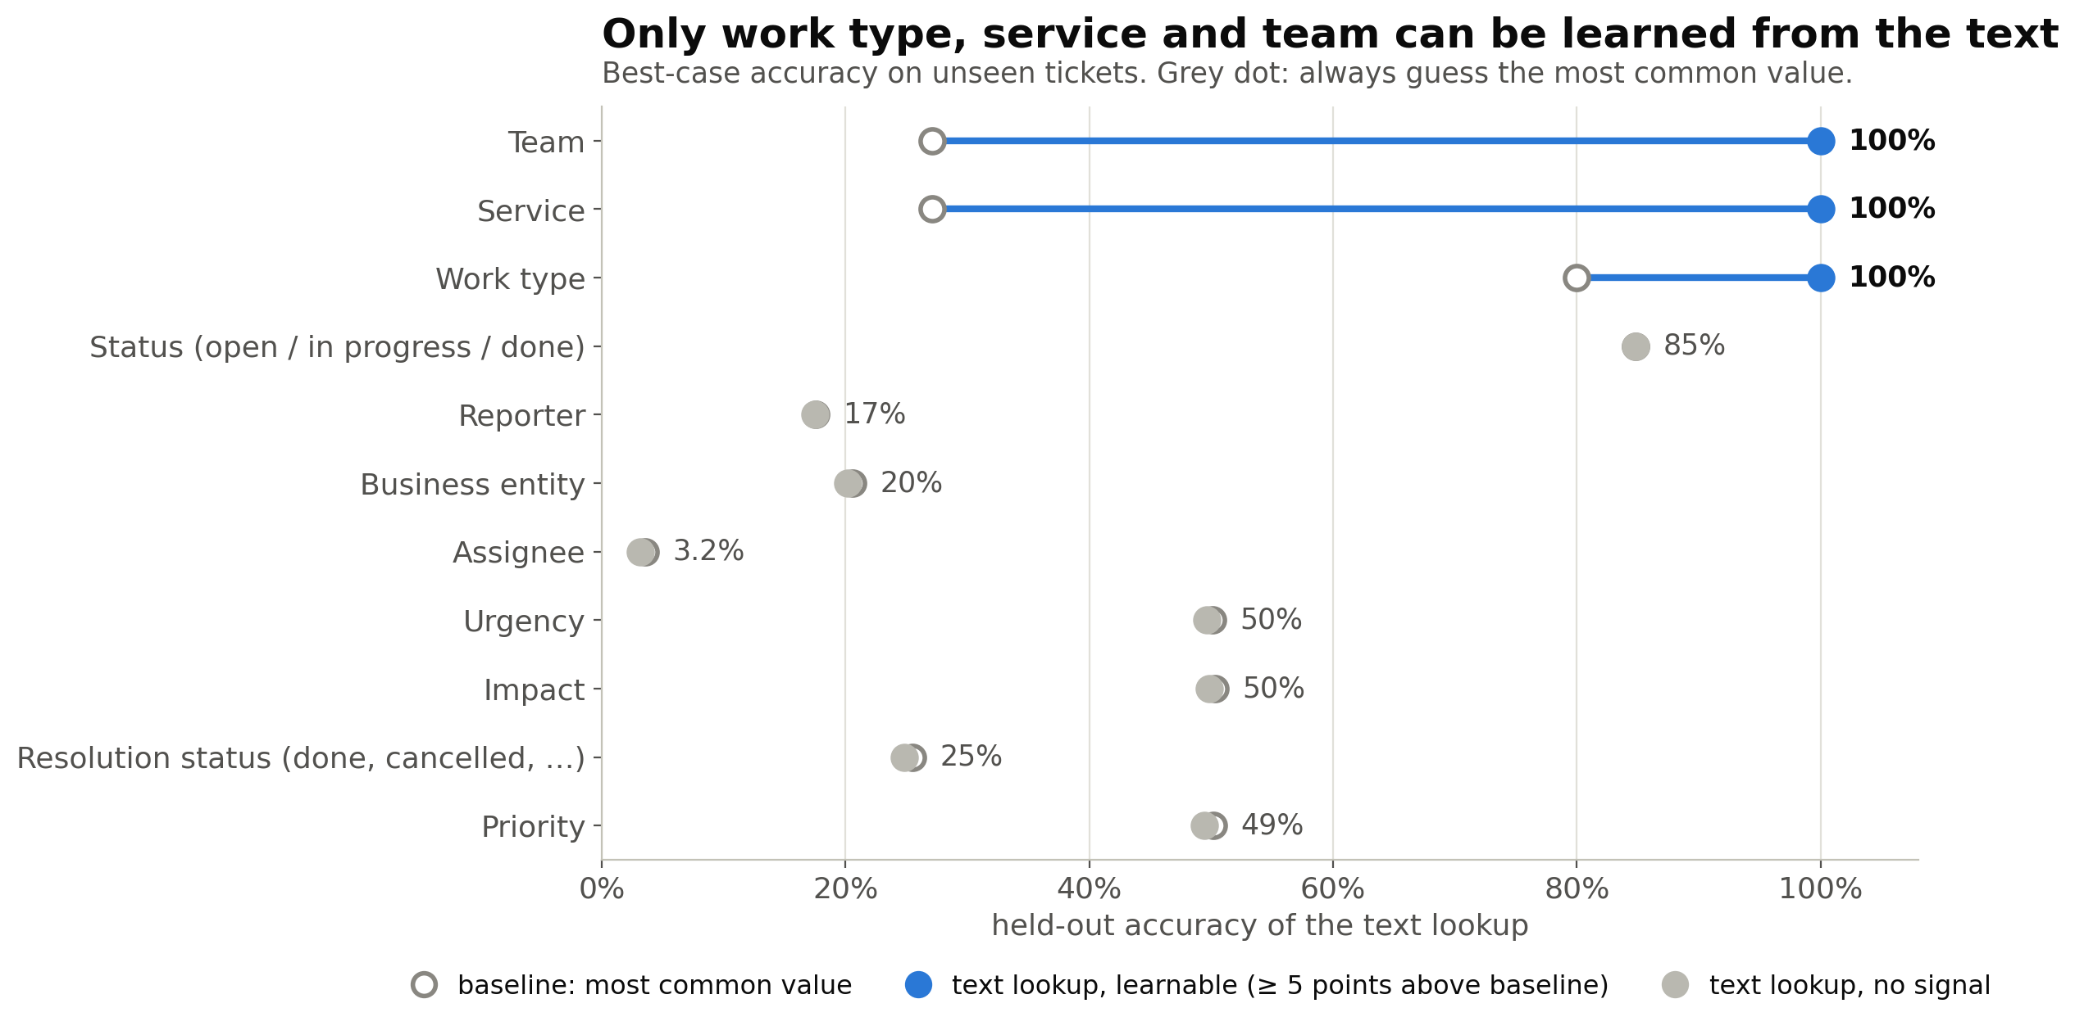
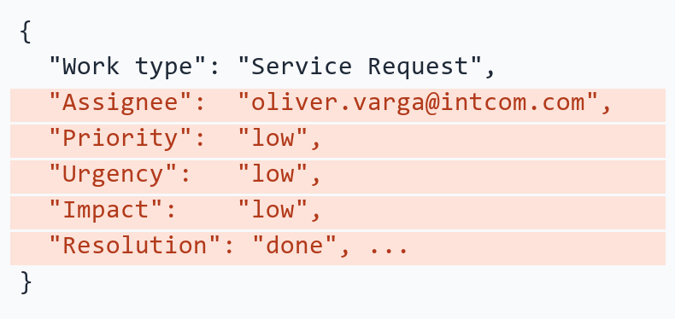
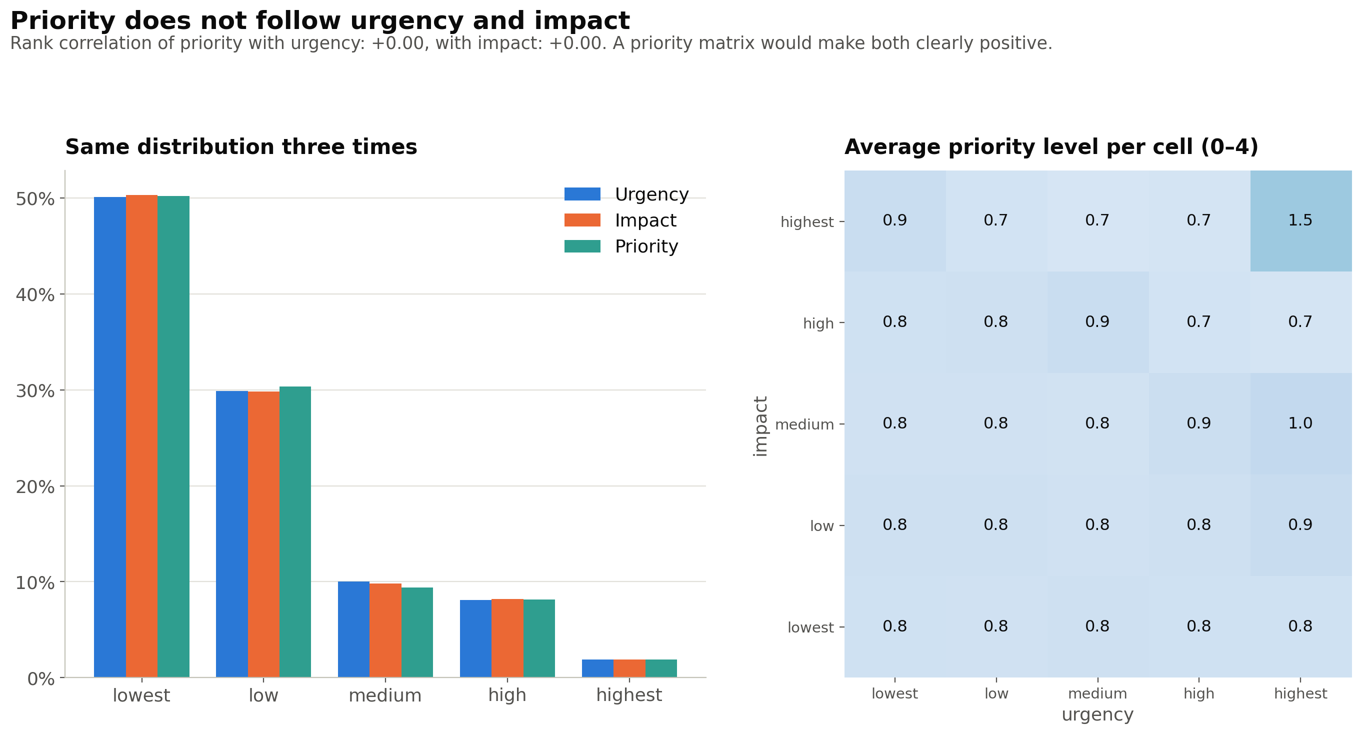
2
The data: 20,000 tickets, almost no signal
What the training export can and cannot teach a model
173
distinct texts in 20,000 tickets: 11 templates × 20 services. The work type follows from the template.
Random
priority, urgency, impact, resolution status and assignee. Accuracy on unseen tickets equals guessing.
3.6 %
best accuracy for the assignee out of 30 people, over every field and model (chance: 3.3 %).
Evidence
Left: a raw ticket, the random fields are marked. Right: priority against urgency and impact, flat.
So the history is only good for retrieval and service → team.
TicketTriage · Swiss {ai} Weeks · Data analysis (Notebooks/ticket_data_analysis.ipynb)
Notes:
The training export looks big (20,000 tickets) but is 11 text templates with 20 service names filled in: 173 distinct texts. Work type, service and team can be read off the text, so those are easy. Priority, urgency, impact, resolution status and assignee are random: the text lookup, a logistic regression on every field, even the ordering of tickets do not beat the most-common-value baseline (assignee 3.6 % against 3.3 % chance for 30 people; a shuffled-label control scores the same). Priority does not follow urgency and impact (rank correlation 0.00). Consequence: we do not train on this data. It serves as a retrieval index for similar tickets and as the service to team table.

Slide 3
3
Architecture: ingest, analyse in the background, review
Tickets are analysed ahead of time; opening a ticket never calls the LLM
SYSTEM FLOW
Jira export
Ingest
Analysis worker
Triage pipeline
Review UI
result.json
Upload page or Batch
saves tickets as New
claims New tickets (lease)
one ticket at a time
Blazor: approve, edit, reject
exported from stored suggestions
SQLite (triage-db): tickets, suggestions, reviews, failure log
TRIAGE PIPELINE, PER TICKET
Code decides
LLM decides
1 Retrieve
2 Classify
3 Route
4 Prioritize
5 Draft
6 Validate
similar tickets: TF-IDF kNN over the history
work type, service, urgency, impact (structured output)
team by statistics, assignee = fewest tickets
PriorityMatrix(urgency, impact)
resolution status and comment
all 7 fields, retry, fallback, failure log
LAYERS: DEPENDENCIES ONLY POINT INWARD
Core
Infrastructure
Agents
Web · Batch
domain and pipeline ports, no references
SQLite, pipeline, retrieval, routing
LLM classifier and drafter (Agent Framework)
Blazor UI and challenge export
TicketTriage · Swiss {ai} Weeks · Architecture (docs/architecture.md, ADR-0001, ADR-0002)
Notes:
Tickets enter through the Upload page or Batch, are saved as New, and a background worker in the Web app claims them and runs the pipeline one ticket at a time. The suggestions are stored in SQLite, so opening a ticket in the UI is instant and never calls the LLM. The analyst approves, edits or rejects; the result file is exported from the stored suggestions. The pipeline has six steps. Blue steps are decided by code: retrieval, routing (team by statistics, assignee by workload), the priority matrix and the validation. Amber steps use the LLM: classification and the resolution draft. The LLM never invents team or assignee names, and priority is never model output. Retries, a timeout and a deterministic fallback mean a ticket always gets a suggestion. The code is layered so that Core knows nothing about the rest; Web and Batch sit on top.

Slide 4
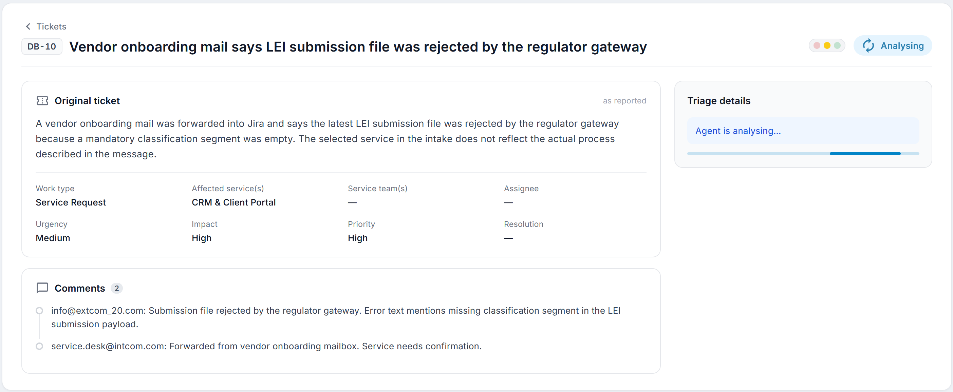
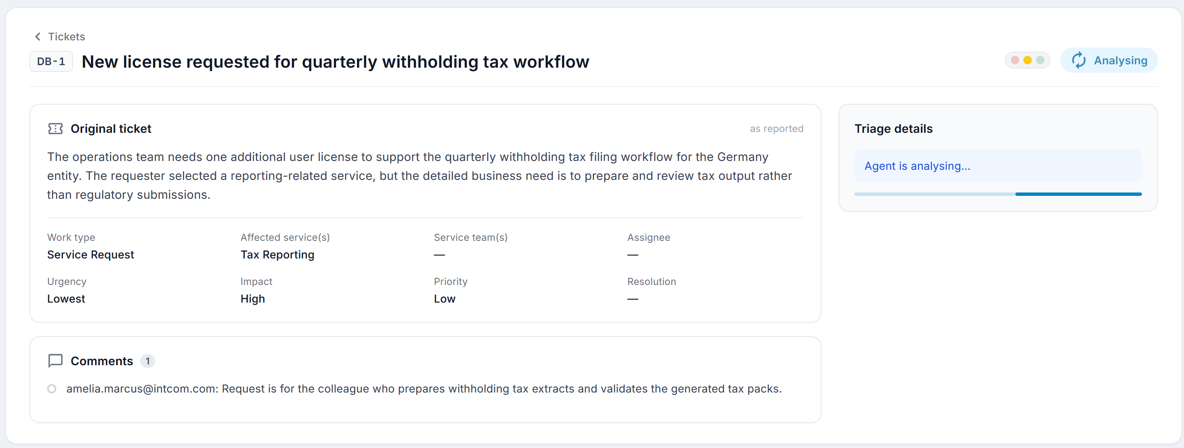
4
Solution: code decides, LLM reads, analyst approves
Every field has exactly one owner, and every suggestion is reviewed by a person
Field | Decided by | How
Work type | LLM | structured output, checked against the vocabulary
Affected service | LLM | picked from the 20 real service names
Service team | Code | majority vote per service (100 % deterministic)
Assignee | Code | person with the fewest tickets (even workload)
Priority | Code | PriorityMatrix(urgency, impact)
Urgency, impact | LLM | judged from the ticket text, never from the history
Status and comment | LLM | drafted from the text and similar tickets
Safety net
Human in the loop
Untrusted text
3 retries, 60 s timeout, deterministic fallback and a failure log per ticket.
Approve, edit or reject. Every edit is stored per field.
Ticket text only in the user message, never in instructions.
TicketTriage · Swiss {ai} Weeks · Pipeline (docs/features/triage-pipeline, web-triage-ui)
Notes:
Design rule: every output field has exactly one owner. Code owns everything it can decide reliably: team from the service (100 % deterministic in the data), priority from the matrix, assignee by workload. The LLM owns only what needs reading the text: work type, service, urgency, impact and the resolution draft. Because the history is noise for priority, urgency, impact, status and assignee, the LLM judges from the ticket text and never copies values from similar tickets. The assignee is spread evenly: the person with the fewest tickets so far, since no rule beats chance. Screenshots of the review page and the ticket list / upload page go into the two placeholders on the right.

Slide 5
5
Tech stack and setup
Modern .NET, one command to run everything, documented decisions
Runtime and UI
Orchestration
Data
.NET 10 (LTS), C# 14, nullable, warnings as errors. Blazor Web App with interactive server rendering and MudBlazor.
.NET Aspire 13: the AppHost starts SQLite, Web and Batch, injects the LLM secrets and gives one dashboard with logs, traces and health.
SQLite with EF Core 10, in-memory TF-IDF retrieval, central package management. Schema created on startup, training file imported once.
.NET 10
Blazor
MudBlazor
Aspire 13
OpenTelemetry
Logs
SQLite
EF Core 10
TF-IDF
AI
Quality
Documentation and workflow
Microsoft Agent Framework 1.x on Microsoft.Extensions.AI. Switch between Azure OpenAI, OpenAI, Apertus (Swisscom) and local Ollama by config.
xUnit v3 with about 580 tests on Microsoft.Testing.Platform, fake chat client for the agents, OpenTelemetry, health checks and resilience.
requirements, architecture, ADRs and a README per feature. Built with Claude Code: CLAUDE.md, skills, review agents, hooks.
Agent Framework
Apertus
Ollama
xUnit v3
580 tests
Analyzers
ADRs
CLAUDE.md
Skills & agents
Setup dotnet tool restore → set the LLM secrets (user-secrets) → aspire run → start Batch from the dashboard
TicketTriage · Swiss {ai} Weeks · Stack and workflow (README.md, CLAUDE.md)
Notes:
Stack: .NET 10 with a Blazor Server UI, Aspire as the orchestrator, SQLite with EF Core, and the Microsoft Agent Framework on Microsoft.Extensions.AI. The LLM provider is a configuration switch, so we can run on Azure OpenAI, OpenAI, Apertus or a local Ollama without code changes. Aspire starts everything and provides the dashboard with traces and logs, and it keeps the API keys in user secrets, never in code. Quality: about 580 automated tests, warnings are errors, central package management. Documentation is part of the work: requirements, architecture with diagrams, ADRs for the key decisions and a README per feature. We built the project with Claude Code: a CLAUDE.md with the rules, skills for the stack, review and test agents, and hooks that protect secrets and format code.

