Slide 1

AI Chatbot for Language Learning
Submitted by
Bhupender Chauhan (2022PGCSCA046)
Under the Supervision of
Dr. Amit Majumder

Slide 2
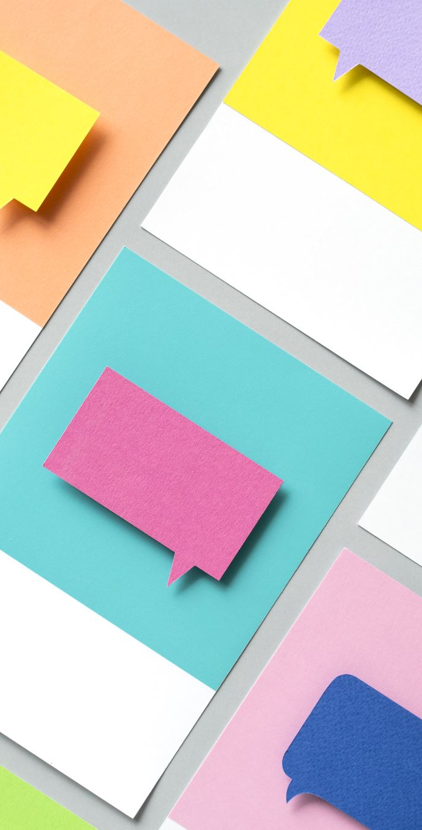
Project Overview
- Developed an AI chatbot for language learning.
- Integrated ChatGPT APIs to provide conversational responses.
- Supports both text-based and voice-based interactions.
- Enhances language skills through interactive practice.

Slide 3

Technologies Used
- Frontend: HTML,CSS
- Backend: Node.js & Express.js
- API: OpenAI's ChatGPT API
- Speech Processing: Web Speech API
- UI Framework: Tailwind CSS

Slide 4
Features Implemented
- Real-time AI chatbot interaction
- Text and speech-based input
- Dynamic response generation
- Customizable user experience (dark mode, UI tweaks, Various languages)

Slide 5

Speech Recognition & Text-to-Speech
- Used Web Speech API for voice input.
- Text-to-Speech for chatbot responses.
- Improved accessibility for users preferring voice interaction.
- Enhanced engagement through natural conversations.

Slide 6

Dark Mode & UI Enhancements
- Implemented dark mode for better user experience.
- Used Tailwind CSS for responsive and modern UI.
- Ensured accessibility features for all users.
- Smooth animations and transitions for a polished feel.

Slide 7
Challenges & Solutions
- API response latency: Used caching strategies.
- Handling multiple languages: Extended API queries.
- UI/UX responsiveness: Optimized layout with Tailwind.

Slide 8
Conclusion
- Successfully built an AI-driven chatbot for language learning.
- Integrated advanced speech and text interaction.
- Improved accessibility and user experience.
- Future improvements: More languages, better NLP.

