Slide 1
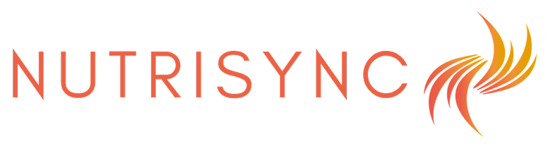
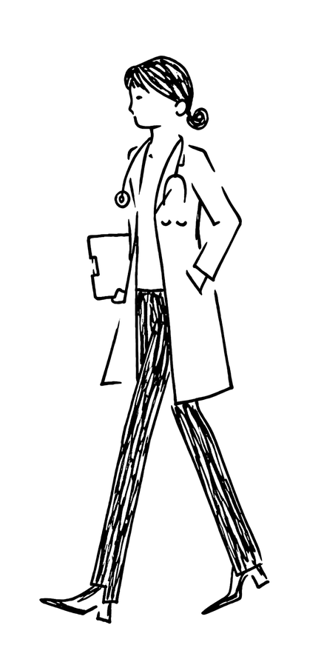
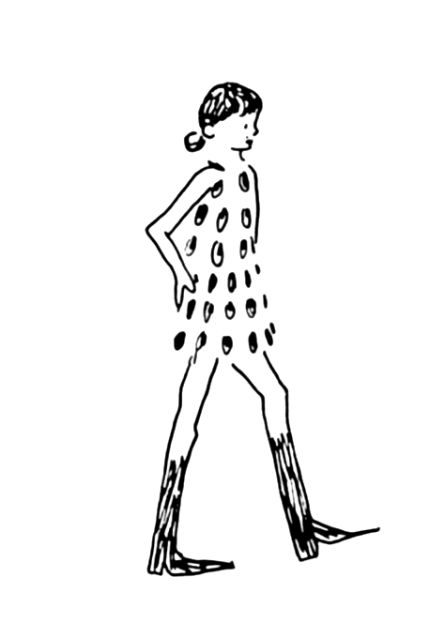




nutrisynccollective.com
contact@nutrisynccollective.com
Adaptive nutrition, movement and recovery guidance that learns across cycles
Pilar Gonzalez
Lucia Cebrian
Maria Paula Garzon

Slide 2


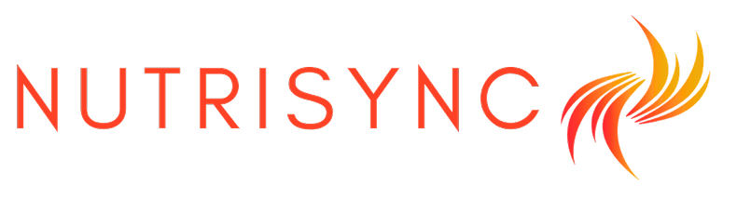

Aligned with Global Priorities (SDGs) in Health & Equality
Preventative & personalized nutrition aligned
with hormones
Closing the women’s health data gap through real world data
Notes:
Most nutrition and fitness guidance is built on male-normed data; large-scale research on how nutrition/movement affects individual women across their cycle barely exists

Slide 3
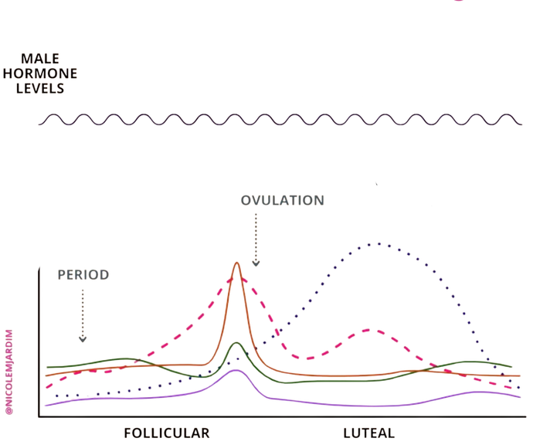
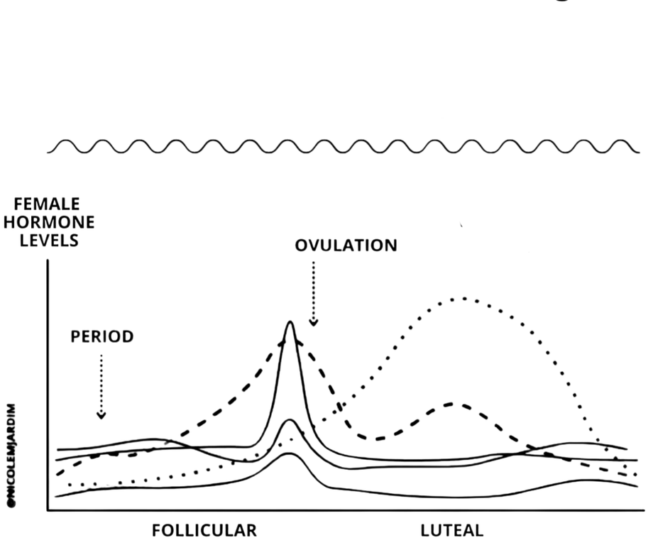


Different Biology Same Nutrition
Nutrition guidance is built on population averages that miss individual cycle variability, cycle length, symptoms, and hormonal response differ significantly from person to person
The ‘one size fits all diet’...
Does not take this into account.
Male Hormonal pattern 28 days
Female Hormonal pattern ~28 days
(Source: FemTech Analytics, 2023)

Slide 4
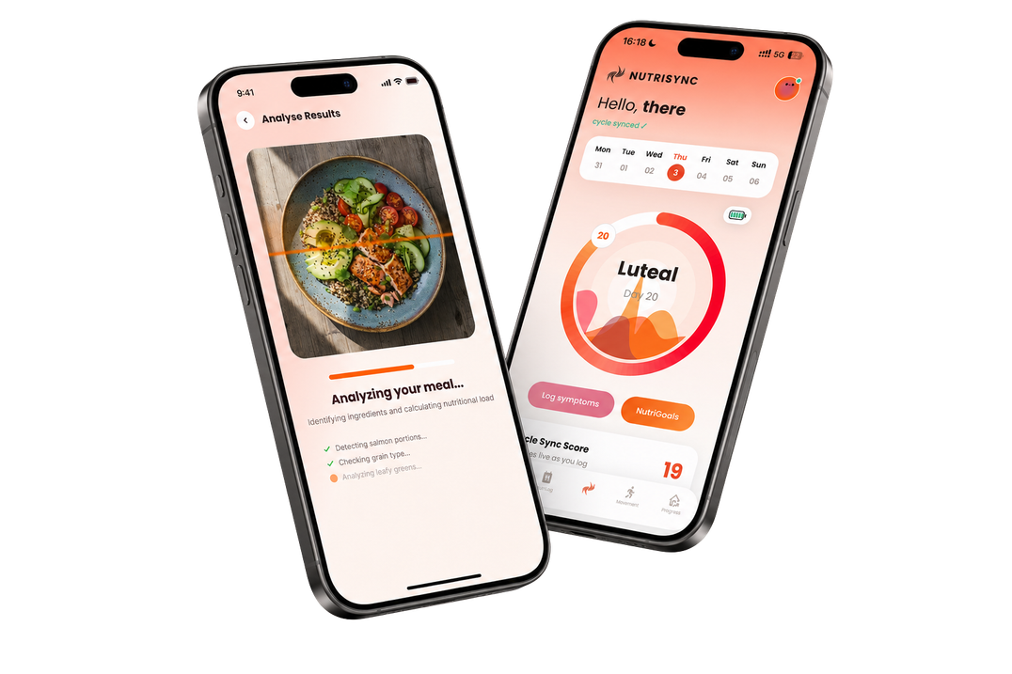






NutriSync The Adaptive Cycle Intelligence
Sense
Interpret
Recommend
Learn
Cycle context, symptoms,
nutrition/movement logs,
biometrics
Builds this person’s own baseline - not a population average
Daily Nutrition and Movement guidance for this specific person
Measures whether it worked, recalibrates for the next cycle
recalibrates every cycle, not just once
TWO OUTPUTS, UPDATED EVERY CYCLE
Cycle
Aligment
Score
Cycle
Stability
Score
Personalized Adaption
Grounded in physiological research on hormone linked variation
Privacy by Design
Do today’s actions fit
this person’s context?
Are outcomes getting more predictable over cycles?
Phase is context. Individual Response is the intelligence.
NUTRISYNC
Notes:
Competitors personalize content around a cycle. NutriSync is designed to learn which actions
produce better outcomes for each individual across cycles.
NutriSync combines cycle context with the user’s symptoms, behaviours and biometric patterns. Recommendations adapt as the system learns the individual

Slide 5
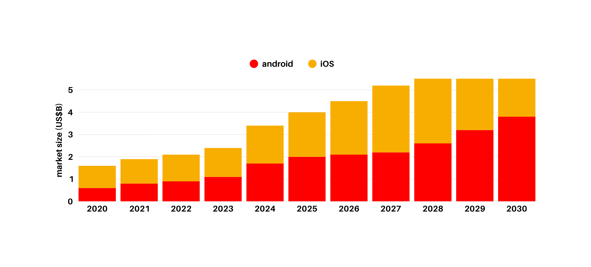
Menstrual Health Apps Market
Menstrual health apps market ≠ NutriSync's addressable market
CAGR: 18%
By 2033: $7.7Bn
Sources: (Grand View Reaserch, June 2026)
Notes:
We compete in a narrower adaptive-personalization slice of this, not the whole category.

Slide 6



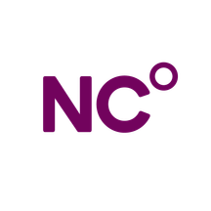





The NutriSync Difference
GENERIC APPS
ADDITIONAL CONTENT
SCIENTIFIC &
CLINICAL BASE
SCIENCE-BACKED CYCLE-SYNC FRAMEWORK
ETHICAL DATA & PRIVACY DESIGN
KEY
-
NOT EXISTENT
-
PARTIAL
PRODUCT &
AI LAYER
INTEGRATED CYCLE, NUTRITION & FITNESS PLANS
SOCIAL & COMMUNITY FEATURES
CORE CAPABILITY
INSTITUTIONAL ATL OUTREACH
DISTRIBUTION &
DATA FLYWHEEL
ADAPTIVE SYSTEM LOOP
-
-
Notes:
replace with icons so less words

Slide 7


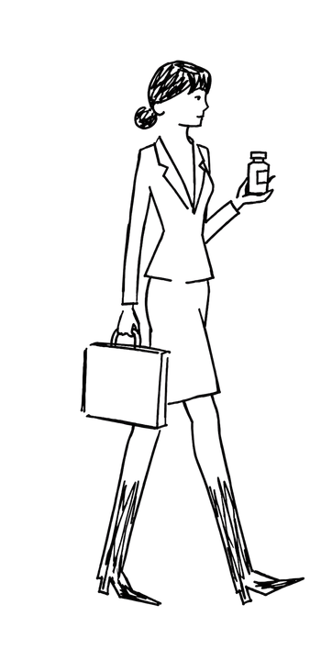
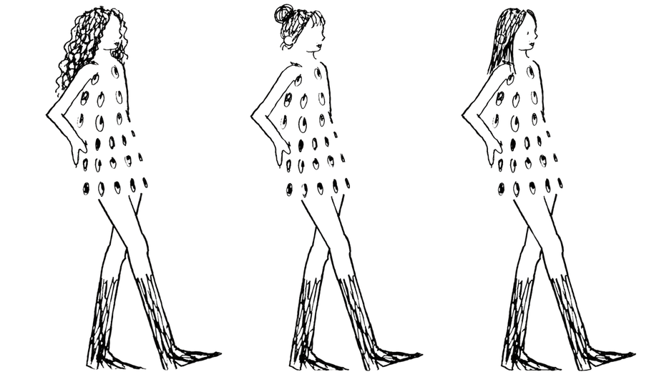
Traction
On track to launch to 250 users in Q4 2026
Early Demand Signals
Customer Validation
Demand Signals
160 Interviews
96% report cycle impacts performance
86% want a personalised solution
150+ Women Waitlist
40k+ Organic Views
University + Corporate Partnerships
40 women piloting wave 1
150+ women piloting wave 2
RUNNER-UP – IE VENTURE LAB (200+ STARTUPS)
FINALIST IN IE ENTREPRENEURSHIP SUMMIT (60 STARTUPS))
2ND PLACE - ESADE SHARK TANK (100+ STARTUPS)
Notes:
make visuals better

Slide 8
Business Model
Four revenue streams, subscription first, B2B as the multiplier, clinical partnerships as the moa
B2C BASIC
B2C PREMIUM
€4.99/mo
€12.99/mo
Core subscription. Cycle aware nutrition + fitness plans. Penetration pricing to maximise Y1 user volume
Launches month 13. AI personalised cycle plans + clinical consultation booking. 160% more revenue per user
B2B CORPORATE WELLBEING
CLINICAL + EVENTS + BRAND
B2B CORPORATE WELLBEING
€3.99/mo
€500-8K/source
€3.99/mo
Corporate wellness contracts. Warm leads active. Avg 150 employees = €7,182/yr per contract. Renews at €5.99.
Clinic referral fees, paid workshops/masterclasses, and founder brand partnerships as social audience scales
13.6x
2.85x
€4.20
€20
89%
~1mo
4.7mo
LTV:CAC
ORGANIC
LTV:CAC
CAC
ORGANIC
CAC
GROSS
MARGIN
PAYBACKPERIOD
ORGANIC
PAYBACKPERIOD

Slide 9
From Waitlist to Global Platform
M1-12 LAUNCH & FIRST DATA
M13-24 ACTIVE
DEEP TECH
M25-36 HORMONAL HEALTH
⟶ Pilot launch August 2026
⟶ Official app launch October 2026
⟶ AI personalisation engine
⟶ 2 clinical partners signed, B2B pilot
⟶ Integrate wearables
Target: 8K+ users €36K MRR
⟶ Premium tier live €12.99 live
⟶ Predictive hormonal modelling
⟶ UK + Australia + Portugual
⟶ 10 B2B, 5 clinical partners
⟶ Perimenopause tracking
Target: 32K+ users €172k MRR
⟶ CGM integration
⟶ At home hormone test kit integration
⟶ Menopause as dedicated product tier
⟶ Academic publication of clinical findings
Target: 135K+ users €612k MRR
FOUNDER SOCIAL
PAID SOCIAL M4+
B2B & CLINICAL
EVENTS & COMMUNITY
Founders posting on Linkedin, Instagram, Tiktok. Target demograhic audience, Zero marginal CAC
€3-5k/mo on Instagram & Tiktok from month 4. CAC €6-8 (50% below industry average)
One 150 employee contract = 150 users instantly. Clinic referrals: 50 patient conversions/clinic/mo
Paid events already generating revenue. Attendees convert to subscribers at 40-60% rate
4K followers today ⟶ 50K+ Y3
375-625 new users/month
5 contracts = 750 B2B users Y1
2 events run ⟶ €500-1k/event
Notes:
make it go higher

Slide 10
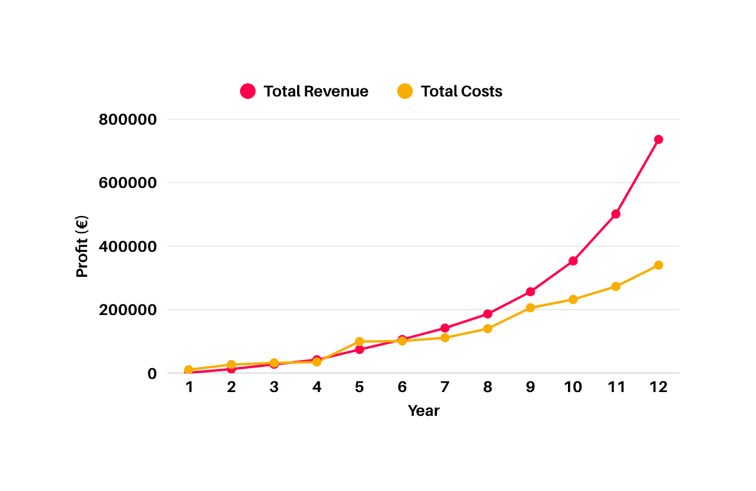

Capital Efficient Growth
€4.9M
NutriSync Projections - Realistic (quarterly)
Y3 Annual revenue
800
ARR: €8.4M annualised
,
,
,
,
135K+
600
,
,
€(Thousands)
400
Year 3 paying users
Deep tech Y2+ impact
,
,
200
Breakeven
M18
,
,
QUARTERS
Reach profitability
USER
GROWTH
>1K
+8K
+32K
+135K

Slide 11





Join Our Growth Journey
350k
Tech infrastructure
34%
€119K
RAISING
Team stipends
26%
€91K
Marketing & paid social
20%
€70K
Clinical partnerships
12%
€42K
Legal, ops & admin
8%
€28K
MONTH 1
MONTH 12
MONTH 13
App live & first revenue
5000+
paying
users
Seed
Round
Closes
Notes:
“We are raising €250K pre-seed to validate our engine, clinical backbone, and early user behaviour. This sets us up for a strong Seed round once traction is proven.”
ASK KANIKA FOR PRE-SEED
GROWTH AND FUNDRISING

Slide 12
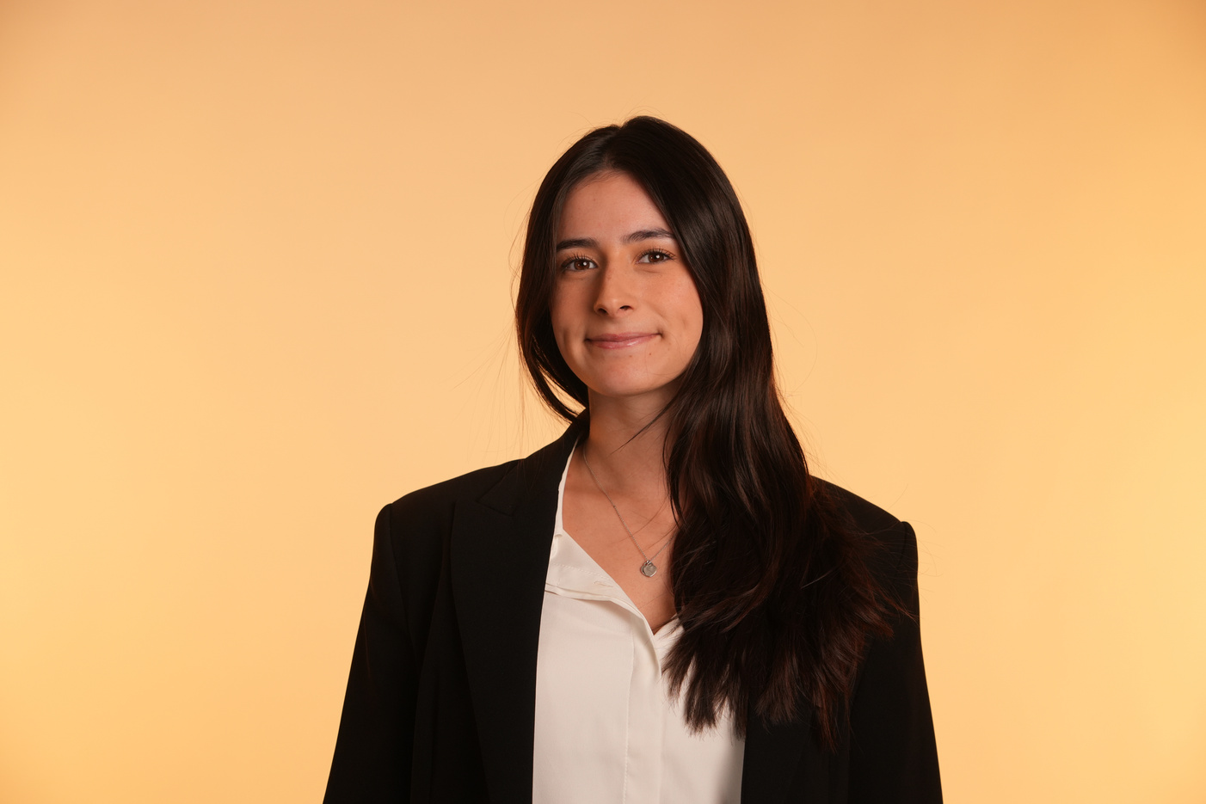

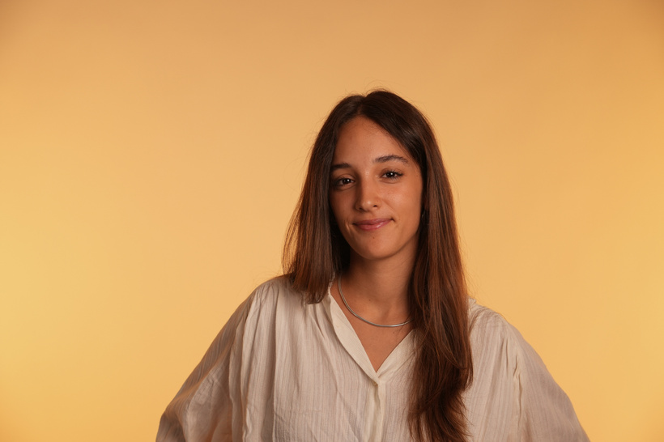
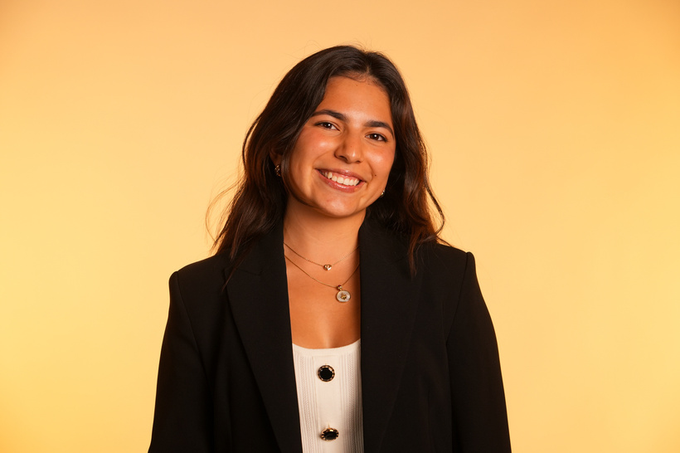
Pilar Gonzalez
Lucia Cebrian
Maria Paula Garzon
CEO - Co Founder
Experienced in strategy, finance, outreach, partnerships
COO - Co Founder
Experienced in branding, marketing & UX design
CMO - Co Founder
Experienced in branding, social media management, marketing
Your Vision

Slide 13
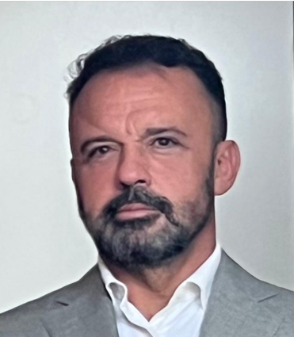
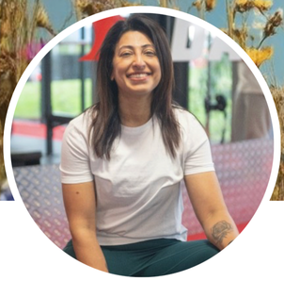

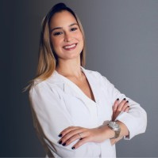
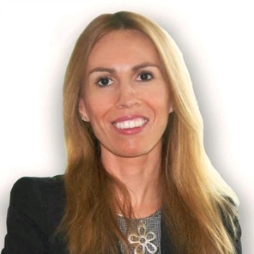
Advisory Board
Juan Jose Cebrian Gonzalez
Technology & Digital Transformation
EMEA CTO and head of engineering at CHUBB.
Global experts in tech, growth and nutrition.
Kanika Pandey
AI & Growth Strategy
Clara Miranda Escribano
2x founder, expert in GTM
Strategy & Brand Innovation
Former Global Innovation Lead at ING.
Constanza Ramirez Milli
Clinical Nutrition
Beatriz Serrano Sordo
Finance & Governance
Nutritionist specialized in clinical nutrition & corporate wellness.
1x founder, ex MD Banco Santander Head of Investor Relations, senior analyst AXA

Slide 14
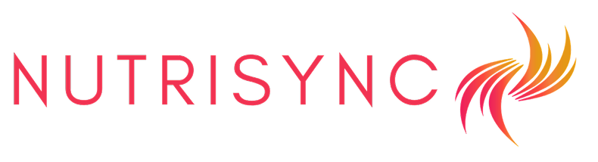
nutrisynccollective.com
contact@nutrisynccollective.com
Adaptive nutrition, movement and recovery guidance that learns across cycles
Pilar Gonzalez
Lucia Cebrian
Maria Paula Garzon

Slide 15
Spanish Market
~€1.4Bn
Spain’s women’s health app + corporate wellness
All Spanish companies and women who could ever pay
~€168M
Women paying for digital health + B2B wellness buyers
2M Spanish women already paying and companies actively purchasing digital employee wellness
~€1.67M
NutriSync's Year 3 revenue target (realistic scenario)
30.3K+ paying users by Year 3 — ~1% penetration of SAM
Sources: (INE, 2024), (Heraldo, 2023), (Agencia SINC, 2023), (European Psychiatry, 2022)

Slide 16

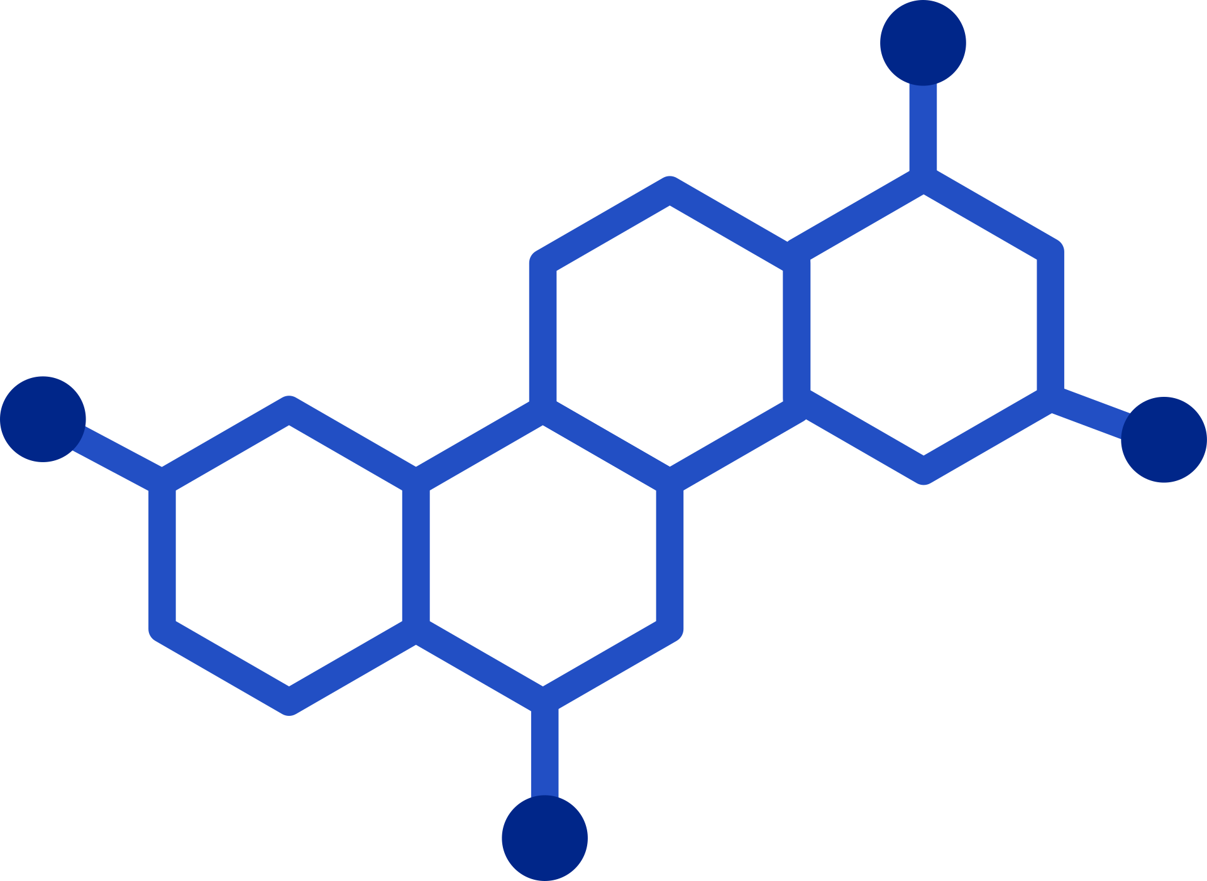






Deep Tech Rollout
Four deep tech layers sequenced by funding stage
1.
3.
ADAPTIVE AI
PERSONALIZATION ENGINE
(now-M6)
CONVERSATIONAL AI NUTRI COMPANION
(M13 Premium)
PREDICTIVE HORMONAL MODELLING
LAB TEST + CGM INTEGRATION
(series A Y3)
DATA MOAT
CLINICAL MOAT
DISTRIBUTION MOAT
Every user who tracks 3+ months creates a unique hormonal data signature.
Clinical partnerships take 12-18 months to build. We start now.
Founder social channels are the acquisition engine. 50K+ combined audience in exact target demographic.
Notes:
Recommendation → action/adherence → symptoms & biomarkers → outcome change → model recalibration → better recommendation.

Slide 17
Long-term Expansion
An even bigger and almost empty opportunity
1.
3.
PERIMENOPAUSE TRACKING
HRT INTERACTION GUIDANCE LAYER
MENOPAUSE AS DEDICTATED PRODUCT TIER
MENOPAUSE B2B - WORKPLACE PROGRAMME
(soft launch M18)
(M22)
(Y3)
(Y3)
MENOPAUSE MARKET
$22.7B
1M+
~12
Global menopause market by 2028, 7% CAGR
Women entering menopause per year in the US alone
App solutions available, mostly symptom trackers
Same infrastructure - different life stage
Higher ARPU than core product
Proven market demand

Slide 18
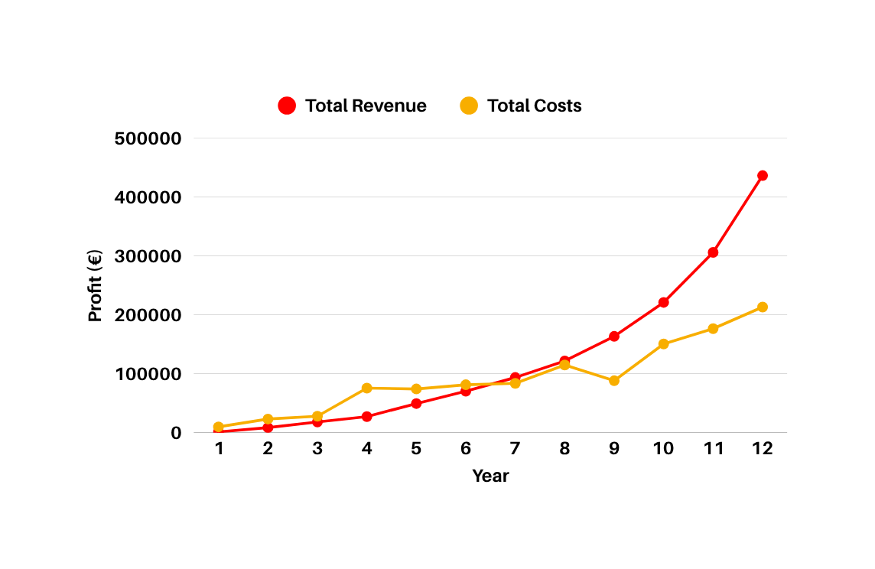
Capital Efficient Growth
€3M
NutriSync Projections Conservative (quarterly)
Y3 Annual revenue
,
500
,
ARR: €4.89M annualised
,
400
,
80K+
300
,
,
€(Thousands)
,
200
Year 3 paying users
,
Deep tech Y2+ impact
Breakeven
100
M19
,
,
QUARTERS
Reach profitability
USER
GROWTH
>1K
+5K
+20K
+80K

Slide 19
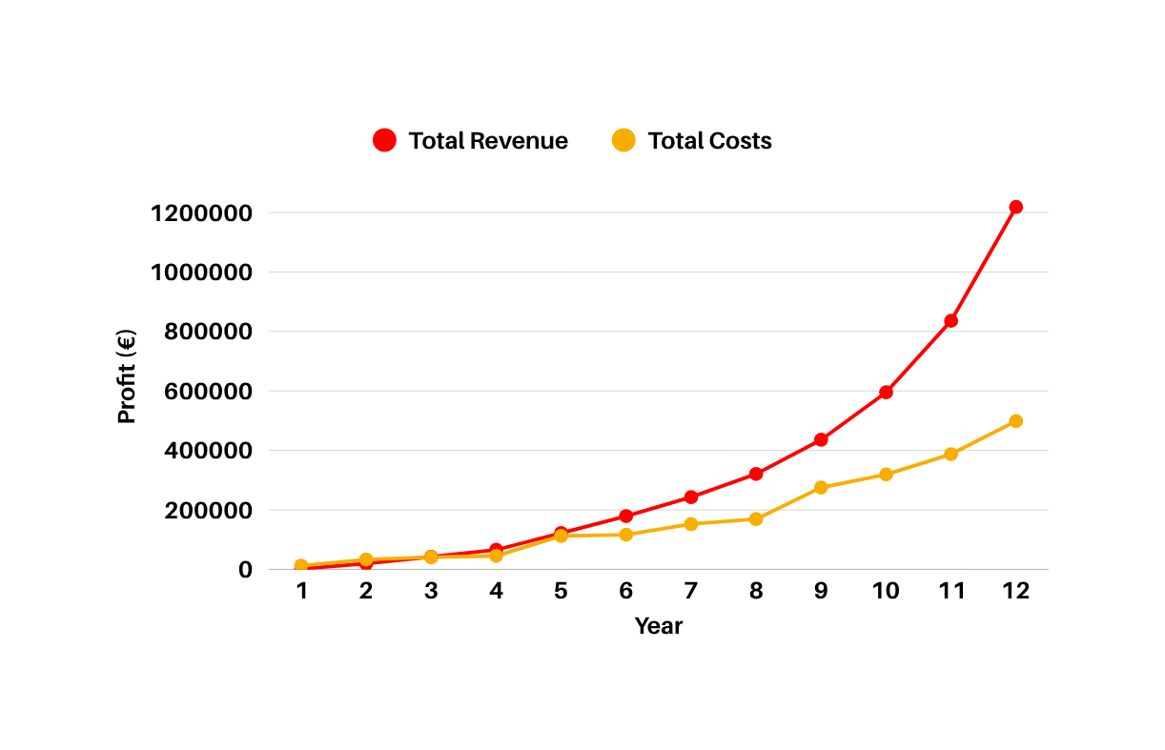
Capital Efficient Growth
€8.2M
NutriSync Projections - Ambitious (quarterly)
Y3 Annual revenue
ARR: €13.8M annualised
,
,
1200
,
,
1000
218K+
,
800
,
€(Thousands)
Year 3 paying users
600
Deep tech Y2+ impact
,
,
400
200
Breakeven
M15
,
,
QUARTERS
Reach profitability
USER
GROWTH
>1K
+12K
+50K
+218K

Slide 20
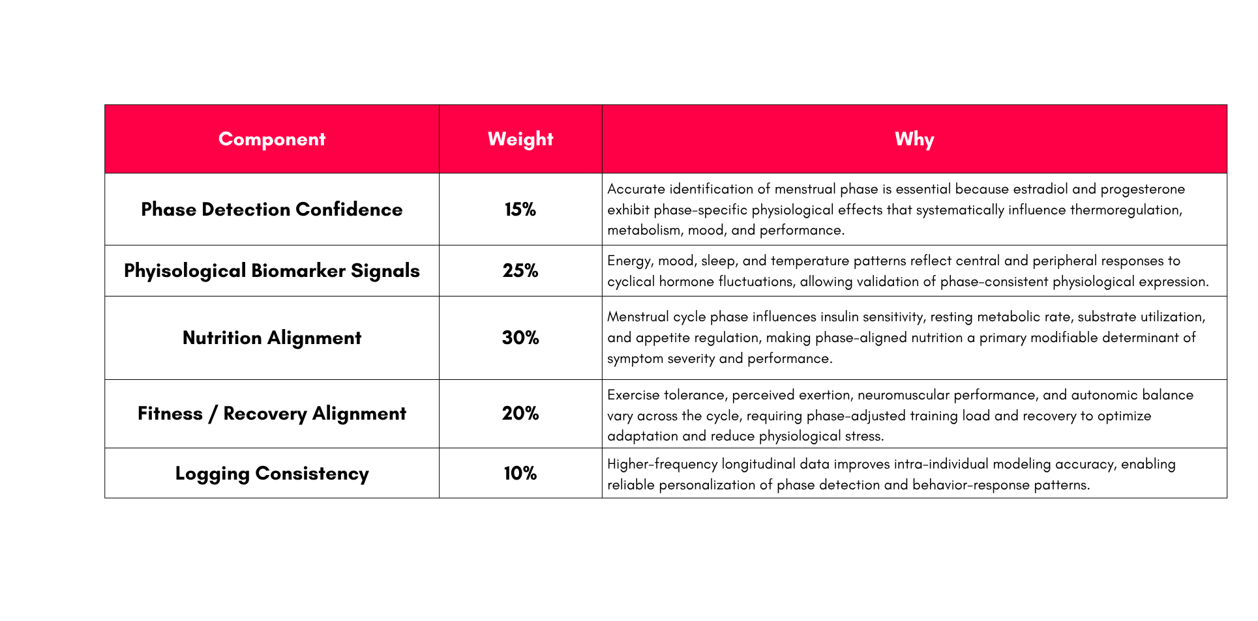
NutriSync’s Adaptive Cycle Intelligence
After 3 cycles algorithm must map symptom intensity per phase, identify user’s high sensitivity window, create a personalized symptom plan.

Slide 21
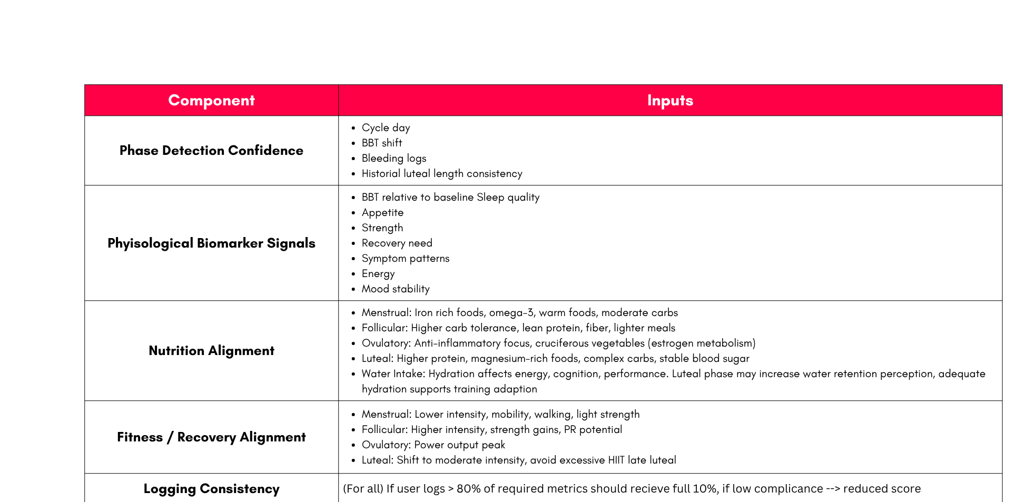
NutriSync’s Adaptive Cycle Intelligence

Slide 22
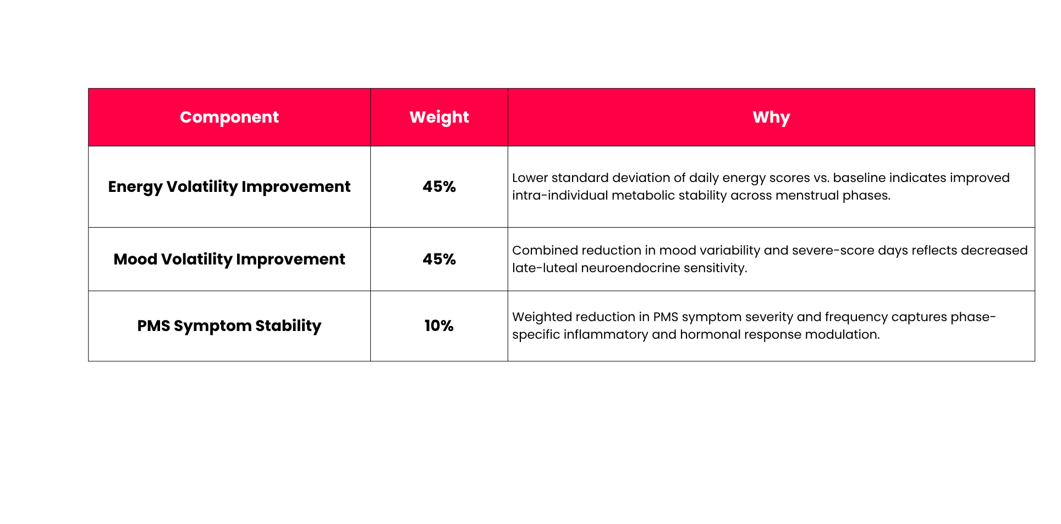
NutriSync’s Adaptive Cycle Intelligence
Measures longitudinal improvement vs. personal baseline using volatility and severity reduction across cycles.

Slide 23
Wearables Strategy
Turning an Apple Watch into a hormonal health advisor costs €0 in hardware and gives us access to 100M+ existing devices
1.
3.
APPLE WATCH + HEALTHKIT (M4)
GOOGLE FIT + WEAR OS (M4)
OURA RING (M15)
CGM - DEXCOM / ABBOTT LIBRE
(Y3)
(Y3)
Data: Heart rate, HRV, sleep stages, activity, skin temperature, blood oxygen
Data: Heart rate, activity, sleep, stress score
Data: Skin temperature trend, HRV, readiness score, sleep stages, resting heart rate
Data: Blood glucose fluctuates across cycle, causing energy crashes and cravings
Essential for Spain and Australia where Android market share is 70% +. Built in parallel with HealthKit, shared codebase, low marginal cost.
60% of our target demographic (urban women 25-45) owns an Apple watch.
HealthKit API free, 4-6 weeks dev time.
Most clinically relevant wearable for NutriSync. Skin temp data makes cycle prediction automatic. Oura has an investment arm and actively partners with health apps.
Glucose + cycle data = the most complete hormonal nutrition picture. Requires medical device partnership agreements. Series A territory.
50%
12.4x
€8K
FREE
Churn reduction for wearable connected users
LTV:CAC for wearable users
Total HealthKit dev cost payback <2 months from retained users
HealthKit, Oura Cloud, Google Fit APIs are all free for developers

