Slide 1

NutriSync Design System
Hormonal care made easy — sync your cycle, fuel your mind.
V2 · SEPTEMBER 2026

Slide 2
WHAT THIS IS
One system, three surfaces, reverse-engineered from real code.
Marketing web (v2)
Mobile app (v1)
Also in the repos
nutrisync-web2 PWA: Home, Community (4 doors + joins), Our Story. Fixed Figma frames, everything in rem (1rem = 10px @ frame width).
Expo/React Native. Calendar · NutriLog · Cycle · Movement · Progress; onboarding wizard, settings, meal photo AI, wearables.
v1 webapp, internal ops Hub, legal pages — documented, not rebuilt.
Sources: githubjuanjose/nutrisync-proyecto (repos/web2, primary) · nutrisync-web · nutrisync-app (src/theme.ts) · local Figma screen exports — sync state tracked in github.md

Slide 3
TWO BRAND GENERATIONS
v2 is the default. v1 stays one attribute away.
v2 — Web 2.0 brand
v2 comes from the new marketing site (repos/web2, faithful to Lucía's Figma). v1 is the original app + Design site, preserved as a token theme: wrap any subtree in data-theme="ns-v1".
Poppins 400 display · Instrument Sans UI · photography-led
v1 — original app & site
Poppins app UI · Bricolage Grotesque web display · peach washes

Slide 4
COLOR · BRAND — 35 TOKENS
Coral is the brand.
--orange-soft
--coral
--coral-3
--coral-2
--pink
--blue
--blue-2
--amber
--brown
#ff3a00
#ff5532
#eb6246
#f52463
#4885ff
#508afe
#ffc164
#ff9055
#6c3732
white
--cream
--cream-2
--cream-3
--grey
--ink · body
--dark · strong
#ffffff
#fcf9f5
#f7f2e8
#fff9f8
#808080
#524e4b
#1a1818
Semantic aliases ship too: --accent → coral · --accent-alt → pink · --text-body → ink · --surface-cream · --card-pink · --scrim. Shadows are always brown-tinted, never grey.

Slide 5
COLOR · GRADIENTS & PHASES
Warm glows, four phases.
moooves
--grad-hero-bg
--grad-hero
--grad-cta · v1
v1 app wash
radial coral → mauve
#ff0ba1 → #ff3a00 → #ffc164
135° #FF7600 → #FD400C
#FE5936 → white
Menstrual
Follicular
Ovulatory
Luteal
--phase-menstrual · #E8472A
--phase-follicular · #6B9E6B
--phase-ovulatory · #D4A017
--phase-luteal · #7B5EA7
Cycle phases per developer spec §2.2 — shared by both generations. Status:
--good #3DBE8B
--warn #ffc164
--error-soft #ffe1d6

Slide 6
TYPOGRAPHY · DISPLAY
Nutrition that moooves with your Cycle
4 phases. 1 body.
--f-display: Poppins at weight 400 — never bold · --fs-hero 70px / 0.9 / −0.03em · --fs-statement 110px / 1.12 / −3px Display is always sentence-case or a short declarative; the playful stretch ("moooves") is part of the voice.

Slide 7
TYPOGRAPHY · UI & ACCENTS
€4.99/mo
Lucía · Mapi · Pilar
Glacial Indifference — Sync your cycle. Fuel your mind.
Community
Ditch the cycle trackers, get your money's worth.
--f-hand: Reenie Beanie handwritten names · --f-alt: Glacial secondary · --f-inter: Inter internal
Phase-synced nutrition & movement guidance
BADGE 12 / 600 / CAPS
Nutrition that moves with your cycle.
--f-ui: Instrument Sans — price 80/700 · nav 25/600 · body-lg 23 · body 18/1.6 · note 15/500
Welcome to NutriSync
v1: --f-display-v1 Bricolage Grotesque 600–800 web display · --f-app Poppins-only app (h1 38/500, titles 26/700, body 15)

Slide 8
CONTENT & VOICE
Direct, warm, a little cheeky.
Speaks to you ; the brand is "we". Sentence case everywhere, UPPERCASE only in small badges; app buttons go lowercase ("log today"). Branded compounds: NutriLog, NutriScore, MovementLog. Numbers lead ("500+ on the Waitlist"). No emoji in product copy — custom Nutri characters instead. EN first, ES catalog maintained. A dark disclaimer bar rides along wherever pricing shows: pilot prices are illustrative.
"Ditch the cycle trackers, get your money's worth."
"4 phases. 1 body."
"WE DESERVE BETTER THAN GUESSWORK"
"You're here because your body deserves better than guesswork."

Slide 9




BRAND MARKS
The swirl-wings. Wordmark in type.
NutriSync
wordmark = Instrument Sans 700
logo-swirl.webp · v2 nav
nutri_wings_coral.png
nutri_wings_white.png
nutri_wings_ink.png
icon-512 · PWA
No lockup file exists in the sources — wherever a lockup is needed, set "NutriSync" in Instrument Sans 700 next to the mark. Never redraw the swirl.

Slide 10











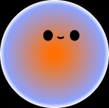






ICONOGRAPHY & CHARACTERS
No icon fonts. No emoji. Exported assets and characters.
Web SVGs + store chips
Nutri mascots & mood emotes (app)
Per-icon SVG exports; v1 web used a Lucide-style 24px line set. Store marks live in brown #6c3732 chips, r12.
Approved PNG set: orb mascot, 4 Nutri avatars (red·pink·yellow·blue), 12 mood emotes, tip characters. Never redraw them.
App tab glyphs — fat-line SVGs with baked captions (Calendar · NutriLog · Cycle · Movement · Progress), active #E4572E / inactive #B8ADA4, 50px in the floating pill bar.
Imagery — warm, editorial, women-centric photography with coral/pink cast; rgba(0,0,0,.2) scrim under white text; white line illustrations over photos.

Slide 11
SHAPE · RADIUS, SHADOW, SPACING
Pills everywhere. Warm shadows only.
--r-install 16
--r-card 24
v1 app 10·16·22
--r-btn 30
--r-app-pill 999
--r-pill 100
Spacing: app = 4px grid (--sp-1…--sp-20, spacing(n)=n×4, screen padding 20, tab bar h62 r32). Web2 = exact per-frame rem values (1rem = 10px @ 1440/1495/390/393), 80px gutters — never snapped to a 4/8 grid.
--shadow-card
--shadow-modal
--shadow-app-card
0 8 24 rgba(108,55,50,.18)
0 24 60 rgba(108,55,50,.25)
0 12 24 rgba(180,64,42,.12)

Slide 12
COMPONENTS · WEB (V2)
10 primitives from components.css + the Figma gen.
Download App
Get App
Join the club
EN
WE DESERVE BETTER THAN GUESSWORK
@nutrisync.collective
Email
NutriSync is in pilot. Prices and claims are illustrative — keep this bar wherever pricing shows.
Premium
you@example.com
€4.99
/mo
Join Community
Full analytics & scores Phase-synced guidance Wearable integration
WebButton · LangToggle · SectionBadge · NavBarWeb (+mobile) · DisclaimerBar · InstallBanner · SoonModal · JoinForm (tabs/field/submit) · PricingCard · SocialChip · GlassStatCard — each with .d.ts contract + .prompt.md usage.

Slide 13
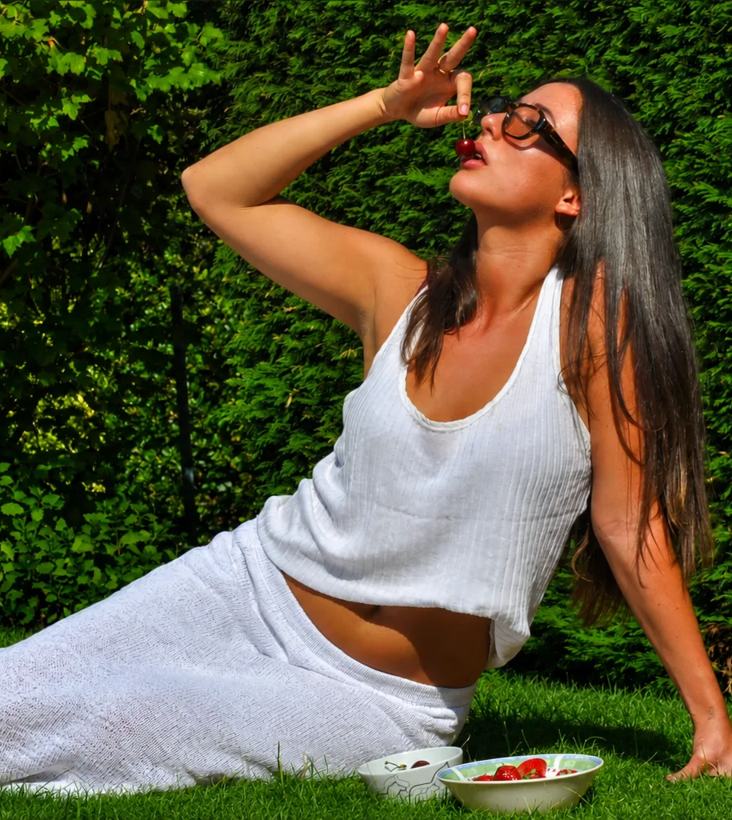
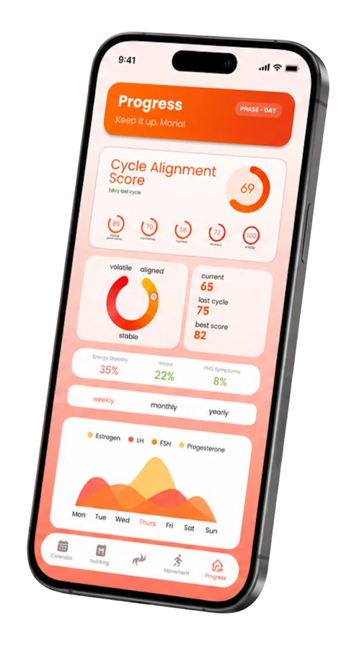
UI KIT · WEB
The whole Home, section by section.
Hero · stats banner · The Problem (silhouettes) · marquee ticker · "4 phases. 1 body." · The App that knows · Daily Guided Experience · Phase-Synced Nutrition · Alignment Score · One Score (glass metrics on blue) · Pricing over photo · Physiology · Get to know us (reels wall) · Weekly Sync footer + waitlist. ui_kits/web/index.html at the production scale rule; community.html adds the four doors + exact join form.

Slide 14
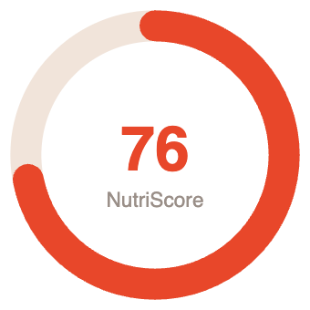

COMPONENTS · APP (V1)
20 primitives from the Expo app's src/ui.
Rings & data: PhaseRing (signature dish + hill waves) · ScoreRing · SuccessRing · HormoneChart · StreakDots · AppProgressBar Inputs: AppButton · ChipGroup · SelectList · WheelSheet (barrel picker) · LanguagePicker Surfaces & feedback: PeachBg · GraceBanner (grace/drift/care) · WearInvite · LoadingView · BioLock · GoalOrb + carousel Navigation & identity: TabBar + NavIcon glyphs · SettingsIcon (17 line icons) · NutriAvatar · NutriOrb Exact theme.ts values: coral #E8472A · gradient #F5641E→#FF9142 · pill 999 · 4px grid · warm card shadow.
Daily Tip
Progesterone rises and your metabolism revs up — magnesium and B6 take the edge off PMS.
Create account
Cramps
Cravings
Headache

Slide 15
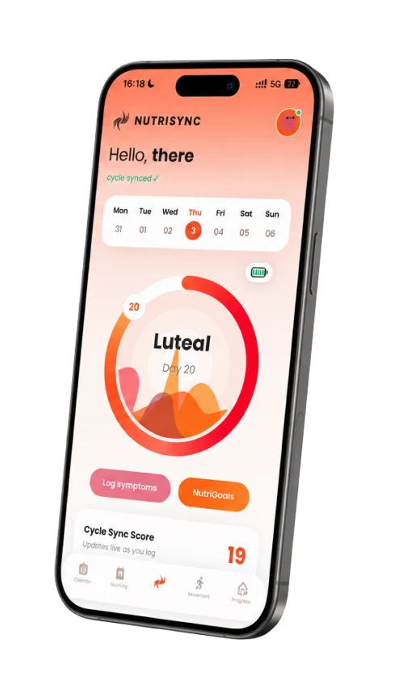
UI KIT · APP
The flow, playable.
ui_kits/app/index.html walks the real journey: Welcome (peach radial, wings, language pills) → onboarding (progress head, GoalCarousel, chips) → the tab bar app: Cycle (PhaseRing + GraceBanner + WearInvite), NutriLog (week strip, Daily Tip / Body Insight, Nutri Basics checklist, TODAY'S MEAL, "log today"), Progress (ScoreRing, streaks, hormone curves). Matched against the Figma screen exports in refs/.

Slide 16
USING THE SYSTEM
One stylesheet in, everything on.
styles.css — tokens + self-hosted fonts (Poppins, Instrument Sans, Inter, Glacial, Reenie Beanie, Bricolage) tokens/ — colors · typography · radius & shadows (v1 via data-theme="ns-v1") components/web · components/app — 30 React primitives with .d.ts + .prompt.md ui_kits/web · ui_kits/app — full-screen recreations guidelines/ — 15 foundation specimen cards assets/ — logos, imagery, mascots, icons, fonts export/nutrisync.tokens.json — W3C tokens for Figma (Tokens Studio) · SKILL.md — agent entrypoint
Ground rules Coral #ff3a00 leads; pink seconds; blue is a section accent. Poppins display at weight 400, never bold. Pills everywhere (24/30/100). Warm brown shadows only — never grey. Photography warm and editorial; mascots in the app. Keep the pilot disclaimer near any pricing. No emoji, no icon fonts — exported SVG/PNG assets only. Copy exact values; never snap to a 4/8 grid on web.
Sources: githubjuanjose/nutrisync-proyecto (repos/web2) · nutrisync-web · nutrisync-app — sync state in github.md · © 2026 NutriSync Collective

