Slide 1

Introduction to PsychToolbox in MATLAB
Psych 599, Summer 2016
Jonas Kaplan, Ph.D.
University of Southern California

Slide 2
Week 5 Recap

Slide 3
Sound data
Sound data should be in the form of a matrix where each row is one sound channel
Samples in the vector should range from -1 to 1, where 0 is silent.
You can create a sound by generating data for a matrix on your own, or you can read in from a wav file

Slide 4
Reading from wav files
Y = wavread(FILE)
[ Y, freq ] = wavread(FILE)

Slide 5
Reading from audiofiles
New Matlab command available in versions 2012b and later, will read many audio formats including WAV, FLAC, MP3, MPEG-4, OGG
[Y, freq ] = audioread()

Slide 6
Preparing sound data for playing
>> whos funkData
Name Size Bytes Class Attributes
funkData 624000x1 4992000 double
>> funkData = funkData'
>> funkData = [funkData; funkData];
>> whos funkData
Name Size Bytes Class Attributes
funkData 2x624000 9984000 double
change column to row
duplicate to make two rows for stereo

Slide 7
Steps to playing a sound
InitializePsychSound
open audio channel with PsychPortAudio('Open')
fill audio buffer with PsychPortAudio('FillBuffer')
start playing a sound with PsychPortAudio('Start')
stop playing a sound with PsychPortAurio('Stop')
close the audio channel with PsychPortAudio('Close')

Slide 8
Step 2: Open audio channel
pahandle = PsychPortAudio('Open' [, deviceid][, mode] [, reqlatencyclass][, freq][, channels] [, buffersize] [, suggestedLatency][, selectchannels][, specialFlags=0]);
playback channels:
1 = mono
2 = stereo
etc.
default is 2
how aggressively to take over the sound device in order to assure latency
requested playback rate in Hz

Slide 9
Step 3: Fill the audio buffer
PsychPortAudio('FillBuffer', pahandle, bufferdata);
This is analogous to drawing on the back buffer with the Screen command. We fill the buffer now, but it will not be heard until we play it.

Slide 10
Step 4: Start playback
startTime = PsychPortAudio('Start', pahandle [, repetitions=1] [, when=0] [, waitForStart=0] [, stopTime=inf] [, resume=0]);
Wait until this time to start playing (default is play now)
Set to 0 to repeat indefinitely
set a time to stop playing
0: Ask playback to start and move on
1: wait for playback to actually begin.
A 1 here is necessary if you want to get timing info back

Slide 11
Remaining steps
Stop playback if necessary: PsychPortAudio('Stop',pahandle);
Close the audio driver: PsychPortAudio('Close',pahandle);
Remember: Do not close audio channel before the sound is finished playing if you want to hear it all

Slide 12
Sound recording steps
Initialize sound driver: InitializePsychAudio
Open audio channel for recording with PsychPortAudio('Open') setting mode to 2
Clear a buffer using PsychPortAudio('GetAudioData')
Start recording with PsychPortAudio('Start')
Stop recording with PsychPortAudio('Stop')
Get audio data using PsychPortAudio('GetAudioData')

Slide 13
Step 2: Open audio channel
pahandle = PsychPortAudio('Open' [, deviceid][, mode] [, reqlatencyclass][, freq][, channels] [, buffersize] [, suggestedLatency][, selectchannels][, specialFlags=0]);
1: sound playback only (default)
2: audio capture
3: simultaneous capture and playback (may not work on all hardware)

Slide 14
GetAudioData
Call before you start recording to setup an empty buffer, then after recording to retrieve recorded data
[audiodata absrecposition overflow cstarttime] = PsychPortAudio('GetAudioData', pahandle [, amountToAllocateSecs] [, minimumAmountToReturnSecs][, maximumAmountToReturnSecs] [, singleType=0]);

Slide 15
Writing data to file
wavwrite(audiodata, freq, nbits, filename)
audiowrite(filename, audiodata, freq)
NOTE: for writing to file, audio channels must be in columns, not rows, so you will have to transpose them again.

Slide 16
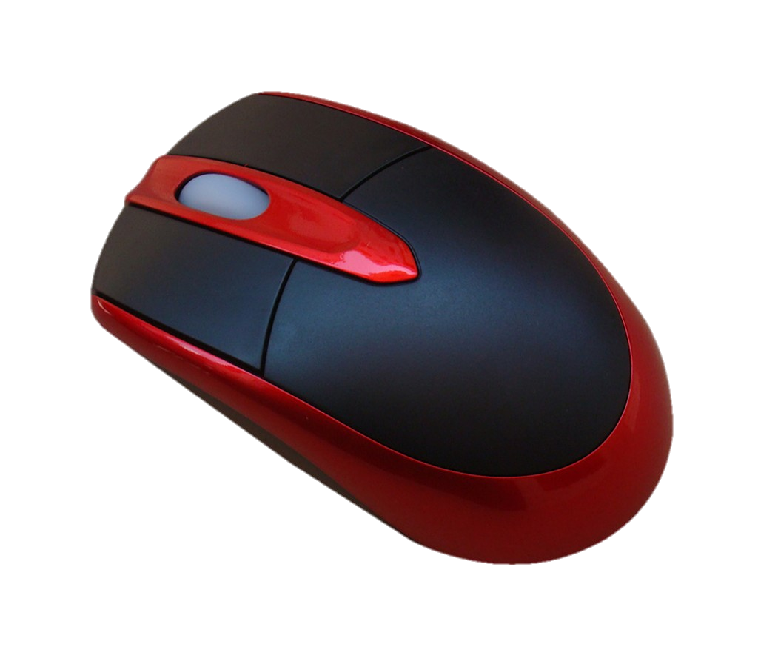
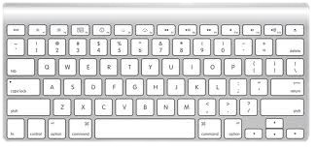
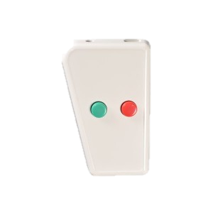
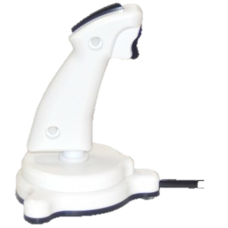
Collecting responses

Slide 17
Listing devices
devices = PsychHID('Devices');
Returns a structure array where each element describes a single device
PsychHID only checks for USB devices on startup. If you plug in a device after starting matlab it wont be recognized by PsychHID, even if you can see its input on the screen. You need to either restart Matlab or issue clear PsychHID to renumerate the connected devices.

Slide 18
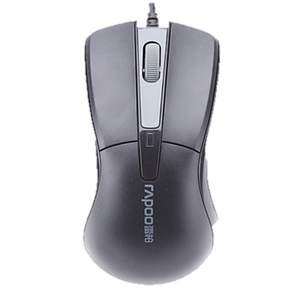
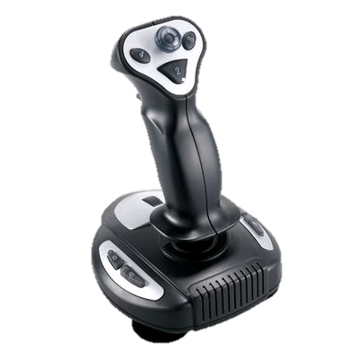
Psychtoolbox Response Monitoring
GetChar()
KbWait()
KbCheck()
KbQueueCheck()
GetMouse()
GetClicks()
GetMouseWheel()
SetMouse()
ShowCursor()
HideCursor()
GamePad()

Slide 19
Keyboard responses
GetChar()
KbWait()
KbCheck()
KbQueueCheck()

Slide 20
GetChar
[ch, when] = GetChar()
GetChar can return characters that were type before you called it!
As long as listening is turned on, GetChar will be listening. It will then return all the keys pressed since it started listening, in order. If there are none left in the queue, it will wait for a new one.
Use FlushEvents() to clear the queue and to start listening. You can also call ListenChar() to turn listening on and off directly.

Slide 21
KbWait
[secs, keyCode, deltaSecs] = KbWait([devicenumber] [, forWhat = 0][, untilTime=inf)
which device are we listening to?
use PsychHID('Devices') to list all devices
GetKeyboardIndices() will return the device numbers of all keyboard devices
Use -1 to listen to all keyboards
Use -2 to listen to all keypad devices
Use -3 to listen to all keyboards and keypads

Slide 22
KbWait
[secs, keyCode, deltaSecs] = KbWait([devicenumber] [, forWhat = 0][, untilTime=inf)
0: Default. Listen for key down
1: Listen for key release
2: Wait until all keys are released, THEN wait for key down
3: Wait until all keys are released, then wait for a full key press and release
Stop waiting when we get to this time

Slide 23
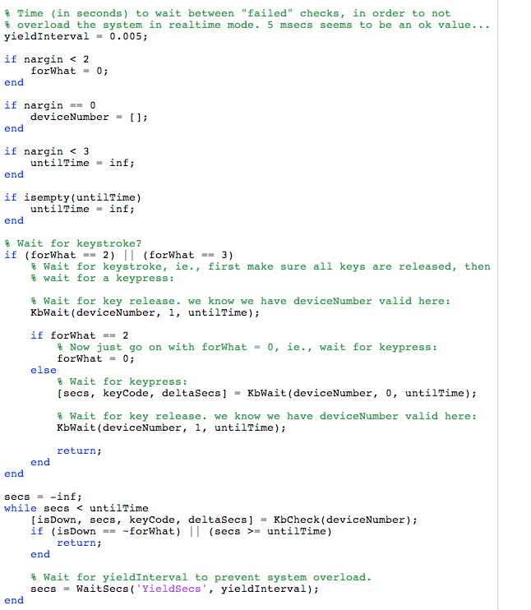
inside KbWait.m

Slide 24
KbCheck
[keyIsDown, secs, keyCode, deltaSecs] = KbCheck([deviceNumber])
Has a key been pressed?
1 if any key has been pressed,
0 otherwise
interval between this check and the last one
Time key was pressed
256-element logical vector indicating which key(s) were pressed

Slide 25
Ignoring responses
DisableKeysForKbCheck([disablekeys])
vector of key codes to ignore
RestrictKeysForKbCheck([enablekeys])
vector of key codes to include

Slide 26
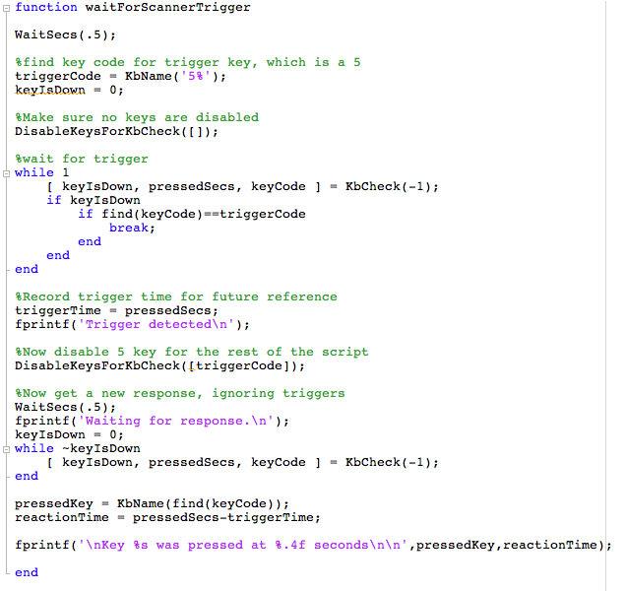
waiting for a specific response
waiting for any response EXCEPT certain keys

Slide 27
KbQueueCheck
An alternative set of commands for collecting keypresses:
KbQueueCreate
KbQueueStart
KbQueueStop
KbQueueCheck
KbQueueWait
KbQueueFlush
KbQueueRelease

Slide 28
KbQueueCheck
Advantages of KbQueueCheck:
Sometimes detects really brief responses that KbCheck can miss
Very accurate time recording
Records presses and releases both
Disadvantages:
Difficulty in recording multiple presses of the same key
May not deal well with many rapid keypresses

Slide 29
Steps to using KbQueue
KbQueueCreate([deviceNumber]) to create the queue.
KbQueueStart() to start listening
KbQueueStop() to stop listening (does not clear the queue)
KbQueueCheck() to check the values recorded while the queue was active
KbQueueFlush() to empty the queue
KbQueueRelease() to destroy the queue object

Slide 30
KbQueueCheck
[pressed, firstPress, firstRelease, lastPress, lastRelease] = KbQueueCheck()
has a key been
pressed?
array indicating when each key was first pressed
array indicating when each key was first released

Slide 31
Mouse responses
GetMouse()
GetClicks()
GetMouseWheel()
SetMouse()
ShowCursor()
HideCursor()

Slide 32
Mouse responses
[x,y,buttons] = GetMouse([windowPtrOrScreenNumber][, mouseDev])
vector of three numbers, one for each mouse button
0 = not pressed
1 = pressed
which mouse device

Slide 33
Other input devices
GamePad()
Type Gamepad in the command window for help, or Gamepad Subcommand? for help with a subcommand

Slide 34
Gamepad
Gamepad('GetButton',gamepadIndex, buttonIndex) to get status of buttons
Gamepad('GetAxis',gamepadIndex,axisIndex) to get joystick position
Gamepad('GetBall',gamepadIndex,ballIndex) to get trackball info

Slide 36
Assignment #5
Create a function called yourinitials_week5()
The function will take one input, radius, which will determine the radius of a circle
Draw a black circle in the center of the screen. Using KbCheck, wait for the user to press a key. If the user presses R, the ball will turn red; if they press G the ball should turn green; B will turn the ball blue.
The ball will begin moving towards the mouse position. Only move the ball 2 pixels each frame, do not jump right to the location of the mouse. The ball will follow the mouse around the screen until the user clicks the mouse, when the program will end and the screen will clear.
While the ball is moving, the user may press R, G, or B to change the color of the circle accordingly.

Slide 37
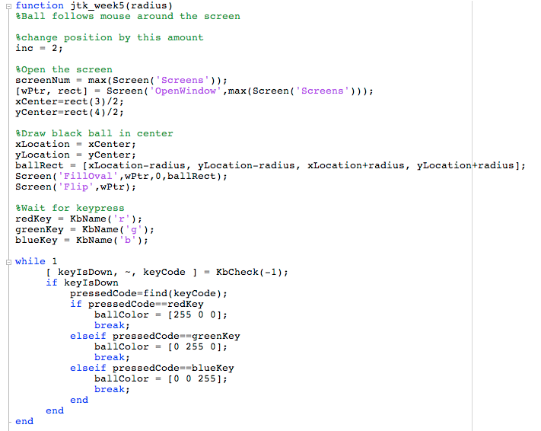

Slide 38
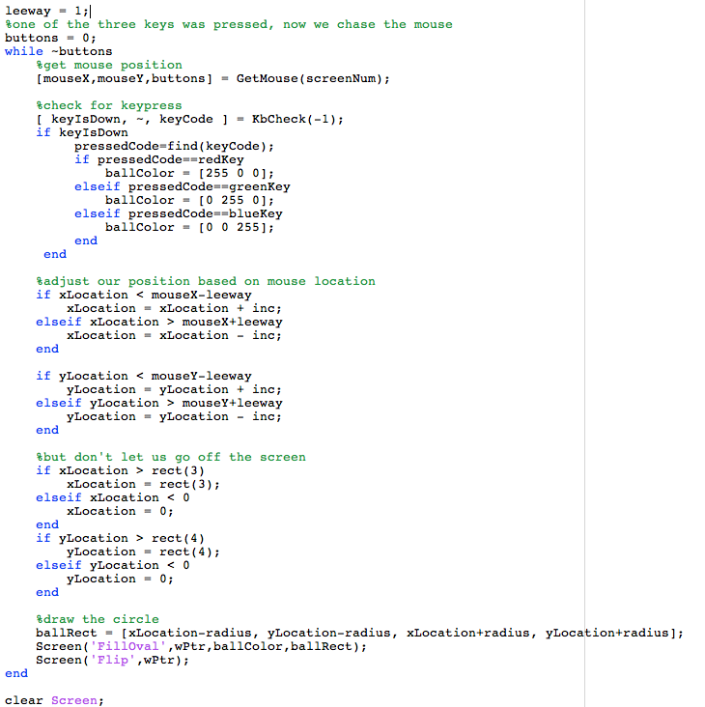

Slide 40
Week 6
DAQ toolbox
Randomization, permutation, condition order
Priority handling
Handling complex code: Subfunctions

Slide 41
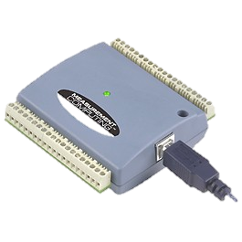
DAQ toolbox
DAQ = Data Acquisition device
For communicating with the USB-1208FS from Measurement Computing
Allows input and out of digital and analog signals

Slide 42
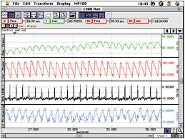

Using the DAQ to synchronize
external measurement system

Slide 43
Daq functions
Type "help DaqFunctions" to see all the PsychToolbox DAQ functions

Slide 44
Sending output with the DAQ
1. Identify the DAQ device in the PsychHID device list
2. Initialize the DAQ device with DaqDConfigPort()
3. Send output with DaqDOut()

Slide 45
Finding your DAQ device
devices = PsychHID('devices');
daqIndex = 0;
DAQFound = 0;
for i = 1:length(devices)
if strcmp(devices(i).product,'USB-1024LS')
daqIndex = i;
end
end
OR
daqIndex = DaqDeviceIndex();

Slide 46
Communicating with the DAQ device
Digital vs Analog connections: DaqAIn DaqAOut DaqAInScan DaqDIn DaqDOut DaqDInScan

Slide 47
Initializing a port
DaqDConfigPort(DeviceIndex, port, direction)
0 = output
1 = input
device index of the Daq device
which port you want to configure

Slide 48
Sending output
DaqDOut(DeviceIndex, port, data)
value you want to send to the output channel

Slide 49
Example
Send a pulse to the Biopac (physio measurement) computer when the script receives the first trigger pulse from the MRI scanner in order to synchronize measurement among the devices

Slide 50
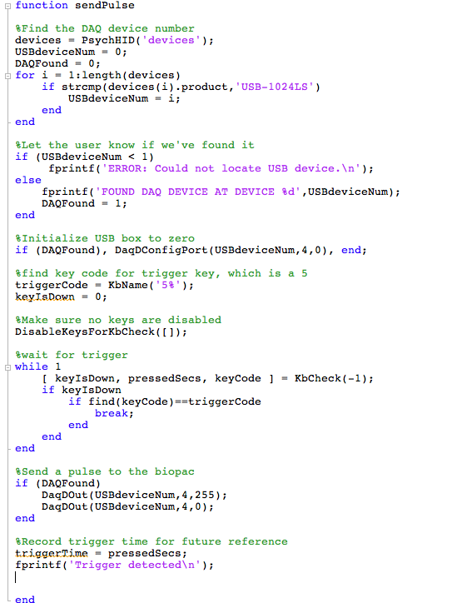

Slide 52
Randomization
On startup, Matlab initializes the random number generator.
The rng creates a sequence of random numbers called the global stream.
The random number functions (rand, randi, randn) access this list of numbers, in order

Slide 53
Randomization
rng controls the random number generator

Slide 54
Randomization
>> rng
ans =
Type: 'twister'
Seed: 0
State: [625x1 uint32]
>> rng default
>> randi(100,[1,10])
ans =
82 91 13 92 64 10 28 55 96 97
>> rng default
>> randi(100,[1,10])
ans =
82 91 13 92 64 10 28 55 96 97

Slide 55
Randomization
"Seed" the random number generator to generate different values
Common seed to use is the current time
rng shuffle to reseed with current time

Slide 56
Randomization
>> rng shuffle
>> rng
ans =
Type: 'twister'
Seed: 2062320423
State: [625x1 uint32]
>> rng(1)
>> rng
ans =
Type: 'twister'
Seed: 1
State: [625x1 uint32]
>> rng(5,'combRecursive')
>> rng
ans =
Type: 'combRecursive'
Seed: 5
State: [12x1 uint32]

Slide 57
Permutation
Matlab function randperm() and PTB function Shuffle() are useful for permuting lists

Slide 58
Permutation
randperm(N) will create a vector of numbers from 1 to N in random order.
You can use these numbers as indexes to reference multiple lists in the same random order

Slide 59
Permutation
Example:
You have a list of fruits, and a separate list of colors that describe those fruits. They are in order, such that colors{1} describes the color of fruits{1}.
You want to describe the name and color of each fruit, but in random order

Slide 60
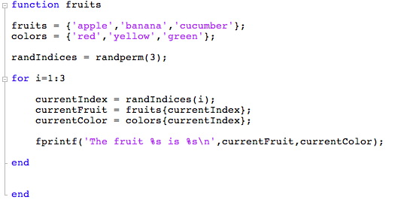

Slide 61
Permutation
PTB function Shuffle() will take a vector or matrix, and return to you the items in random order
If the input has multiple rows, each column will be shuffled, but numbers will stay in their columns. Note this multi-column shuffle does not work with cell matrices.

Slide 62
>> fruits = {'apple','banana','cucumber'};
>> fruits = Shuffle(fruits)
fruits =
'apple' 'cucumber' 'banana'
>> fruits = {'apple','banana','cucumber'; 'red','yellow','green'}
fruits =
'apple' 'banana' 'cucumber'
'red' 'yellow' 'green'
>> fruits = Shuffle(fruits)

Slide 63
Other randomization functions
RandSample()
ChooseKFromN()
RandSel()
URandSel()
CoinFlip()

Slide 65
Priority
Modern computers have multiple software processes constantly competing for access to resources.
How these resources are allocated moment to moment can affect the execution of your script

Slide 66
Priority
Recommendation: When you are testing with PTB, close applications other than Matlab
Use PTB's Priority function to assign a priority to the execution of your process

Slide 67
Priority
Use Priority() to set the priority level
The higher the priority level, the less chance there is of other processes interfering with your script
Available levels and their functions differ depending on your OS

Slide 68
Priority: OSX
OSX: Priority levels range from 0-9 and relate to the percentage of CPU time guaranteed to the PTB thread
However, if you use too much CPU, the OS may kick you back down to level 0
If you frequently call WaitSecs or Flip, you are unlikely to be demoted

Slide 69
Priority: Windows
On Windows there are 3 levels available:
0 : normal priority level
1: high priority level
2: real time priority level
Using level 2 may cause problems (for example, it may disable keyboard input). Probably only want to use this when absolutely necessary, for example when running an intense animation where timing really matters.

Slide 70
Priority
MaxPriority(windowOrScreenNum) will tell you the maximum priority allowed on your system
Not recommended to use greater than 1 on windows

Slide 71
Priority
whichScreen = max(Screen('Screens'));
maxPriorityLevel = MaxPriority(whichScreen);
Priority(maxPriorityLevel);
These lines would go at the beginning of your script to set priority level for that script

Slide 72
Testing for OS
>> IsOSX
ans =
1
>> IsWindows
ans =
0
if IsOSX
%OSX specific code here
elseif IsWindows
%Windows specific code here
end

Slide 74
Code organization
Functions and subfunctions
In your script all of the following functions are available to you:
Built in Matlab functions
Any functions whose name is a filename in your current directory
Any functions whose name is a filename in another folder when that folder is in your Path

Slide 75
Functions and subfunctions
Outsource repeated and often-used code to its own function
Remember variable scope! Variables that exist in one function will not be available to another, unless you pass them as parameters

Slide 76
function addEmUP(x,y)
addedUp = x + y;
printItOut();
end
function printItOut
fprintf('The output is: %d\n',addedUp);
end
function addEmUP(x,y)
addedUp = x + y;
printItOut(addedUp);
end
function printItOut(numToPrint)
fprintf('The output is: %d\n',numToPrint);
end

Slide 77
function welcomeUser
[wPtr,rect] = Screen('OpenWindow',1);
myText = 'Welcome to my script';
drawAtCenter(myText);
KbWait();
myText = 'So, here we are.';
drawAtCenter(myText);
KbWait();
end
function drawAtCenter(theText)
DrawFormattedText(wPtr,theText,'center','center');
end

Slide 78
function welcomeUser
[wPtr,rect] = Screen('OpenWindow',1);
myText = 'Welcome to my script';
drawAtCenter(myText);
KbWait();
myText = 'So, here we are.';
drawAtCenter(wPtr,myText);
KbWait();
end
function drawAtCenter(wPtr,theText)
DrawFormattedText(wPtr,theText,'center','center');
end

Slide 80
Acccessing the web
web(url) to open url in matlab web browser
web(url,'-browser') to open in system browser

Slide 81
Invoking programs outside Matlab
system()
>> system('open –a Textedit.app')

Slide 82
Other PTB toolboxes
PsychGLImageProcessing
PsychVideoCapture
PsychColorimetric
PsychKinect

Slide 84
Final Exam
Full Experiment. Must:
Write the entire thing from scratch yourself
Take subject code and any relevant conditions as inputs
Present repetitive trials that involve at least 2 different conditions
Must present either visual or auditory stimuli (or both)
Must collect some kind of behavioral response where timing is recorded
Must write responses out to a log file
Please run your experiment plan by me as soon as possible. If you don't have something you are working on now, I will make something up for you.

