Slide 1


(Computer Engineering and Technology) (TYB.Tech)
Subject : Data Warehouse and Data Mining
Flagship University of MIT Group of Institutions
MIT-WPU is recognized by UGC and Approved by AICTE
M. Tech. (Computer Science & Engineering)
Notes:
© Copyright Showeet.com – Free PowerPoint Templates

Slide 2
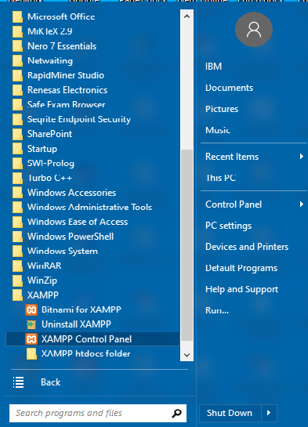
Data Preparation
Start → All Programs->XAMPP->XAMPP Control Panel

Slide 3
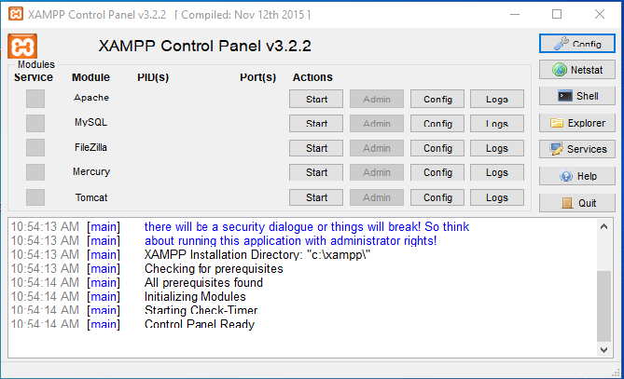
Data Preparation
Start all the services by pressing button start

Slide 4
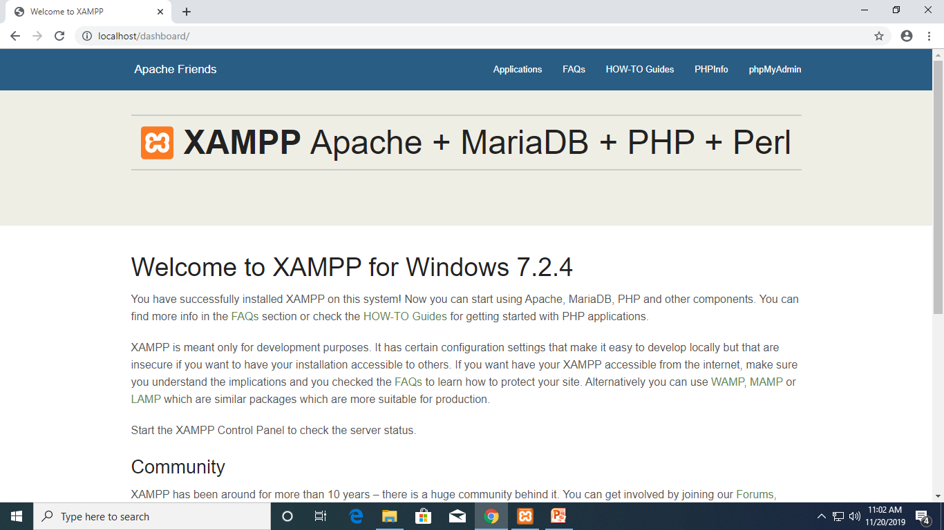
Data Preparation
Open browser and type
localhost/dashboard/

Slide 5
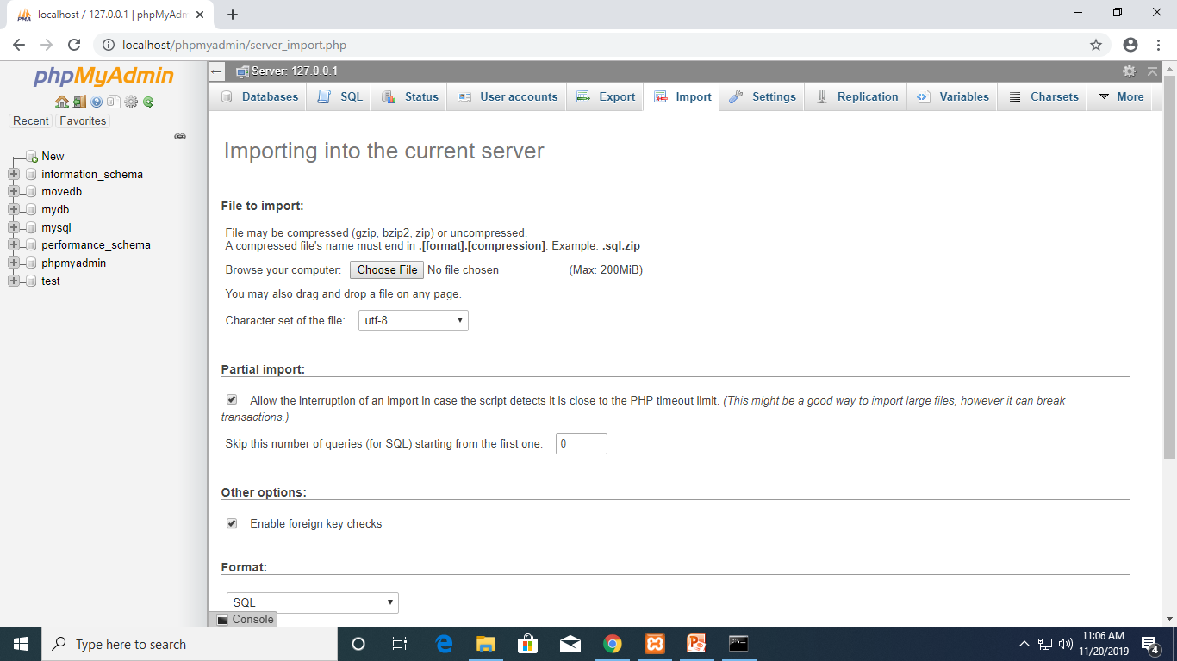
Data Preparation
Click on phpMyadmin
Import dump.sql

Slide 6
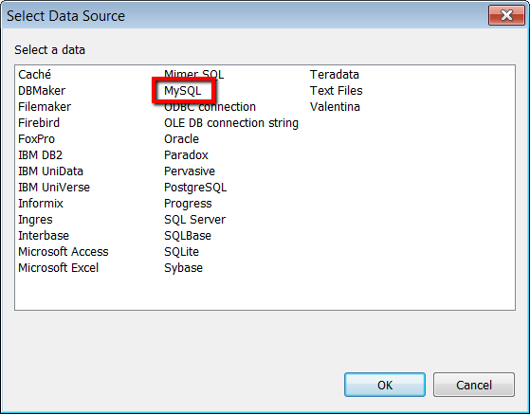
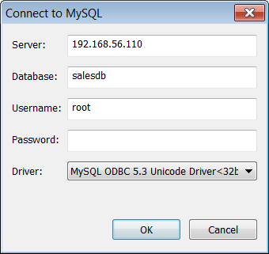
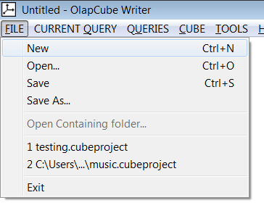
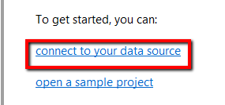
Connect to Data Source
Open OlapCube
Select File → New and connect to MySQL data source

Slide 7
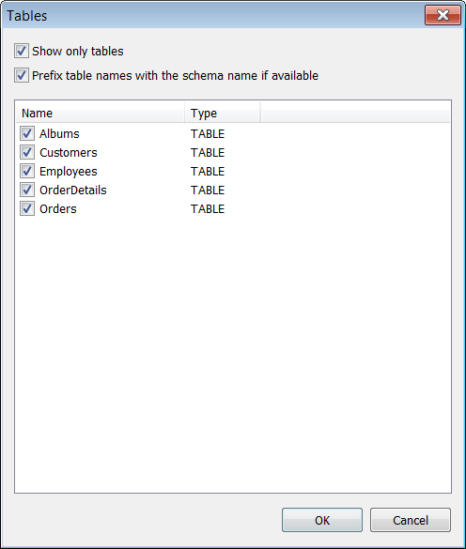
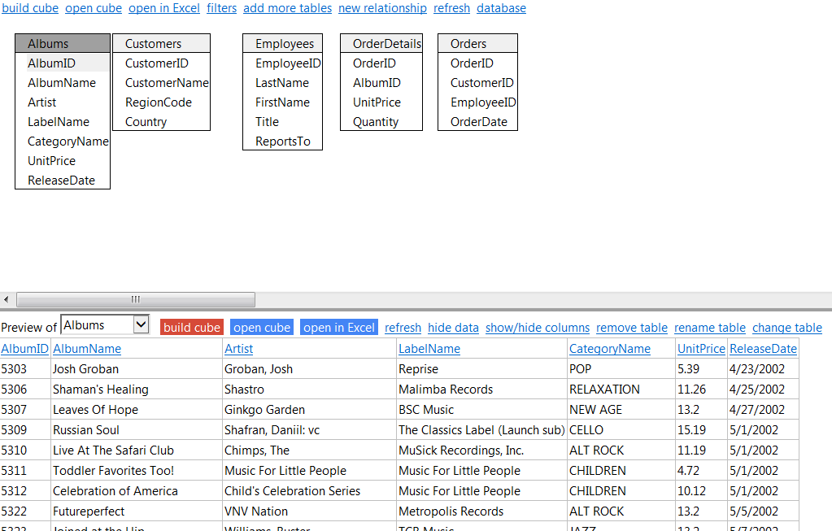
Source Tables
Select all tables from source database
* Clicking on any table will show its data

Slide 8
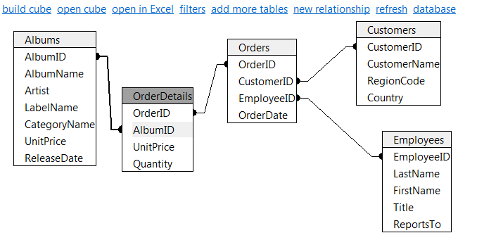
Creating STAR Schema
Drag and drop fields from Orders table to join with other tables
Order table is the key table holding facts about the business transaction
Albums, Customers, Employees tables hold additional attributes

Slide 9
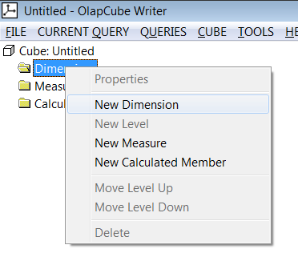
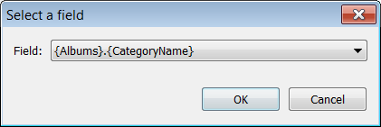
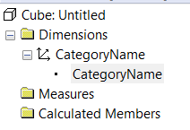
Create Dimensions
In left hand side tree, select Dimensions → New Dimension
Select CategoryName from Albums table as a dimension

Slide 10
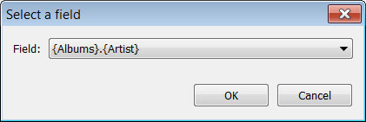
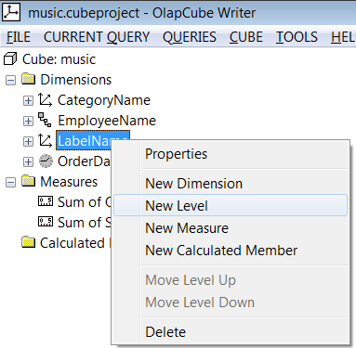
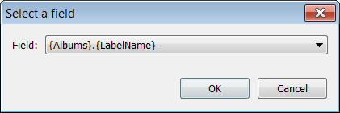

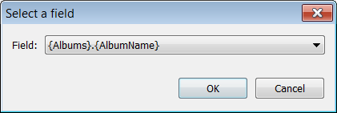
Create Hierarchical Dimensions
Create New Dimension with field Albums.LabelName
Add new level Albums.Artist followed by another level Albums.AlbumName

Slide 11

Create Hierarchical Dimensions
Similarly create Hierarchical Date dimension as shown below

Slide 12
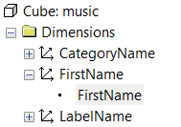
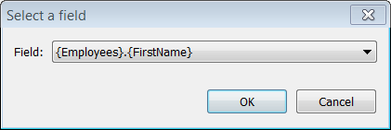
Create Relational Dimension
Add new dimension using field Employee.FirstName

Slide 13
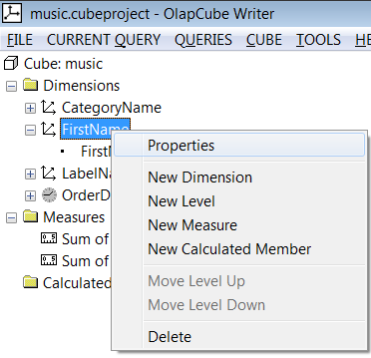
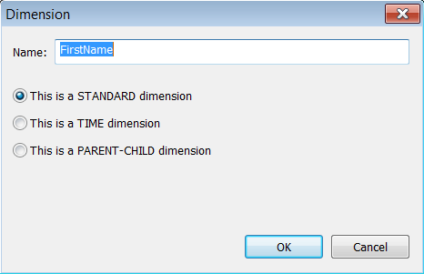
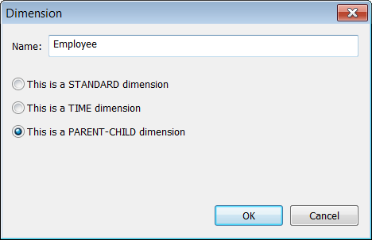
Create Relational Dimension
Rename Dimension name selecting properties option
Also, change type of dimension from STANDARD to PARENT-CHILD

Slide 14
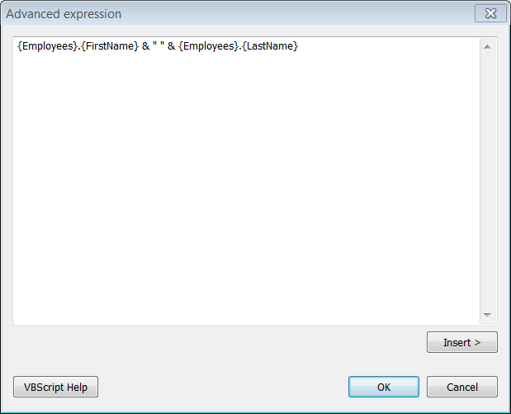
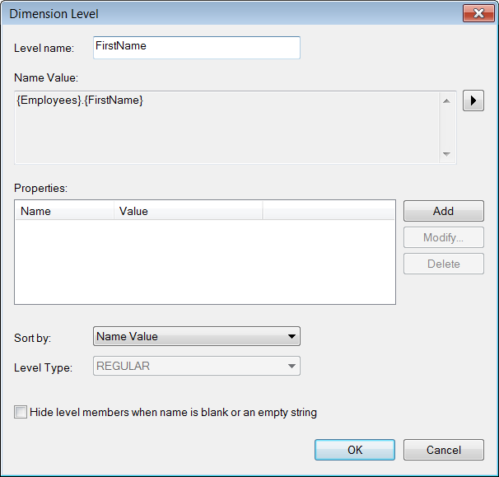
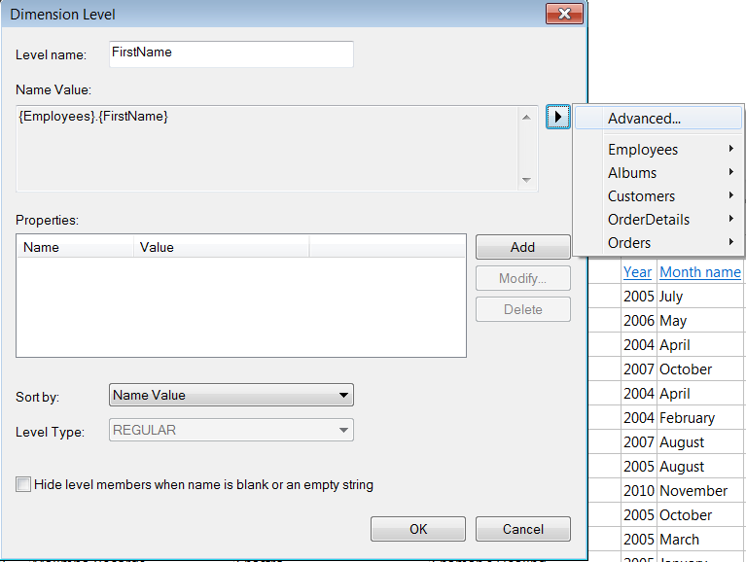
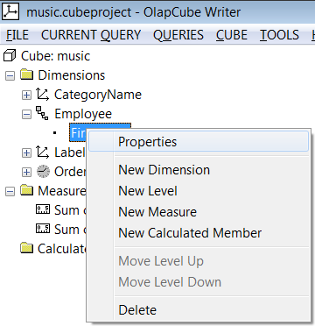
Create Relational Dimension
Right click level item and select properties

Slide 15
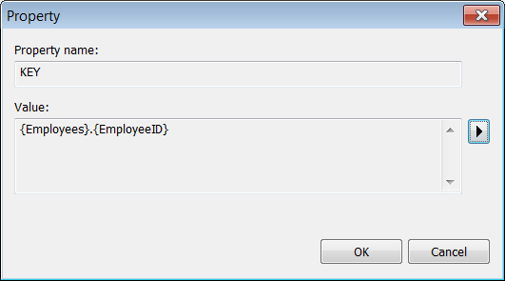
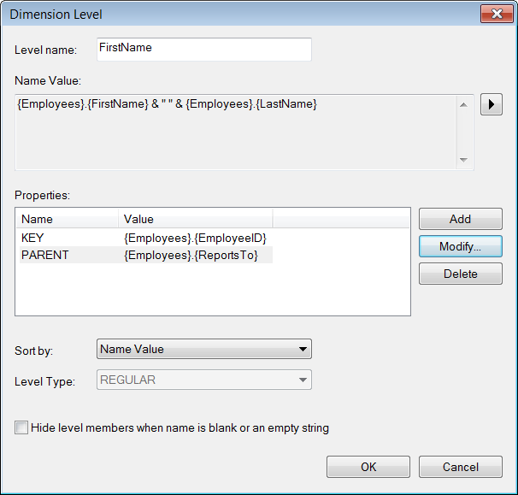
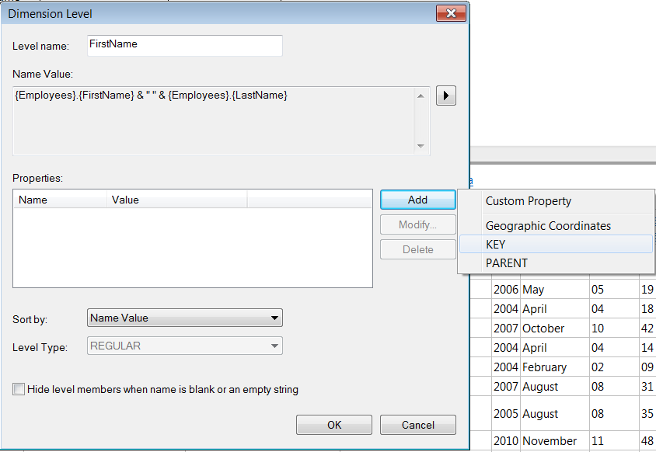
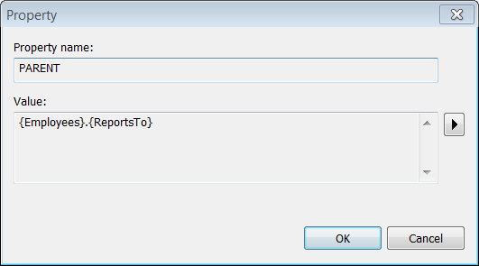
Create Relational Dimension

Slide 16
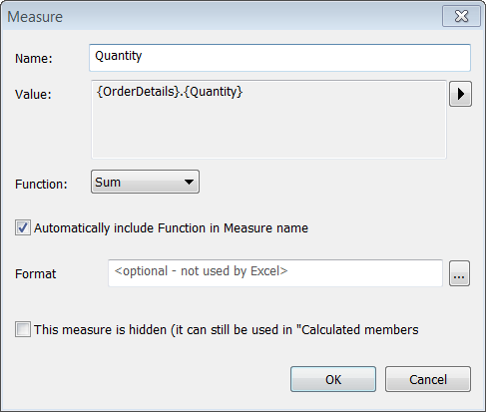
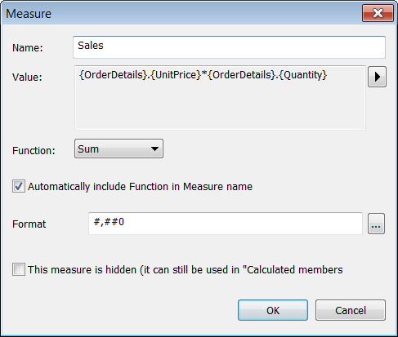
Create Measures
Create measures for
Sum of Order Quantity
Sum of Sale

Slide 17
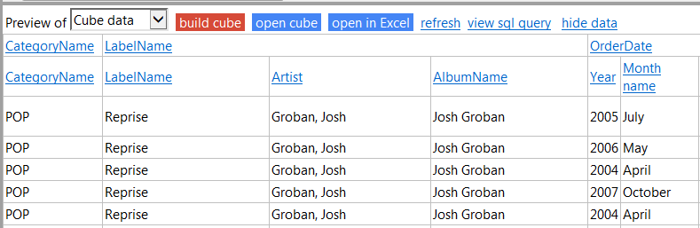
Build Cube
Click on build cube option to build the build from the schema

Slide 18
Reports

Slide 19
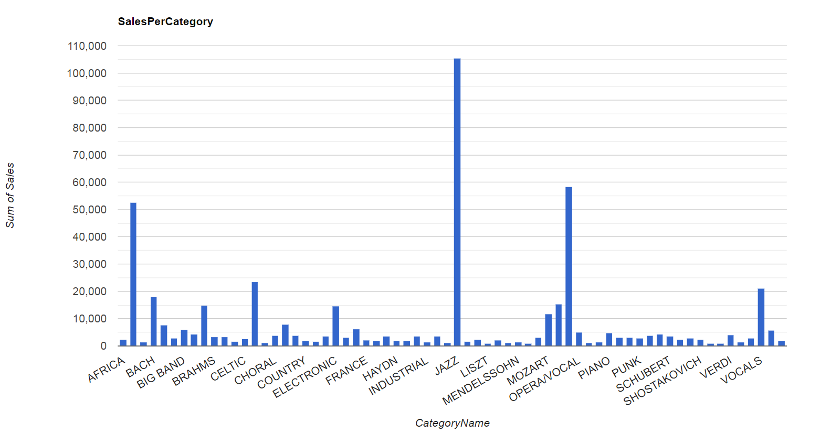
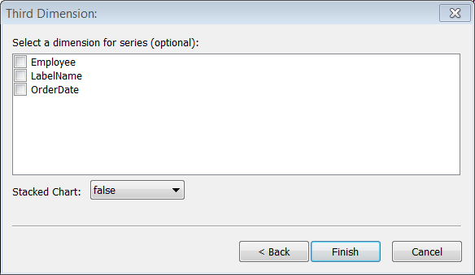
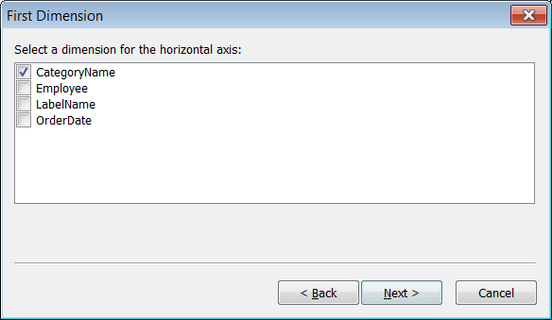
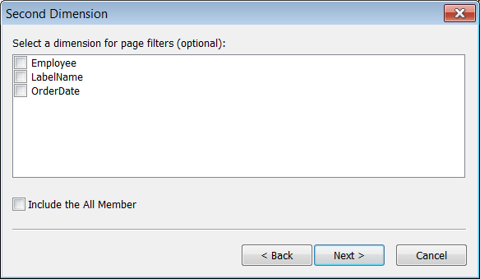
Sales Per Category
Add New Bar Chart to show total sales per category

Slide 20
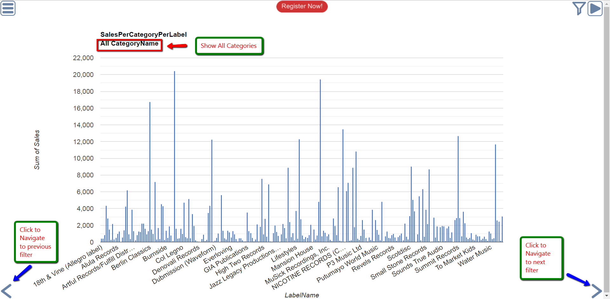
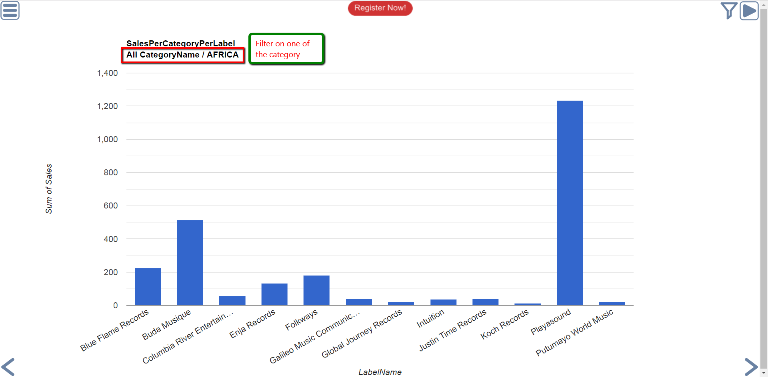
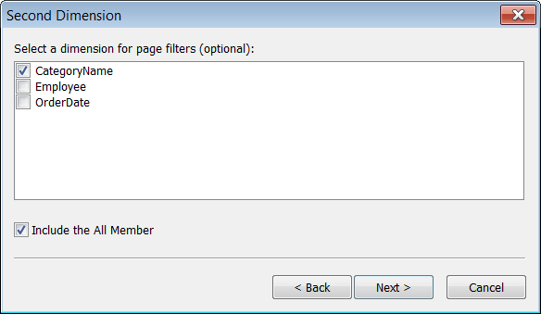
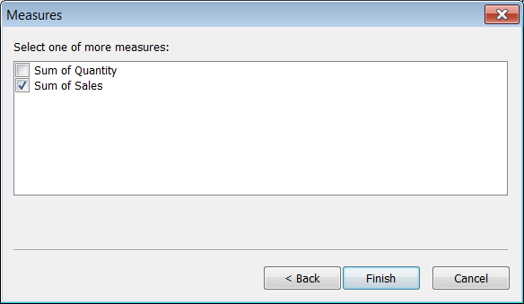
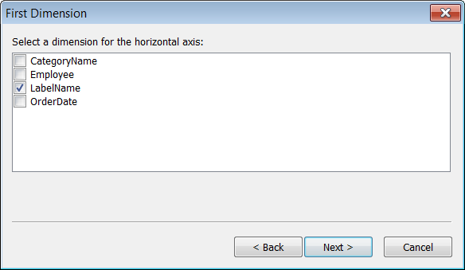
Sales Per Category Per LabelName

Slide 21
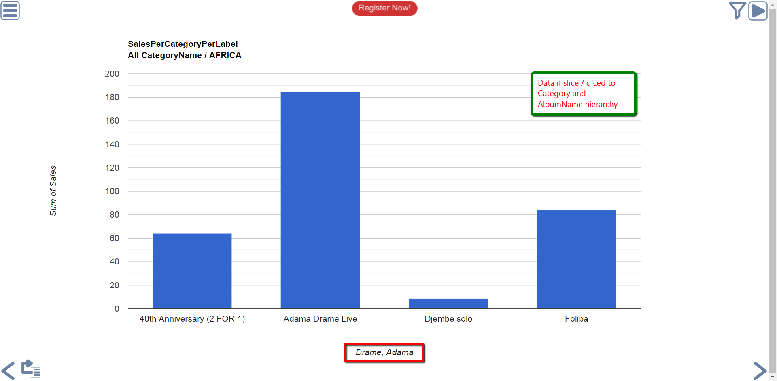
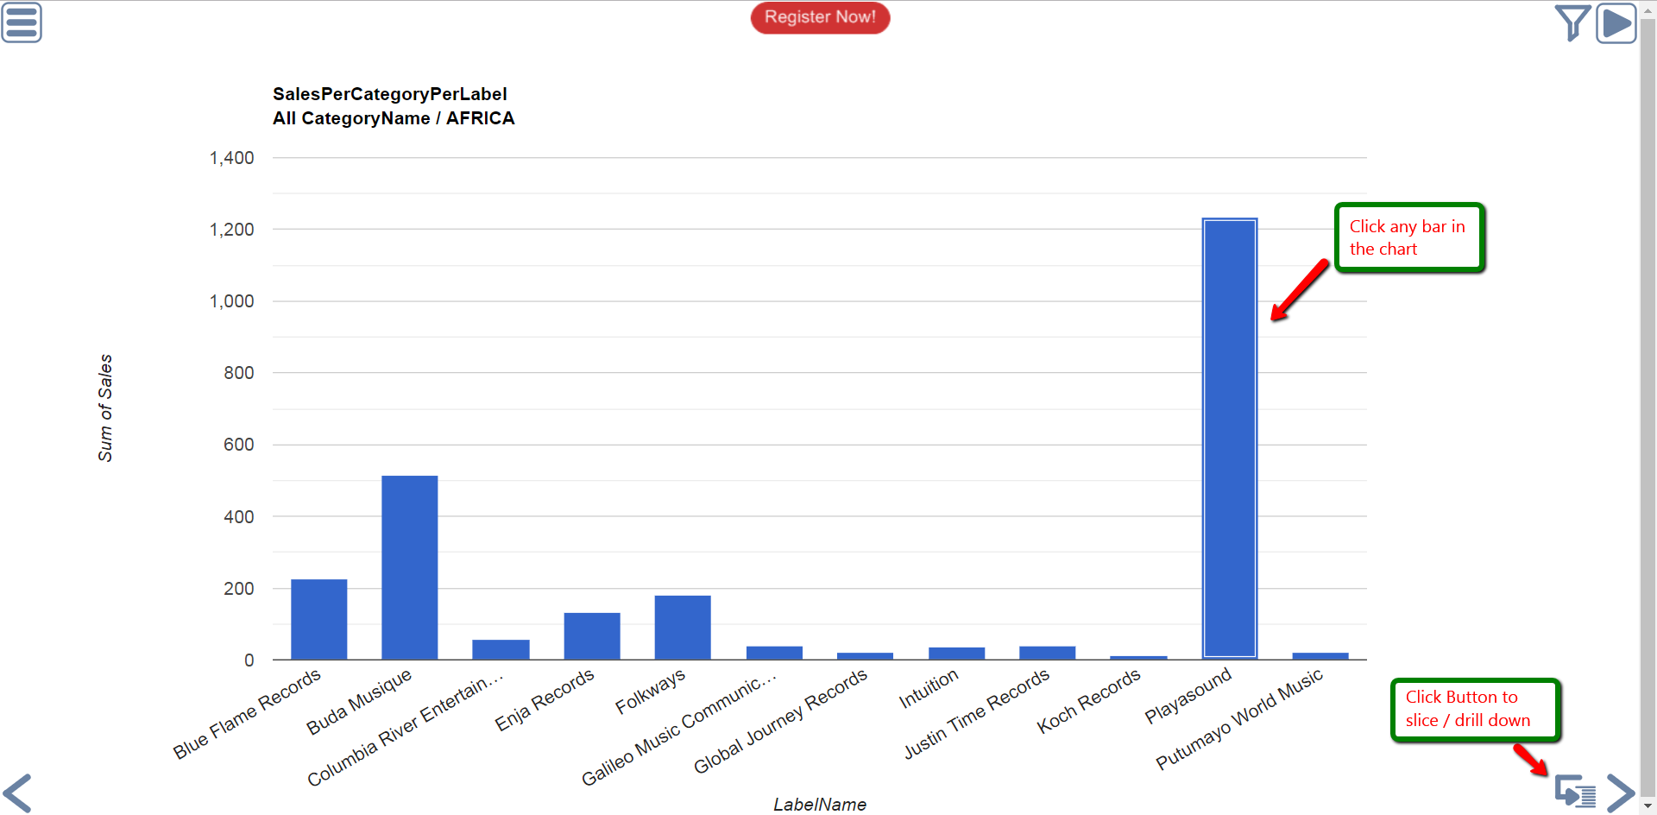
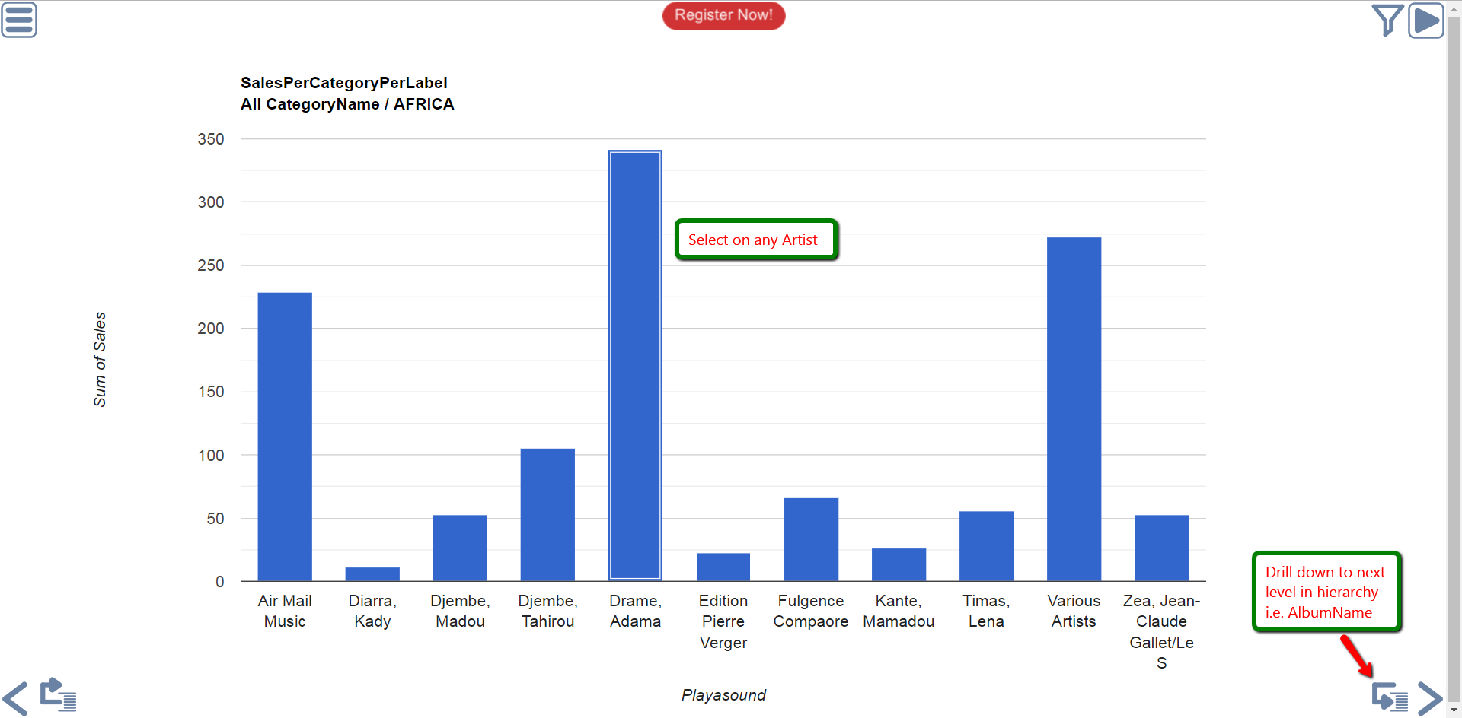
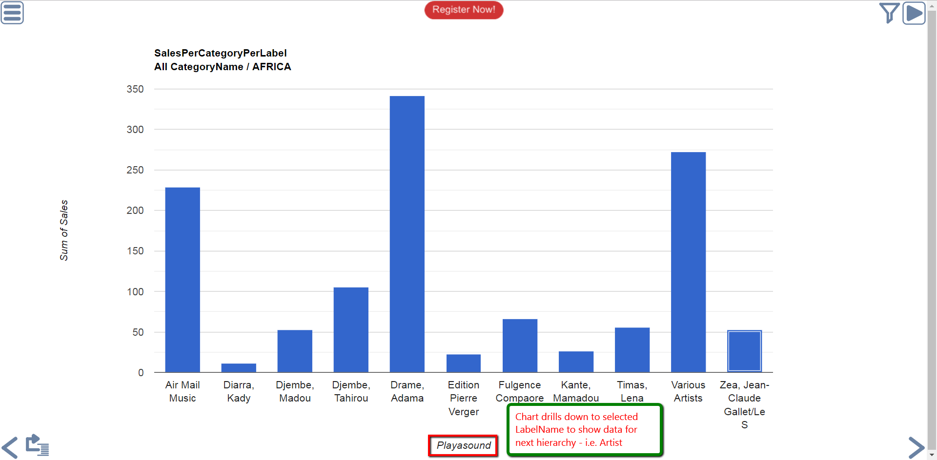
Slice Data on Hierarchical Dimension

Slide 22
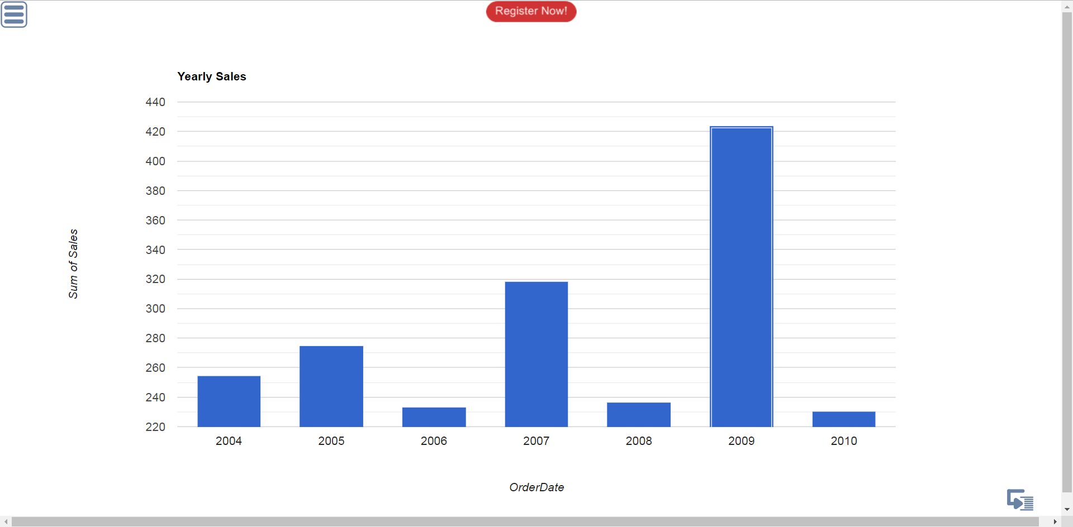
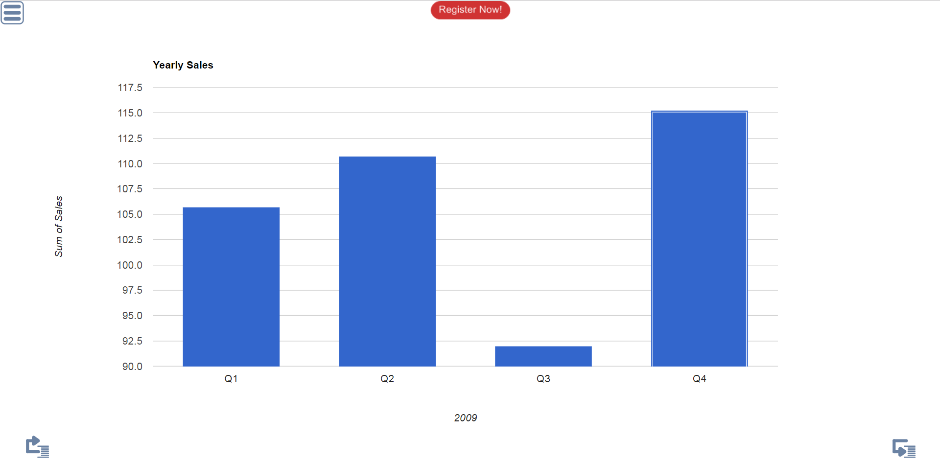
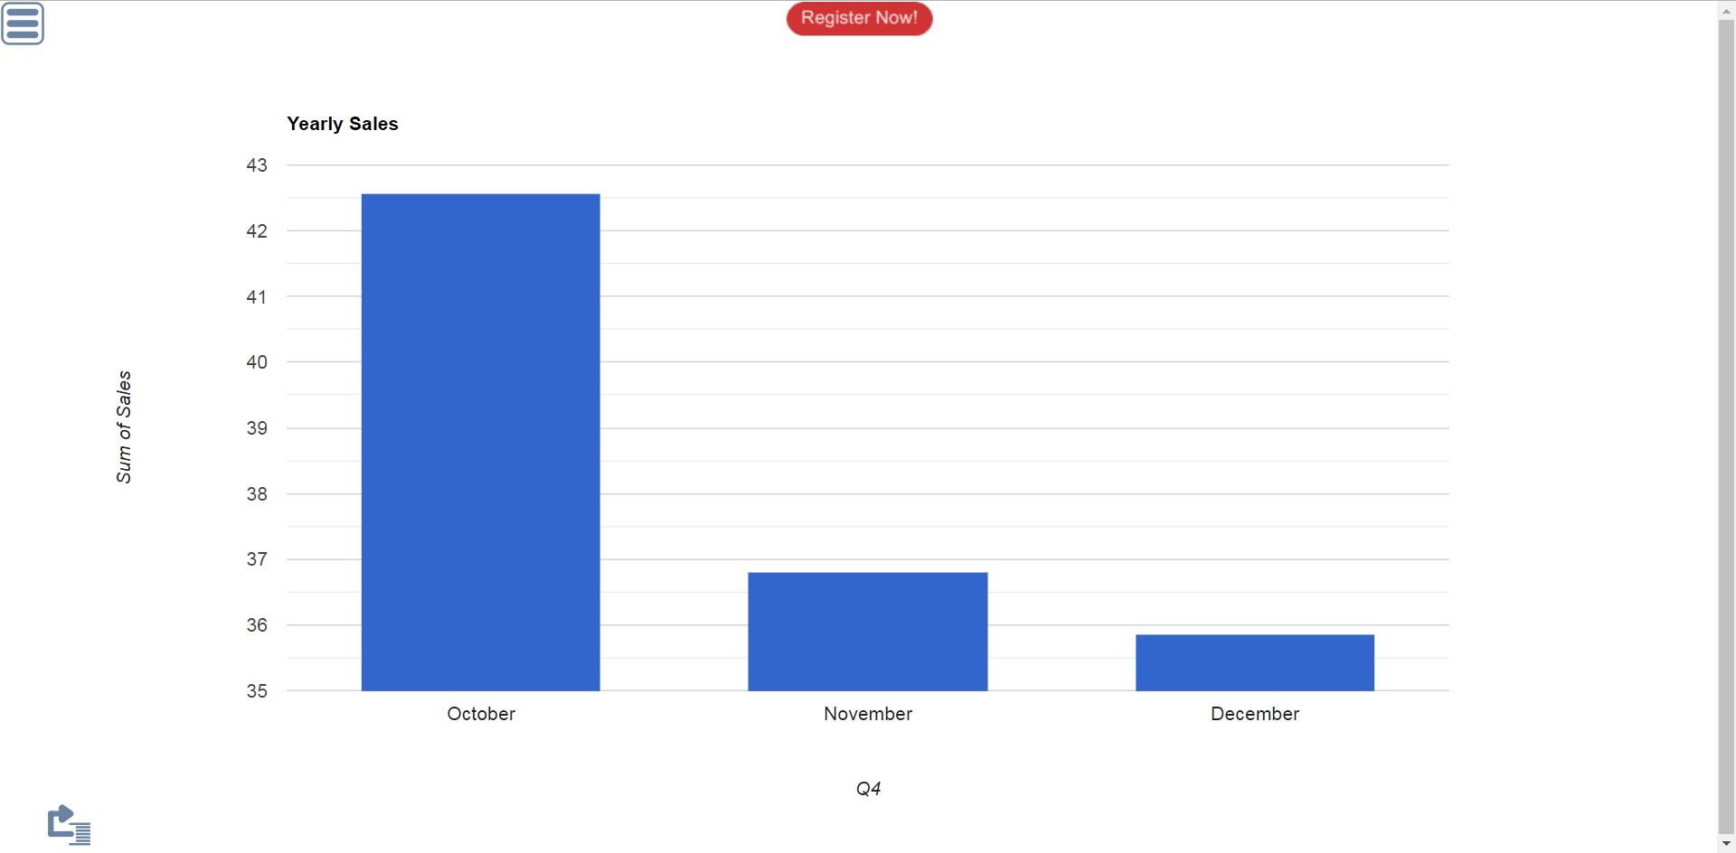



Slice Data on Hierarchical Date Dimension

