Slide 1

Median Balancing: A Linearly Convergent Algorithm for Time Gain Power Correction
Sketching and Learning Seminar
May 2015
Yenming (ICES), Eric Price (CS), Rachel Ward (MATH), Sergey Fomel (BEG)

Slide 2
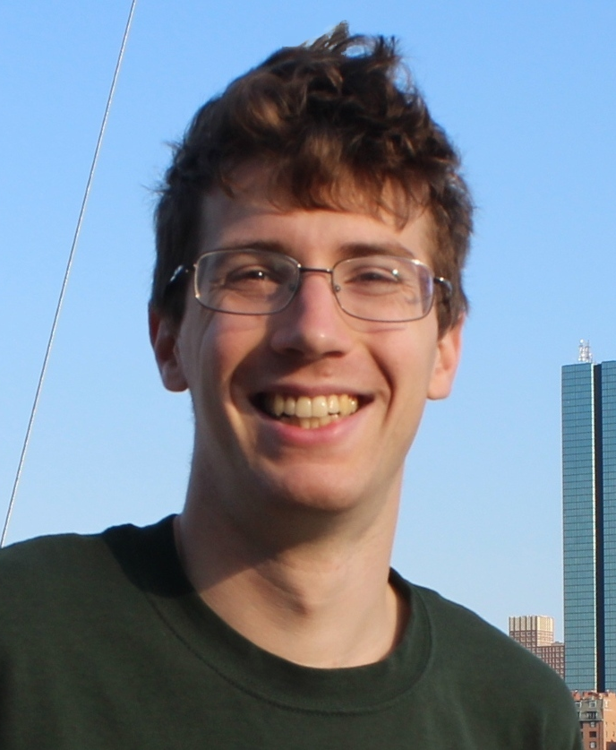
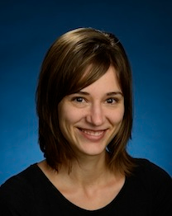
Eric Price
Assistant Professor
Computer Science
Algorithms, Lower Bounds
Rachel Ward
Assistant Professor
Mathematics
Mathematical Signal Processing

Slide 3
4 second attenuated trace
observed trace
1
3
5
Time (seconds)

Slide 4
Assume time power loss
power loss (unknown)
1
3
5
Time (seconds)

Slide 5
Assume time power loss
power loss (unknown)
observed trace
correct trace
1
3
5
Time (seconds)

Slide 6
Goal: Find power gain
Find this number e.g. 2.07
1
3
5
Time (seconds)

Slide 7
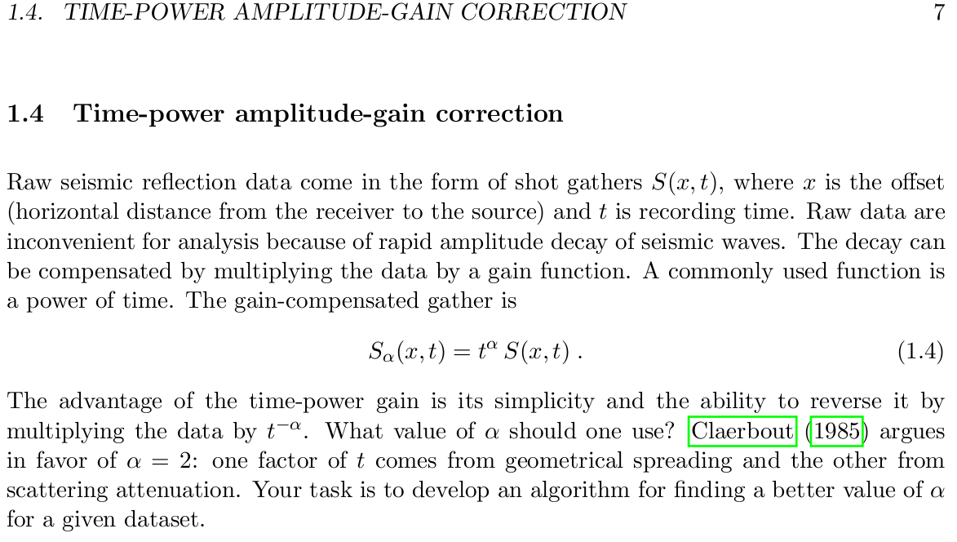
GEO 391: Homework 1

Slide 8
What gave you the idea to do median balancing?

Slide 9
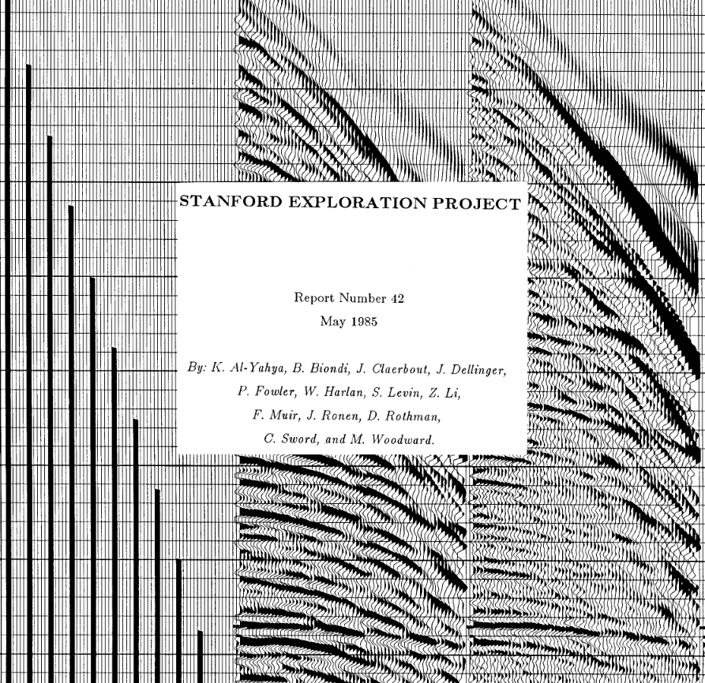

Slide 10
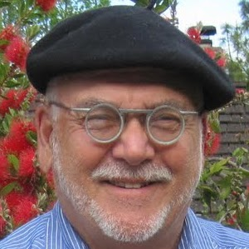

Jon Clarebout
Cecil Green Professor Emeritus of Geophysics
Stanford University
SEG Maurice Ewing Medal
Zhiming Li
Senior VP Data Processing, R&D
TGS
SEG Cecil Green Enterprise Award
Notes:
Joined small startup PDS as 3rd owner in 2002, PDS was sold to TGS-NOPEC in 2007 for US$72.5 million.

Slide 11
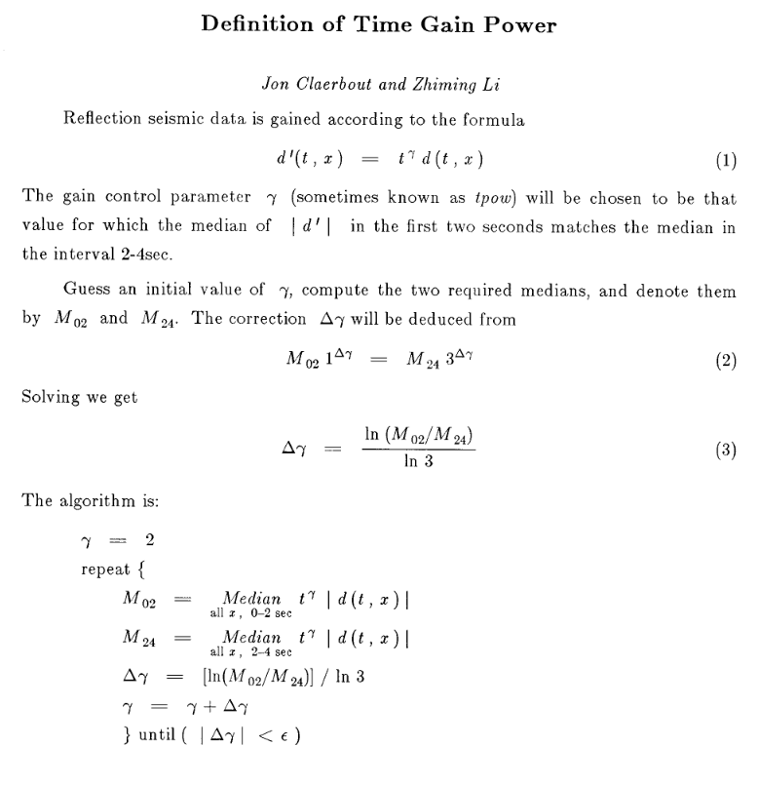
5 sentences
7 lines

Slide 12
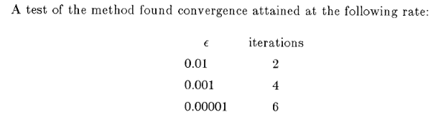
no figures, unknown data set
1 ¼ page report – nothing else!

Slide 13
That's interesting. Can you explain the algorithm in plain English?

Slide 14
Assume left and right median of correct signal equal
(1.4,2.3)
(4.6,2.3)
2.3
1
1.4
2.3
3
4.6
5
Time (seconds)

Slide 15
Apply correct gain to d[t],
recover c[t] and ...
1
3
5
Time (seconds)

Slide 16
left median = right median
1
1.4
3
4.6
5
Time (seconds)

Slide 17
Apply too large of gain to d[t],
then ...
1
3
5
Time (seconds)

Slide 18
left median < right median
1
3
5
Time (seconds)

Slide 19
Apply too small of gain to d[t],
then ...
1
3
5
Time (seconds)

Slide 20
left median > right median
1
3
5
Time (seconds)

Slide 21
Median Balancing Algorithm
1) Choose gamma (time power)
2) Apply gamma to observed trace
3) If left median > right median
________ gamma
Elseif left median < right median
________ gamma
Else
return gamma
Repeat 2) and 3)
Quiz: increase or decrease?

Slide 22
Median Balancing Algorithm
1) Choose gamma (time power)
2) Apply gamma to observed trace
3) If left median > right median
increase gamma
Elseif left median < right median
decrease gamma
Else
return gamma
Repeat 2) and 3)

Slide 23
How do you know the algorithm is guaranteed to find the true gamma?

Slide 24
Ex:
Quiz: Want large or small μ?

Slide 25
Got it. So what convergence rate guarantee μ did you derive?

Slide 26
Inner Endpoint Ratio
1
2.99
3
5
Inner endpoint ratio e.g. 3.00/2.99
(gap between partitions)

Slide 27
Outer Endpoint Ratio
1
2.99
3
5
outer endpoint ratio e.g. 5.00/1.00
(partition spread)

Slide 28
Convergence Rate Guarantee = μ
To get small μ, want large inner endpoint ratio e.g. large gap between partition

Slide 29
Convergence Rate Guarantee = μ
To get small μ, also want small outer endpoint ratio e.g. small spread of partitions

Slide 30
Convergence Rate Guarantee = μ
To get small μ, want medians in middle

Slide 31
If consecutive signal values including right end point,
(1) occur to right of ungained median
(2) are larger than ungained median
then any time power gained median will occur to left of values
ungained median
“perpetual elite”
1
3
5

Slide 32
Can you sketch the convergence proof for me? I don't want to get lost in details.

Slide 33
Median Balancing Algorithm
1) Choose gamma (time power)
2) Apply gamma to observed trace
3) If left median > right median
increase gamma
Elseif left median < right median
decrease gamma
Else
return gamma
Repeat 2) and 3)

Slide 35
3) If left median > right median
increase gamma
Elseif left median < right median
decrease gamma
Else
return gamma

Slide 36
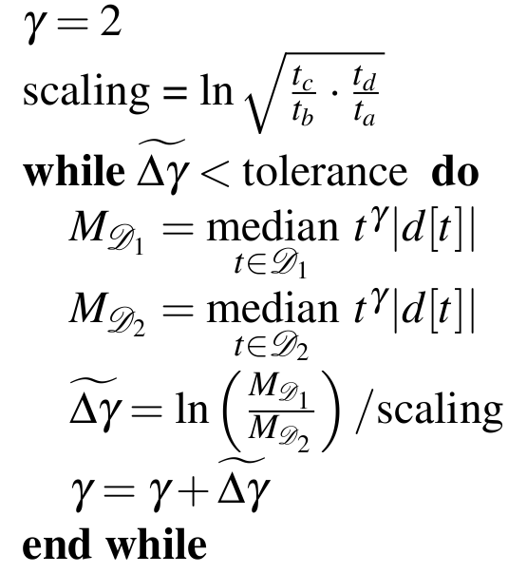
initial guess
step size, based on endpoint ratios
apply gamma to trace and compute left and right medians
calculate correct step
set new gamma

Slide 37
Idea 1: How do these medians (gamma guess) relate to true medians?

Slide 38
Idea 2: How does gamma guess median ratio relate to true median ratio ?

Slide 39
Idea 1: How do these medians (gamma guess) relate to true medians?

Slide 41
Penalty for not guessing correctly

Slide 42
Claerbout, Li (1985): assume median in middle

Slide 43
Lai,Price,Ward,Fomel (2015): Find lower and upper bounds

Slide 44
Idea 2: How does gamma guess median ratio relate to true median ratio ?

Slide 45
bound true ratio with guess ratio

Slide 46
bound true ratio with guess ratio
take natural log, rearrange terms, scale

Slide 47
bound true ratio with guess ratio
take natural log, rearrange terms, scale
subtract (true gamma – gamma), take absolute value

Slide 48
Can you show me some numerical results?

Slide 49
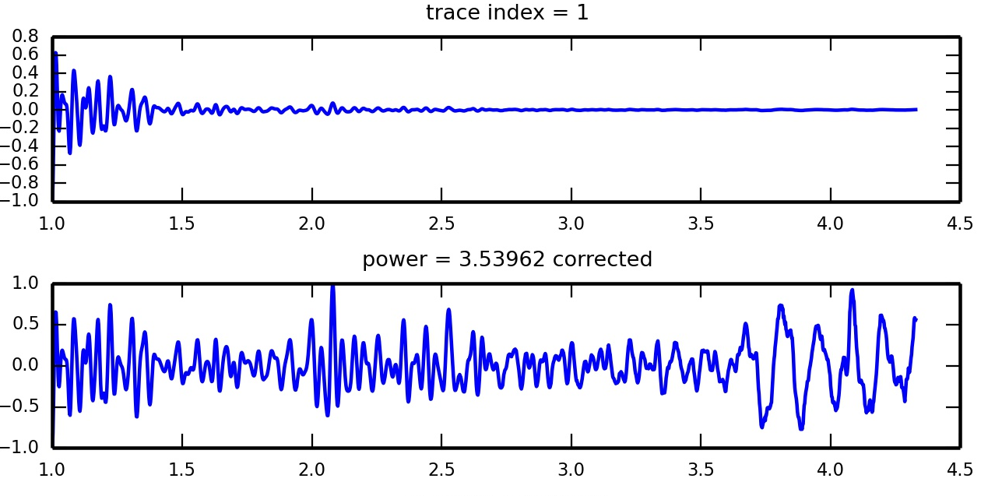
tolerance | iterations
0.01 = 1e-2 | 9
0.001 = 1e-3 | 12
0.0001 = 1e-4 | 14
0.00001 = 1e-5 | 16

Slide 50
Summary
(1) Reexamined 30 year old median balancing algorithm
(2) Modified step size to accelerate convergence
(3) Showed convergence rate if partition medians equal

Slide 51
Questions?
iteration=0, delta=0.657113, exponent_power=2.65711, median_1=(1.842,0.0636322), median_2=(1.858,0.0242857)
iteration=1, delta=0.372398, exponent_power=3.02951, median_1=(1.792,0.0947899), median_2=(1.444,0.0549147)
iteration=2, delta=0.226251, exponent_power=3.25576, median_1=(2.426,0.118839), median_2=(2.582,0.0852952)
iteration=3, delta=0.132414, exponent_power=3.38818, median_1=(2.04,0.134562), median_2=(1.588,0.110822)
iteration=4, delta=0.069469, exponent_power=3.45764, median_1=(2.496,0.144241), median_2=(2.63,0.130276)
iteration=5, delta=0.0339302, exponent_power=3.49157, median_1=(1.85,0.149619), median_2=(1.15,0.14236)
iteration=6, delta=0.0238456, exponent_power=3.51542, median_1=(1.458,0.15307), median_2=(1.892,0.147812)
iteration=7, delta=0.0131718, exponent_power=3.52859, median_1=(1.93,0.155382), median_2=(2.632,0.152411)
iteration=8, delta=0.00598175, exponent_power=3.53457, median_1=(1.93,0.156733), median_2=(2.632,0.155365)
iteration=9, delta=0.002839, exponent_power=3.53741, median_1=(1.93,0.157351), median_2=(2.316,0.156698)
iteration=10, delta=0.00143725, exponent_power=3.53885, median_1=(1.93,0.157645), median_2=(2.316,0.157313)
iteration=11, delta=0.000529731, exponent_power=3.53938, median_1=(1.46,0.157748), median_2=(2.316,0.157626)
iteration=12, delta=0.000167323, exponent_power=3.53955, median_1=(1.46,0.15778), median_2=(2.316,0.157741)
iteration=13, delta=5.28512e-05, exponent_power=3.5396, median_1=(1.46,0.15779), median_2=(2.316,0.157778)
iteration=14, delta=1.66938e-05, exponent_power=3.53962, median_1=(1.46,0.157793), median_2=(2.316,0.157789)
iteration=15, delta=5.27296e-06, exponent_power=3.53962, median_1=(1.46,0.157794), median_2=(2.316,0.157793)

