Slide 1
Speaker Bonnet
Ryan Antolin N01100308 CENG317

Slide 2

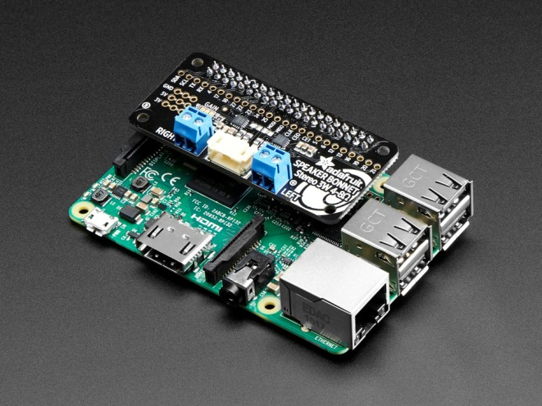
Introduction to Speaker Bonnet
- A speaker bonnet is a stereo amplifier for the raspberry pi.
- Uses I2S (inter-ic sound) digital sound standard for quality audio (no static).
- Standard 20pin for all the raspberry pi versions.
- Power use: 5v/2.4A recommended.
- Recommend speakers: 4Ω 3W or 8Ω 1W (demo)
Notes:
I2S Audio Interface provides a bidirectional, synchronous, serial interface to off-chip audio devices.

Slide 3
Budget for project
Raspberry PI 3 Model B Starter Kit $99
Speaker – 3” DIAMETER 8OHM 1WATT $2.44
3W Stereo Speaker Bonnet Raspberry Pi $16.19
Total Price: $132.92

Slide 4
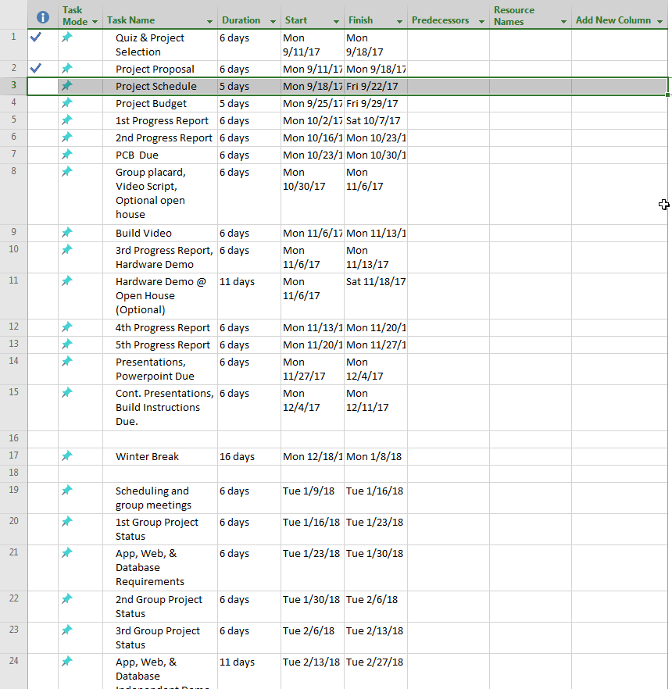

Project schedule

Slide 5
Demo project/Course Knowledge
Here’s a demo of the project. Music should be playing onto the speaker using mpg123 or mPlayer.
Course Knowledge:
Soldering parts
Updating github weekly to keep up on progress
Installing drivers for the Bonnet.
Learning about how useful a raspberry pi can be.

Slide 6
End thank you for listening

