Slide 1
GitHub Orgs Webhooks/ Workflows

Slide 2


Agenda
Choose one approach to grab the audience’s
GitHub Actions
Workflow Differences
GitHub WebHook Workflow Diagram
GitHub Webhook for Org changes

Slide 3
GitHub Actions
Github actions helps us to Automate the tasks in the development workflow
This can be Triggered based on Event or It can be scheduled
For Example:
The Action can be ran when some events happened on the Github repo while Performing commits to a specific branch or PR

Slide 4
GitHub Actions
GitHub Actions are Event driven automated procedures that can be added to the repository.
We can use the GitHub actions to perform the code scan, Vulnerability scan and Lint
Additionally we also add workflows to perform code checks to validate the Organizational standards
October 2015
August 2015
November 2015

Slide 5
GitHub Actions
October 2015
WORKFLOWS
Workflows can be Added to the repository itself under root .github/workflows/<workflowname>.yml
Events
Events are the triggers that can be added to the workflows
The Events can be triggered on Pull Request
August 2015
November 2015

Slide 6
GitHub Actions
October 2015
Jobs
We can add multiple jobs under a workflows, That can be run parallely
Inside the Jobs, We can have multiple steps, Which can be shell script/Action
Runners
Runners are the servers which has the Github runner application installed
Runners can be self hosted/Github hosted
August 2015
November 2015

Slide 7
Git Repo Regular Workflow
Git Commit/Push from Develop Machine
Merge with Develop
PR Creation
+
Review

Slide 8
Git Modified Workflow
Git Commit/Push from Develop Machine
PR Creation
GitHub Workflow
Review
Merge with Develop

Slide 9
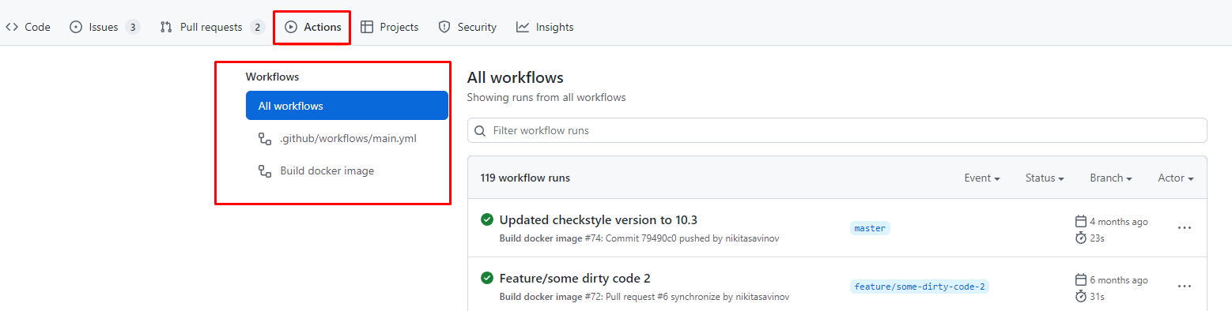
The Workflows created under the .github/workflows will be scanned on events and will be executed
The Workflows executions will be visible under Actions
The executions can be configured using the Runners as well - Self Hosted/ Github Hosted

Slide 10
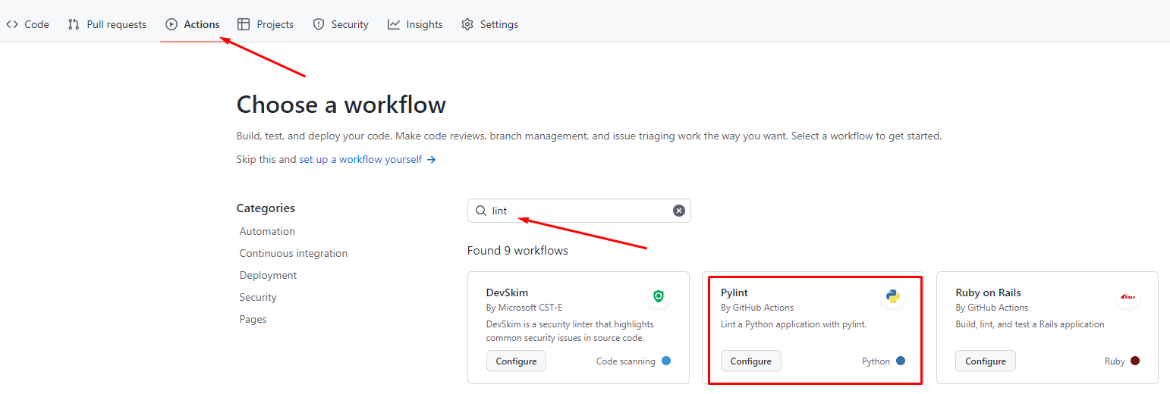
We can configure Custom workflows under Actions to perform specific pre checks on PR creation/ Every Commits
Lint (Pylint - Python)
Code Scan - CodeQL Analysis
Vulnerability Assessments - Contrast Scan
Image Scanning - Synk Container

Slide 11
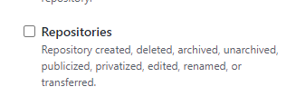
GitHub Webhooks
Orgs Changes
The Organization webhooks can be triggered to a Specific repo(Infra Repo in our case) where we maintain all our workflows
repository_dispatch Event can be triggered when there is a repo creation from organization webhook as mentioned below
October 2015
August 2015
November 2015

Slide 12
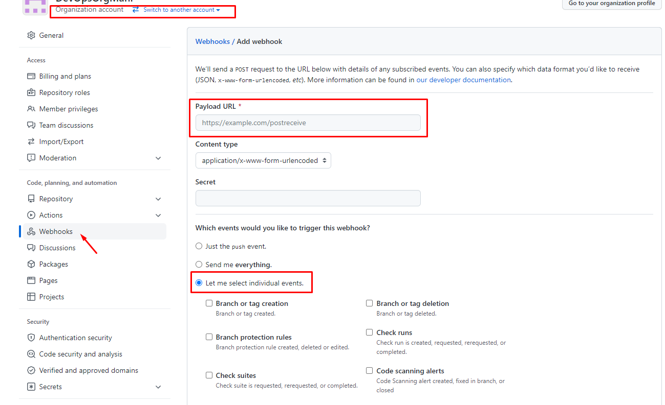
Under Webhooks we can provide the Infra repo action to trigger on repo creation curl -H "Authorization: token <YOUR_GITHUB_TOKEN>" \
--request POST \
--data '{"event_type": "<YOUR_EVENT_TYPE>"}' \
https://api.github.com/repos/<YOUR_GITHUB_USER>/<YOUR_GITHUB_REPO>/dispatches

Slide 13
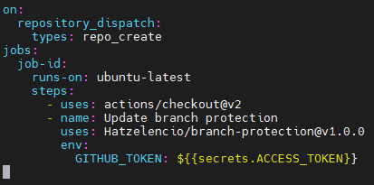
Branch Protection
Orgs Changes
Repo creation hooks will be trigger the org-hook-action.yml
Inside the workflow, The branch protection rules will be triggered to protect the branch specified on the config
October 2015
August 2015
November 2015

Slide 14
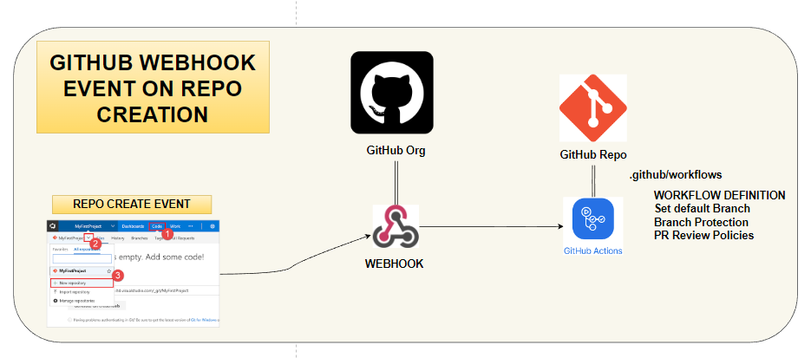
GitHub WebHook Workflow

Slide 15
WebHook Trigger
The Webhook must be created with repo created with Repository as Event
Once Repo creation, The webhook will be triggered against the Workflow to perform the branch_protection workflow
On Successful run, The Branch protection will be applied and Branch will be protected.
Along with Protection, We can define custom rules to the branches along with the branch protection like reviewers count, etc.

Slide 16

Good luck!
References:
https://docs.github.com/en/actions/using-workflows/workflow-commands-for-github-actions#setting-a-notice-message
https://docs.github.com/en/actions/using-workflows/creating-starter-workflows-for-your-organization

