Slide 1
NLP-Powered Mental Health Assessment: Analyzing Speech with Text Conversion MoodPredict
Capstone Project
Digital Solutions Management
Dhrumilkumar Panchal (8854214)
Prabhnoor Kaur (8856211)
Shalmonne Berson (8852748)
Shivani Nalamati (8853177)

Slide 2




Team: DPS²
Dhrumilkumar Panchal
Prabhnoor Kaur
Shalmonne Berson
Shivani Nalamati
NLP Specialist
Project Leader
QA Engineer
Data Analyst

Slide 3
Agenda
Introduction and Problem Statement
Use Case Diagram
Features
Benefits
Business Case
Stakeholder Analysis
Personas
Requirement Gathering
Implementation
Conclusion

Slide 4

Introduction and Problem Statement
This project introduces Mood Predict, an advanced platform leveraging Natural Language Processing (NLP) and machine learning to predict emotional states through speech patterns.
With a focus on addressing the inadequacies in mental health care in Canada, Mood Predict aims to empower individuals by providing insights into their emotional well-being. The project seeks to bridge the existing gaps in mental health support, offering early intervention and personalized assistance through innovative technological solutions.

Slide 5
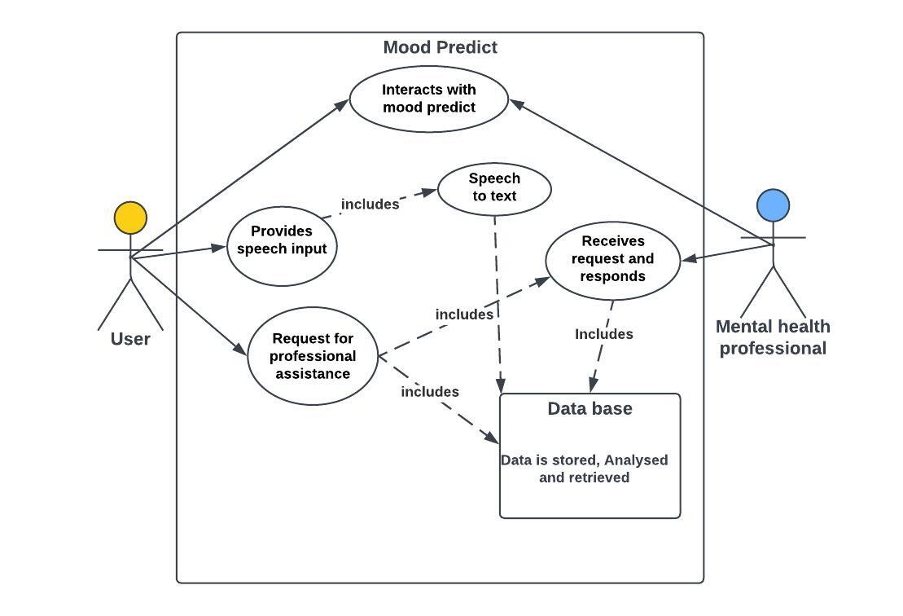
Use Case Diagram

Slide 6
Features
Speech Analysis: Utilizes advanced Natural Language Processing (NLP) and machine learning to analyze speech patterns, including tone, pitch, cadence, and word choice.
Real-Time Feedback: Users receive immediate feedback on their emotional state through a user-friendly interface.
Dashboards: Provides user-friendly dashboards displaying historical and emotional data, medical records for reference, and progress graphs.
Advanced Mood Tracking: Records and analyzes additional data such as sleep patterns, heart rates, and dietary information for a comprehensive understanding of emotional well-being.

Slide 7
Features
Real-Time Emotional Support (AI-powered Conversational Agent): Incorporates an AI-powered conversational agent that provides immediate emotional support using empathy.
Certified Therapy: Functions as a two-sided marketplace connecting users with certified therapists for scheduled appointments.
Videos: Integrates YouTube links to a variety of content, including funny videos, yoga sessions, and motivational clips.
Relaxation Games: Offers interactive games such as puzzles and coloring activities to promote relaxation and stress relief.

Slide 8
Benefits
Improved Mental Health: MoodPredict can assist individuals in recognizing and managing their emotional well-being, potentially reducing stress, anxiety, and depression.
Enhanced User Experiences: Companies can leverage MoodPredict to create more empathetic and responsive user interfaces and customer interactions.
Early Intervention: In mental health contexts, MoodPredict can provide early warning signs of emotional distress, allowing for timely intervention and support.

Slide 9

Business Case
Over 70% of Canadians with mental health issues receive inadequate care (Mental Health Commission of Canada), highlighting the need for innovative solutions like MoodPredict.
Canada's mental health care expenditure is estimated at over $50 billion annually, with a growing focus on early intervention and personalized care (Mental Health Commission of Canada).
MoodPredict's predictive capabilities can drive cost-effective interventions and personalized support, significantly impacting this market.
MoodPredict addresses this challenge by offering a data-driven solution that can analyze speech patterns to predict emotional states, providing individuals with a greater understanding of their emotions and promoting emotional wellbeing.

Slide 10

Stakeholder Analysis
Users (Individuals):
Interests: Seek accessible and technology-driven solutions for emotional well-being.
Concerns: Privacy, data security, effectiveness of emotional support.
Mental Health Practitioners and Healthcare Institutions:
Interests: Integration of innovative tools into practices, real-time emotional support, and mood tracking.
Concerns: Data security, ethical use of technology in mental health, collaboration challenges.
Developers and Project Team:
Interests: Successful development and implementation of the mental health analysis platform, positive user engagement.
Concerns: Ethical considerations, potential biases in the NLP system, data security measures.
Regulatory Bodies and Ethical Committees:
Interests: Ensuring ethical conduct in research and application, adherence to data privacy regulations.
Concerns: Potential risks to users, ethical promotion and marketing of the platform.
Investors or Funding Organizations:
Interests: Successful development and commercialization of the mental health analysis platform.
Concerns: Return on investment, adherence to ethical standards, and regulatory compliance.
Competitors in the Mental Health Tech Industry:
Interests: Market trends, competitive landscape, innovations in mental health technology.
Concerns: Impact on their market share, technological advancements in competing platforms.

Slide 11
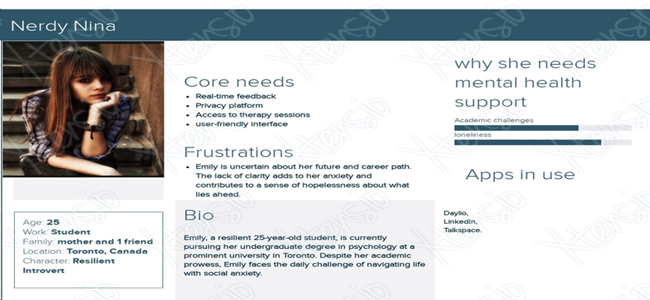
Persona 1 – Student

Slide 12
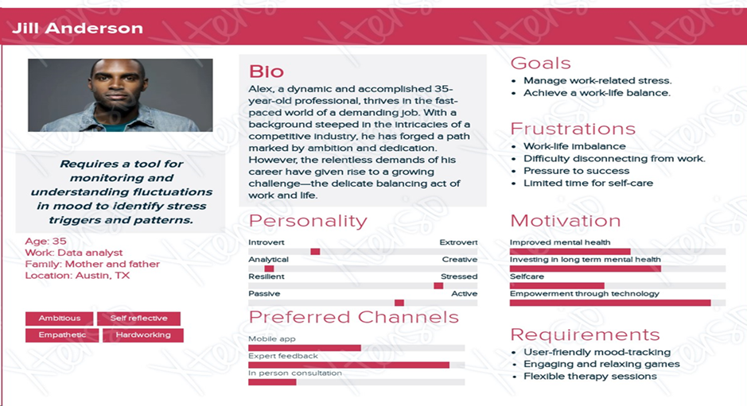
Persona 2 – Working Professional

Slide 13
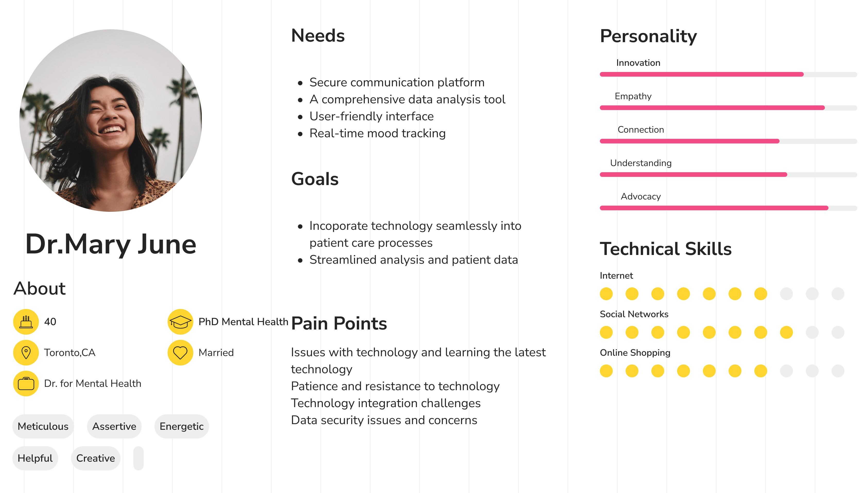
Persona 3 – Medical Professional

Slide 14
Requirement Gathering
Functional Requirements:
Speech to Text Converter: Google Cloud Speech to Text
Sentiment Analysis: Natural Language Processing (NLP) Libraries such as NLKT, numpy, panda
Machine Learning Library: Sklearn (scikit-learn)
Website Development: HTML, CSS, JS, PHP
Database: MongoDB
Data Encryption: OpenSSL
Collaboration and Communication: Microsoft Teams

Slide 15
Requirement Gathering
Non-functional Requirements:
Performance: Responsive, Scalable
Security: Data Encryption, User Authentication
Reliability: System Uptime, Error Handling
Usability: UI/UX, Accessibility
Compatibility: Browser and Device Compatibility
Documentation: Technical Documentation
Backup and Recovery: Data Backup

Slide 16

Implementation
Link of the Website: https://mentalhealthusingmoodpredict.mydurable.com/
Code of the System: https://colab.research.google.com/drive/1uFPkvQaLO6Gpc91FMAdE460mJcZla_HU#scrollTo=qjxAtPyc_XsP

Slide 17

Conclusion
Platform for Mental Health Analysis Developed
Adept in solving problems and being flexible
Data protection and immediate emotional support were given priority.
Vibrantly displayed on the webpage with characters and images
Contextual analysis and multilingual assistance for inclusion
Focus on commercialization for long-term user welfare
A dedication to sharing knowledge after the project
Increased awareness of the significance of mental health
Promoting ethical issues and their effects on society
Constant achievement and the advantages of teamwork

Slide 18
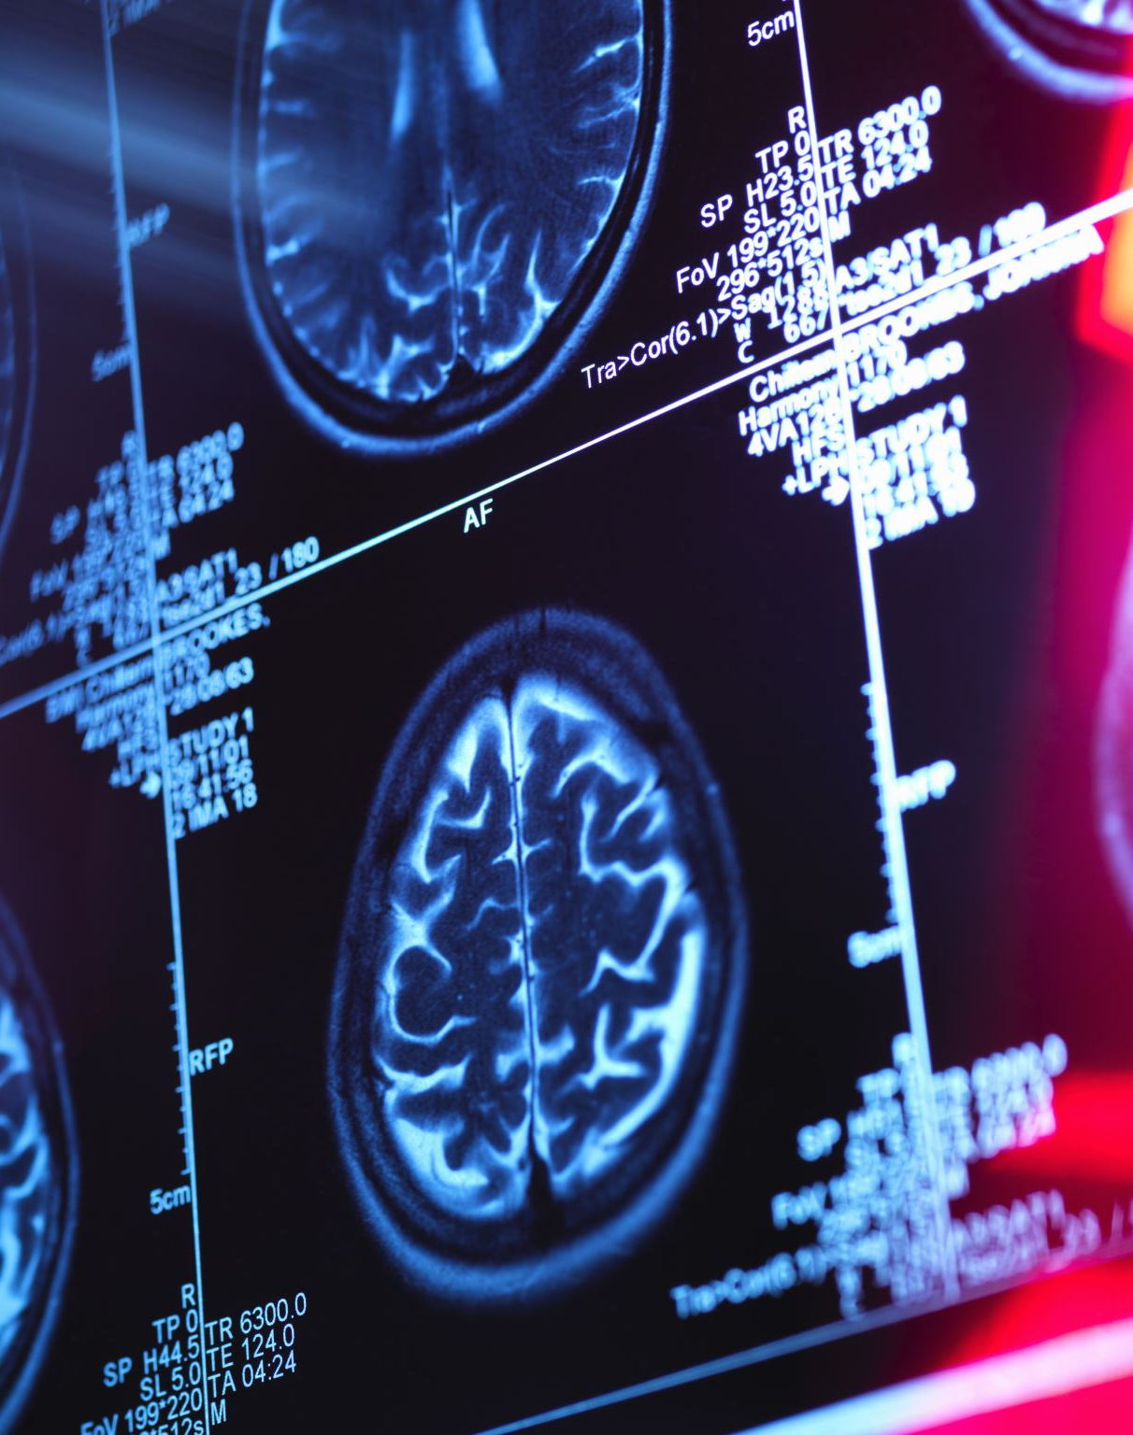
References
Low, D. M., Bentley, K. H., & Ghosh, S. S. (2020). Automated assessment of psychiatric disorders using speech: A systematic review. Laryngoscope Investigative Otolaryngology, 5(1), 96–116. https://doi.org/10.1002/lio2.354
CALVO, R. A., MILNE, D. N., HUSSAIN, M. S., & CHRISTENSEN, H. (2017). Natural language processing in mental health applications using non-clinical texts. Natural Language Engineering, 23(5), 649–685. https://doi.org/10.1017/S1351324916000383

Slide 19

Thank You

