Slide 1
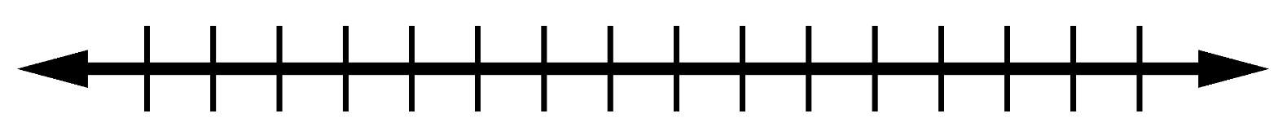
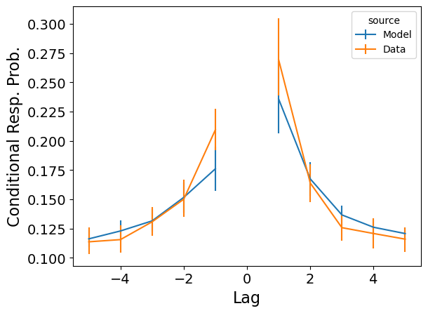
Same item, different traces: Dissecting the structure of memory for repeated experience
Jordan Gunn, Sean Polyn, Department of Psychology, Vanderbilt University
Introduction
Repetition Lag-CRP
A Bias Toward Neighbors of First Presentation!
But CMR Struggles to Capture the Effect
Interpreting CMR’s Challenge
Background
+2
-5
Fit model parameters based on likelihood of response sequences instead of summary statistic MSEs (Kragel et al, 2015; Morton & Polyn, 2016). Find best fits for each subject and simulate trials from experiment design using each fit.
Main Explanation:
Repeater Traces Don’t Include Forward Contexts
Mental Time Travel To Item A
A B C D E F G H I J D K L
A B C D E F G H I
A…B
CMR (Main Analysis)
1st
Study
Study
Free Recall
Retrieved context theory (RCT) conceives free recall as a sort of mental time travel, where people revisit past contexts to retrieve associated items (Tulving, 1972).
Each retrieval reactivates and reinstates the context of the retrieved item, biasing subsequent retrievals to nearby items in the study list.
But RCT is most fundamentally reflected in lag-contiguity effect, where items studied close together are more likely to be recalled together (Howard & Kahana, 2002).
For recalls for repeated items with spacing >= 4, track relative to their first and second study positions:
1. For lags [-3, -2, -1, 1, 2, 3] if transition with lag is possible
2. For lags [-3, -2, -1, 1, 2, 3] if transition with lag happened
Actual Count / Possible Count = Recall Probability by Lag
Repeat
Study
But How Does Mental Time Travel Work for Items
With Multiple Study Contexts?
Control Analysis
How Much of This is Actually a Repetition Effect?
In CMR, repeating an item reinstates context associated with its prior presentation, linking current and prior contexts in memory (study-phase retrieval).
Later, when the repeated item is recalled, an average between these two context states is reinstated to prime the next recall. The next retrieval is primarily driven by the similarity of retrieval context to items’ encoding contexts.
But since first-presentation reinstated context occurs before forward neighbors, biased support for first-presentation neighbors is insufficient to drive effect. Instead, both contexts similarly prime retrieval for either presentation’s forward neighbors.
?
?
C…?
To measure the proportion of transitions expected in the absence of repeated items, we match the serial positions used in the mixed lists to corresponding items in the control lists, shuffling assignment 100 times.
The effect disappears under this control analysis, confirming that it’s a repetition effect.
A B C D E F G C H I
?
?
Study
Free Recall
Similar Challenge for Trace-Weighting Strategies
Context Maintenance and Retrieval Model (CMR; Polyn & Kahana, 2009)
To account for effect, CMR must predict a difference in mixed lists but not control lists. It doesn’t!
So observed difference is mainly serial position effects.
Deficient processing (Greene, 1989) and instance-retrieval accounts of repetition effects traditionally explain phenomena such as the spacing effect in terms of diminished access at retrieval to the memory trace corresponding to an item repetition.
But variants of CMR that modulate learning rates in M^{FC} or M^{CF}, or more selectively reinstate trace contexts before retrieval, fail to account for the effect and are dis-preferred during model fitting.
Shared problem with study phase retrieval: driving retrieval with either trace’s context does not substantially bias transitions to either presentation’s +1 neighbors.
MEMORY
(Item to Context)
M^{FC}
Update Context
CONTEXT (C)
ITEM (F)
CMR Controlled +1 Transition Rate Result: t=1.07, p=0.1456
Guide Search
MEMORY
(Context to Item)
M^{CF}
But Good Fits to Other Benchmarks!
Is the Difference Significant?
Extends mental time travel account of memory search to explain
what temporal context is and
how temporal context evolves.
Temporal context derives its state from the reactivation and partial reinstatement of the temporal context already associated in memory with the current item
To summarize the effect and control for serial position effects, we measure +1 lag conditional transition rates relative to each repetition index.
Consider just transitions from repetitions
Separately calculate relative to each repetition-index
Subtract control analysis values (when available)
Perform subject-level one-tailed paired t-test of scores relative to first study position versus relative to second.
Serial Position Curve
Probability of First Recall
Predicted Transition Rate as Function of Context Cue Under a Subject’s Parameters
Context Probe
First Presentation Fwd Neighbors
Second Presentation Fwd Neighbors
Default Composite
Just First Trace
Just Second Trace
-1
+1
+2
-1
+1
+2
Datasets
Lag-CRP
Spacing Effect
Item Index
Lohnas & Kahana (2014)
Test Result: t=3.704, p=0.0004
Activation scaling (applying an exponent to item activations before retrieval competition) drives larger differences but is similarly dis-preferred under model fitting!
For main analyses, used data from Lohnas & Kahana (2016).
35 participants performed delayed free recall of 48 lists presenting 40 words each, with three relevant conditions:
Control: No item repetitions
Spaced: 20 Items repeated with 1-8 intervening items
Mixed: 28 items presented once; 6 items presented twice with 0-8 intervening items
For replication, we used data from Howard and Kahana (2005).
66 participants performed delayed free recall of 15 lists presenting 90 words each. Each item presented three times per trial in two relevant conditions:
Short spacing: Two to six intervening items
Long spacing: six to twenty intervening items
Discussion
Is This Dataset-Specific?
Across two datasets, after recalling an item presented repeatedly in study lists, participants tended to transition to neighbors of the item’s initial rather than successive study positions.
Control analyses indicate that bias is due to repetition rather than serial position.
CMR could not account for these patterns, despite study-phase retrieval and even after considering mechanisms to emulate deficient processing accounts of repetition effects.
Suggests need for more detailed account of context-based retrieval when items have multiple study contexts
Same analysis using Howard & Kahana (2005) data:
Simulation of Howard & Kahana (2005)
Uncontrolled +1 Transition Rate Test:
t=0.93, p=0.1771
Tulving, E. (1972). Organization of memory.
Howard, M., & Kahana, M. (2002). Journal of mathematical psychology.
Lohnas, L. & Kahana, M. (2014). JEP: LEMC.
Howard, M., & Kahana, M. (2005). Psychonomic bulletin & review.
Morton, N. & Polyn, S. (2016). Journal of memory and language.
Polyn, S., Norman, K., Kahana, M. (2009). Psychological Review.
(Uncontrolled) +1 Transition Rate Comparison Result: t=2.909, p=0.0025

