Slide 1
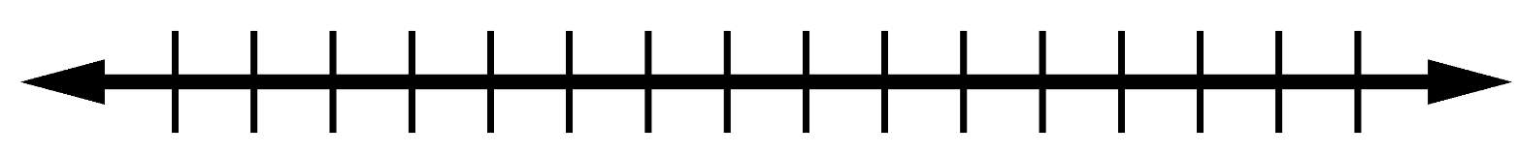
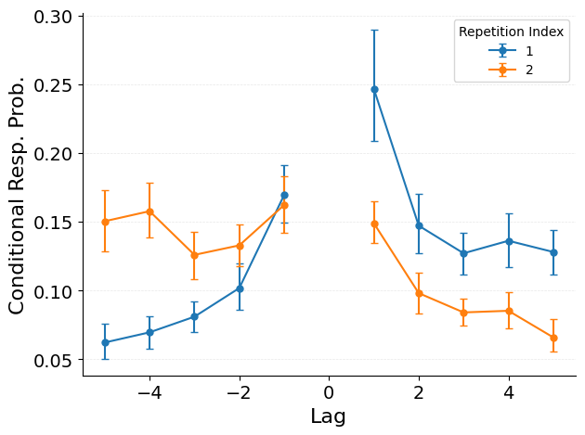
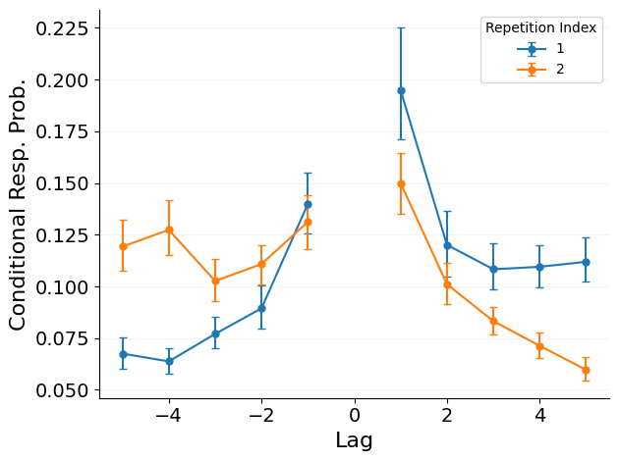
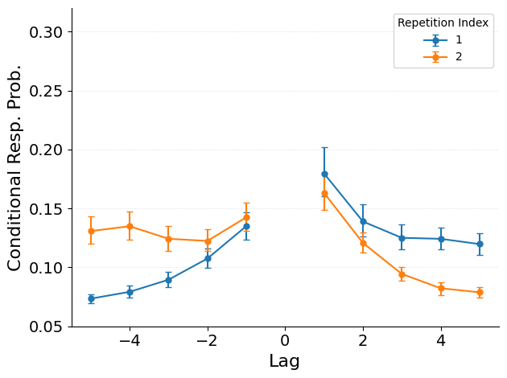
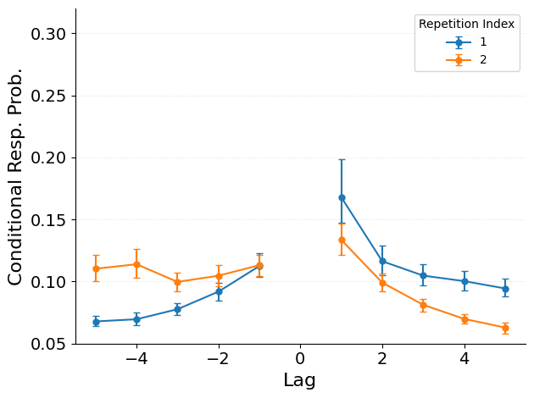
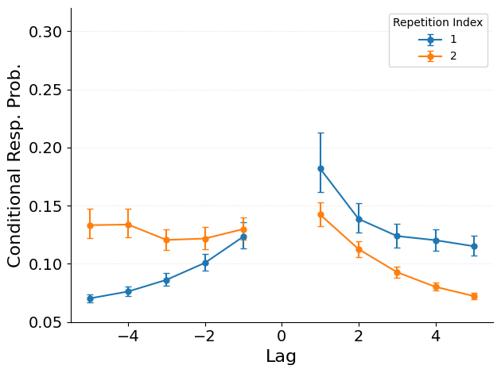
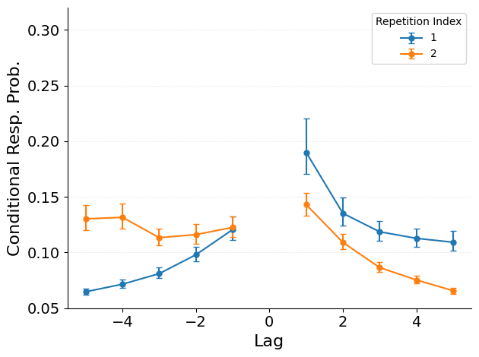
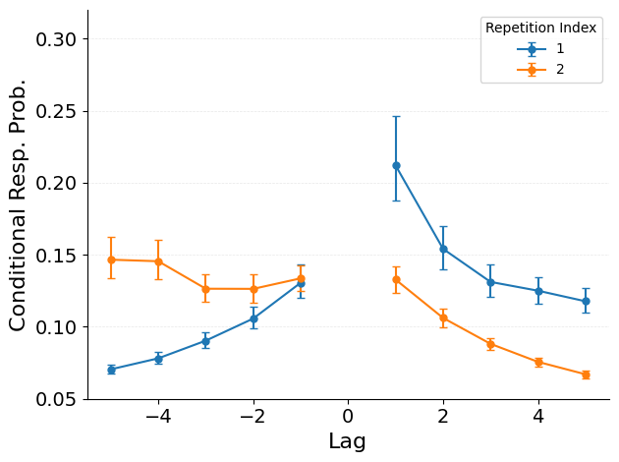
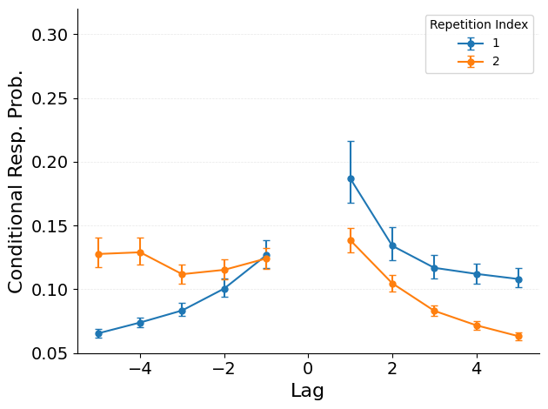
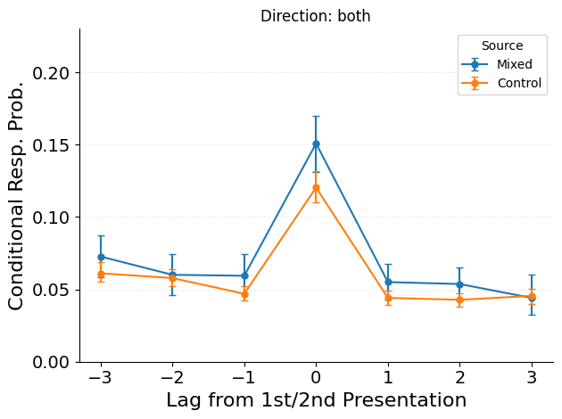
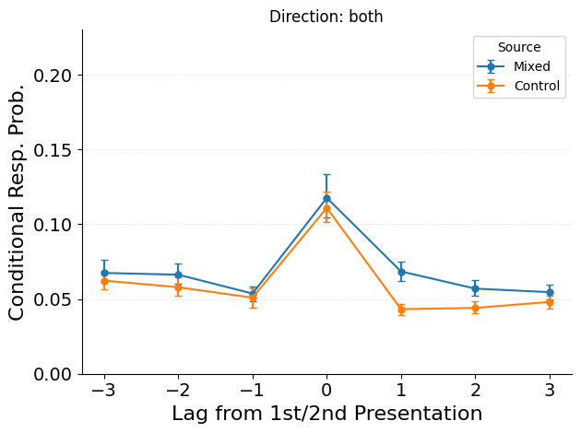
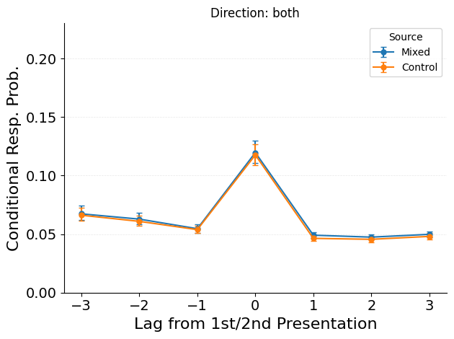
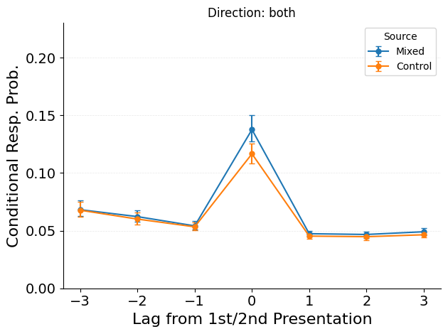
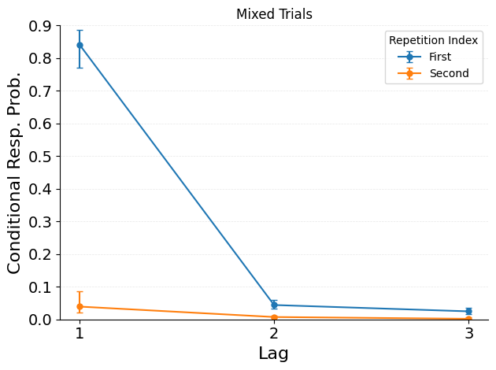
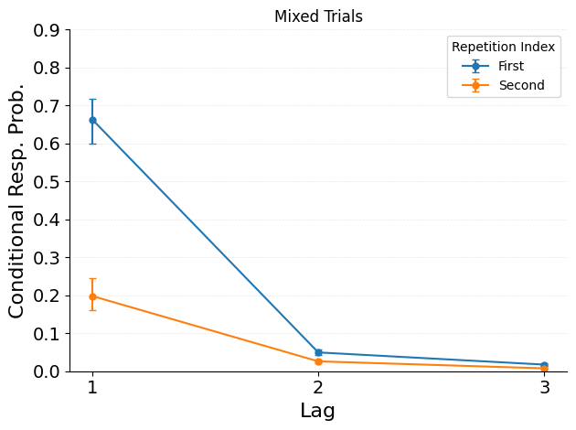
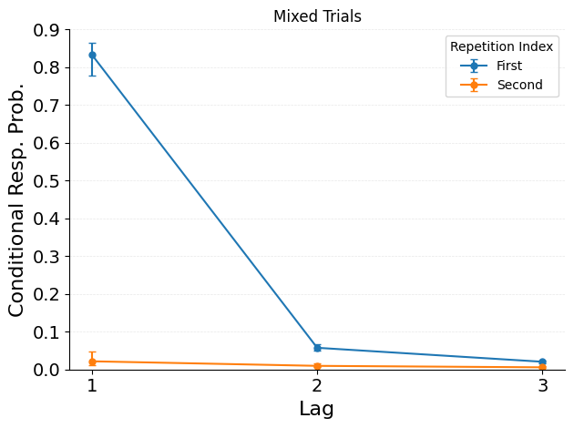
Same item, Distinct Contexts:
Episode-Specific Reinstatement in Free and Serial Recall
Jordan Gunn, Sean Polyn, Department of Psychology, Vanderbilt University
Introduction
Item-Based Reinstatement
(Standard CMR)
VS
Episode-Specific Reinstatement
(Instance CMR)
Retrieved context theory (RCT) explains memory search as mental time travel, where people revisit past contexts to retrieve associated items. Recalling an item reinstates its associated temporal context, biasing subsequent retrievals to items studied nearby in time. (Tulving, 1972; Howard & Kahana, 2002).
In CMR, item identity drives context evolution. Each time an item appears, it reinstates a blend of contexts associated with the item. At encoding, restudying C reinstates context that overlaps with its first presentation. At recall, retrieving C reinstates a composite of occurrence contexts that targets both presentations’ neighbors for successive retrieval. Both processes knit the two contexts together.
In Instance-CMR, context evolves independently of items. Each occurrence encodes to a fresh, non-overlapping context. At recall, occurrence traces compete; the winner’s context is selectively reinstated. Context traces are kept distinct and separate.
Mental Time Travel To Item A
ENCODING:
A B C D E F G C H I
ENCODING:
A B C D E F G C H I
?
?
C…?
(Fresh)
(Fresh)
A B C D E F G C H I
Restudy Produces Overlapping Context
Restudy Preserves Distinct Contexts
?
?
A B C D E F G C H I
A B C D E F G C H I
Study
Free Recall
RETRIEVAL:
RETRIEVAL:
But How Does Mental Time Travel Work for Items
With Multiple Study Contexts?
C…?
C…?
OR
C…?
Retrieval Reinstates an Item-Level Composite of Contexts
Retrieval Reinstates a Single Winner Context
Datasets
Identifying “True” Repetition Effects With a Position-Matched Symmetric Baseline
For main free recall analyses, used data from Lohnas & Kahana (2014).
35 participants performed delayed free recall of 48 lists presenting 40 words each, with four conditions: control lists with no item repetitions, massed repetition lists with 20 items repeated with no intervening items; spaced repetition lists feature 20 Items repeated with 1-8 intervening items; and mixed lists featuring 28 items resented once and 6 items presented twice with 0-8 intervening items.
For main serial recall analyses, used data from Kahana & Jacobs (2000). Twenty participants recalled 36 x 12 lists of lengths 11, 12, or 13 with two repetition conditions (no repeats vs one repeated consonant). Analyses focused on the first trial of each unique list.
Additional datasets (Lohnas 2025; Kahana & Jacobs 2000; Broitman & Kahana, 2024; Howard & Kahana, 2005) analyzed for generalization but no room here – ask if interested!
Perform analyses to recall of control lists...
…But re-label items at same study positions as repetitions from mixed lists.
A B C D E F G H I J
A B C D E F G C H I
A good definition of repetition effects must distinguish between (a) the ordinary consequences of exposing participants to additional study material and (b) the special consequences of encountering the same material twice instead of distinct material.
For our baseline, we focus on (b) and ask what would performance look like if the memory system processed the repetition in exactly the same way it would have processed a novel token, differing only in the arbitrary fact that the stimulus label is repeated? The difference between baseline and observed performance constitutes a bunder our methodology.
For every mixed-list trial, we pair many control-list trials performed by the same participant. In each control list, we designate the items occupying the repeater's two positions as a pseudo-repeater pair. We then recompute the target statistic after relabeling those two positions as a single pseudo-item. Repeating this resampling many times yields a null distribution under the no-special-status hypothesis: the memory system treats the two positions as independent study events that differ only in label.
Free Repetition Lag-CRP
+2
-3
Mixed List Data
Control List Data
In free recall datasets, transitions from repeaters are biased to +1 neighbor of their 1st study over 2nd vs baseline (t= +3.009, p=.0049).
Standard CMR predicts the opposite pattern: more balanced transition rates to each presentation’s neighbor vs baseline (t= -2.286, p=.0286).
Instance-CMR predicts slim difference from baseline, while an extension that boosts first presentation traces upon repetition without knitting contexts fully captures the first presentation bias (t=5.562, p<.0001).
A B C D E F G C H I
For recalls for repeated items with spacing >= 4, track relative to their first and second study positions:
1. For lags [-3, -2, -1, 1, 2, 3] if transition with lag is possible
2. For lags [-3, -2, -1, 1, 2, 3] if transition with lag happened
Actual Count / Possible Count = Recall Probability by Lag
Item-Based Reinstatement
(Standard CMR)
Episode-Specific Reinstatement
(Instance CMR)
Instance-CMR
Plus a First Trace Boost
Mixed List Sims
Control List Sims
Mixed List Sims
Control List Sims
Mixed List Sims
Control List Sims
Repetition Neighbor Contiguity
Data
Standard CMR
Instance-CMR
Instance-CMR
Plus a First Trace Boost
Standard CMR but not Instance CMR proposes that neighbors of repeated items will be associated with overlapping contexts, implying boosted transitions across neighborhoods as their associated contexts become good cues for one another.
We can adjudicate by plotting transitions from +1/+2 neighbors of the first presentation of repeated items to neighbors of second presentation, and vice versa.
Data shows no such boosted cross-neighborhood transition rates, and instead reveals a new pattern: boosted transition rates to the repeated item itself. Captured by Trace Boost extension.
Serial Repetition Lag-CRP
Data
Item-Based Reinstatement
(Standard CMR)
Episode-Specific Reinstatement
(Instance CMR)
In serial recall datasets, there is a correct transition to make after recall proceeds successfully through first presentation of a repeated item: The transition must be to the +1 neighbor of the item’s 1st pres., and not to the +1 neighbor of the 2nd presentation.
The data shows humans reliably make the correct transition and Instance-CMR successfully predicts the same absence of repetition-driven errors! But Standard CMR predicts opposite pattern: a high rate of erroneous transitions to the second presentation’s neighbor.
Conclusion
- Repetition effects may be frequently defined and measured inadequately in the literature, muddling interpretation. Comparison of performance to a position-matched symmetric baseline can distinguish real effects from natural outcome of two study positions sharing the same label.
- CMR’s Item-based context reinstatement predicts patterns of associative interference that do not consistently arise in free or serial recall data. Occurrences may instead encode to distinct, non-overlapping contexts that compete and are reinstated separately during retrieval. With an instance-based framework, retrieved-context models can adapt to address these limitations.
- Instead of study-phase retrieval, reminding may boost memory for an item’s first presentation w/o knitting occurrence contexts. However, model comparison outcomes so far are ambiguous.
Model | Pooled ΔAIC vs Best Mean [CI] | Reliably Worse?
Instance CMR + Trace Boost | 0.00 [0.00, 0.00] | No
Instance CMR | 2.31 [-1.73, 6.35] | No
Standard CMR | 22.83 [15.31, 30.34] | Yes
Tulving, E. (1972). Organization of memory.
Howard, M., & Kahana, M. (2002). Journal of mathematical psychology.
Lohnas, L. & Kahana, M. (2014). JEP: LEMC.
Kahana, M., & Jacobs, J. (2000). JEP: LEMC.
Morton, N. & Polyn, S. (2016). Journal of memory and language.
Logan, G. (2021). Psychological Review,
Broitman, A. & Kahana, M. (2024). BioArxiv.
Lohnas, L. (2025). Psychonomic Bulletin & Review.
Polyn, S., Norman, K., Kahana, M. (2009). Psychological Review.

