Slide 1
Modelling Meeting
10 November 2025
Notes:
One-liner reminding attendees we're aligning grant aims with near-term modelling choices.

Slide 2
Goals for Modelling Project (From Grant)
Address the selective interference effect with CMR. Characterize and evaluate a retrieved-context account of the post-trauma visuospatial dissociation between intrusive involuntary memories and deliberate recall.
Formally contrast dual-representation and unitary recall accounts. Specify matched model variants for voluntary and involuntary retrieval and compare their predictions under shared task settings.
Clarify and test the DRA's emotion-disrupted integrative encoding claims. Encode the dual-representation hypothesis that heightened affect strengthens sensory/affect bindings while loosening contextual links, then assess its behavioral implications within CMR.
Notes:
These aims roughly align but can pull in different directions depending on implementation choices.
CMR might reproduce the selective interference effect under specific paradigms without giving us leverage to adjudicate dual versus unitary accounts.
A model embodying the dual-representation account could provide different predictions, even about the interference effect, depending on how and which features we implement.
Finally, the significance of disrupted integrative encoding in either the interference effect or dual-representation account can vary based on our other modeling choices.

Slide 3
Goals for Meeting
Select the focal experiment(s) for the selective interference / Tetris effect. Different published paradigms emphasize different measurements and outcomes; agreeing on the anchor keeps us from targeting the wrong behavioral signature.
Define the dual-representation commitments for the initial model. We need to confirm which elements of the DRA belong in the first implementation so that downstream comparisons are meaningful.
Set the theoretical framework and comparison approach. Clarifying how we conceptualize interference and voluntary vs involuntary recall will determine the modelling toolkit and evaluation strategy.
Notes:
Because of that ambiguity, we can't assume progress on one aim satisfies stakeholder expectations for the others. To keep the strands aligned, we need explicit initial decisions about three key issues before moving the modelling forward. Here I outline key considerations for each decision, along with questions to guide our discussion.

Slide 4
Select the focal experiment(s) for the selective interference / Tetris effect
Question: Which paradigm and dataset should anchor modeling of the selective interference effect?

Slide 5
Criteria
Unambiguous effect: the study should clearly show visuospatial load suppressing intrusions more than voluntary recall.
Representative measures: dependent variables should match common practice (FR scoring, intrusion diaries, VIP), so results speak to the literature.
Rigorous procedures: data collection/scoring must control for key confounds, so we're sure we're modelling the intended process.
Maps to model observables: outputs need to correspond to quantities our frameworks already simulate (or can extend to) without speculative bridges.
Constrains mechanisms: data needs detail and within-subject measures beyond aggregate scores (e.g., trial-level sequences, order manipulations) so competing models can't all fit.
It’s unlikely that any option totally satisfies, so we may triangulate with multiple datasets. Still, we want one primary benchmark.
Notes:
A range of experiments have examined the selective interference effect, but they differ in task structure, dependent variables, and manipulations. So that we don’t chase mismatched outcomes, we need to pick one or more paradigms that best align with our modeling capabilities and the project’s goals.
The behavioral signature should be unambiguous. Ideally the focal study clearly shows the selective interference effect (visuospatial load reducing intrusions more than voluntary recall) so we know what the models are meant to capture.
The measurement approach should be representative. Dependent variables ideally align with how this phenomenon is typically measured in the literature so our results directly speak to prior findings.
The measurement procedures should be rigorous. The methodology is ideally one the team trusts so we are confident that we’re addressing the intended processes.
The measures should map onto model observables. The dataset’s outputs ideally correspond to quantities our modelling frameworks already produce or at least can extend to without forcing speculative bridges that would themselves need validation.
Data and procedures should be detailed enough to constrain mechanisms. Beyond aggregate scores, we prefer enough resolution to distinguish between competing accounts. In particular, tests of retrieved-context assumptions generally benefit from exact study and recall sequences per trial, as well as different presentation orders across trials.
That choice has to balance several constraints, but our best options might not satisfy all of them. Some paradigms might be representative, demonstrate an unambiguous effect, and map clearly to CMR observables (e.g., free recall + diary intrusions) but lack rigor (Lau-Zhu, Henson & Holmes, 2019 discusses this issue). Other studies might match our methodological standards and have detailed procedures (e.g., Experiment 1 from the current project) but not show the effect clearly enough for us to target. Still others might have strong measurements and clear effects but would take more work to relate to CMR outputs or evaluate its key assumptions. It could be best to target multiple datasets to triangulate these tradeoffs, but we should limit the scope to what we can manage within the project’s timeline. And either way, we’d still prefer to select one primary benchmark for initial model development.

Slide 6
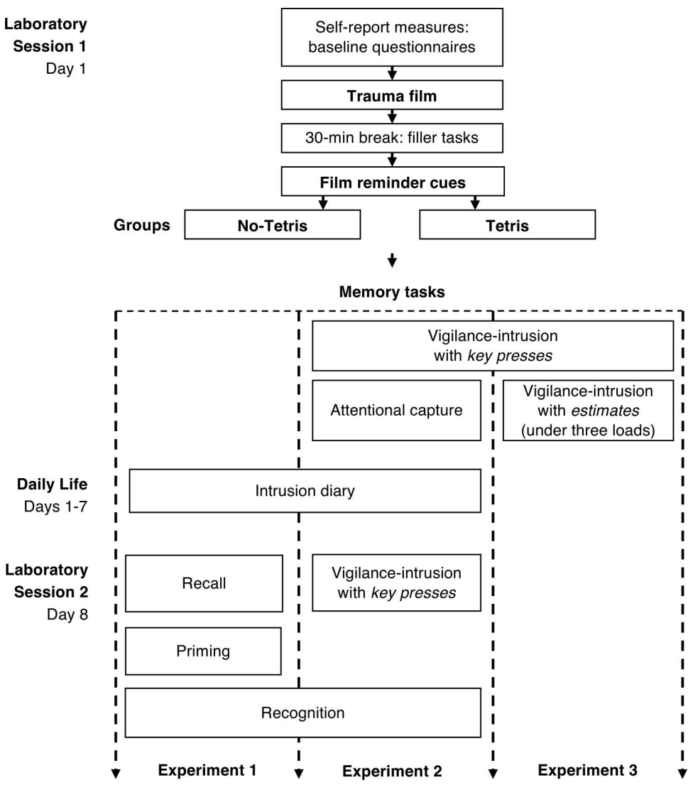
Example: Lau-Zhu, A., Henson, R. N., & Holmes, E. A. (2019)
Includes several experiments aimed to rule out unitary/single-trace accounts that all reproduce the effect under desired conditions
If data is present and detailed enough, would thus provide strong constraints and help bridge across paradigms
Would still select one experiment as primary target!

Slide 7
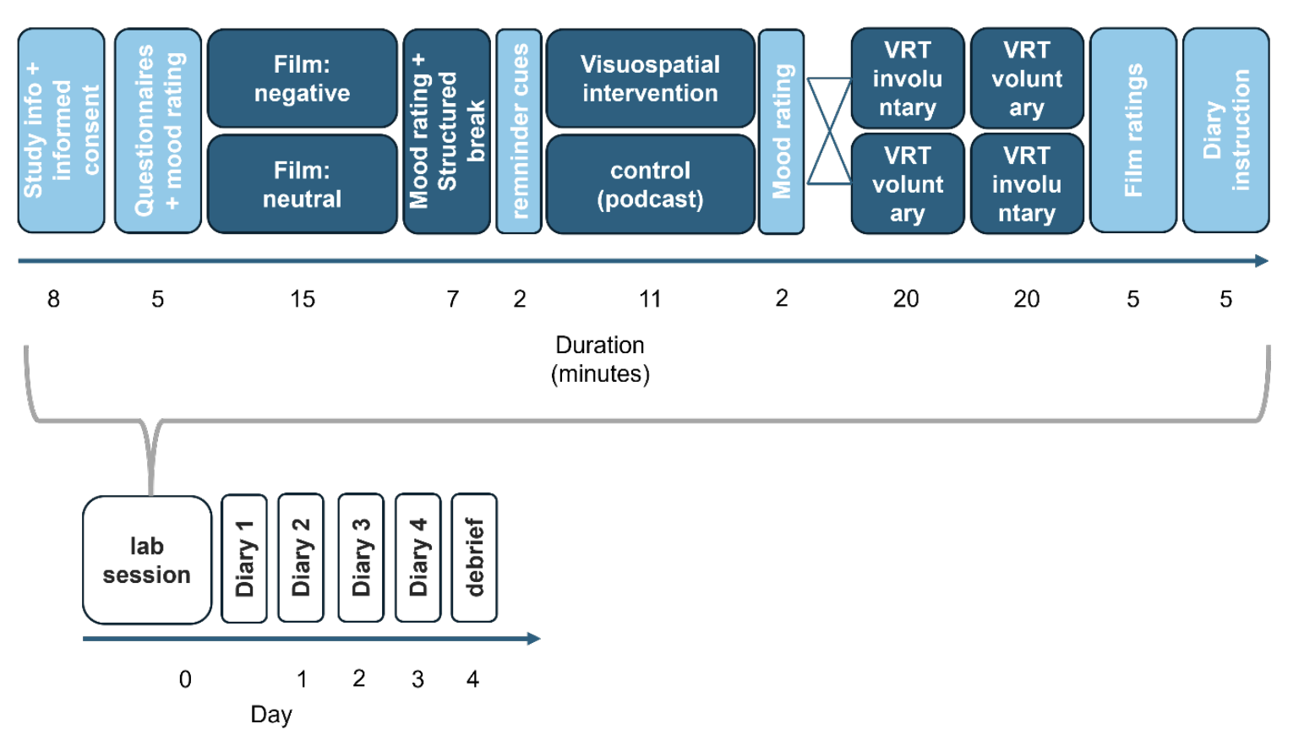
Example: Experiment 1 from current project
Detailed procedures and data
Methodology we trust
Has trouble showing a clear selective interference effect
May still be useful for modeling anyway if exploring ideas separate from the focal effect (impacted temporal organization?)

Slide 8
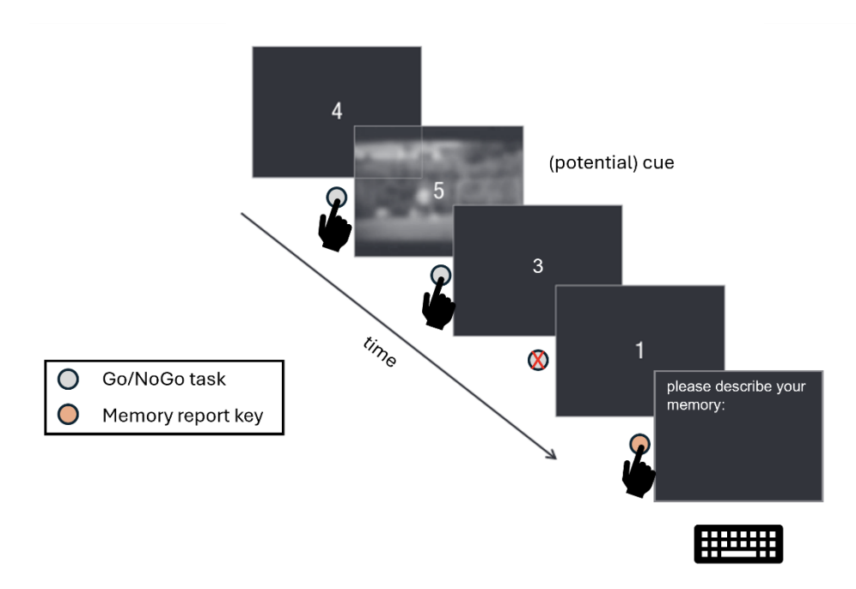
Note: The Vigilance Retrieval Task is Very Cool!
CMR makes reasonably clear predictions about how item-based retrieval priming affect memory performance, even when interleaved in a free recall task
So datasets like are well-suited for model evaluation if detailed enough!
Other applicable paradigms beyond free recall: recognition, paired associates learning, some kinds of memory-based decision-making tasks

Slide 9
Any Clearly Favored Options?
Literature has many large-scale reviews and meta-analyses
Ex. James et al (2016) reviews 74 articles and highlights methods, including free recall + intrusion diary designs
Other stakeholders might have clearly preferred studies that better balance these considerations.
In worst case, we could limit modeling focus to “proof of concept” demonstrations that borrow parameters fit to other data, simulate experiment designs under specified assumptions, and plot predictions
Notes:
Free recall vs diary option from a meta-analysis?. An approach I discussed with Deborah in an earlier meeting contrasts free recall performance with diary intrusion. This method is frequently used in the literature, seems to produce large effects, and aligns well with CMR observables, though extension to diary intrusions may require assumptions. However, the paradigm is vulnerable to explanation in terms of cue mismatch, and extant data may be poor quality.
Emily or Rick might have other preferred studies that better balance these considerations.
In the worst case though, we can focus modeling on just evaluating and demonstrating basic consistency of the model using simulations from pre-existing parameter sets. This might be valuable, especially if it can identify and highlight new predictions that can be tested elsewhere. But I’d be worried about theoretical constraint.

Slide 10
SELECT commitments from dual-representation ACCOUNT (DRA) for initial model
What parts of the dual representation account should inform the initial model? Can we relate these features to functional properties?

Slide 11
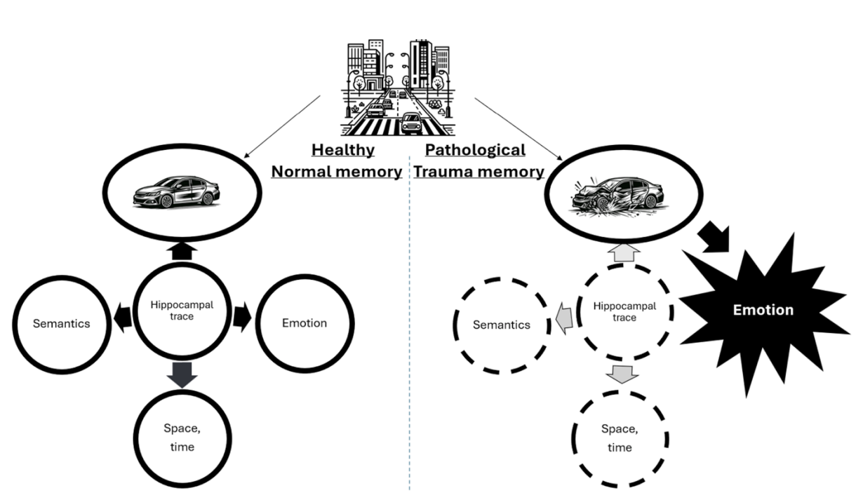
The Dual Representation Account (DRA)
“The core assumption of the DRA is that there are in effect two memory traces – sensory and contextualised representations – and that pathological encoding of trauma strengthens the former but weakens the latter, leading to dissociations between involuntary and voluntary memory.”
Notes:
We need a shared definition of “dual representation” so we can concretely compare it to unitary alternatives. In one sentence, the RR offers this summary of the DRA: “The core assumption of the DRA is that there are in effect two memory traces – sensory and contextualised representations – and that pathological encoding of trauma strengthens the former but weakens the latter, leading to dissociations between involuntary and voluntary memory.” More detailed accounts frequently specify a neurobiological substrate, phenomenological consequences, or broader structural commitments. Imposing these additional may be important for theoretical fidelity or scientific communication. However, our definition should normally clarify functional commitments that narrow the model’s possible behaviors in ways that can be evaluated against data within the project’s timeline.

Slide 12
Are These the DRA Properties We Care About?
Emotional arousal strengthens binding among sensory and affective elements. Retrieval cues that overlap on perceptual or feeling dimensions should readily reinstate the experience, and vice versa.
The same arousal weakens links between those elements and spatiotemporal context. Context cues cannot as effectively reinstate the full episode and vice versa.
Key Implication: Cues matching sensory or affective features can retrieve the memory even when context mismatches. Reminders that match only sensory or affective facets should still trigger involuntary recall, even in settings that share none of the original context.
But what about the selective interference effect?
Notes:
The grant and registered report converge on three functional properties, but the team has discussed and may add possible extensions or variations:
But what about the selective interference effect? Even with these details, DRA’s account of the selective interference effect may still be underspecified. If visuospatial interference reduces intrusion rates without affecting voluntary recall, what is the dual representation explanation for that pattern and how does the explanation contrast with a unitary account? So far, I’ve mostly seen descriptions of the effect as supportive evidence for the DRA, but not a detailed mechanistic account that could aid implementation or evaluation.
Does this specification capture the DRA sufficiently for our initial model? Are there other commitments we should include or consider in alternative versions or future extensions?

Slide 13
Set the theoretical framework and comparison approach
Given our goals, empirical targets, and dual-representation commitments, how should we set up an evaluation of competing accounts of interference and of voluntary vs involuntary recall?
Notes:
Question: Given our goals, empirical targets, and dual-representation commitments, how should we set up an evaluation of competing accounts of interference and of voluntary vs involuntary recall?
To help guide discussion, I outline CMR’s default account of interference effects in general and under two paradigms for measuring the selective interference effect. Then I attempt to relate the dual representation commitments to those frameworks. Then I try to enumerate possible predictions that could distinguish and test the accounts and guide model development. These can hopefully related with everyone else’s perspectives and goals to clarify a path forward.

Slide 14
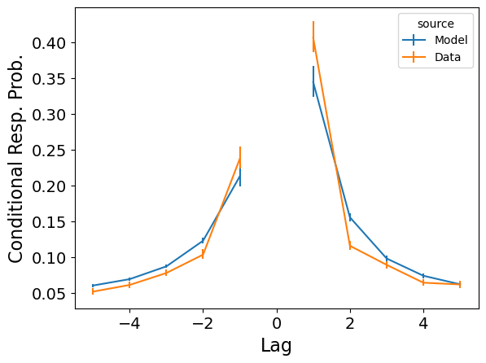
CMR Addresses a Signature of the Retrieval of Temporal Context
In the free recall task, you are invited retrieve studied items in whatever order.
Participants most frequently transition to study neighbors, producing a temporal contiguity effect.
Present in most other episodic memory tasks too (e.g., recognition).
A B C D E F G H I J K L
D…?
Study
?
Recall

Slide 15
Retrieved Context Theory (Howard & Kahana, 2002): Experiences Tied To, Retrieved By Temporal Contexts
MEMORY
(Item to Context)
M^{FC}
Update Context
Each study or recall event blends associated features into a context state that evolves over time, creating a recency-weighted record
At study, states of temporal context are associated with items in memory traces
At retrieval, temporal context is the primary cue, targeting items studied in similar contexts
Result: mental time travel!
CONTEXT
(C)
ITEM FEATURES (F)
MEMORY
(Context to Item)
M^{CF}
Guide Search
A B C D E F …
D…?
Study
?
Recall
Notes:
Retrieved‑context theory (RCT) – a really prominent account of all this -- explains recall as the interaction of a drifting temporal context with item‑driven reinstatement [@howard2002distributed; @kahana2020computational].
Each study or recall event blends associated features into a context state that evolves over time, leaving a recency‑weighted record.
At study, states of this dynamic temporal context are associated with items in memory;
at retrieval, it serves as the primary cue, prioritizing items studied in similar contexts.
Reinstating the context associated with an item at retrieval allows the system to bridge the past and present.
This has been a super successful account of episodic memory across a range of tasks and formalized into detailed computational models that can fit to and simulate human performance with great fidelity too. Among these is the Context Maintenance and Retrieval model, or CMR.

Slide 16
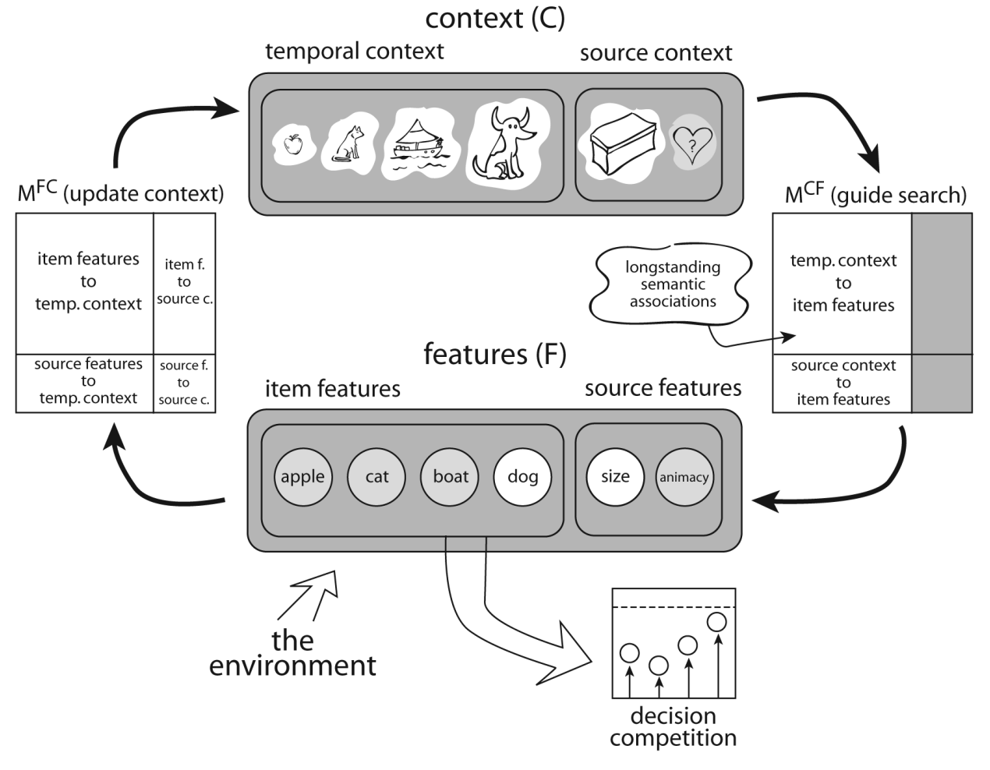
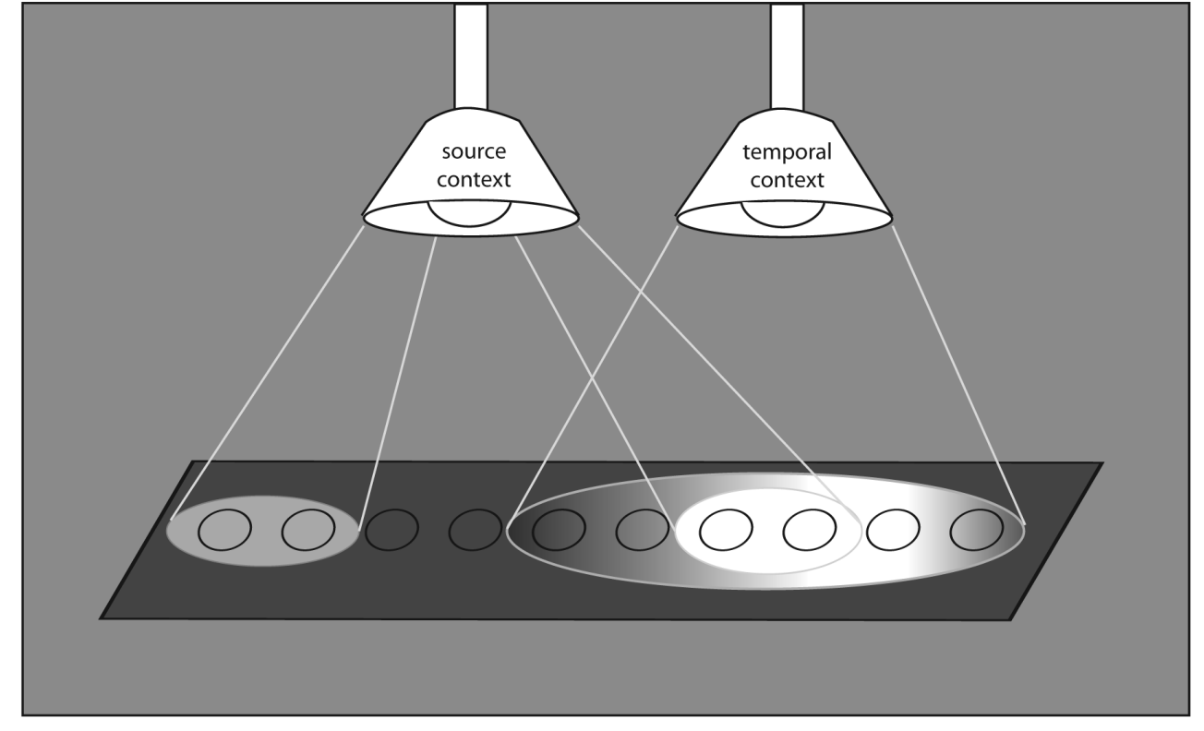
CMR (Polyn, Norman & Kahana, 2009): Visual/Other Features Also Carried in Context
Key idea: similar events reinstate overlapping context, allowing transitions to similar items – not just nearby items.

Slide 17
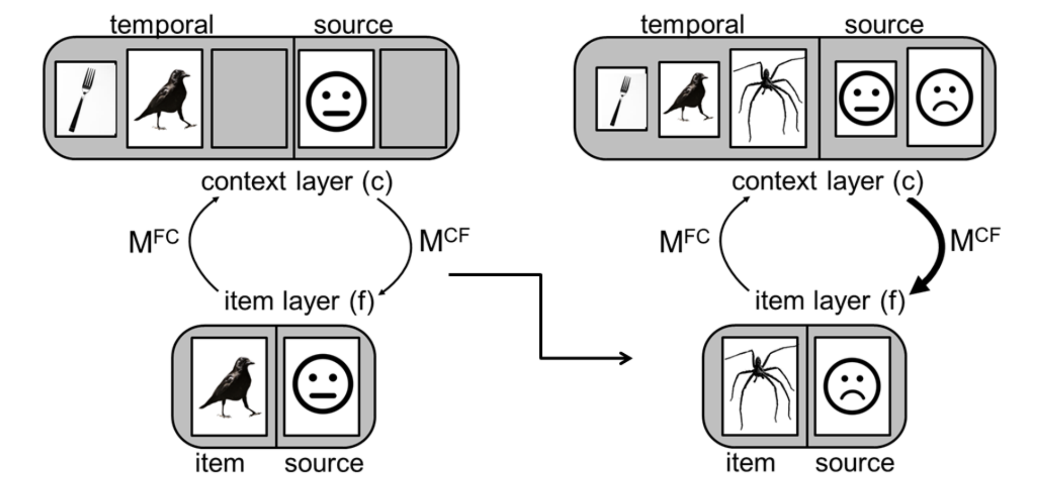
eCMR (Talmi et al, 2019) Extends to Emotional Similarity, Adds Arousal-Boosted Encoding

Slide 18
Key Tie to Dual Representation Account: Both Address Spatiotemporal Context
DRA: Emotional arousal strengthens binding among sensory and affective elements.
DRA: The same arousal weakens links between those elements and spatiotemporal context.
CMR: items associated to temporal contexts drives the temporal contiguity effect
eCMR: emotional items more strongly associated to context than neutral items
Key alternative prediction for a DRA-CMR hybrid: diminished temporal contiguity effect even in voluntary recall?
But unimpaired or boosted sensory contiguity.

Slide 19
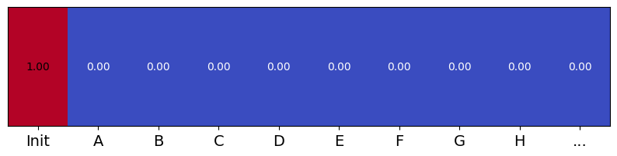
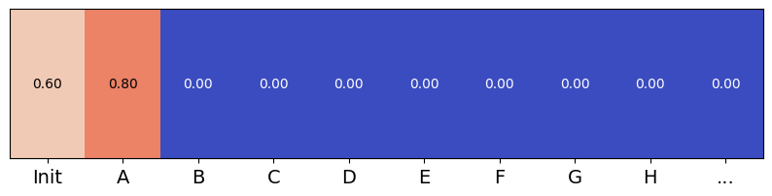
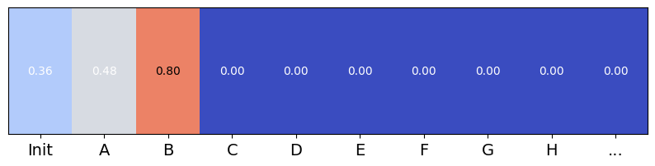
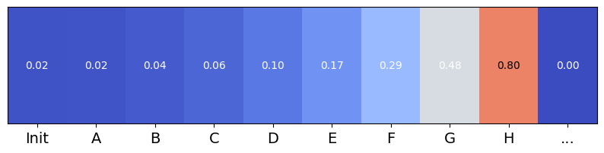
Distraction Account of Post-Encoding Interference in CMR: Reduced Contact Between Stored Contexts
MEMORY
(Item to Context)
M^{FC}
Update Context
CONTEXT
(C)
ITEM FEATURES (F)
MEMORY
(Context to Item)
M^{CF}
Guide Search
…
CMR predicts that strong distraction effectively accelerates context drift between successive states. Later, cues generated from retrieving one time become worse cues for the other item, reducing overall access during unconstrained recall.

Slide 21
Alternatives
Not interference, but forward-going association with strong neutral memory.
…

