Slide 1
Exemplar models as a mechanism for performing Bayesian inference
12 November 2025
Notes:
One-liner reminding attendees we're aligning grant aims with near-term modelling choices.

Slide 2
Why This Paper?
Lots of Sanborn’s papers seem focus on idea that people sample information from memory to make judgments and choices
How psychologically-realistic sampling processes can implement probabilistic reasoning
Bridges rational Bayesian models and psychological process models in a clear and general way

Slide 3
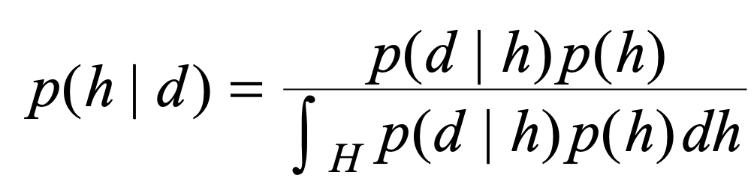
What is Bayesian Inference?
Think of cognitive problems as evaluations of a set of hypotheses about processes that could have produced observed data
For hypothesis h and data d, a learner encodes degree of belief about h before seeing d using a probability distribution p(h) – called the prior distribution
Probability of seeing d if h were true is P(d|h) -- the likelihood
Belief in h after seeing d define the posterior distribution:
Notes:
First, what is Bayesian inference?
Bayesian inference is relevant whenever a cognitive problem can be framed as evaluating a set of hypotheses about which processes could have produced observed data
But to understand what Bayesian inference is, imagine you have a hunch about the world, you see a bit of noisy evidence, and you revise that hunch. That’s Bayesian inference in one sentence.
Formally, we start with a **prior**—our initial degrees of belief over hypotheses—then combine it with how well each hypothesis would have produced the evidence (the **likelihood**) to get an updated **posterior**.
The gist of this idea, Bayes rule is that “updated belief in your hypothesis = fit of the hypothesis to the data × initial belief.”

Slide 4
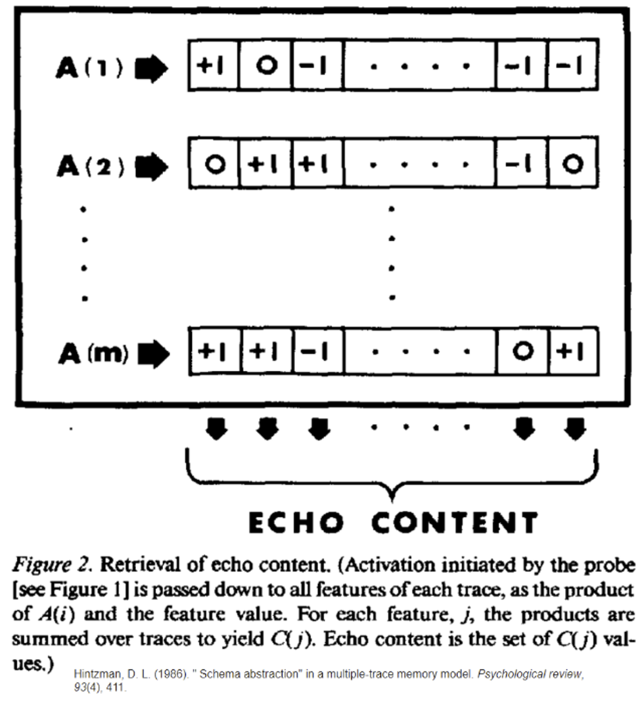
What Are Exemplar Models?
Store one trace per experience
During retrieval, probes contact each trace activating each based on their similarity
Echo content is a sum of traces, weighted by activation!
An exponent scaling parameter boosts activations to prioritize highly similar traces
Notes:
And now, what are exemplar models?
Exemplar models say we don’t always keep abstract rules or aggregate prototypes to make decisions—instead, we keep **examples**, a representation of each study instance as a separate trace in memory.
When evaluating a new stimulus, the cue probes all traces. Each trace is activated in proportion to its similarity to the cue. In models, each trace is represented as a vector where each slot represents the extent to which a given feature is present or not. When you do a dot product using a cue vector a trace, the value gets higher the more their feature sets overlap.
The system returns an echo—literally a weighted sum of those trace contents—and that echo decides the response. Since the sum is weighted, highly similar and relevant traces get prioritized in the final echo, while dissimilar traces get de-emphasized and might not even factor into the echo at all.

Slide 5
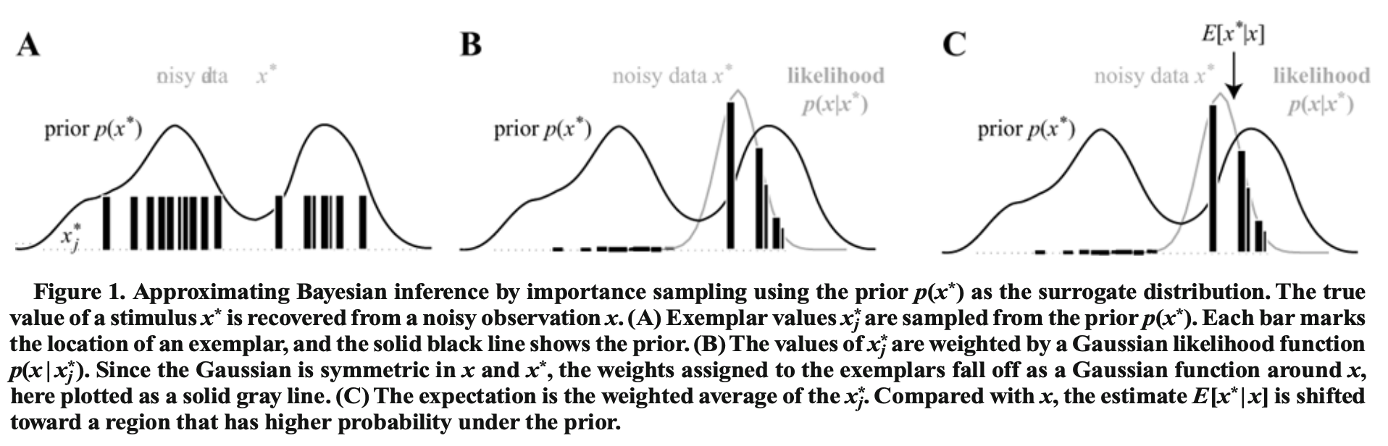
Exemplar Models Implement Importance Sampling, Which Approximates Inference
Importance Sampling:
repeatedly sample possible guesses from your prior distribution p(x*)
Give each guess a weight based on how well it explains the data P(x|x_{j}*)
computing a weighted average over guesses estimates E(x*|x), an updated belief distribution across guesses!
Notes:
The idea that connects Bayesian inference and exemplar models together is importance sampling.
Importance sampling is a standard way to approximate Bayesian inference – like in general, not just in psychology or otherwise. You draw a piece of data from a probability distribution (here, the prior, p(h) ) and give each sample a weight based on how well it matches with your candidate hypothesis – the likelihood function representing P(data | hypothesis). You can then compute a weighted average across all your sampled observations. With many samples, this gives you a good estimate of the probability of your hypothesis given your samples, p(hypothesis | data) from our Bayesian inference slide.
The paper shows that **exemplar models implement exactly that**: stored exemplars ≈ prior samples; similarity $s(\text{new},\text{old})$ ≈ likelihood $p(\text{data}\mid\text{hypothesis})$; and the exemplar “blend” is the importance‑sampling estimator for a posterior average.
Approximating Bayesian inference by importance sampling in this general case can also be interpreted as a kind of exemplar model, but here the stored exemplars correspond to hypotheses, rather than stimuli. As in a standard exemplar model, these hypotheses can be stored in memory as the consequence of previous learning events. Each hypothesis needs to be weighted by its likelihood, which no longer has a natural interpretation in terms of similarity but represents the degree to which a hypothesis is activated as a result of observing the data. Thus, all that is required for an agent to be able to approximate Bayesian inference in this way is to store hypotheses in memory as they are encountered and to activate those hypotheses in such a way that the hypotheses that best account for the data receive the most activation
Here’s the connection. A standard way to **approximate** Bayesian inference is **importance sampling**: draw a bunch of guesses from an easy distribution (here, the **prior**) and give each guess a weight based on how well it explains the data (the **likelihood**). Then compute a weighted average. The paper shows that **exemplar models implement exactly that**: stored exemplars ≈ prior samples; similarity $s(\text{new},\text{old})$ ≈ likelihood $p(\text{data}\mid\text{hypothesis})$; and the exemplar “blend” is the importance‑sampling estimator for a posterior average. (Eq. 12 and general Eq. 13; pp. 4–6.) :contentReference[oaicite:3]{index=3}

Slide 6
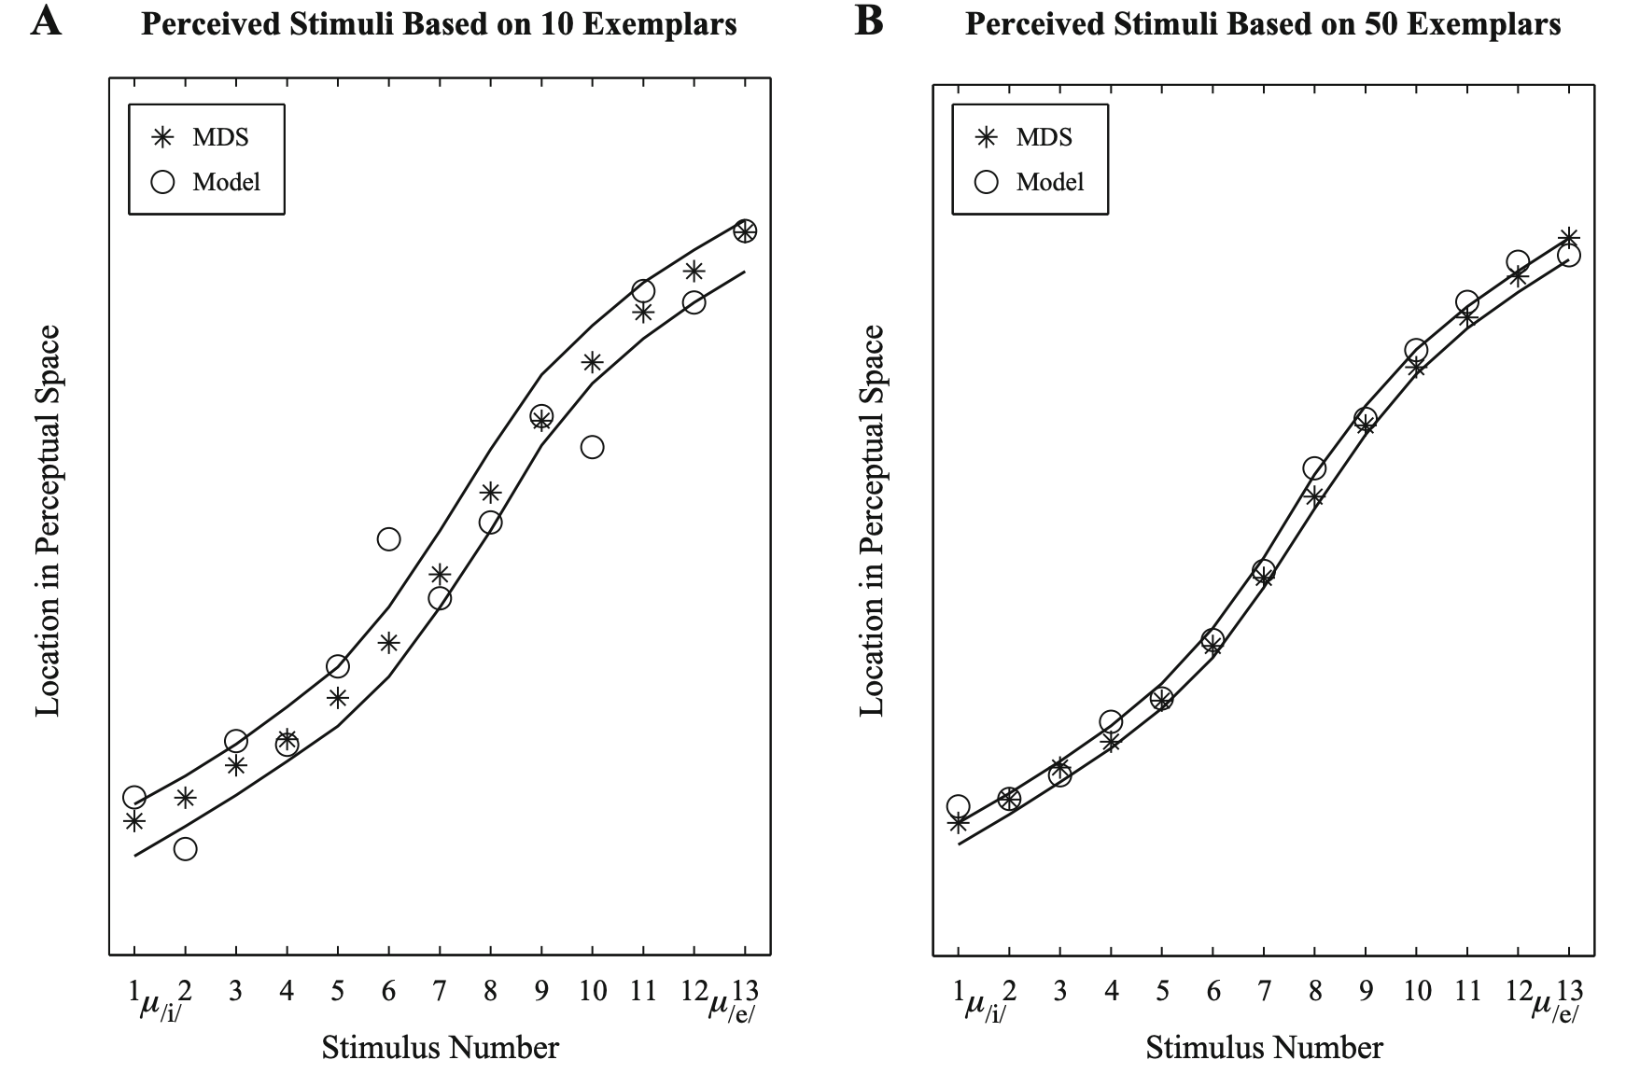
Demo 1: Perception & Generalization
Task: hear a noisy vowel and try to recover the *intended* sound
Bayesian view: combine a category-shaped prior over intended productions with how plausible the noisy signal is if that intention were true
Exemplar view: store past vowel tokens, activate based on similarity to new sound, average: your estimate of the denoised sound
Notes:
Listeners hear a noisy vowel and try to recover the **intended** sound. In a Bayesian view, they denoise by combining a **category‑shaped prior** over intended productions with how plausible the noisy signal is if that intention were true. The exemplar story says: store past vowel tokens; when a new sound arrives, activate stored tokens by acoustic **similarity** (which here plays the role of the likelihood), and average. With only **10–50** stored exemplars, the model reproduces the classic **magnet effect**—perceptual space compresses near category centers—and matches human multidimensional‑scaling data. See **Figure 3** (page 8). (Eqs. 14–16; pp. 7–8.) :contentReference[oaicite:6]{index=6}

Slide 7
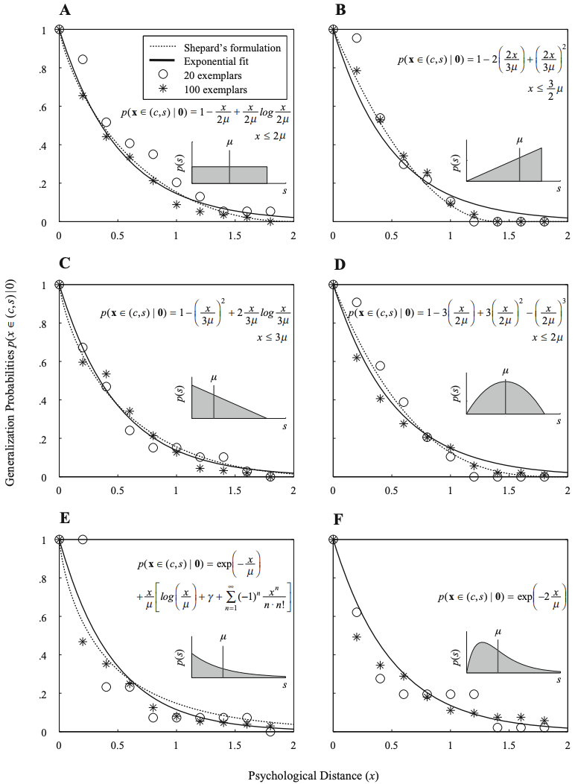
Demo 2: Prediction From Similarity
Ask: “If object 0 has a property, how likely is object x to have it?”
Shepard showed these probabilities usually fall off with distance* in psychological space.
Bayesian view: Consider how many possible consequential regions could include 0, weigh consistency with seeing 0, average whether x falls in that region
Exemplar view: sample regions, weigh them by consistency with 0, take weighted sum to form guess!
Approx improves with samples!
Notes:
**What to emphasize:** “Same machinery, different domain: store candidate hypotheses, activate by fit to data, and average.” :contentReference[oaicite:9]{index=9}
Ask: “If object 0 has a property, how likely is object $x$ to have it?” Shepard showed these probabilities usually **fall off with distance** in psychological space. The Bayesian setup says: consider many possible “consequential regions” that could include 0, weigh each by how consistent it is with seeing 0, and average whether $x$ falls in that region. The exemplar version pre‑samples such regions and **weights** them by consistency with 0—again, importance sampling. With **20–100** samples, the exemplar method approximates the classic gradients for six different prior assumptions (see **Figure 4**, page 10). (Eqs. 17–18; pp. 9–10.) :contentReference[oaicite:8]{index=8}

Slide 8

Takeaways (and Limitations)
Big idea: Exemplar models are rational process models—a psychologically plausible implementation of approximate Bayes via importance sampling.
Works when: data are sparse/noisy and prior–posterior overlap is decent
Watch the assumptions: (i) exemplars ≈ prior samples (or use proposal $q$with $p/q$ reweighting), (ii) similarity ≈ likelihood; violations break the equivalence.
Scope: Static hypothesis spaces

