Slide 1
Between planning and map building: Prioritizing replay when future goals are uncertain
21 January 2026

Slide 2
Hippocampal Replay: The brain “re-runs” experience offline
Replay happens during pauses and rest
“replay of nonlocal trajectories during sharp-wave ripples in hippocampal place cells (and similar events elsewhere)”
It often looks like rapid sequences through locations or states
It is structured enough to suggest it is doing work
Key question: what work might it be doing?
Notes:
The authors begin with a simple observation. During pauses and rest, hippocampal activity can form rapid sequences. In spatial tasks, those sequences often look like trajectories through locations. That is already striking because it suggests an organized offline process, not just static storage. The second observation is that replay is selective. Some paths and locations show up a lot, while others show up rarely, even when many experiences are available. So the scientific target is not "does replay exist." The target is "what principle determines which experiences get replayed." As you listen, keep two questions active. What could replay be updating in the brain? And why might some updates be worth doing before others?
replay of nonlocal trajectories during sharp-wave ripples in hippocampal place cells1–6 (and similar events elsewhere7–9)

Slide 3
Why replay is worth explaining
Replay is a window into what the brain prioritizes offline
Replay might change what is learned
Replay sits at the interface of memory and decision-making
A functional account should predict content
Notes:
The authors' motivation is that replay is one of the clearest windows we have into offline processing. We often talk about consolidation, planning, or memory integration, but we rarely see the process unfold. Replay gives a candidate readout of what the brain chooses to revisit when the animal is not acting. That matters because selection can shape learning. If some experiences are replayed repeatedly, they get extra chances to influence what is stored, generalized, or linked to other knowledge. So explaining replay content is a mechanistic problem, not just an interpretive one. It also matters for anyone who cares about memory and behavior together. A replayed sequence could help with a specific upcoming choice. Or it could help build knowledge that will be useful for many future choices. This paper takes that second possibility seriously, especially when the future is uncertain. For our lab discussion, I want us to keep returning to a concrete question. If a theory claims replay is functional, what does it predict will be replayed next, given the same past experience.

Slide 4
The key puzzle: Replay is not clearly aligned with "what I want right now."
Sometimes replay aligns with current objective
When goals change, replay can "lag”, fixate on the old
Conflicting results set up competition between “value” and “map” hypotheses about what replay is directed at
This paper bridges them!
Key diagnostic: which replay trajectories are prioritized and why?
Notes:
Now we get to the tension the paper is designed to resolve. A simple intuition when you start thinking about what hippocampal replay might be _for_ is that replay should focus on reflecting on information that can advance ongoing goals. In some datasets, replay does look like it is pointing toward the current goal. But the authors emphasize goal switching tasks where this alignment fails.
IN some maze tasks experiments, after the reward location changes, animals can update their behavior fairly quickly, even after a lot of time practicing under the previous regime. But when you measure hippocampal replay between tasks, it can remain biased toward old goal locations for a while. The paper describes this as replay lagging behind updated choice behavior. That is awkward for a naive "replay equals immediate planning" story, so instead people have proposed that hippocampal replay is more neutrally focused on building a map instead of helping to pursue goals. At the same time, it is not satisfying to declare replay goal-independent and stop there. Replay often looks structured in ways that still seem behaviorally meaningful. So the job of the theory is to predict when replay should track the present and when it should track something else. Ideally, the theory should also generate signatures we can test, not just labels. As we move forward, this lag phenomenon is the concrete benchmark to keep in mind.

Slide 5
Maps as a Generalized Value Function
A local map: "what can I reach in one step?”
Replayed trajectories already reflect local connectivity, so they can’t be what replay is for
A usable map: "which way should I go to reach a destination?"
This definition is not goal-neutral, but instead goal-flexible
A set of value functions: one for each potential goal
Can appear decoupled from current reward or choice, but still suggests a consistent structure in behavior
Notes:
In Block 1, we treated replay as a selective offline process and set up the goal-switching puzzle. Now we need a concrete idea of what replay could be updating. The authors' first representational move is to treat the relevant "map" as more than local adjacency. A purely local map answers "where can I go in one step from here." That is useful, but it does not directly tell you which route is best to a distant destination. To act effectively, you need multi-step structure, like which corridors connect regions and which junctions sit on many routes. The paper wants a representation where that multi-step structure is explicit, so it can be learned and updated by replay. This is the point where the paper starts borrowing standard language from reinforcement learning, but the intuition can stay simple. Think of a map not as a list of neighbors, but as a set of "route guides" that tell you what to do to reach a destination. If the destination changes, you want to swap guides quickly rather than relearn the environment. That is the representational problem we solve in the next two slides.

Slide 6
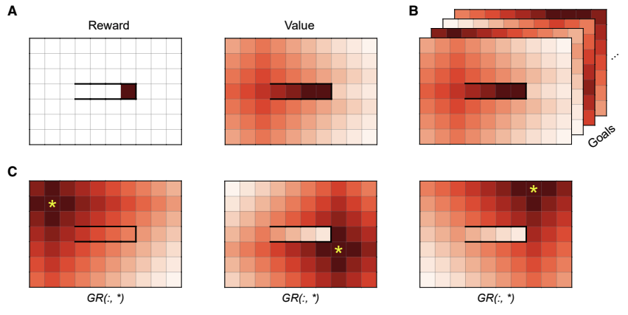
The Geodesic Representation: one "page" per goal
GR stores action guidance for many possible goals
G(s, a, g) = "action score given goal g"
Fix g, and you have a normal goal-directed guide
Change g, and you flip to a different page (no relearning)
Notes:
Now we can state the core representation in the paper. They define a quantity they call G(s, a, g). You do not need the equation here. Read it as "how good is it to take action a in state s if my goal is g." If you have G, then for any fixed goal g you can choose the action with the highest score and you will move along an efficient route. The important trick is that g is an input, so you are not learning one value function. You are learning a whole family of goal-conditioned guides, one per possible goal. A helpful picture is a book of pages. Each page is labeled by a goal location. On that page, every location has guidance about which move is best for reaching that goal. If the goal changes, you do not start over. You flip to a different page. This is why the representation supports flexible behavior under goal switching. It also makes the map hypothesis concrete, because the "map" is now a specific object with content we can reason about.

Slide 7
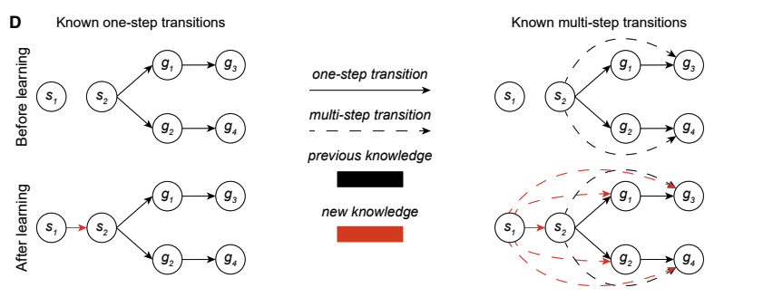
Why this map is learnable from replay.
Replay samples a remembered transition: s --a--> s'
A "backup" updates the GR using that one step
One step can matter for many goals at once
Notes:
The last step in this block is to explain why this representation is learnable from replay without doing full planning from scratch each time. The paper uses the standard idea of a "backup," which you can treat as a one-step learning update. You take a single experienced transition, like "from this location, after this move, you ended up there." Then you update the corresponding part of the goal page. The critical point is that the same transition can be informative for many goals at once. If a corridor connects two regions, that fact changes shortest paths to lots of destinations on the far side. So a single update can propagate to many goal pages, which is what the authors mean by going beyond local information. This motivates why replay could focus on structurally important transitions. Replaying a bottleneck transition is not just rehearsing one path. It is updating a connection that many routes depend on. In the next block, the paper asks the control question. Given many possible transitions to replay, which ones should be chosen first.

Slide 8
Replay as selective offline learning
Replay can be treated as doing extra "learning updates" offline.
Each replay event selects one remembered step (s -> s').
Replay time is limited, so order matters.
How do we choose what to replay next?
Notes:
In Block 2, we introduced the idea that replay can update a goal-conditioned guide for navigation. Now the paper's main control problem is that there are many memories you could replay, but only time for a few. The authors treat each replay event as selecting one remembered transition, like "from s, doing a, I ended up at s'." Then the brain performs one learning update to its stored guidance using that one step. The details of the update are not the focus on this slide. The focus is that replay is a limited compute budget, so selection matters. So we can rephrase the question of replay function as a scheduling question. Which transition should be replayed next, and why. The paper imagines this happening iteratively. Pick one transition, update, then pick again. So the key scientific object is the priority score used for that choice. If the rule is correct, it should predict when replay hugs the current goal. It should also predict when replay instead emphasizes shared structure like bottlenecks. This is what turns replay from a label into a testable algorithm.

Slide 9
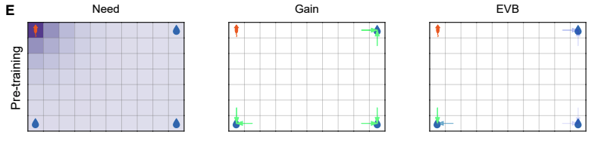
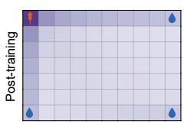
A Priority Score for Replay: Expected Value of Backup
Score a candidate replay step by its expected future benefit.
EVB is the paper's name for that score.
EVB has two parts:
Need = how often it will matter.
Gain = how much it would improve choices.
Notes:
The authors call their prioritization score the expected value of a backup, or EVB. I translate that as: how much better will future behavior get if this one offline update happens right now. The key move is that they show EVB can be broken into two intuitive parts. They call them need and gain. Need is about relevance. How often will this state matter again in the future. Gain is about impact. If I update here, will it change what I do, and will that improve reward. This is a compute-allocation story, not a simple "replay the biggest reward" story. A rare jackpot state might be high gain but low need if you almost never go there. A busy corridor might be high need but low gain if you already navigate it perfectly. EVB says the best replay targets are the ones that are both reusable and still improvable. Operationally, the paper computes this score for candidate memories and prioritizes the largest. This is why bottlenecks are natural replay magnets. They are reused across many routes, and updates there can propagate widely.

Slide 10
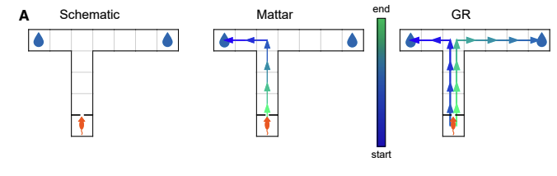
A Priority Score for Replay: Expected Value of Backup
Score a candidate replay step by its expected future benefit.
EVB is the paper's name for that score.
EVB has two parts:
Need = how often it will matter.
Gain = how much it would improve choices.
Notes:
The authors call their prioritization score the expected value of a backup, or EVB. I translate that as: how much better will future behavior get if this one offline update happens right now. The key move is that they show EVB can be broken into two intuitive parts. They call them need and gain. Need is about relevance. How often will this state matter again in the future. Gain is about impact. If I update here, will it change what I do, and will that improve reward. This is a compute-allocation story, not a simple "replay the biggest reward" story. A rare jackpot state might be high gain but low need if you almost never go there. A busy corridor might be high need but low gain if you already navigate it perfectly. EVB says the best replay targets are the ones that are both reusable and still improvable. Operationally, the paper computes this score for candidate memories and prioritizes the largest. This is why bottlenecks are natural replay magnets. They are reused across many routes, and updates there can propagate widely.

Slide 11
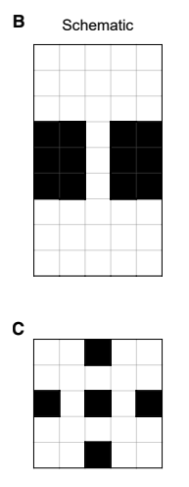

Slide 12
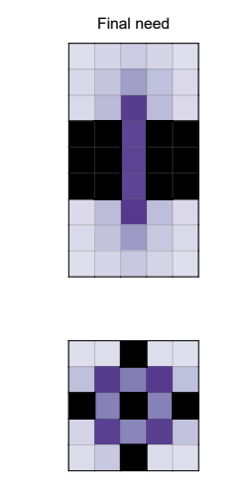
Need: Replay What Will Be Reused
Need asks: how much of the future runs through this state.
High need states are bottlenecks, hubs, and gateways.
Need depends on expected future occupancy (successor-like).
Need can be high even when reward is elsewhere.
Notes:
Need is the relevance term. In everyday language, need asks: how much of my future will run through this state. If you expect to pass through a place many times, improving guidance there gets reused many times. If you expect to pass through it rarely, improvements are mostly wasted. The paper links need to a successor-like idea: a learned heat map of predicted future occupancy. You can picture it as: starting from where I am now, which states am I likely to visit soon, assuming I keep behaving sensibly. Need changes with context. If I start in a different region, different corridors become high need. Need depends on environment structure and typical routes, not on whether the state is rewarding. So it naturally highlights hubs, gateways, and bottlenecks. This also makes "off-goal" replay less mysterious. A bottleneck can be high need even when it is not part of the current goal path. A quick test is: if the goal moved tomorrow, would I still need to pass through here.

Slide 13
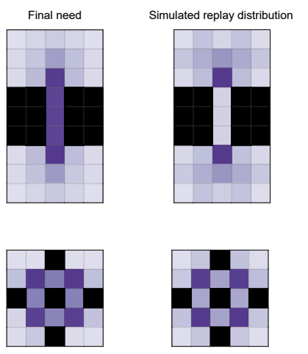
Gain: replay what would change behavior (especially when goals are uncertain).
Gain asks: would this update change what I choose.
Gain is high when you are wrong or uncertain.
Gain is low when the policy is already correct.
With uncertain future goals, EVB averages over possible goals.
Notes:
Gain is the impact term. In everyday language, gain asks: if I update this, will it change my choices, and will they get better. This is why gain is not just reward magnitude. A big reward can have low gain if you already know the best route. A modest reward can have high gain if you are currently choosing the wrong action or are uncertain. So gain is strongest where learning is still changing behavior. Surprise can increase gain, but only when it changes which action seems best. Now add the paper's central twist: future goals can be uncertain. Under uncertainty, the best replay is the one that has high expected value averaged over the goals you might face. The paper implements this by separating a fast estimate of the current goal from a slower estimate of goal statistics used for replay prioritization. The talk-level intuition is that behavior can switch quickly when the goal changes. Replay can lag because it is preparing for what is likely overall, not only what is true right now.

Slide 14
Key Insight: Replay Priorities Can Depend on Uncertainty of Future Goals

Slide 15
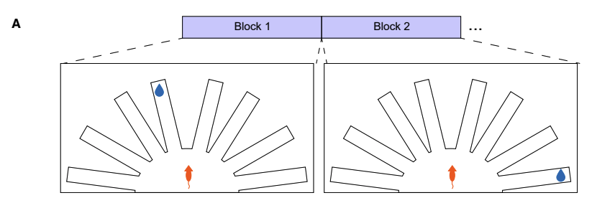
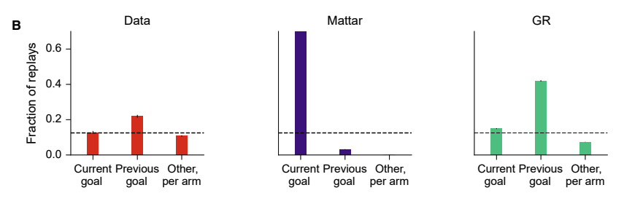
Geodesic replay model captures replay “lag” that challenged single-goal account
Notes:
Three findings about the content of replay during the repeat phase challenge the value view. (1) Replayed locations featured the goal arm from the previous block more often than any other arm. (2) Replay of the current-goal arm increased gradually throughout the repeat phase (i.e., over repeated sampling of that arm). (3) The enrichment of a goal for replay persisted for several blocks after it had become irrelevant, decreasing smoothly over time.

